Slide 1
Writing a Research Proposal for an FYP, Master’s Dissertation or PhD Thesis
Regional Writing Centre, University of Limerick (RWCUL)
Lawrence Cleary, Director Regional Writing Centre, University of Limerick
www.ul.ie/rwc

Slide 2
Good writers…
assess the context into which they write, and plan
follow a process
have strategies for reaching their research and writing goals
Notes:
Context:
occasion: (academic context/argumentative/disciplines-specific conventions/assessed),
topic (gap in knowledge or point of contestation),
audience (those in the literature who talk about the gap or contested point/assessors and programme directors),
purpose (to get an A/to demonstrate good scholarship),
writer (what topics interest me/what are my strengths and weakness relative to research and writing?)
Planning: Time (how much time do I have to do this?)/ Space (how many pages do I need to fill? Word Count?)
Process: Writer-based writing (pre-writing and drafting), reader-based writing (revising, editing and proofreading)
Strategies: cognitive, procedural, metacognitive, affective and social (What strategies do I use to achieve my writing goals? Why do strategies used to begin my paper not work when finishing my paper? What thoughts, feelings or people stand between me and my writing goals? What do I do? Is it working?)

Slide 3
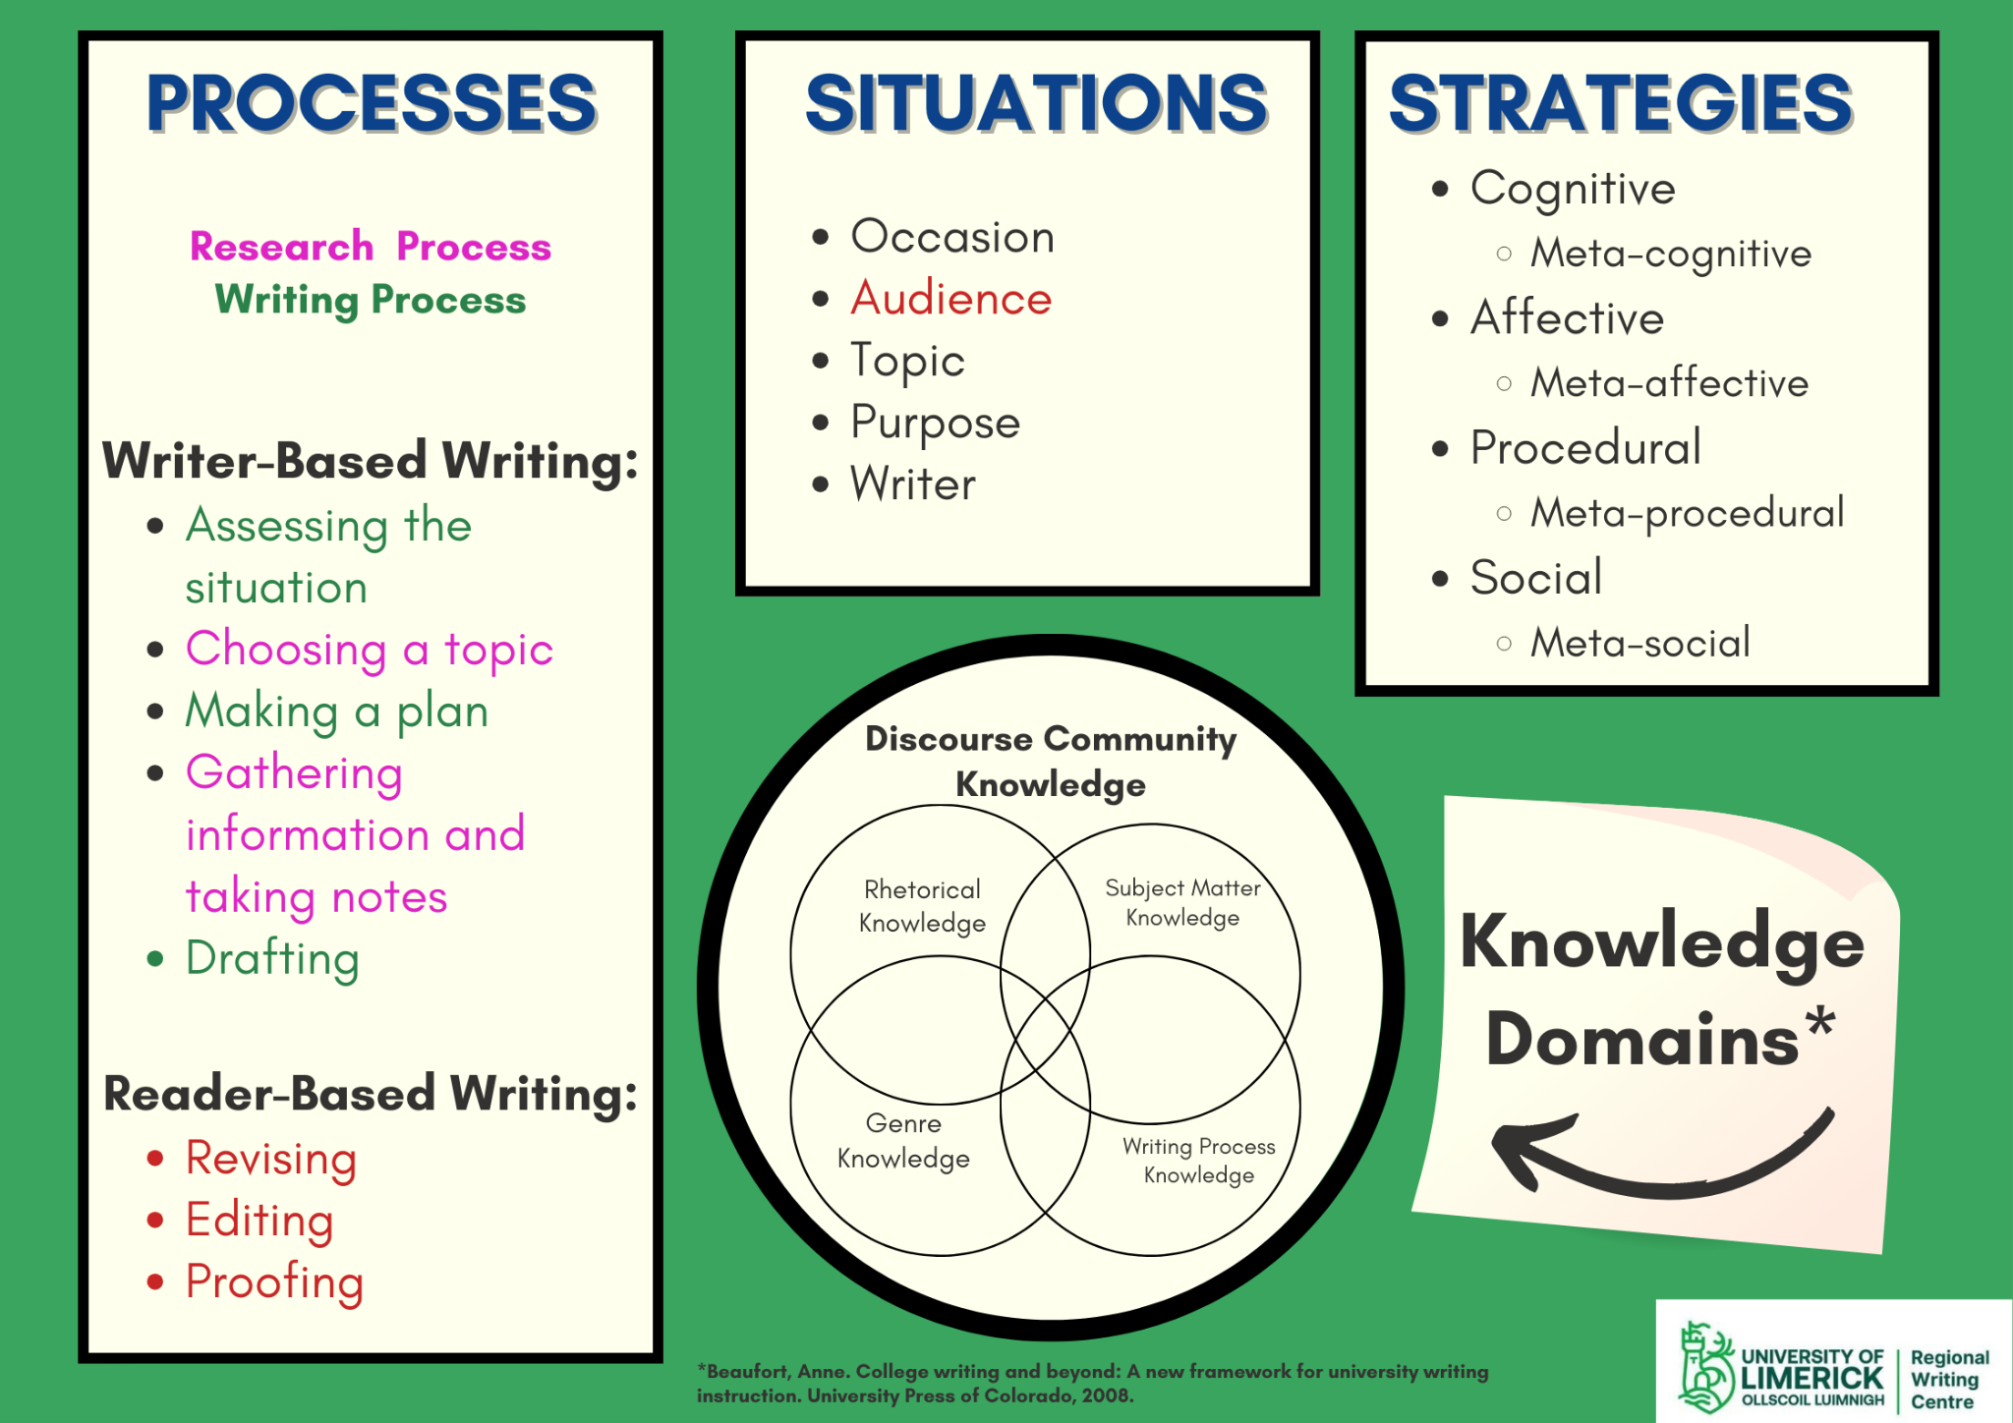
What do good writers think about?
Notes:
This is our framework for talking about writing. The context is academic, so the occasion is likely to be an assignment or an obligation to complete a short dissertation or a more in-depth thesis. The purpose is always, firstly, to get an A. After that, you may have other personal motives, including just wanting to explore a problem that intrigues you to wanting to impress the teacher hoping they’ll recommend you for postgraduate work or a job after graduating. The topic in an academic context is always a problem, either something that people are still arguing over or something about which people in the field still do not understand, a knowledge gap. The audience is always the person assessing the paper, but also those who are arguing in the literature, the people you read as part of your research on the problem. The writer is you, and as you see in the column on the right, an important strategy for overcoming an obstacle to your research and writing goals is metacognition, reflection. Reflecting on what you know about the topic is also part of that analysis of the writer, recognising that having previous knowledge on the problem helps save time as you have read a great deal and thought about this problem already. Other strategies for overcoming obstacles for negative thinking (cognitive dissonance), debilitating emotions (affective dissonance) and people who stand between you and the time and space you need in order to work on the task (social dissonance) are important resources for writers to develop and to draw on when the time arises. Naturally, the best defence is a good offence, as the saying goes, and drawing on resources that allow you to stay motivated through positive thinking, a positive, confident attitude and commitment to protecting a time and a place for writing is a course of action that will likely lead to the results you wish for. These resources can be anything from recollections of past successes, motivating music, locks on doors and ear-plugs.

Slide 4
Assessing the writing situation
What is the FYP or Masters dissertation measuring?
  Whether you can locate a challenging point of contention or gap in the knowledge field of your discipline(s) (research question(s))
  Whether you can defend your position on that contested point or fill that knowledge gap by using valid, reliable evidence (methodology)
  Whether you can produce good scholarly research (do good science)
What is the PhD thesis measuring?
  All of the above, plus
  A unique contribution to the knowledge of the field (create knowledge)
Notes:
One stark difference between the FYP and Masters dissertation and the PhD thesis is that the PhD candidate has the obligation of creating knowledge.
The FYP and Masters Dissertation writer is being measured on how well they can use sound methodologies and appropriate literature to find information that will help them argue a point that is relevant to the field. The FYP and Masters-level students are not required to create knowledge, but only take a position on a contested point or speculate about what is happening that explains a knowledge gap in the field.
For listeners/readers not familiar with how we frame ‘topic’ in an academic context, please look at or listen to An Introduction To How The RWC Frames The Conversation On Writing on our Writing Across Disciplines page, particularly slide 6.
A question that all of these people should ask themselves when deciding on a problem to tackle as the subject of their dissertation or thesis is what issue in their field-specific education has most intrigued them? And what authoritative information can I draw from the readings I’ve done in past modules and programmes?

Slide 5
The Goal:
To present the research problem and to justify its study
  Who has previously studied this problem?
  What did those studies find and what problems remain?
  Where are you going to come in
    Will you argue a position on a point of contestation? Or
    Will you attempt to unearth information that will help to understand that which is presently not understood or not fully understood?
To propose a method for treating the problem
  What methods have been used in past studies on this problem or similar problems?
    What methods will you use to gather data/information?
    What information will those methods yield?
    Will that information help to defend a position or explain the unexplained?
    What methods will be used for an analysis of the data gathered?
Notes:
The point of the proposal is to name the problem, establish its relevance in the current literature and propose a course of action—how you will make your case.
Part of this decision on how you will proceed will be on the methods by which you will gather data and, then, the methods you will use to analyse the data.
The researcher/writer has to remember that methods can yield specific types of information, so before employing the method, the should be able to explain how that kind of information will help them to answer their question.
We learn a lot about how to choose methods by reading the methodology sections of research articles by others who have written on the problem we are addressing or on some related or tangential problem. What were their justifications for choosing those methods and what other methods did they consider and reject? Why did they reject those other methods?
Most importantly, here, once you choose a problem, you have narrowed the scope of the reading you will do to only the literature that is relevant. That takes a big load off.

Slide 6
Why do I have to write a research proposal?
To give your dissertation/thesis supervisor the opportunity to be sure that:
  The problem you have selected is relevant
  The problem is of a scope that can be treated in the time and space allotted to you
  The manner in which you will make your case is both appropriate and doable.
“In general, a compelling research proposal should document your knowledge of the topic and demonstrate your enthusiasm for conducting the study. Approach it with the intention of leaving your readers feeling like, ‘Wow, that's an exciting idea, and I can’t wait to see how it turns out!’ (USC Libraries, 2020).
Notes:
In addition to what is said on the slide, the researcher/writer will find that just going through the process of writing a proposal forces one to make decisions about
whether the problem is one of enough interest that it will sustain me—this is a bigger issue for PhD writers, who have a much longer trajectory than do undergrads and Masters-level students, but can be an issue for those two groups as well.
Whether the problem they’ve identified is too big or not big enough for the occasion and how it can be reduced in size or expanded upon.
The best way to answer the question or solve the problem etc. There may be many options, and what is involved may make the difference. Do you have time, for instance, to get ethical approval for a particular method of inquiry? Is the information on the problem available or protected by corporations or other professional or governmental bodies?
There are many questions that arise and get answered and make a difference in the shape of the final proposal that you submit.
Keep in mind, too, that more changes will come as you go through the process of doing the research and attempting to make sense of your findings. Nothing is final until it is submitted for a grade or for a defence (in the case of all PhD theses and some Masters dissertations).

Slide 7
How do you find a problem to research?
What did you study in your course?
What kinds of questions or problems arose in the readings and still are current?
What issues in your field are of interest to you?
Which issues are manageable in the time/space available?
Can you narrow your focus to an aspect of the problem that interests you?
What is my thesis statement: the claim or question or problem or hypothesis that motivates the research? Can I write it out?
Notes:
When you think about it, the course you signed up to made a promise that is usually found on the course homepage and is usually expressed as “The graduates of [course name] will be able to…”. These are promises that are being made to students and to potential employers of these students, so anything that you can do in your dissertation or thesis to demonstrate that you are able to perform as promised is good.
The most important thing to think about when going through your course is ‘What most interests me? What problems or questions or positions most intrigue me?’
A dissertation that draws from the readings of the courses many modules demonstrates a synthesis, a tying up of all of the various relevant strands that you studied as you went through your course, providing evidence that you were paying attention and that you were able to detect connections between the problem you chose to study and what appeared to be disparate or discrete, unrelated issues in your field of study.
This deeper understanding will be rewarded.
Again, for students unfamiliar with the RWC framework for talking about writing, check in on An Introduction To How The RWC Frames The Conversation On Writing on our Writing Across Disciplines page, particularly slides 6 and 12.

Slide 8
Write your thesis statement
A thesis statement might take the form of a…
  Claim 🡪 a defence
  Question 🡪 an answer
  Problem 🡪 a solution
  Hypothesis 🡪 a test 🡪 affirmation or negation of the hypothesis
For a few minutes, consider an issue in your field that you are interested in and attempt to formulate a thesis statement.
Remember: this statement will evolve as you engage with the act of making your case.

Slide 9
What are the function of sub-questions?
Sometimes, a comprehensive study is a career, not an FYP/Master’s Dissertations or PhD Thesis, so…
    Sub-questions/themes/problems can reduce the scope of your study
      They become the areas of focus on which your evaluation of the main question relies:
      The answer to my main question will be influenced most by the findings of the studies I do to inform my answers to my sub-questions.
    Sub-questions/themes/problems can dictate the kinds of information you will gather
      They informed the methods you use to answer your main question because methods of inquiry are specific to particular kinds of data
    Sub-questions/themes/problems can organise your dissertation or thesis
      They can be the logical steps necessary to finding an answer

Slide 10
The structure:
Introduction
Background and Significance
Literature Review
Research Design and Methods
Preliminary and Supplementary Implications
Conclusion
References
Also see Genres in academic writing: Research proposals
Notes:
This is an IMRAD structure (Introduction, Methodology, Results, and Discussion), but some disciplines would not follow this structure at all. It is important to study how professionals in the field organise their arguments.
Follow the hyperlinks to know more about the research proposal. Modify what you find to the conventions in your own field. Read other’s proposals if you can find them online or in the library.

Slide 11
More sample research proposals
From York St John University
From University of Houston
From University of Sheffield, Dept. of Sociology
From Open University
From the OWL Purdue

Slide 12
Planning: Back to the situation
Occasion
Topic
Audience
Purpose
Writer
Notes:
Planning requires a good understanding of your research and writing situation.
How many words to you need to write and how much time to you have? What can I meaningfully say about this problem in the space available to me? Do I have too many objectives? Can I limit the scope of my findings?
Who are my audiences? What do the assessors need to know about what I know? What is their level of expertise in this area? What will need to be explained to them so that they understand the rationale behind my assertions and how much do I need to explain so that they know that I don’t just know it deeply enough to explain it, apply it, analyse it and measure its value?
What are some of the avenues for making my case? Do I have enough time to gather the information I need? For instance, if the case I am making requires a testing tool that is booked months in advance, will I be able to get my data and make sense of it before the submission deadline?

Slide 13
Some language relevant to the task
Introducing the problem and the work proposed
Classifying and listing
Defining terms
Explaining causality
Being critical
Being cautious
Other Rhetorical Functions
Notes:
These are some links to websites that focus on the language typically used to perform rhetorical functions such as showing scepticism, defining terms, disputing the findings of others, etc.

Slide 14
Things to remember:
Be concise (edit and proofread)
Include the most relevant research on the problem
Delimit the research (be able to say what questions or problems your research will answer or solve and to what extent and which questions and problems you research will not answer or solve)
Propose a coherent, convincing argumentative framework
Explain difficult concepts and theories
Remember Bloom!
Notes:
Once you know what you are arguing, then you need to think about how to say it so the audience gets it. This is when you move from writer-based writing to reader-based writing (See An introduction to how the RWC frames the conversation on writing on our Writing Across Disciplines page. Also, if you are not sure how to use Microsoft Word proofing tools, see the video presentation titled A word about Word for formatting and proofing before submission on that same page.
There is a warning on this slide about being careful to not overstate the value of your findings. See slides on being a good scientist in An introduction to how the RWC frames the conversation on writing on our Writing Across Disciplines page. Delimiting is distinguishing explicitly what can be known based on your findings and what cannot be known because the findings do not provide enough information. Basically, you need to be critical about what your data actually tells you and what it cannot tell you because you don’t have enough information.
The reference to Bloom is to remind the writer that we are writing about complex issues to an audience that is accustomed to taking about complex issues. We want to demonstrate that we able for higher order cognitive processing of information, being able to explain concepts and phenomena, apply them, analyse them and synthesize information and establish tools for measuring the value of information.

Slide 15


