Slide 1
Structuring the PhD Thesis/Masters Dissertation and Writing the Literature Review
Lawrence Cleary, Director Regional Writing Centre
C1065 Main Bldg., University of Limerick
www.ul.ie

Slide 2
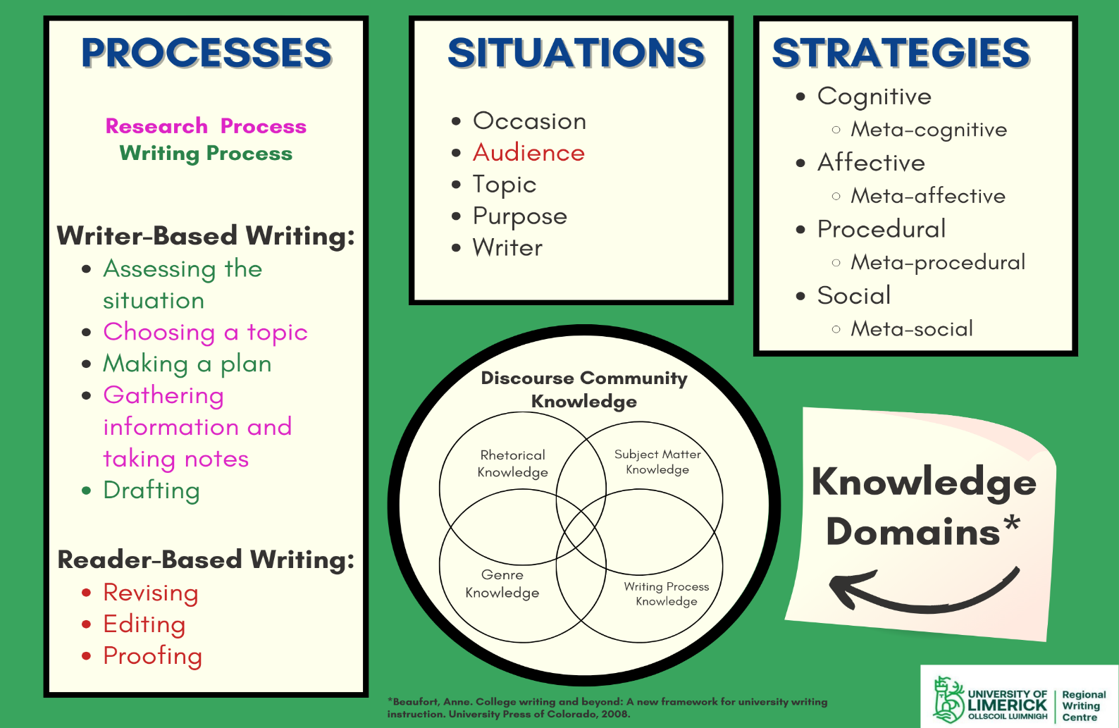
What do good writers think about?
Notes:
This is the framework that the RWCUL uses to both organise our conversation about writing and analyse new occasions for writing.
A full explanation of the framework can be found on separate workshop on our website here: https://media.heanet.ie/page/0bb2383fa6f74926992709397266da75
Basically, though, good writers are good at analysing the writing situation and figuring out the options available to them for responding. They have a writing process that works for them, but they are adaptable so can recognise that some occasions for writing are going to require modifications to the processes that they typically undergo. They also monitor their understanding and process to evaluate whether those understandings and processes are working or not. They monitor their cognitive and affective response as they go through their processes, and they monitor how others are either facilitating or inhibiting their progress toward their research and writing goals.

Slide 3
The ‘topic’ in an academic research context
The topic is a problem:
  Claim→Defence
  Question→Answer
  Problem→Solution
  Hypothesis→Test→Affirmation or Negation
Academic researchers do one of two things:
  Take a position on a point of contestation
  Fill a gap in the field of knowledge
Notes:
The topic in an academic context is almost always an argument, whether it be an argument about the whether Ireland benefits from its EU membership and how (or how not), about what is happening at the edge of the universe or what the best tablet design is for students in third level education.
The topic must be relevant to the field of study from which the assignment derives.
The topic must be exigent; it must be something that grips the field; the audience must find it of importance, a pressing matter.
The topic is usually a point about which there is endless debate in an effort to reach consensus, where the writer argues for a position on the matter, or…
…the topic is a gap in the field of knowledge, something not understood or, at least, not well or completely understood, where the writer proposes a particular course of secondary or primary research in order to increase our understanding of what is going on in that gap or to offer up information that fills the gap.
Finally, the announcement by the writer is expressed in a thesis statement, usually in the introduction to the paper, dissertation or thesis. The thesis statement is usually one sentence. It could be in the form of a claim, a problem or a hypothesis (declarative) or in the form of a question (interrogative). The sentence might contain much detail and many clauses, but it is usually expressed in a single sentence in the form of a claim or a question, a problem or a hypothesis that the paper will defend or answer, solve or affirm/negate.
The thesis statement is the organising principle for the entire paper, dissertation or thesis. Nothing should be in the paper, dissertation or thesis that does not function to answer the question or defend the claim or solve the problem or affirm or negate the hypothesis.

Slide 4
Some organisational principles
The Context
The Argument
Principles of Organisation
Genre Conventions
Notes:
The context: If your paper asks a question, then the natural order is that is established by the attempt to answer the question. Not all questions are the same, nor are they all answered in the same way, so whatever the argument, whatever way you go about making your case for a particular answer, that argument is what organises the paper.
There are principles of organisation that we observe or experience every day: changing of the seasons, special order, logical order etc.
Finally, there is the cultural order that are reflected in genres. A genre will be the typical form that cultures use to perform various functions that are unique to the culture. These genres constrain options for organisation of information.

Slide 5
The Context
How many words? How much time?—what can I meaningfully argue in this much space, given this much time to build my case?
How does the academic context impact on the scope of my argument? (how much space is allotted? How much time?)
What are the expectations in terms of theoretical/conceptual/argumentative framework? In terms of Register? In terms of epistemic values?
Notes:
When we are given an assignment or are in a position where we have to write a major research paper such as a Master Dissertation or PhD Thesis, we are obligated to make a case for a particular position on a contested point or for a particular explanation for an unexplained phenomena in the field of knowledge in our discipline. We have to ask ourselves, what can be meaningfully said in the space and time provided?
I have to make a case, but the academic contexts limits my appeals to appeals for reason and appeals for my own credibility as a scholar in the field, someone who readers can trust, someone who knows what they are talking about. I cannot try to make my case by appealing to my readers emotions.
But what can I say in this context? An assessment of my space and time (word count/due date) determines the breadth and depth of the case made. If my word count limits me to 2500 words, the argument cannot be encyclopaedic or wide-ranging.

Slide 6
The Argument
Your Introduction acquaints the reader with the problem and the background on the problem.
The introduction is also where you articulate your specific thesis statement and any sub-topics you need to address on the road to making your case.
The introduction is where you announce your process—how your thesis will proceed in making the case:
  How you will attempt to answer the question, solve the problem, defend the claim, test the hypothesis
  How you plan to make a case for a particular position
  What you will do to get information that will lead to a better understanding of the gap in the field of knowledge
Notes:
The academic context requires that I seek the truth, which means that I have to do good science. I can’t use weighted dice. I need to look at all sides of the argument, all positions, then evaluate, based on sound criteria, which positions are most valid, most sound.
My conclusions have to be supported by good, reliable evidence, garnered from experts in the field.
Again, we are not trying to make a case that disregards the truth of things. If the evidence doesn’t support a position in a debate or if it doesn’t explain an understanding of what occupies a gap in the field of knowledge, then a good scientist would have to concede the weakness of his or her own case.
Also, again, we must appeal to reason and the credibility for our authority on a topic.

Slide 7
What is your thesis?
“A research problem is the main organizing principle guiding the analysis of your paper.”
In one sentence, state your thesis (the claim, question, problem or hypothesis that motivates the denouement of your dissertation).
  Are you taking a position on a point of contestation? Or attempting to understand something not currently or fully understood by researchers in your field?
  How is it being expressed? As a claim, a question, a problem or a hypothesis?
Example: the statement of my problem in my own Master’s dissertation: “What can a stylostatistical, comparative examination of a single word class and its sub-classes in Joyce’s Finnegans Wake reveal about what Geoffrey Leech and Michael Short (1981: 74) call ‘the artistic principles underlying a writer’s choice of language’?”
Notes:
Your thesis is your statement of the problem, and it can be expressed as a claim or a question or a problem or a hypothesis.
I encourage you to attempt to establish a statement that is one sentence long (either declarative or interrogative). Everything in your dissertation or thesis should be motivated to defend that claim or answer that question or solve that problem or test that hypothesis in order to affirm it or negate it. And, of course, your claim or answer or solution or affirmation/negation must all be defended—how did you get there, and was it through sound research and findings?

Slide 8
What do you want to know?
How are you going to come to know what you want to know?
  Purely secondary research?
  Some primary research?
Are there some sub-questions that can help contain the scope of your research?
  (How do people learn English as a Second or Other Language vs. How do Vietnamese immigrants in Ireland use modal verbs?)
  How will each sub-question be answered?
  What is the relationship between your sub-questions and your main, over-riding question?
Sub-questions in my Master’s dissertation:
  “When is a noun a noun [in Finnegans Wake] and how does one know?”
  “Is there a high incidence of neologisms in Finnegans Wake?”
  “What classes of nouns are present in my sample?”
Notes:
What do you want to know, and how are you going to come to know it.
Sub-questions can help limit the scope of your inquiry. In my case, the answer to my main question would rely on the answers to my sub-questions and what we already know from previous studies. The information gathered in answering these sub-questions would limit my response to my main question. The exercise of answering my sub-questions would give me some information, though it is unlikely I would have enough information to make a comprehensive and definitive statement about ‘the artistic principles underlying a writer’s choice of language’ in Finnegans Wake. It is important in the conclusion that the scholar state what the findings permit him or her to know and what it is not possible to know given the limited information available. This is the delimitation of the data. https://libguides.usc.edu/writingguide/limitations

Slide 9
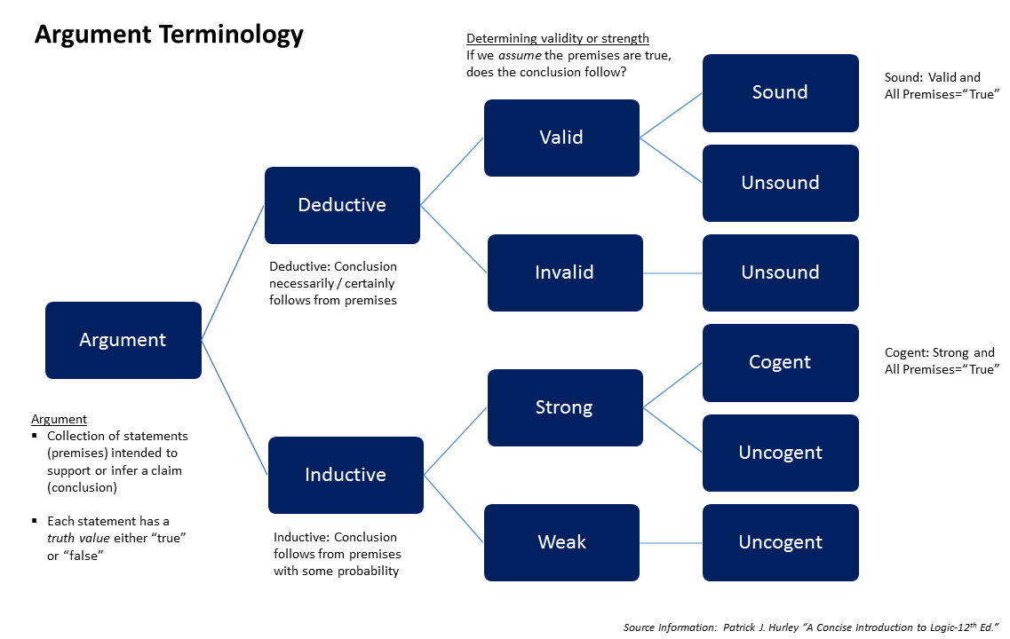
Types of arguments (1)
Notes:
Arguments can be formal or informal.
“The difference between a formal and an informal argument is in the burden of proof. A formal argument clearly states the claim or position it argues and presents a well-developed chain of evidence leading to a reasonable conclusion supporting the claim. The chain of evidence itself may include a wide variety of elements ranging from personal experience to statistical data and expert testimony.
Informal arguments contain little or no supportive evidence. "I did the dishes last night" may be all that's necessary to encourage your roommate to do them tonight but it's hardly an argument designed to convince or persuade. Its primary purpose is merely to assert, or point something out, nothing more.” WAC Clearinghouse: https://wac.colostate.edu/resources/writing/guides/argument-overview/
Arguments can also be deductive or inductive. Deductive reasoning start from general principles or theories and try to explain specific instances of events or behaviour or movements, etc.; whereas, inductive reasoning observes some event or behaviour or movement, ect., and tries to establish a general principle or theory that explains it.
Deductive: Theory →Explanation of a Specific Instance
Inductive: Specific Instance→Development of a Theory that explains it.
In the slide, you can see that Deductive arguments lead to conclusions that are certain (factual); it is assumed that if all of the premises on which the conclusion are based are ‘true’ (certain/proven), then the conclusion is necessarily true—it must be true, the conclusion is valid and the argument is sound.
Inductive arguments lead to conclusions that are probable. Conclusions in inductive arguments are cogent. It is strong if all of the premises are true; it is weak if there is a suggestion of truth, but many of the premises on which the conclusion is based are iffy.
The arguments are invalid or uncogent if the premises on which the conclusion is based are not ‘true’.

Slide 10
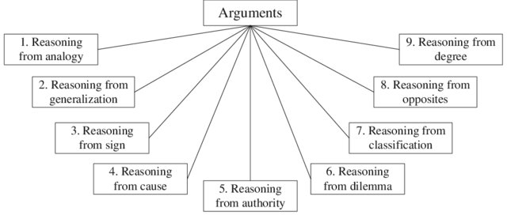
Types of Arguments (2)
Notes:
There are many types of arguments: (See https://www.comm.pitt.edu/reasoning)
Reasoning from analogy: “Argument by analogy examines alternative examples in order to prove that what is true in one case is true in the other. This is an attempt to points out relevant parallels that could utilize experience and example as a guide.”
Reasoning from generalization: “Argument by generalization assumes that a number of examples can be applied more generally. This is a form of inductive reasoning, whereby specific instances are translated into more general principles.”
Reasoning from sign: “Argument by Sign. Argument by sign asserts that two or more things are so closely related that the presence or absence of one indicates the presence or absence of the other. This is in some ways a type of tightly linked cause and effect reasoning that has more certainty.
Reasoning from cause: “Argument by cause attempts to establish a cause and effect relationship between two events. This is a form of reasoning that argues that the interactions of two or more incidents are not merely coincidental, but was actually related in some meaningful way.”
Reasoning from Authority: “Argument by authority relies on the testimony and reasoning of a credible source. This is an attempt to use expertise in a particular field (from parenting to religion to education) to advance a particular belief.”
Reasoning from Dilemma: “A dilemma (Greek: δίλημμα "double proposition") is a problem offering two possibilities, neither of which is unambiguously acceptable or preferable. The possibilities are termed the horns of the dilemma, a clichéd usage, but distinguishing the dilemma from other kinds of predicament as a matter of usage.” (Wikipedia) It is an ‘either/or’ arguments, more often found in formal logical arguments in philosophy and law.
Reasoning from Classification: Pluto is not a planet because it doesn’t fit the classification of ‘planet’.
Reasoning from Opposites: Plato’s first argument that the idea that “every quality comes into being from its own opposite.” A thing cannot be small if there were not anything big to compare it to.
Reasoning from Degree: “The fourth proof [of Aquinas’s argument for the existence of God] arises from the degrees that are found in things. For there is found a greater and a less degree of goodness, truth, nobility, and the like. But more or less are terms spoken of various things as they approach in diverse ways toward something that is the greatest, just as in the case of hotter (more hot) that approaches nearer the greatest heat. There exists therefore something that is the truest, best, and most noble, and in consequence, the greatest being. For what are the greatest truths are the greatest beings, as is said in the Metaphysics Bk. II. 2. What moreover is the greatest in its way, in another way is the cause of all things of its own kind (or genus); thus fire, which is the greatest heat, is the cause of all heat, as is said in the same book (cf. Plato and Aristotle). Therefore there exists something that is the cause of the existence of all things and of the goodness and of every perfection whatsoever—and this we call God.[3]” (Wikipedia: Argument from Degrees)

Slide 11
Arguments and Order (1)
Recall the way thesis statements are formatted and how papers unfold:
  Claim→Defence
  Question→Answer
  Problem→Solution
  Hypothesis→Test→Affirmation or Negation
A sample assignment: Evaluate the contribution of political parties to the development of public policy in the United States and Canada.
  There are two political parties in the US; whereas, in Canada, there are many.
    Can parallels be made between the two political parties in the US and the six main parties in the Canadian parliament?
    Can we reduce the parties to conservatives and liberals or left and right?
  Is there some parity between the US and Canadian public policies?
    Which policies will the paper focus on? How many?
    Is the paper long enough to categorise public policies as Criminal Justice, Culture and Society, Economic Affairs, Education, Environment, Government Operations, Health, Social Welfare, Foreign Affairs and National Security? (9 categories)
    Or does the paper length require a further categorical reduction: Social Policy, Fiscal & Monetary Policy, Welfare & Income Policy, Regulatory Policy and Foreign Policy? (5 categories)
Notes:
Papers written for academic assessment often ask questions that the author then tries to answer. Or it starts with a claim and presents a defence for the claim. Or it may begin with a statement of the problem and attempt some sort of solution or work toward establishing the knowledge needed to pursue a solution. Finally, it may begin with a hypothesis and work toward an affirmation or negation of that hypothesis.
The reason that writing into rigid forms like the 5-paragraph essay doesn’t work is because no two questions are the same, nor are those two very different questions going to require the same path toward an answer. Every argument is organised around the requirements, within the scope of the permitted space allotted, of a meaningful answer, a cogent or valid argument.
There is a sample in this slide of a possible assignment and some reasoning that a student might have exercised to establish a way of organising the answer.

Slide 12
Arguments and Order (2)
Contribution of Political Parties to Public Policies | Social Policy: Crime, Education, Health, Housing | Fiscal & Monetary Policy: Central Bank decisions, Budgetary decisions of gov’t | Welfare & Income Policy: Children, Income supports, welfare, pensions | Regulatory Policy: Banking, insurance, and other financial services, Safety, Environmental impact, Minimum wages | Foreign Policy: Treaties, Diplomacy, Trade, Security
Conservatives (US: Republicans/Canada: Conservative Party
Liberals (US: Democrats/Canada: Liberal Party, New Democratic Party, Bloc Québécois, Green Party, People's Party of Canada
Notes:
So, now we are ready to make decisions about the arrangement of the answer.
There are five public policy categories, each with sub-categories that belong to it. The degree to which a student might examine each party’s contribution to each and every category and sub-category may depend on the word count assigned. A 9000 word paper is going to allow for much more space for examining each of the sub-categories in detail; whereas, a 1500 word paper may only allow the student to address each party’s contribution to the five main policy areas, and even there, the coverage may only be covering the differences between the parties in terms of their contribution without getting into the similarities or have examples from each sub-category, only those that show stark difference.

Slide 13
Principles of Organisation (1)
We move from birth to death, morning to evening, dark to light to dark to light… Some might refer to this as a kind of natural order.
It is, perhaps, too easy to over-simplify this idea of order. (See, for instance, Nisbett, Peng, Choi & Norenzayan (2001).) Our culture influences how we reason.
All examples of order that can be perceived by our readers/listeners are models on which we can organise our arguments in the papers we write.
If a type of order is recognisable, we can use it as an order that others can follow.
Notes:
Here we return to logical order. It should be said that logic is culturally established, so Western logic can be different from Eastern logic. Some things are universal: the movement of seasons, the movement from light to dark to light each day. This is a natural order that is familiar to most people. It might be thought of as a kind of cyclical order or, temporally, linear. When arguing, we can appeal to reader/listener’s sense of that order when trying to help them to understand the order we are constructing for our argument.

Slide 14
Principles of Organisation (2)
Natural Order—dawn to dusk, autumn to winter to spring to summer, birth to death
Chronological Order—early to late, then to now, 1888 to 2019
Spatial Order—near to far, a bird’s eye view, high to low, large to small
Climactic Order or Order of Importance—the most important to the least important, the general-to-specific (deduction), specific-to general (induction), most-familiar-to-least-familiar, simplest-to-most-complex, order of frequency, order of familiarity, etc.
Thematic Order—the first element; another key part; a third common principle is...
Logical Order—All men are mortal. Socrates is a man. Socrates is mortal.
Notes:
Here we have some other categories of order that we might consider when arranging ideas in an effort to construct a coherent argument.

Slide 15
Genre Conventions (1)
Sometimes, the argument needs to fit into a pattern of information organisation such as the IMRaD structure:
  Introduction—where the problem is stated, its relevance highlighted, what others have done to understand the problem, what you will do
  Methods—how you will do it—how you will gather data and how you will analyse the data that you find
  Results—what you found
  Discussion—how your findings cohere (or not) with the findings of others, what the findings mean given what is known in the literature and what logic tells you
  Conclusion—what your findings allow you to know (delimitation: what can not be concluded from your findings)
  Recommendations for further study
Notes:
Finally, genres establish order to some extent. Genres are not fixed forms but reflections of a culture. The genre performs a function for that culture, that community that discourses on topics relevant to them. The genre evolves as the priorities and concerns of the culture change and as the work to be done by the genre change. It is important that those who attempt to address that community recognise where the genre is at the moment (by reading and observing what the conventions are).
The imrad structure is only one possible structure. Those hoping to enter a community that get work done through the performance of genres should try to analyse the structure of the genres of that community.

Slide 16
Genre Conventions (2)
Genre Expectations and Conventions
Challenges presented by genres to order:
  Eagleton vs. Stefanov, et al.
Where is the argument?
  In Eagleton’s case, it seems the thesis is in the first sentence, the entire text that follows defending the claim—a position is taken on a contested point.
  In Stefanov, et al.’s case, the argument is posed as an unexplored problem (last paragraph of the introduction) that is explored in the study that follows—a knowledge gap is to be filled.
What is its structure?
  For Eagleton, it is a narrative structure.
  For Stefanov, et al., it is an IMRaD structure.
Clearly, genres tell us a lot about what is permissible and what isn’t—both in terms of style and order.
Notes:
How do different genres organise arguments and what are some of the conventions that are unique to it?
Looking at the two samples, one from literary criticism and the other from biomedical engineering, we can note lots of very obvious differences, most notably Eagleton’s narrative structure in comparison to the IMRaD structure of Stefanov, et al.

Slide 17

I hope this workshop helps, but if not…
Book a Peer Tutoring Session with one of our RWCUL tutors.
Best of luck!

