Slide 1
Regional Writing Centre (RWCUL): Writing for Academic Contexts
Lawrence Cleary, Director Regional Writing Centre, CTL Educational Developer
Notes:
Welcome to ‘Writing for Academic Contexts’.

Slide 2
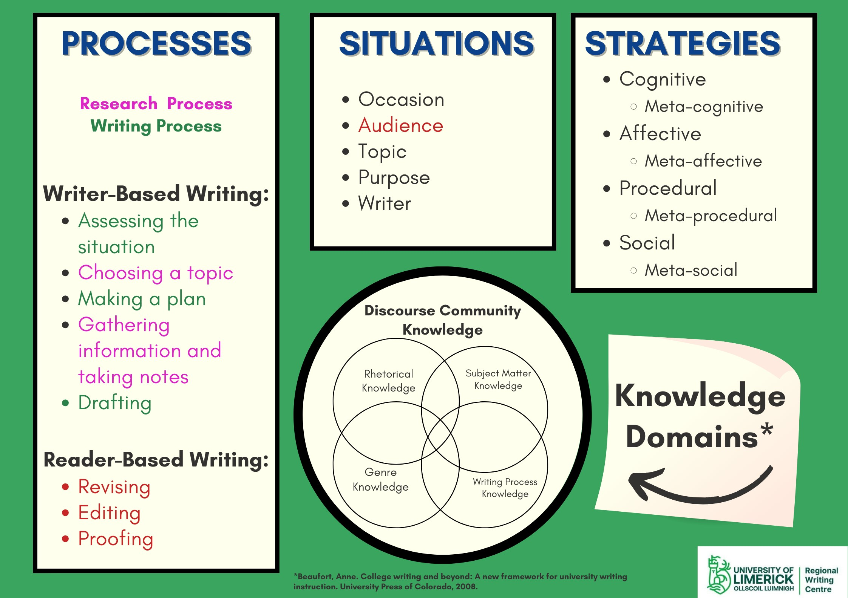
Keep it simple
Process
Strategies
Situation
Notes:
At the RWC, we keep it simple: process, strategies, situation. These are our three touchstones when examining what is working or now working. Papers don’t write papers, writers write papers, so when a paper doesn’t work (gets a poor grade), it is not the paper’s fault. There is something in the writer that didn’t work. It could have been her understanding of her writing situation, her processes (research and writing processes) and her strategies for negotiating those processes in that particular writing situation.
Please watch ‘An Introduction To How The RWC Frames The Conversation On Writing (with voice over)’ on our Workshops Across Disciplines page, https://ulsites.ul.ie/rwc/workshops-across-disciplines, for more on this.

Slide 3
Process
What you do when you are given a writing task. Writing is an act, a behaviour.
Two Parts:
  First, all the things you do when you are trying to figure out what you want to say
    Assessing the situation, making a plan, choosing a topic, gathering information, taking notes, drafting
  Second, all the things you do when you are trying to figure out how to say it so that your audience gets it
    Revising/re-seeing, editing, proofing—thinking in terms of best word choice, style choice, genre conventions, etc.
Notes:
Everyone has a process that works for them (or not), and what works for one may not work for someone else. However, there are some things that all writers do, even if it is not in the same way or in the same order. We know that because, despite having different research and writing processes, they all get ‘A’s on their papers or have long lists of publications under their belts.
Two questions that have to be foremost in the writer’s mind are:
What am I trying to say? And
If I say it like this, will my audience be receptive to what I am trying to say?
One possible way of talking about our own processes then is to ask, ‘What am I doing now? Am I trying to articulate this to myself? Trying to figure out what I am trying to say or argue? Or Do I now know my what I am trying to say or argue and now wish to figure out how to bring the reader (the audience(s)) with me?
If it is the former, then why am I wasting time worrying about my grammar and spelling and the concision of my sentences? Who cares? I am just trying to figure out what I’m saying here.
If it is the latter, then how does the audience(s) like this organised? What would make this argument more convincing to this audience(s) and how can I say it so that they are not paying attention to how I am saying it, but to what I am saying?

Slide 4
Strategies
Metacognitive—reflection and self-assessment—is it working?
  Cognitive—thoughts that either motivate or de-motivate
  Affective—feelings that move me forward or hinder my progress
  Social—people that either facilitate my work or impede it
  Procedural—what am I doing that’s working? What isn’t working?
Notes:
The number one strategy that all good writers employ (even if not consciously) is metacognition (reflecting on what worked in the past and what didn’t). If we don’t reflect, we cannot locate the problems and cannot modify what we do. We will not learn from our mistakes and miscalculations.
Procedural strategies involve trying different ways of going through the process of writing. In our case, it is an academic context that we write into, so we also reflect on our research process as well and consider altering strategies that don’t work, strategies such as wasting hours and days a weeks reading tons of books before even knowing for sure what my paper is about. There has to be a better way, even if I enjoyed reading all those books. I like sleep too.
Cognitive and affective strategies are about dealing with our thoughts and emotions. Naturally, positive thoughts and emotions motivate us, even if we are delusional, and negative thoughts often evoke negative, sometimes debilitating emotions. We need strategies to turn those negative thoughts and emotions on their heads, strategies like remembering we’ve received ‘A’s on papers before and thinking, ‘I can do this!’ and taking deep breaths and listening to ‘A Professional Pirate’ on the Muppet’s Treasure Island soundtrack to get my spirits up.
Hey ho ho! / We're honorable men / And before we lose our tempers we will / Always count to ten
On occasion, there may be someone you have to execute,-
But when you're a professional pirate-
-you don't have to wear a suit

Slide 5
Situation
Occasion—an academic context; a discipline-specific context; an informal writing context or a formal one
Topic—a point of contestation or a gap in the field of knowledge
  All academic papers are argumentative
  A claim🡪a defence; a question🡪answer; a problem🡪a solution; a hypothesis🡪a test🡪an affirmation/negation
Audience—the person assessing the paper; the community that talks about the problem
Purpose—to get an A+; and maybe more
Writer—what am I bringing to the table that contributes/that interferes?
Notes:
Finally, no matter how effective your process or your strategies, they will be ineffective if they have not accounted for the writing situation, the context for writing.
We are in an academic context, where an occasion for writing is an assignment or a wish to publish. And this context is loaded with all kinds of affordances and prohibitions. We can use sound methods of inquiry to learn about the nature of our world, and we can argue a case, but we can’t fudge data or lie. Assignments and articles for publications also have due dates or submission dates and word count restrictions. These kinds of issues matter when planning and choosing a topic. We don’t want to investigate a cure for cancer if we only have 10 days before the paper is due.
The audience are those that are assessing our paper (either for a grade or for it’s value to the readers of a publication), so we need to know the basis for their assessment, their grading criterial—what learning is to be evidenced here? But the audience is also the people who discourse on the problem your paper addresses—those that write the books and articles on the subject that you read in preparation for writing the paper. At what point are you entering this conversation? And what is your contribution? What are you adding to the conversation?
Your purpose (I hope) is to get an ‘A’ or be published, and maybe more (get noticed by someone who might recommend you for postgraduate work, or a job or membership in an academic or professional society?
Finally, there is you. You are part of the occasion for writing. You bring knowledge, intrinsic or extrinsic motivation and habits of learning and writing to the table. If you choose a topic you already know something about, for instance, you can devote more time to reading about the specific issue and not have to spend so much time reading about the context in which the situation emerged in your field.

Slide 6
The WHAT of it: What we do in an academic context
It is important to know what people do in an academic context:
  They try to improve their understanding of the nature of things, things being our shared realities.
  They argue.
    They either try to make a case that explains what is currently not well understood or
    They take a position on a point of contestation.
  They do this by appealing to
    Your sense of reason: logos
    Your trust in the person arguing: ethos
  i.e., they do good scholarly work:
    Accounting for the knowledge that has be established by previous scholars,
      they use sound, tried and tested methods of inquiry, accepted as valid by scholars in their field, to acquire information and to analyse that information in an effort to make sense of the new information so that they can defend what might either be new knowledge (PhD) or a further confirmation of what is already known (Bachelors and Masters).
    i.e. they strive to move the knowledge base forward to increase our understanding of the nature of things.
Notes:
There are books and articles that you will be asked to read as part of your course. Some of this will be informative, but some of what you read will be current research on a problem in your field where a case is being made for an understanding of a gap in the field of knowledge or, if it is a problem such as whether there is a God, for instance, which will be interminably debated (barring a convincing appearance from God herself), a case is being made that justifies a particular position on the matter: Yes, there’s a God; no, there is not a God; there are many gods; there is a doG; etc.
In an academic context, we make our case through reasoning and the presentation of evidence to support our conclusions. Naturally, every discipline values particular kinds of evidence over other kinds of evidence. For instance, in Choreography and Mechanical Engineering, statistics are rarely, if ever, used to make a case; whereas, they are highly valued in Sociology and some accounting degrees like Risk Management and Insurance. Facts are very highly valued by most disciplines but more heavily relied on in the sciences, and some Humanities subjects such as the study of literature will almost never rely on facts to make a case, though there may include factual information such as when someone was born or where they were living when they wrote some book or poem, etc.

Slide 7
The Thesis Statement
  Claim 🡪 Defence
  Question 🡪 Answer (defence of answer)
  Problem 🡪 Solution (defence of solution)
  Hypothesis 🡪 Test 🡪 Affirmation/Negation (defence of the interpretations of the findings and the conclusions drawn)
Notes:
A thesis statement is usually a single sentence that states the problem that will be addressed by the inquiry. The problem can take the form of a question that the paper will answer or a claim that it will defend or a problem that either needs information to better understand it or that leads to the proposal of a solution. Finally, the thesis statement can take the form of a hypothesis that is tested in an effort to affirm or negate it.
The answering or defending or solving or affirming/negating is the denouement of the paper, the paper’s conclusion, and the way we come to those conclusions is the argumentative structure that organises the paper, that communicates the story of how we came to those conclusions, that keeps the promise of the thesis statement—that a claim will be defended, a question answered, a problem solved, a hypothesis affirmed or negated.
The important point here is keep it simple. If you promise to answer a question, do it. And give us what we need in the paper to understand how you came to that answer; i.e. defend the answer along the way, give us the evidence we need to be convinced that the reasoning is valid or sound.

Slide 8
The HOW of it: Talking the Academic Talk
Think context:
  Think being a good scientist:
    Ask how do respected scholars in my field think/speak/write?
Features of acadehttps://studentaffairs.aua.am/ewca-summer-institute-2023/mic writing
Reporting on the findings of others
Expressing your own position
More of you and your position
Notes:
Once we know what we want to argue, we need to return to a reflection on our audience. What are their expectations:
Have I clearly presented the complexities of the problem? And the case?
Does my audience expect a high or moderate degree of formality?
What degree of objectivity is expected by this audience?
In what degree of precision do people in my field report quantities and measures?
Do people in my field focus on facts or on possibilities and probabilities?
What kinds of methods do people in my field use to gather data/information and what kinds of methods do they use to analyse that information in order to make sense of it?
Have I situated my argument in the scholarly literature on the problem?
How do people in my field report others’ findings and conclusions?
Have I taken a critical stance when weighing the scholarly evidence in the literature before using it as support for a particular position or evidence of a truth.
How do people in my field position themselves in relation to the findings of others?

Slide 9
Scaffolding the argument (logical order)
You have to bring the reader with you. Logic helps.
Flow
Logical order
Types of arguments:
  Categorical or definitional arguments
  Causal arguments
  Resemblance arguments
  Evaluation/ethical arguments
  Propositional arguments
Organising the argument
Avoiding logical fallacies
Notes:
Is my argument coherent? And is its organisation typical of the way information is organised in the publications that I read when I research to inform my case?
Does the argument flow: Can I follow?
Is the arrangement of ideas logical (in a Western sense of logic if my audience operates in the Western tradition)?
Let’s say we are arguing for a particular way of defining terms or concepts. All definitions have three parts: the thing defined, the class to which it belongs and the features that distinguish it from everything else in its class. So if we were to define writing, we might claim that writing belongs to a class of communication or we might argue that it belongs to a class of activities or processes. And even in this sense of ‘writing’ as an activity or process, we might distinguish it from other activities or processes by aligning it with a composition or with calligraphy. So these three parts of all definitions are categories that help us organise our argument for a particular definition of something or for distinguishing between one definition and an alternate definition.
See Ramage, J. D., Bean, J. C., & Johnson, J. (2018). Writing arguments: A rhetoric with readings. Pearson. In the library for more on types of arguments.
Politicians use logical fallacies to obfuscate or confuse voters. Take Trump’s claim that if Biden wins the election, the economy will crash and the socialists will take over. This is the ‘slippery slope’ fallacy that one event will lead to an inevitable series of catastrophic consequences. If it were true, Trump would provide some kind of evidence that would give credibility to the claim, but he doesn’t. He uses some ‘loaded language’ (‘economic disaster’, ‘socialism’) designed to provoke fear in the people who are unknowledgeable about Biden’s record during the Obama administration or where he stands on a scale that runs from far right reactionary to full on socialist. The slippery slope argument portends consequences that have no basis in logic or fact.
See https://writingcommons.org/section/rhetoric/rhetorical-reasoning/rhetorical-appeals/logos/logical-fallacies/ for more on logical fallacies.

Slide 10
Genres
http://www.uefap.com/index.htm
https://writingcenter.unc.edu/tips-and-tools/
https://owl.purdue.edu/owl/purdue_owl.html
Notes:
In Using English for Academic Purposes, go to the Writing page. Then look in the menu on the left for Genres.
In the writing centre at the University of North Carolina. Click on Tips and Tools, then look over to the last two columns on the right, ‘Specific Writing Assignments or Contexts’ and ‘Writing for Specific Fields’
In the OWL at Purdue, search ‘genre’ and find many links to information about specific kinds of genres and sub-genres.

Slide 11
Samples of writing for academic purposes
Engineering
  Technical background report
  Other types of writing by engineers
Psychology
Marketing
Literary Studies
Biology
  Lab reports
Notes:
Some of these links may require that you log into the library or log in through an institutional log in link provided by the publishers, but it is my hope that most of these links will be accessible to you. If not, just open Google Scholar and search for an article in a field that interests you. Look at how they format and organise the discussion. Look at the genres.
It is helpful to be comparative in our observation. Comparing the engineering article, ‘Lévy-Flight Moth-Flame Algorithm for Function Optimization and Engineering Design Problems’ and the biology article, ‘Altered metabolite levels in cancer: implications for tumour biology and cancer therapy’, for instance, we see a lot of similarities, as we probably would have expected. Both articles have multiple authors, both begin with an abstract and both separate sections with headings. However, in the engineering text, the headings are numbered; whereas, they are not in the biology article. Both articles include figures, but the engineering text also includes equations and tables. The biology article includes colour, where there is none in the engineering articles. The biology article includes definitions of terms along the left hand margin. No such nomenclature or glossary is included in the engineering paper. The engineering paper follows an IMRaD structure (Introduction, Methodology, Results and Discussion). The biology article has an unmarked introduction, followed by headings in bold text, Mechanisms of metabolite level changes, followed by sub-headings in italicised bold font and sub-sub-headings in what appears to be a slightly reduced bold, italicised font. This biology article does not follow the engineering paper’s IMRaD structure but is organised around a complex categorical arrangement of discussions of
the mechanisms that lead to changes in metabolite concentrations in cancer cells,
the consequences of these changes for the cells and
how they might be exploited to improve cancer therapy
And the discussion of these three themes are organised around specific metabolites, such as
2-hydroxyglutarate,
fumarate,
succinate,
aspartate and
Reactive oxygen species
And the results of changes in the levels of these metabolites:
altered cell signalling,
enzyme activity and/or
metabolic flux
A comparison between the engineering text and the literary paper reveals more obvious disciplinary and genric differences.
The literary paper has a single author, which is more common in this field of literary criticism. There are no headings in the literary criticism and paragraphs are not blocked as in the engineering article, but are indented. The paragraphs carry the burden of organising the case being made; whereas, in the engineering and biology articles, the headings take some of that burden away. Paragraphs often operate with topic sentences that announce the topic of the paragraph and a controlling idea that communicate the limits of the conversation of that topic in that paragraph. Headings supplement that work, making it easier to find and revisit particular kinds of information.
The thesis statement in the engineering paper is found in the next to last paragraph of 1. Introduction. It is not stated clearly in a single sentence, but can be summarised as a proposed solution (Levy-flight moth- ´
flame optimization (LMFO) algorithm) to an engineering optimisation problem (performance issues with the Moth-flame optimization (MFO) algorithm, a new
metaheuristic optimization method). In the literary paper, the thesis statement can be found in the last two sentences of the article (this is not necessarily typical, but obviously possible): “Literature enables both profane pleasure and reverence. On Bloomsday, no one has to choose.”
You will also note the number of quotes in the engineering text (none) compared to the literary paper (ka-trillions). Engineers do not rely on testimony for evidence or support for assertions made. Also, look at the difference in the degree of objectivity and formality: ‘I’ appears 15 times in the engineering text, each time as a mathematical symbol. In the article on literature, 39 times, each time as a self-reference. “Indeed, Sam Slote of Trinity College Dublin notes with a hint of smug amusement that many people were asking him what he thought of Bloomsday from a scholarly perspective and he was ‘about to say something,’ until he realized, ‘I’m not going to be this guy’.” versus “The 𝑡 parameter in the spiral equation defines how much the next position of the moth should be close to the flame (𝑡 = −1 is the closest position to the flame, while 𝑡=1 shows the farthest).”
The engineering paper would show a higher degree of formality and objectivity. Whereas the literary article submits evidence that support sound reasoned conclusions, the engineering paper submits evidence that supports valid conclusions grounded in fact. The cultures are different; their values are different; they argue differently.

Slide 12
Acculturating to the discourse in your field
It takes time.
People who read and write a lot tend to develop an academic voice more quickly.
Everyone should recognise that each year you will be better at figuring out what to write about and how to say the things you want to say.
Aim to be really good at it by year 4.
Notes:
The more you write, the better you get at it. Learning from the feedback you get from teachers or peers or RWC peer writing tutors helps. Getting a C3 on your first paper is not shameful. Getting a C3 on your second paper is. Even working up to a C2 by learning from the mistakes made on the first paper is evidence of learning and that you are starting to understand what the audience wants. Working your way up to As might take more time, but the RWC believes everyone is capable of achieving that grade. It requires attentiveness to what is working and what isn’t working and putting in the work. Everyone should try to be a good writer in this context by the final year of their graduate their undergraduate programme as doing so opens doors to recommendations for postgraduate study or to progression through the ranks in the workplace. Statistics show that the candidates for progression in the workplace that possess good interpersonal, presentational and written communication skills are more likely to advance.
Also, the importance of reading to writing cannot be overstated. When students read for content and for style, they more quickly acculturate to the conventions of the genres that people in their field adhere to. Read for content, but read again for not just what the author(s) is(are) saying, but how he/she/they are saying it.

Slide 13


