Slide 1
Writing History
Lawrence Cleary, Regional Writing Centre Director,
University of Limerick
www.ul.ie/rwc

Slide 2
Writing for your life
If writers are to adapt more easily to new concepts, we need to help them develop a theory of writing that includes reflections on:
  writing process knowledge,
  rhetorical knowledge,
  discourse community knowledge,
  subject matter knowledge,
  genre knowledge.
    Beaufort, A. (2000) ‘Learning the Trade: A Social Apprenticeship Model for
    Gaining Writing Expertise’. Written Communication 17(2), pp. 185-223.

Slide 3
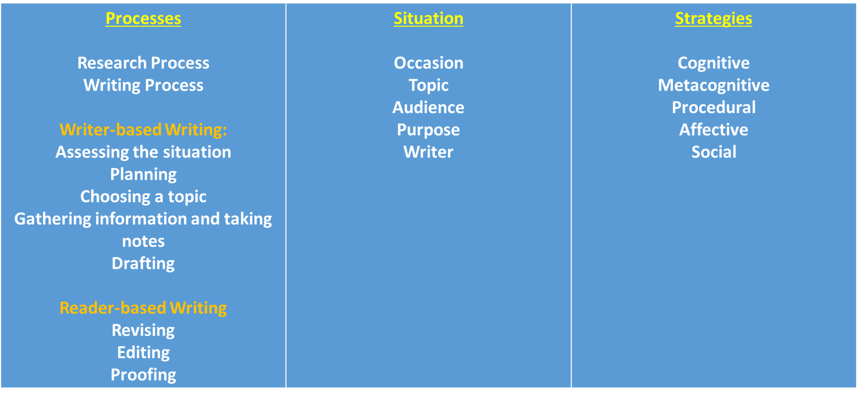
What do good writers think about?

Slide 4
Situation
Occasion—an academic context; a discipline-specific context; an informal writing context or a formal one
Topic—a point of contestation or a gap in the field of knowledge
  All academic papers are argumentative
  A claim→a defence; a question→answer; a problem→a solution; a hypothesis→a test→an affirmation/negation
Audience—the person assessing the paper; the community that talks about the problem
Purpose—to get an A+; and maybe more
Writer—what am I bringing to the table that contributes/that interferes?

Slide 5
Process
What you do when you are given a writing task. Writing is an act, a behaviour.
Two Parts:
  First, all the things you do when you are trying to figure out what you want to say
    Assessing the situation, making a plan, choosing a topic, gathering information, taking notes, drafting
  Second, all the things you do when you are trying to figure out how to say it so that your audience gets it
    Revising/re-seeing, editing, proofing—thinking in terms of best word choice, style choice, genre conventions, etc.

Slide 6
Strategies
Metacognitive—reflection and self-assessment—is it working?
Cognitive—thoughts that either motivate or de-motivate
Affective—feelings that move me forward or hinder my progress
Social—people that either facilitate my work or impede it
Procedural—what am I doing that’s working? What isn’t working?

Slide 7
‘Topic’ in an academic context
Two things that academic researchers do:
  Take a position on a point of contestation
  Attempt to fill a gap in their discipline’s field of knowledge
They do it in a number of ways:
  Claim → Defence
  Question → Answer (defence)
  Problem → Solution (defence)
  Hypothesis → Test (defence) → Affirmation/Negation (defence)

Slide 8
How do you find a problem to research?
What did you study in your course?
What kinds of questions or problems arose in the readings and still are current?
What issues in your field are of interest to you?
Which issues are manageable in the time/space available?
Can you narrow your focus to an aspect of the problem that interests you?
What is my thesis statement: the claim or question or problem or hypothesis that motivates the research? Can I write it out?

Slide 9
discourse community knowledge,
subject matter knowledge,
genre knowledge.
Notes:
Ireland in the inter-war period football violence hooliganism religious bigotry sectarianism identity nationalism

Slide 10
What makes for a quality paper?
Rhetorical Knowledge
  (How to get an ‘A’)
Discourse Community Knowledge
  (all the stuff spoken about in lectures from beginning to the end of the course)
Research and Critical Thinking Skills
Engagement
  (with the topics and the community)
Notes:
pp. 21-35

Slide 11
Genre Conventions: IHS
Formatting
Some details around use of quotes, numbers, dates, denominations, titles, and letter case
Citations in footnotes
  Primary vs Secondary Sources in History
Bibliography
Grammar & Punctuation
Style
Notes:
pp. 36-45

Slide 12
An assignment:
Consider the significance of the year 1848 for the Hapsburg Empire.
  “consider” means “requires an answer in which the students describe and give their thoughts on the subject.”
  “the significance of”, an aspect
  “the Hapsburg Empire”, the topic
  “the year 1848”, a restriction or focus
Possible thesis statements:
  How was the year 1848 significant for the Hapsburg Empire?
  The year 1848 was significant for the Hapsburg Empire because…
Who talks about this problem?

Slide 13
What else?

