Slide 1
Writing for Academic Assessment and Publication
The Case of
the School of Allied Health
Lawrence Cleary, Director, Regional Writing Centre, University of Limerick
Notes:
Go to website,
We are not a service. We are a resource.
Our ethos: we are non-invasive, inductive in our approach
show them the resources that are available to them

Slide 2
What are your concerns?
You have some experience of writing for academic assessment, possibly for publication.
What concerns you about writing for your postgraduate programme?

Slide 3
Global Issues
Lack of clarity or required detail
‘Key assumptions' must be explained for the reader
Paper elements align
Poor organisation/sequencing of ideas - arguments are lost
Poor presentation of results - present them in the order of the planned analyses
Including new information & results in the discussion or conclusion
Failure to consider stated learning outcomes, grading criteria and/or rubric
Notes:
Some issues typically flagged by assessors

Slide 4
Local Issues
Using a reference to support a statement, which is not in fact, attributable to the author(s) who are cited.
  E.g. 'we used a purposive sampling approach (Smith & Jones 1992), instead of 'we used .....consistent with Smith and Jones' (1992) recommendation.
Not using Tables/figures to their best advantage
Using incorrect tenses or changing tenses inappropriately during a paragraph
  e.g. from past (done) to future (will do) / subject-verb agreement errors
Using referring pronouns (he/she/this/that/which) in a way that causes confusion
Failing to edit of proof, leaving grammatical errors and spelling
Using abbreviations without explaining them on first use
Referencing poorly/incorrectly - http://libguides.ul.ie/citeitright
Notes:
Some issues typically flagged by assessors

Slide 5
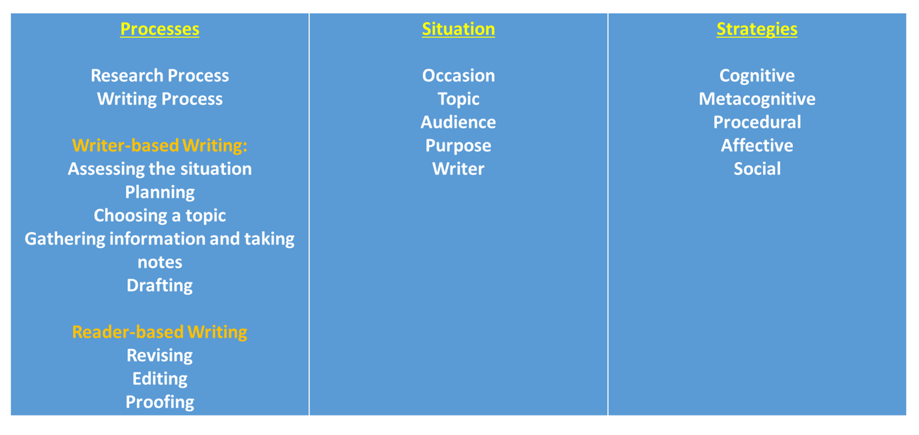
Keeping it simple
Notes:
This imperfect diagram tries to capture behaviours that all good writers exhibit, even if not in any particular order. Most processes of production begin with an assessment of the situation.
This centre column is from Aristotle’s Rhetoric. The occasion for you folks is a Master’s dissertation or module assignment. There is a timeline (due date) and parameters (word count). There are formatting issues—referencing, manuscript formatting style or, if publishing, the formatting style of the journal.
The writer brings knowledge and experience to the writing situation. Past writing experiences prepared them for this new occasion or not. Students did well on past papers or they didn’t. Student writers bring habits along from past writing experience that are appropriate or not.
The process of creating a text in an academic context necessitates that the contribution is informed: hence, a research process and a writing process. We have to learn how to find out what people in our field are talking about. What is relevant now? What is it that we know? What remains to be known? How can I contribute to the conversation?
Where are the conversations taking place? How can we trust our sources? What is it that constitutes evidence for assertions made or conclusions drawn?
The process of writing does not need to begin with an assessment of the writing situation, but when time is an issue, it helps. Here, I break the process into two parts: writer-based writing and reader-based writing. Writer-based writing is all the writing (and other things) that we do in order to figure out what we want to say. Writers, during this stage of writing are not concerned with grammar and style but with finding something meaningful to interrogate, something relevant to the discourse community. The writer at this stage is assessing what is required in order to get the text to be as good as it can be by the deadline. Planning, assessing when they can work on the research/writing (days, hours, weeks). Writers at this stage are dipping into the discourse that is out there on the problem they have chosen to investigate. They are taking notes, possibly planning primary research projects to supplement the data they get from the literature. They begin to write, introducing the problem, informing the reader of the purpose of the paper/thesis, laying out for the reader how the text/study will be organised, reporting on the findings of others, etc.
Reader-based writing is all the things we do when we get to the point where we know what we want to say, but we begin to examine how we are going to say it. We are thinking about our audience again. How do they like information delivered—think rhetorical knowledge and genre. This may happen after the entire paper/chapter/article/thesis is drafted or after sections are ready for revision—sections that are necessary to the story so assuredly not to be extracted later.
In order to produce a text that is ready for submission/evaluation, all writers need to overcome obstacles. The most prevalent obstacle is the writer—the writer’s negative thoughts and, often subsequent, emotions. Negative thoughts can lead to fears and anxieties that accelerate and take over, debilitating the writer. The writer has to develop strategies for overcoming demotivating thoughts and emotions. Another obstacle is the unexamined self (metacognition), not monitoring our thoughts, emotions or processes or people that we either invite into our process or people who intrude upon our process. Examples of the former would be family, friends or colleagues from whom we get positive, constructive feedback or from whom we get permission (time and space) to do our work. Examples of the latter might be supervisors who ask us to teach more than the prescribed hours or to contribute beau-coup time to the organisation of a conference or it might be partners or children who, in fairness, expect some time with you or it could be employers who are overscheduling you, especially when you have a deadline. The writer needs social strategies for negotiating with these people who are holding you back so that they get something and you get what you need: time and space.

Slide 6
The writing situation: the occasion (1)
The context is an academic one.
  The written work indicates the degree to which a student has engaged with the discourse of a particular academic problem in the field of study.
  The academic project is to better understand the nature of things, the nature of our physical and/or metaphysical realities.
    We do this by being good scientists: maintaining objectivity, excluding biases and following a sound method of inquiry, not over-stating the value of our findings or the findings of others—following the evidence.
  The integrity of academic work is safe-guarded by adherence to particular fundamental values: Honesty, Trust, Fairness, Respect, Responsibility and Courage.
    We follow up on the research of others in order to discover what is known and to move the knowledge field forward.
    We honestly and accurately represent the opinions and findings of others.
    We honestly distinguish our contributions from those who precede us (citing/referencing sources).
    Through our research, we find out who we are.
Notes:
Honesty: “Dishonest behavior not only jeopardizes the welfare of academic
communities and violates the rights of its members, it can also
tarnish the reputation of the institution and diminish the worth
of the degrees it grants.”
Trust: “Trust is a necessary foundation of academic work. Only with
trust can we ground new inquiries in the research of others and move forward with confidence. Trust enables us to collaborate, to share information, and to circulate new ideas freely, without fear that our work will be stolen, our careers stunted, or our reputations diminished.”
Fairness: “Important components of fairness include predictability, transparency, and clear, reasonable expectations. Consistent and just responses to dishonesty and integrity breaches are also elements of fairness. Fair, accurate and impartial evaluation plays an important role in educational processes, and fairness with respect to grading and assessment is essential to the establishment of trust between faculty and students.”
Respect: “Respect in academic communities is reciprocal and requires showing respect for oneself as well as others. Respect for self means facing challenges with integrity. Respect for others means valuing diversity of opinions and appreciating the need to challenge, test, and refine ideas.”
Responsibility: “Cultivating responsibility means learning to recognize and resist the impulse to engage in unscrupulous behavior. Being a responsible member of an academic community also means holding others accountable when they fail to uphold the values of the group.”
Courage: “Courage is an element of character that allows learners to commit to the quality of their education by holding themselves and their fellow learners to the highest standards of academic integrity even when doing so involves risk of negative consequences or reprisal.”

Slide 7
The writing situation: the occasion (2)
The occasion could be an essay or report, a case study or a major dissertation or Phd thesis.
  This is where the processes begin—the research and writing processes—research because: We follow up on the research of others in order to discover what is known and to move the knowledge field forward.
  Most importantly for planning, we think about the time and space restrictions: how much time do I have to complete the assignment or project and how much space am I required to fill?
  We think about our topic.
  We consider what we want from this work.
  We reflect on what had worked in past assignments and what didn’t.
  We consider obstacles to our work: significant others, jobs, children, thoughts and emotions that inhibit our progress.

Slide 8
The topic
In an academic context, the topic is a problem. Researchers
  Take a position on a point of contestation
  Fill a gap in the field of knowledge
Papers do one of four things (maybe more):
  Claim → Defence
  Question → Answer (defence for the answer)
  Problem → Solution (defence for the solution)
  Hypothesis → Test → Affirmation/Negation (defence for the reliability of the test and the reasons for affirming or negating the hypothesis)

Slide 9
The Audience
In academic contexts there are two audiences:
  Those who assess your work
    What do they want to know about what you know?
      Evidence that you can perform the programme goals
      Evidence of your ability to perform many of the learning outcomes of the modules you have taken over the course of your programme
      Evidence high-order cognitive processing appropriate to your level (undergraduate degree) (See Bloom’s Taxonomy)
      Evidence that you have engaged with the discourse of those in your field who talk about problems that interest you→
  Those in the field who talk about the problem you chose to, or were assigned to, address
    Are you engaged in the conversations out there?
    Do you talk like them?
    Do you demonstrate your understanding of the values of those in your field, etc.

Slide 10
Things to remember about the assessment in this context
It is not only about what you know, but also about whether you have demonstrated that you are a good scholar…a good scientist.
Good science gets to the bottom of things: scientists address problems that are difficult to solve, questions that may even be unanswerable—still, they try to understand the nature of things.
The goal of the research is not about being right, it’s about coming to know the nature of things through sound, methodical inquiry leading to supportable, reasoned conclusions about the world and how it works
  —consequently, hypotheses tested and negated are as valuable as hypotheses tested and affirmed.

Slide 11
Purpose
To get an ‘A’
Maybe more:
  Recommendation for further post-graduate study
  Recommendation for a professional position
  Satisfying intrinsic curiosity about the problem

Slide 12
The writer
What does the writer already know about the problem? (saves time on the research side of things)
What is the writer’s investment in this paper? (intrinsic or extrinsic motivations? Both?)
What are the writers’ past experiences of writing in this context?
What is the writer good at?
What needs work?

Slide 13
Research Process
Students are either given a problem to address or asked to choose a topic that is relevant to the subject being studied.
Students who do well on papers read books that give an overview of the field to identify a problem that interests them and to give the assigned problem or the chosen problem some context. Is it a recent problem, for instance, or is it a problem that emerged as a result of previous research done on a separate, but related problem?
Once the writer identifies a point of contestation on which they will take a position or identifies a gap in the field of knowledge that they will investigate to better understanding what’s going on, their reading focuses.
Questions that efficient researchers ask are:
  Who has researched this problem(s)?
    Maybe this involves using keyword searches in the databases in the library, limiting the search field to publications on the problem in the past five years or so.
    This may involve identifying five or six recent articles on the problem that are relevant, reading them and investigating who the researchers used in making their case—their References.
    By identifying studies that appear in all five or six papers, the efficient researcher has identified the main players who discourse on the problem and contribute to its understanding. It is only sensible to read the material that all of the research relies on to understand and ground the problem.
Notes:
Reading texts that talk about anything but the problem your dissertation addresses is not a waste of time, but it is pulling you away from the time you should devote to the texts that talk about the problem.
Find five articles that specifically address the problem you have chosen or closely related problems. Then, read the reference pages. Are there any authors that appear in all five lists? Read those texts! They are foundational, obviously, as everyone who talks about the problem has read them.

Slide 14
Writing Process
Writer-based writing—all the things a writer does to better understand what they are trying to say
  Assessing the situation
  Planning
  Choosing a topic
    A thesis statement—a claim or question or problem or hypothesis around which the paper will organise
  Gathering information/taking notes
  Drafting
    The conceptual framework
Reader-based writing—all the things good writers do to better understand how to say it
  Revising
    The argumentative framework
  Editing
  Proofing
Notes:
The thesis statement is that claim or question or problem or hypothesis around which the paper organises. The paper that makes a claim unfolds in the form of a defence; the paper that asks a question unfolds in the form of an answer, etc.—in the broadest sense, when we choose to state a hypothesis, the reader expects a test that leads to an affirmation of negation of the hypothesis—the choice organises the paper in its broadest sense, at least in the mind of the reader.
The conceptual framework establishes the epistemic framework in which your assumptions about reality rely. If you are studying the sciences, you are likely positivists, so you believe that certain knowledge is only accessible through an application of the scientific method, reason and logic to the experience of our senses. That is an over-simplification, but for the purposes of this workshop, the expectation of the writer who relies on this epistemic philosophy, it would be confusing and incoherent for that writer to attempt to understand a natural phenomenon through the lens of a phenomenologist, for instance.
The argumentative frame work is how a writer organises the answer to the question posed or the defence of the claim posed or the solution to the problem posed at the beginning of the paper. Often, genres such as the IMRAD (Introduction, Method, Results and Discussion) structure, for example, force the argument to unfold in stages that would be inconsistent with the logically, scaffolded narrative of an arts essay. Also, every question or claim or problem or hypothesis is unique and the answer, defence, solution or affirmation/negation has to unfold in a way that is unique to it.

Slide 15
The What of it: What we do in an academic context
It is important to know what people do in an academic context:
  They try to improve their understanding of the nature of things, things being our shared realities.
  They argue.
    They either try to make a case that explains what is currently not well understood or
    They take a position on a point of contestation.
  They do this by appealing to
    Your sense of reason: logos
    Your trust in the person arguing: ethos
  i.e., they do good scholarly work:
    Accounting for the knowledge that has be established by previous scholars,
      they use sound, tried and tested methods of inquiry, accepted as valid by scholars in their field, to acquire information and to analyse that information in an effort to make sense of the new information so that they can defend what might either be new knowledge (PhD) or a further confirmation of what is already known (Bachelors and Masters).
    i.e. they strive to move the knowledge base forward to increase our understanding of the nature of things.
Notes:
There are books and articles that you will be asked to read as part of your course. Some of this will be informative, but some of what you read will be current research on a problem in your field where a case is being made for an understanding of a gap in the field of knowledge or, if it is a problem such as whether there is a God, for instance, which will be interminably debated (barring a convincing appearance from God herself), a case is being made that justifies a particular position on the matter: Yes, there’s a God; no, there is not a God; there are many gods; there is a doG; etc.
In an academic context, we make our case through reasoning and the presentation of evidence to support our conclusions. Naturally, every discipline values particular kinds of evidence over other kinds of evidence. For instance, in Choreography and Mechanical Engineering, statistics are rarely, if ever, used to make a case; whereas, they are highly valued in Sociology and some accounting degrees like Risk Management and Insurance. Facts are very highly valued by most disciplines but more heavily relied on in the sciences, and some Humanities subjects such as the study of literature will almost never rely on facts to make a case, though there may include factual information such as when someone was born or where they were living when they wrote some book or poem, etc.

Slide 16
The Thesis Statement
  Claim → Defence
  Question → Answer (defence of answer)
  Problem → Solution (defence of solution)
  Hypothesis → Test → Affirmation/Negation (defence of the interpretations of the findings and the conclusions drawn)
Notes:
A thesis statement is usually a single sentence that states the problem that will be addressed by the inquiry. The problem can take the form of a question that the paper will answer or a claim that it will defend or a problem that either needs information to better understand it or that leads to the proposal of a solution. Finally, the thesis statement can take the form of a hypothesis that is tested in an effort to affirm or negate it.
The answering or defending or solving or affirming/negating is the denouement of the paper, the paper’s conclusion, and the way we come to those conclusions is the argumentative structure that organises the paper, that communicates the story of how we came to those conclusions, that keeps the promise of the thesis statement—that a claim will be defended, a question answered, a problem solved, a hypothesis affirmed or negated.
The important point here is keep it simple. If you promise to answer a question, do it. And give us what we need in the paper to understand how you came to that answer; i.e. defend the answer along the way, give us the evidence we need to be convinced that the reasoning is valid or sound.

Slide 17
The HOW of it: Talking the Academic Talk
Think context:
  Think being a good scientist:
    Ask how do respected scholars in my field think/speak/write?
Features of academic writing
Reporting on the findings of others
Expressing your own position
More of you and your position
Notes:
Once we know what we want to argue, we need to return to a reflection on our audience. What are their expectations:
Have I clearly presented the complexities of the problem? And the case?
Does my audience expect a high or moderate degree of formality?
What degree of objectivity is expected by this audience?
In what degree of precision do people in my field report quantities and measures?
Do people in my field focus on facts or on possibilities and probabilities?
What kinds of methods do people in my field use to gather data/information and what kinds of methods do they use to analyse that information in order to make sense of it?
Have I situated my argument in the scholarly literature on the problem?
How do people in my field report others’ findings and conclusions?
Have I taken a critical stance when weighing the scholarly evidence in the literature before using it as support for a particular position or evidence of a truth.
How do people in my field position themselves in relation to the findings of others?

Slide 18
Scaffolding the argument (logical order)
You have to bring the reader with you. Logic helps.
Flow
Logical order
Types of arguments:
  Categorical or definitional arguments
  Causal arguments
  Resemblance arguments
  Evaluation/ethical arguments
  Propositional arguments
Organising the argument
Avoiding logical fallacies
Notes:
Is my argument coherent? And is its organisation typical of the way information is organised in the publications that I read when I research to inform my case?
Does the argument flow: Can I follow?
Is the arrangement of ideas logical (in a Western sense of logic if my audience operates in the Western tradition)?
Let’s say we are arguing for a particular way of defining terms or concepts. All definitions have three parts: the thing defined, the class to which it belongs and the features that distinguish it from everything else in its class. So if we were to define writing, we might claim that writing belongs to a class of communication or we might argue that it belongs to a class of activities or processes. And even in this sense of ‘writing’ as an activity or process, we might distinguish it from other activities or processes by aligning it with a composition or with calligraphy. So these three parts of all definitions are categories that help us organise our argument for a particular definition of something or for distinguishing between one definition and an alternate definition.
See Ramage, J. D., Bean, J. C., & Johnson, J. (2018). Writing arguments: A rhetoric with readings. Pearson. In the library for more on types of arguments.
Politicians use logical fallacies to obfuscate or confuse voters. Take Trump’s claim that if Biden wins the election, the economy will crash and the socialists will take over. This is the ‘slippery slope’ fallacy that one event will lead to an inevitable series of catastrophic consequences. If it were true, Trump would provide some kind of evidence that would give credibility to the claim, but he doesn’t. He uses some ‘loaded language’ (‘economic disaster’, ‘socialism’) designed to provoke fear in the people who are unknowledgeable about Biden’s record during the Obama administration or where he stands on a scale that runs from far right reactionary to full on socialist. The slippery slope argument portends consequences that have no basis in logic or fact.
See https://writingcommons.org/section/rhetoric/rhetorical-reasoning/rhetorical-appeals/logos/logical-fallacies/ for more on logical fallacies.

Slide 19
Strategies
Cognitive—strategies for overcoming negative, self-defeating thoughts and for developing positive thoughts.
Metacognitive—strategies for reflecting and modifying behaviours (processes, analysis of situation, strategies for negotiating the strategies in a given situation) that don’t work
Affective—strategies for overcoming self-defeating emotions, such as fear or panic, and for developing a sustainable, positive attitude toward research and writing for academic assessment
Social—inviting people into our research and writing process: writing buddies, writers’ groups, bosses, significant others, children—people who can help further our research and writing goals by reading our work aloud, chatting with us about what we are trying to do in the paper, giving feedback on written work, giving us time off from work when due dates loom, allowing us a time and a space to write, etc.

Slide 20
Writing is Situated
MSc in Occupational Therapy (Professional Qualification)
MSc in Speech and Language Therapy (Professional Qualification)
MSc in Physiotherapy (Professional Qualification)
MSc Human Nutrition and Dietetics
Masters by Research
MSc in Advanced Healthcare Practice
Notes:
Is there anything that could be termed ‘academic writing’ if students of Music and Dance write nothing like Civil Engineers? All writing is situated. Physiotherapists and Dieticians may share some audiences and, therefore, values, but they constitute different areas of expertise. Though they may share some vocabulary, there is a language that is unique to each. The genres of physiotherapists may or may not be similar to the genres of dieticians. The differences might be subtle, nuanced. One would expect differences. If genres are expressions of a culture, we would expect that cultures such as speech or language therapists do not dine with physiotherapists. They share a world but not a table. Their reasons for conversing are different and what they discuss is different. The genres have differing purposes with differing audiences, though they are both novice or expert applied health science practitioners.
How do I become more knowledgeable about the discourse community in my field? About the topics they discuss, the topics that concern them? About the genres they perform? The evidence that they rely on to make their case when arguing a disputed point or trying to explain what has thus far frustrated an explanation from scholars and practitioners in the field? How?
READ!!! Read, and don’t just make note of what they say but also how they say it. Content and form, Aristotle’s artificial divide.

Slide 21
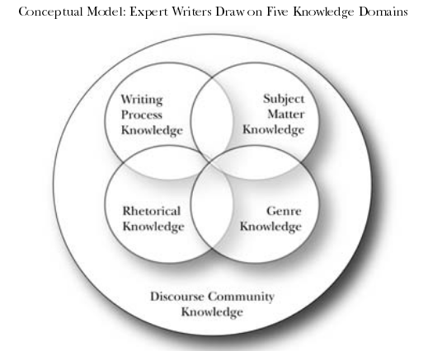
Writing is Situated
Anne Beaufort (2007) College Writing and Beyond: A New Framework for Writing Instruction, Utah State UP, p. 19.
Notes:
Anne Beaufort is a writing specialist. She earned a B.A. in Education from Wheaton College in 1969, followed by an MA in American Studies from Purdue in 1971 and, finally a Ph.D. in Language, Literacy and Culture from Stanford University in 1995. She is currently a Professor Emeritus in the School of Interdisciplinary Arts and Sciences at the University of Washington, Tacoma. She is best known in writing circles as the author of two books: Writing in the Real World: Making the Transition from School to Work, 1999, which attempts to answer the question: How can we prepare the work-force of tomorrow for the increasing writing demands of the Information Age? And the book from which the diagram pictured comes: College Writing and Beyond: A New Framework for University Writing Instruction, 2007, which exposes the absurdity of college writing programmes that organise their pedagogy around an intuitive set of general writing “skills” that can be used across contexts of writing, including across disciplines and contexts of culture such as from the academy, writing for academic assessment and publication, and the workplace, which of course has its own agenda and evaluative criteria.
In the diagram shown, Anne Beaufort proposes the knowledge domains from which expert writers in their field draw. Engulfing everything is ‘discourse community’. Expert writers have to know what people in this discourse community talk about, what is relevant to them, where the conversations are headed and, depending where they are within the community, they have to have a deep understanding of the topics relevant to the field (Subject knowledge). They have to be cognizant of the processes of production of texts, how people go about producing the texts that are valued by the field (Process Knowledge). Process knowledge does not only apply to the process of writing but also to the process of gathering information, research. They have to know what makes the case as well (Rhetorical knowledge)—for instance, as an obvious example, in the communities that discourse on Allied Health issues, unlike in the communities in which politicians discourse, writers and presenters cannot use false information to make their case. Finally, there is genre knowledge. Genres are unique to the discourse community that perpetuates and evolves the genre.
John Swales (1990, p. 58), another Professor Emeritus at the University of Michigan, a linguist, refers to discourse communities as “the parent of genre”. Swales references Herzberg (1986) to justify his preference for discourse community as a term over, for instance, Community of Practice:
“Use of the term “discourse community” testifies to the increasingly common
assumption that discourse operates within conventions defined by communities,
be they academic disciplines or social groups. The pedagogies associated with
writing across the curriculum and academic English now use the notion of
“discourse community” to signify a cluster of ideas: that language use in a group
is a form of social behaviour, that discourse is a means of maintaining and
extending the group’s knowledge and of initiating new members into the group,
and that discourse is epistemic or constitutive of the group’s knowledge
(Herzberg, 1986: 1, as cited in Swales 1990, p. 21). “
Swales lists six characteristics of discourse communities: 1. Discourse communities have “a broadly agreed set of common public goals” (Swale 1990, p. 11); 2. They have “mechanisms of intercommunication among its members” (Swales 1990, p. 12); 3. “A discourse community uses its participatory mechanisms primarily to provide information and feedback” (Swales 1990, p. 14); 4. “A discourse community utilizes and hence possesses one or more genres in the communicative furtherance of its aims” (Swales 1990, p. 15); 5. “In addition to owning genres, a discourse community has acquired some specific lexis” (Swales 1990, p. 16); and 6. “A discourse community has a threshold level of members with a suitable degree of relevant content and discoursal expertise.” “A genre”, he writes, “comprises a class of communicative events, the members of which share some set of communicative purposes” (Swales 1990, p 58). A discourse community like, for instance, Health Care Practitioners have a common set of communicative goals that can be accomplished with the performance of a communicative event: the performance of a genre.
This way of thinking of genre is similar to how I think and how I encourage the RWC tutors to think about writing. This way of thinking is very similar to how Rhetorical Genre scholars think about genre, as framed by Carolyn Miller (1984), genres perform social actions.
Why is all this important? Because when it comes time to analyse our writing situation, a stage that occurs, possibly several times, in the process of every successful writer, we are going to want to remember that we are not just talking to those who are assessing our knowledge but that we need to engage in the discourse in our field. Writers who do well are engaged in the discourse of the community to which they aspire to belong.
All writing is situated. Get situated.
Herzberg, Bruce (1986). ‘The politics of discourse communities.’ Paper presented at the CCC Convention, New Orleans, La, March, 1986.
Miller, Carolyn R. (1984) ‘Genre as Social Action’, Quarterly Journal of Speech 70, pp. 151-67.
Swales, John. M. (1990) Genre Analysis: English in Academic and Research Setting. Cambridge: Cambridge University Press.

Slide 22
Research Themes in The School of Allied Health
Research within the School of Allied Health is organized under two themes – Health Services Research and Population Health Research,… A cross-cutting feature of our research is its multidisciplinary and inter-professional focus incorporating the disciplines of Nutrition and Dietetics Occupational Therapy, Physiotherapy and Speech and Language Therapy. Collaborations with patient and community groups and allied health professionals communities of practice enables high quality, impactful research outputs.

Slide 23
Research Themes in The School of Allied Health
Health Services Research
  Our research in this area is focused in two key groups; Health Service Delivery and Education, and Social Science Informed Analysis of Practice. Working with stakeholders across the health and social care sectors, these groups aim to understand and address the challenges in health service delivery.
Population Health Research
  Our Population Health research groups are: Musculoskeletal Health, Acquired Neurological Conditions Integrated Research, Speech, Language and Communication Needs, and Long-Term Conditions. These research groups adopt a patient and public involvement approach to discover the needs and develop matching interventions for a wide range of populations across primary, secondary and tertiary care in collaboration with clinical colleagues.

Slide 24
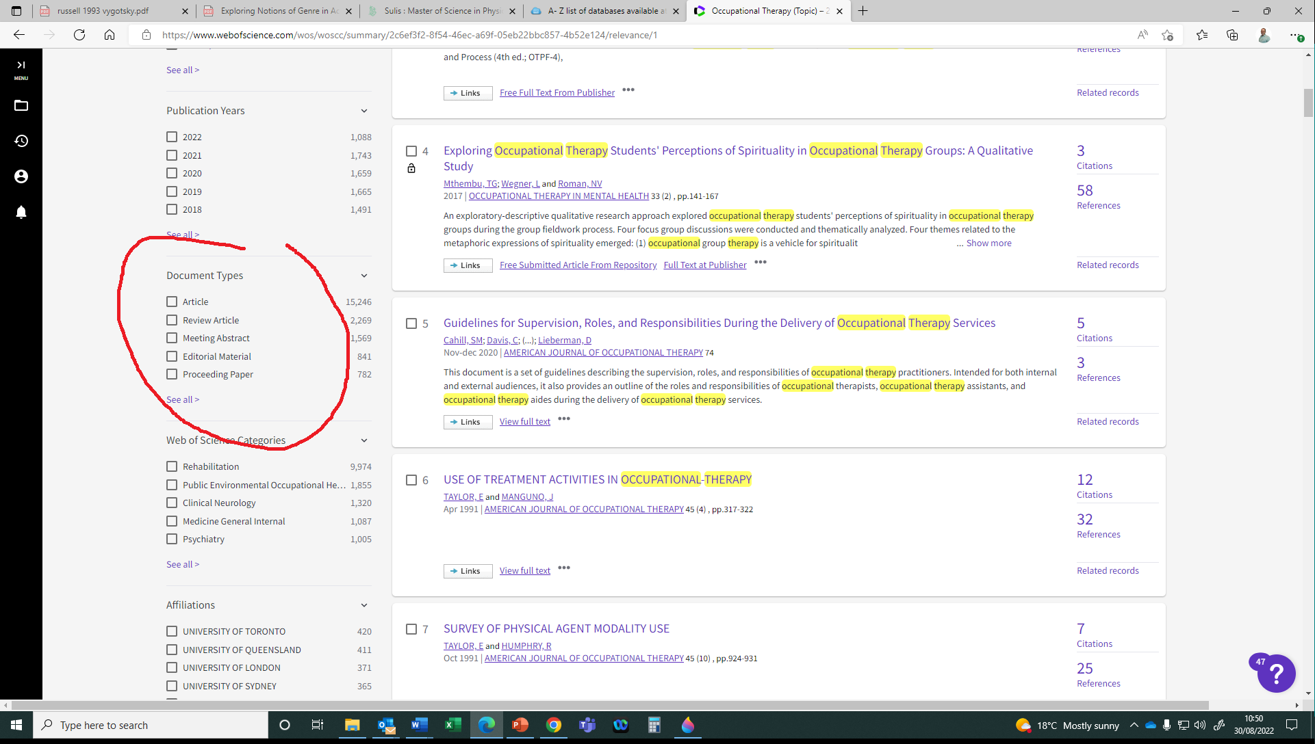
The library databases
Notes:
This is something that we don’t see on Google Scholar: genres
What are we looking for?
Articles are research articles that report on findings of studies and suggest further research.
Review Articles are reviews of the literature on a particular problem that is relevant to the field. Often review articles are bringing readers up to date on what has been done in order to better understand something not well understood in the field. These kinds of papers usually end with recommendations for future research are often announcements of intent to engage in such research.
I’m not familiar with Meeting Abstracts or Editorial Material or how those genres fit into the advancement of knowledge (what we do in the academy), but it would be easy enough to find out by clicking on the link and checking out what is coming up.
Proceedings papers are conference presentations that are published. Generally, they carry less weight than articles in rhetorical terms, their level of credibility. Of course, often, it depends on who is presenting.

Slide 25
Genres
http://www.uefap.com/index.htm
https://writingcenter.unc.edu/tips-and-tools/
https://owl.purdue.edu/owl/purdue_owl.html
Notes:
In Using English for Academic Purposes, go to the Writing page. Then look in the menu on the left for Genres.
In the writing centre at the University of North Carolina. Click on Tips and Tools, then look over to the last two columns on the right, ‘Specific Writing Assignments or Contexts’ and ‘Writing for Specific Fields’
In the OWL at Purdue, search ‘genre’ and find many links to information about specific kinds of genres and sub-genres.

Slide 26
Acculturating to the discourse in your field
The conversations happening now in your field appear in academic and professional journals.
Read.
The more you read the work of those who are advancing the knowledge in your field, the more you internalise the voices of experts and begin to sound like a member of that community.
Getting an A requires that you get involved in those conversations, that you attempt to make a contribution.
Notes:
The more you write, the better you get at it. Learning from the feedback you get from teachers or peers or RWC peer writing tutors helps. Getting a C3 on your first paper is not shameful. Getting a C3 on your second paper is. Even working up to a C2 by learning from the mistakes made on the first paper is evidence of learning and that you are starting to understand what the audience wants. Working your way up to As might take more time, but the RWC believes everyone is capable of achieving that grade. It requires attentiveness to what is working and what isn’t working and putting in the work. Everyone should try to be a good writer in this context by the final year of their graduate their undergraduate programme as doing so opens doors to recommendations for postgraduate study or to progression through the ranks in the workplace. Statistics show that the candidates for progression in the workplace that possess good interpersonal, presentational and written communication skills are more likely to advance.
Also, the importance of reading to writing cannot be overstated. When students read for content and for style, they more quickly acculturate to the conventions of the genres that people in their field adhere to. Read for content, but read again for not just what the author(s) is(are) saying, but how he/she/they are saying it.

Slide 27


