Slide 1
Immigration Information Session

Slide 2
Student Immigration Steps
1
2
3
4
Airport Immigration Control
Immigration Registration
Permission Renewal
Third Level Graduate Programme

Slide 3
What If I Am A European National?
  If you are a national of the European Economic Area (EEA) or of Switzerland, you have the right to stay and study in Ireland.
When you come to Ireland you do not need to register with the local immigration office and you do not need a residence card to live here.
  UK Citizens: People who are citizens of the United Kingdom (UK) are entitled to live in Ireland without any conditions or restrictions.

Slide 4
Immigration Registration
Mandatory for all Non-EEA students (including those who do not require a visa to come to Ireland) and must be done in due time
If you reside in Dublin, you will need to book your own appointment online with the Immigration Service Delivery Office.
If you are residing outside of Dublin, you will be registering with the Garda National Immigration Bureau. Important: If you do not have a Limerick address, you will need to book your immigration appointment at your local immigration office. Contact details can be found on the Garda website here - https://www.garda.ie/en/contact-us/station-directory/ If you live in Limerick you can book an appointment by email Limerick.registration@garda.ie

Slide 5


Immigration
Registration Documents
Valid passport ​​
Confirmation of Registration and Attendance Letter. This letter is available through the Student Portal Please see this link for instructions on how to access this document
Proof of medical insurance.
Visa and Immigration | University of Limerick (ul.ie)
Proof of financial support (approx. €3,000) ​​
IRP Fee €300
Proof of Tuition Fees Paid ​
Proof of Limerick Address​
Important: All documentation must be presented to the immigration officer in hard copy.
​

Slide 6
Immigration
Registration Documents
Evidence of financial support (approx. €3,000)
If you are supporting yourself – this can be an up to date bank statement in English and in Euros
If you are a scholarship holder - evidence of the same will be required.
If your parents are supporting you - a notarised letter stating that they will be supporting you financially for the duration of your academic stay in Ireland.
Students will need to provide proof of address:
Please provide a utility bill with your name and address
or a tenancy agreement with your name and address
or a letter from the village manager if you are living on campus
or a signed letter from your landlord/lady stating that you are residing at the said address along with a utility bill in his/her name.

Slide 7
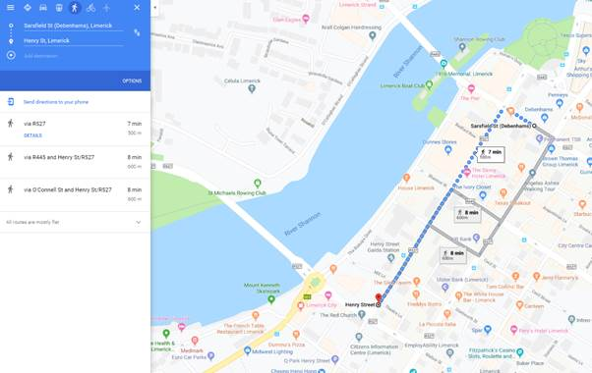
IMMIGRATION OFFICE DIRECTIONS
The Immigration Office is located Estuary House which is the building next door to the Garda Station on Henry Street, please see screenshots below

Slide 8
Registration Appointment
Biometric data (fingerprinting) is part of this registration process. Your photo will also be taken.
Your passport will receive a new Stamp usually valid for 12 months.
Your IRP card should be delivered to your address within 10 working days from the date of your appointment.

Slide 9
Permission Renewal
Done Every 12 Months
Renewal appointments will not be made by UL Global. Students must contact the immigration office themselves ahead of their expiry date to request a renewal appointment.

Slide 10

Working in Ireland with Stamp 2 immigration permissions
Term Time: Part time work is permitted - up to 20 hours per week.
Holiday Periods (15th December to January 15th, June, July, August and September): Full Time work is permitted – up to 40 hours per week.

Slide 11
Third Level Graduate Programme/Stamp 1G https://www.irishimmigration.ie/my-situation-has-changed-since-i-arrived-in-ireland/third-level-graduate-programme/
The intention of the programme is to allow legally resident Irish educated Non-EEA graduates to remain in Ireland after their studies.
Graduates with an award from an undergraduate programme will be granted a twelve-month permission.
Graduates with a Masters or PhD award will be granted permission for twenty-four months (twelve months initially).
Holders of Stamp 1G are exempt from the requirement to possess an employment permit from the Department of Jobs Enterprise and Innovation.
This should be for the purpose of seeking graduate level employment and applying for a general employment permit, a critical skills employment permit or research hosting agreement.

