Slide 1
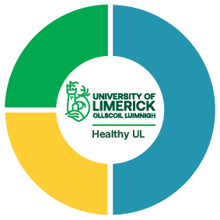
Healthy UL,
Healthy UL and Wellbeing for Postgraduate Researchers
Sarah Kennedy, Healthy UL Manager
27/10/2022

Slide 2
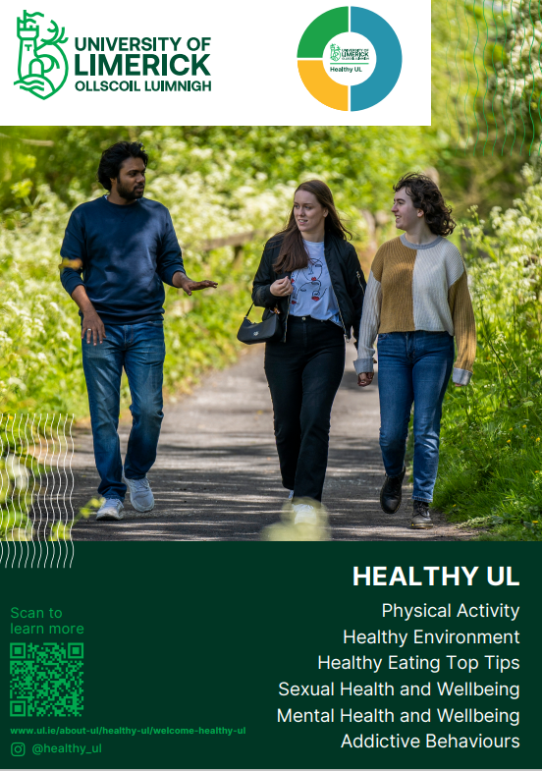
Welcome!

Slide 3

Healthy Campus Initiative
On July 2nd, 2021, Healthy Ireland’s National Healthy Campus Framework was launched, developed in partnership with the HEIs , the HSE and Healthy Ireland.
The framework was developed in line with international best practice and is based on the Onkangan International Charter for Health Promoting Universities.
To create a shared understanding of a healthy campus to guide and inspire action by HEIs.
To support and recognise the work of HEIs in improving the health and wellbeing of campus communities.
To generate and disseminate knowledge for promoting health and wellbeing in the HEIs.

Slide 4

‘A healthy campus adopts a holistic understanding of health, takes a whole campus approach, and aspires to create a learning environment and organisational culture that enhances the health and wellbeing of its community and enables people to achieve their full potential’

Slide 5
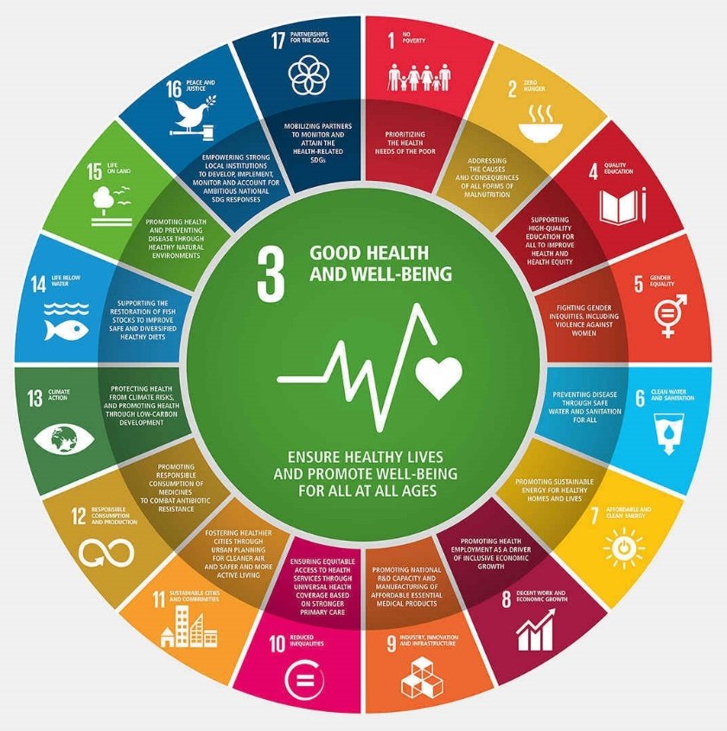
Healthy UL: Sustainable Development Goals
By 2030, reduce by one-third pre-mature mortality from non-communicable diseases (NCDs) through prevention and treatment, and promote mental health and wellbeing

Slide 6



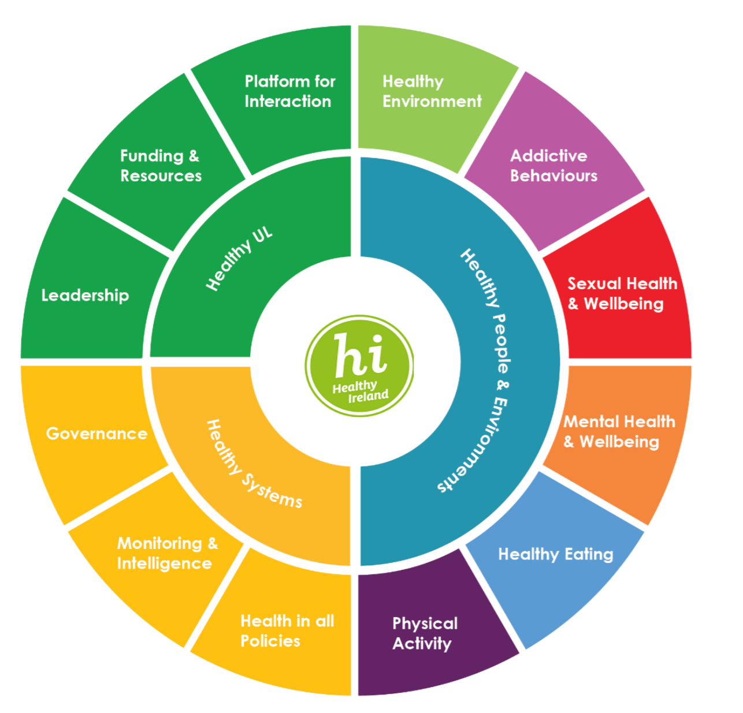




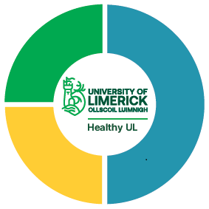




Notes:
‘Healthy UL’ seeks to bring together university expertise from multiple disciplines and in addition enhance partnership links with local and national agencies like Limerick City and County Council, the Health Services Executive and the wider health, education, transport, planning and environment systems. In so doing, and in addressing the promotion of health and wellbeing, UL will also be contributing, in part, to addressing some of the issues surrounding chronic disease and wider societal concerns.

Slide 7
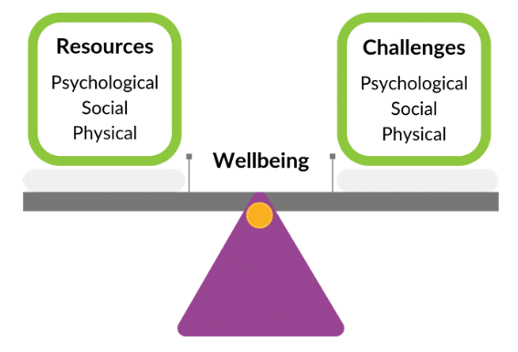
What is Wellbeing?
Dodge et al
Wellbeing is the balance between resources and demands

Slide 8

Importance of Health and Wellbeing while Studying
There is a strong and expanding evidence base indicating that university students are a ‘very high risk population’ for psychological distress
Evidence shows that pandemic has had apparent negative impact on perceived mental health and wellbeing
Record demand for mental health services across universities
Healthy UL developing a Student Life Module, a module ‘for students, by students’ to help promote resilience and life skills
Mental health and wellbeing affects academic performance
Regular exercise promotes better mental health and emotional wellbeing

Slide 9
Importance of Health & Wellbeing for College Students
Student health and wellbeing fundamental to successful performance and productivity. (Dooris et al, 2020)
Growing appreciation that human and planetry health are interconnected (WHO, 2016)
Campus dedication to health and wellbeing can improve academic performance and graduation rates.
Regular exercise promotes better mental health and emotional wellbeing
“Healthy Body, Healthy Mind!”

Slide 10
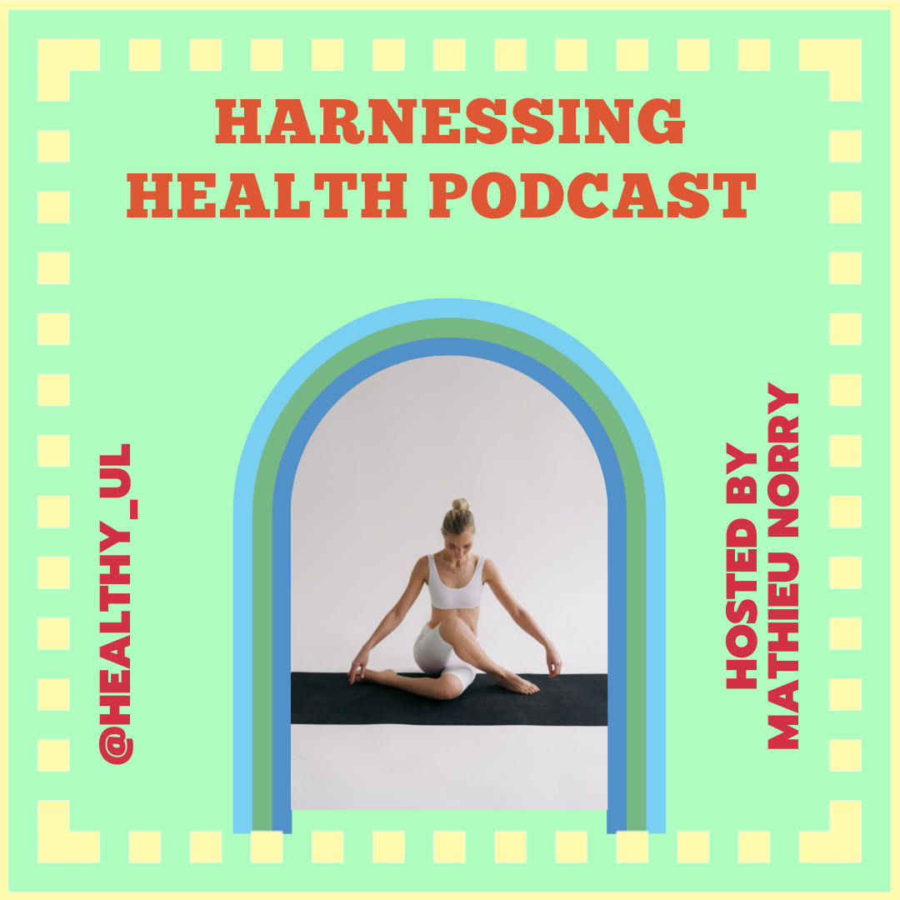




First 7 Weeks

Slide 11



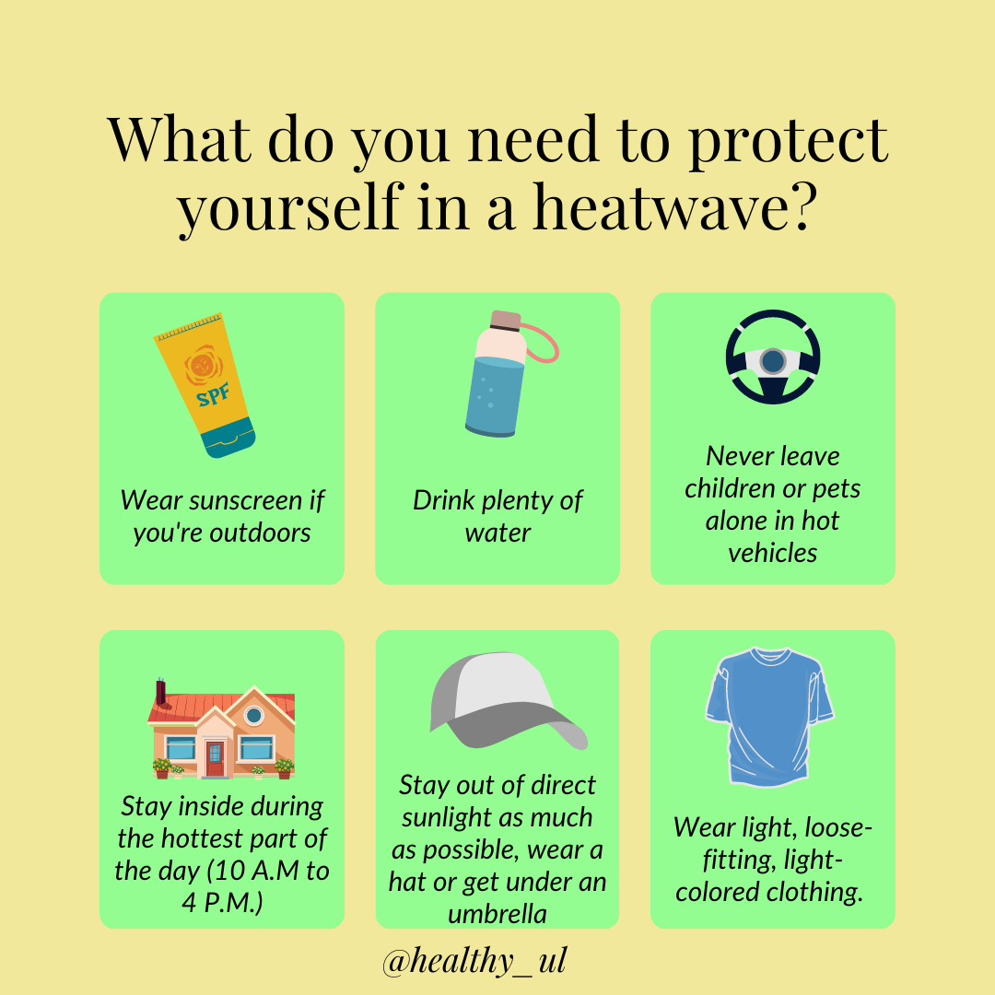
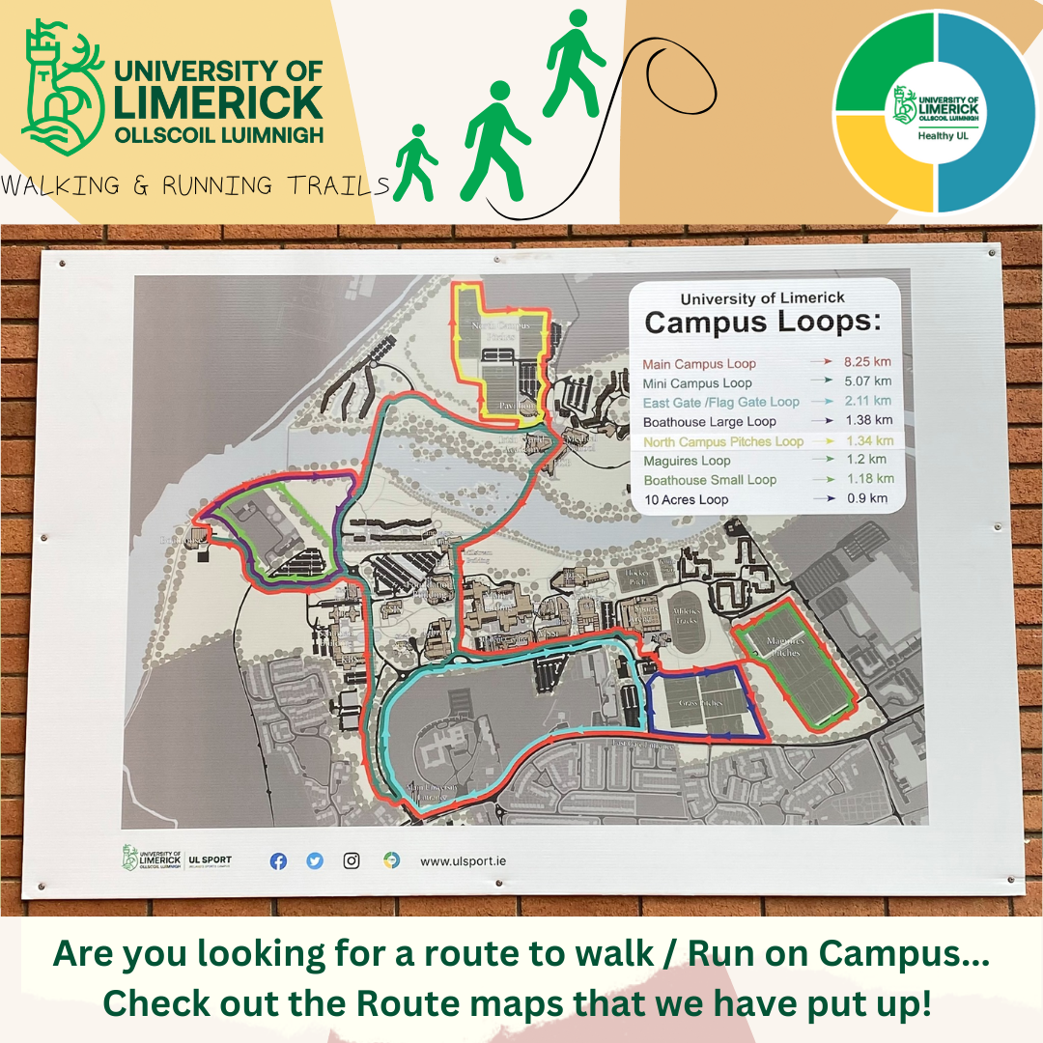

Instagram and Twitter Outputs

Slide 12
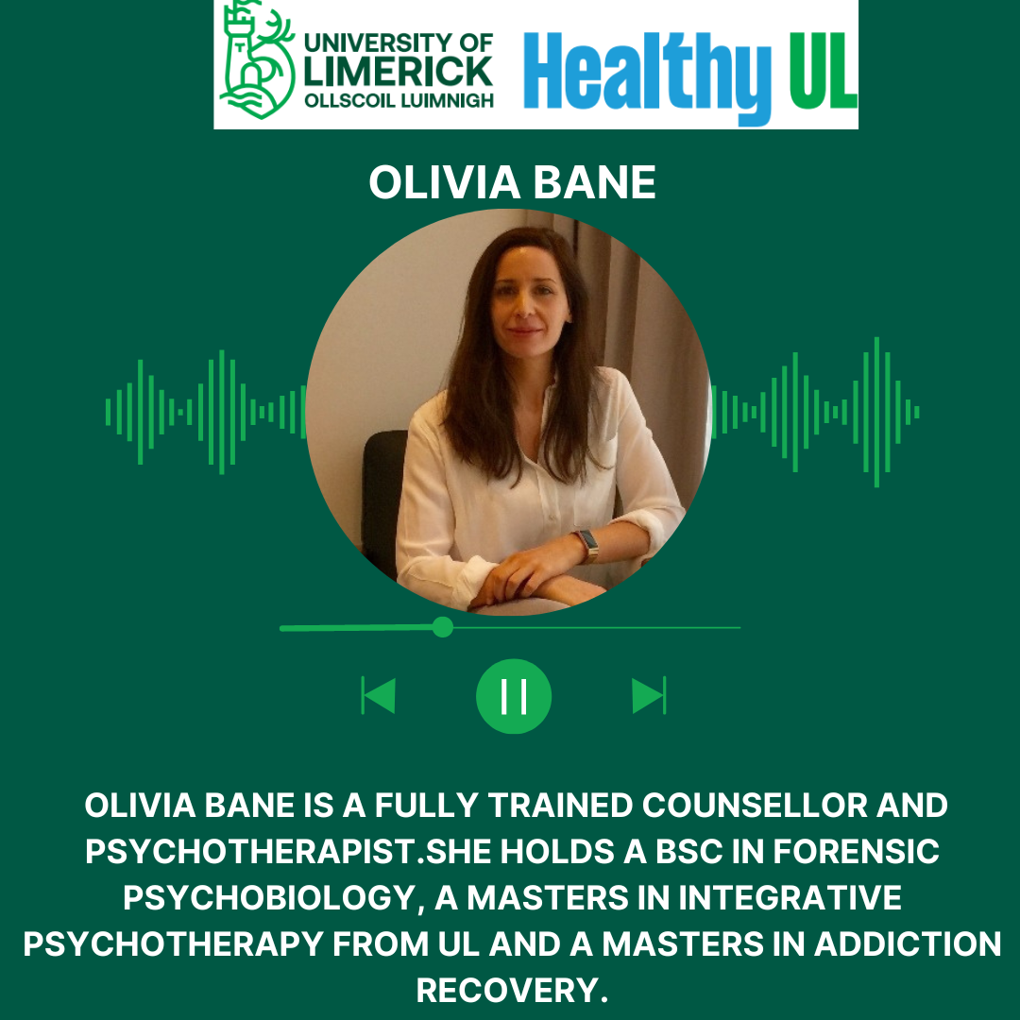
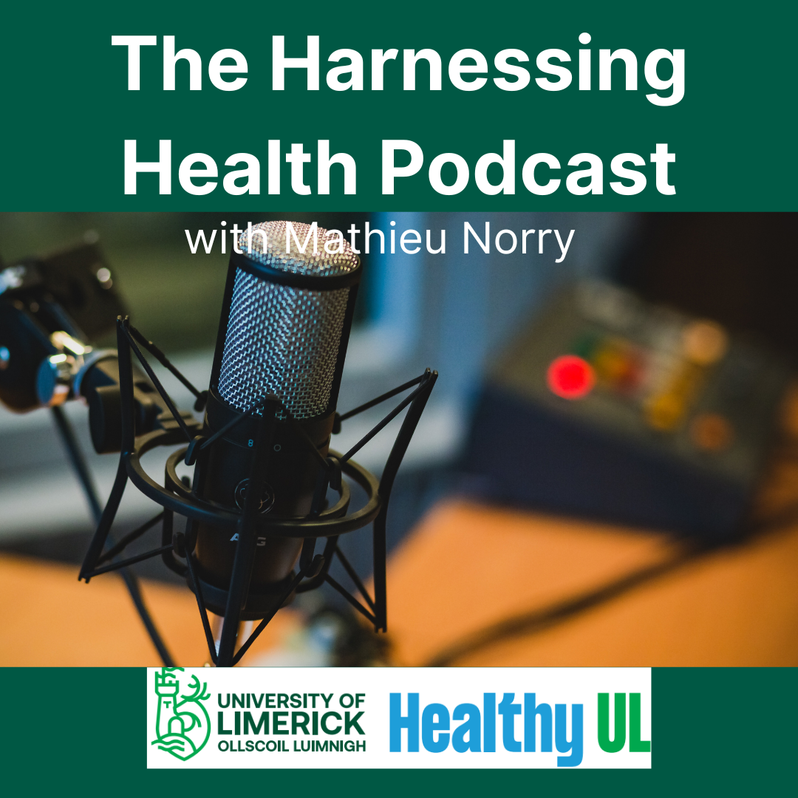
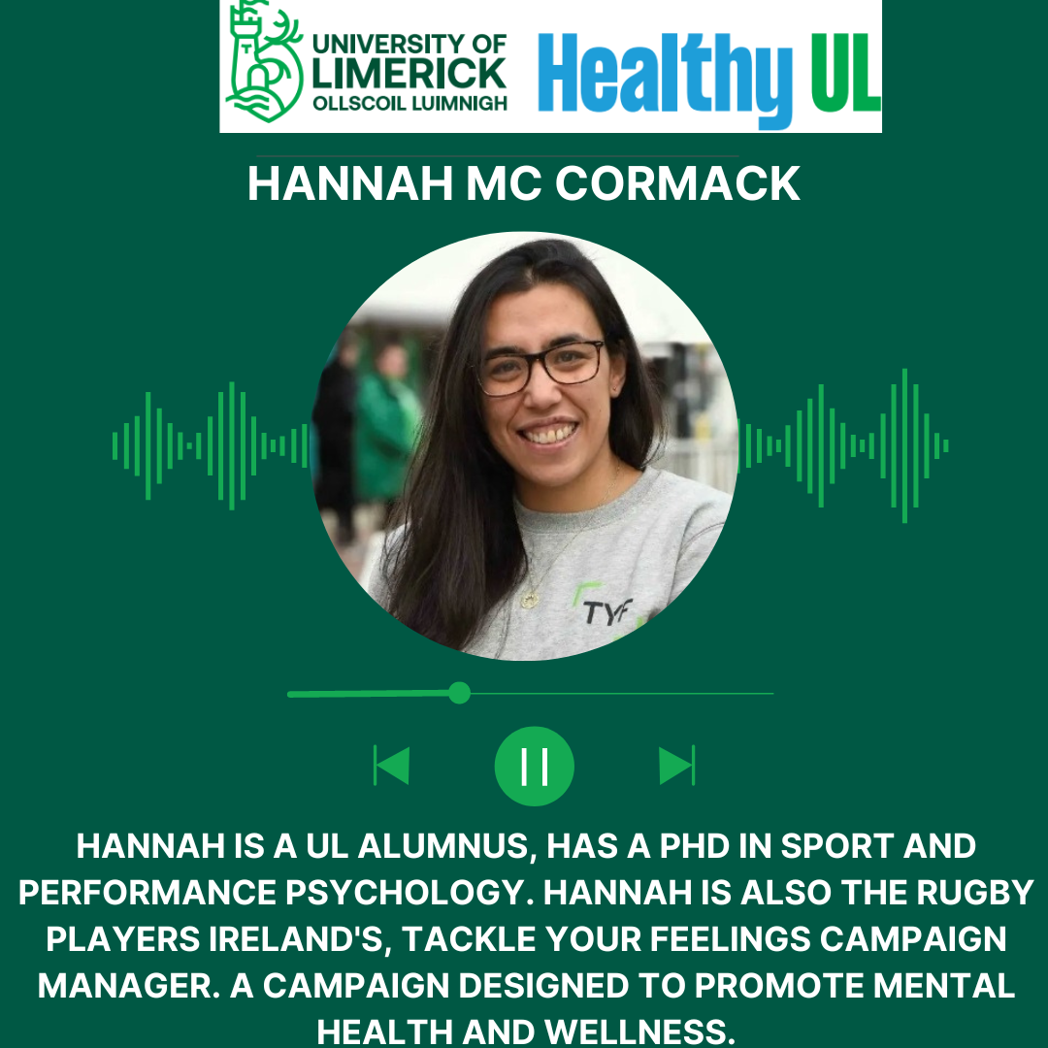
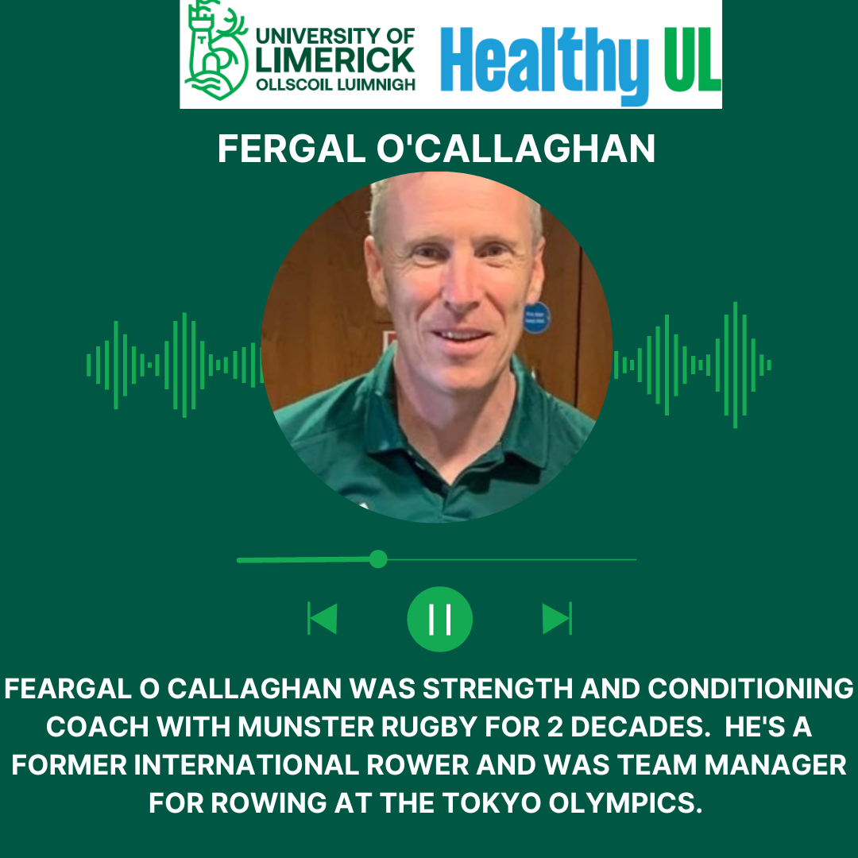
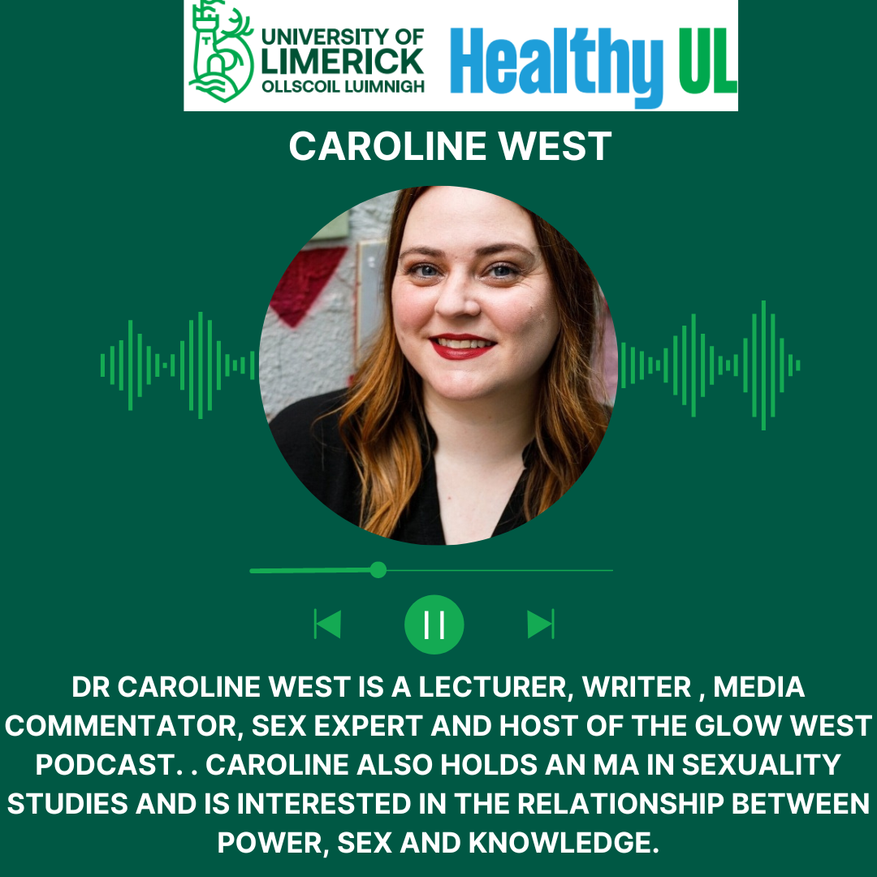

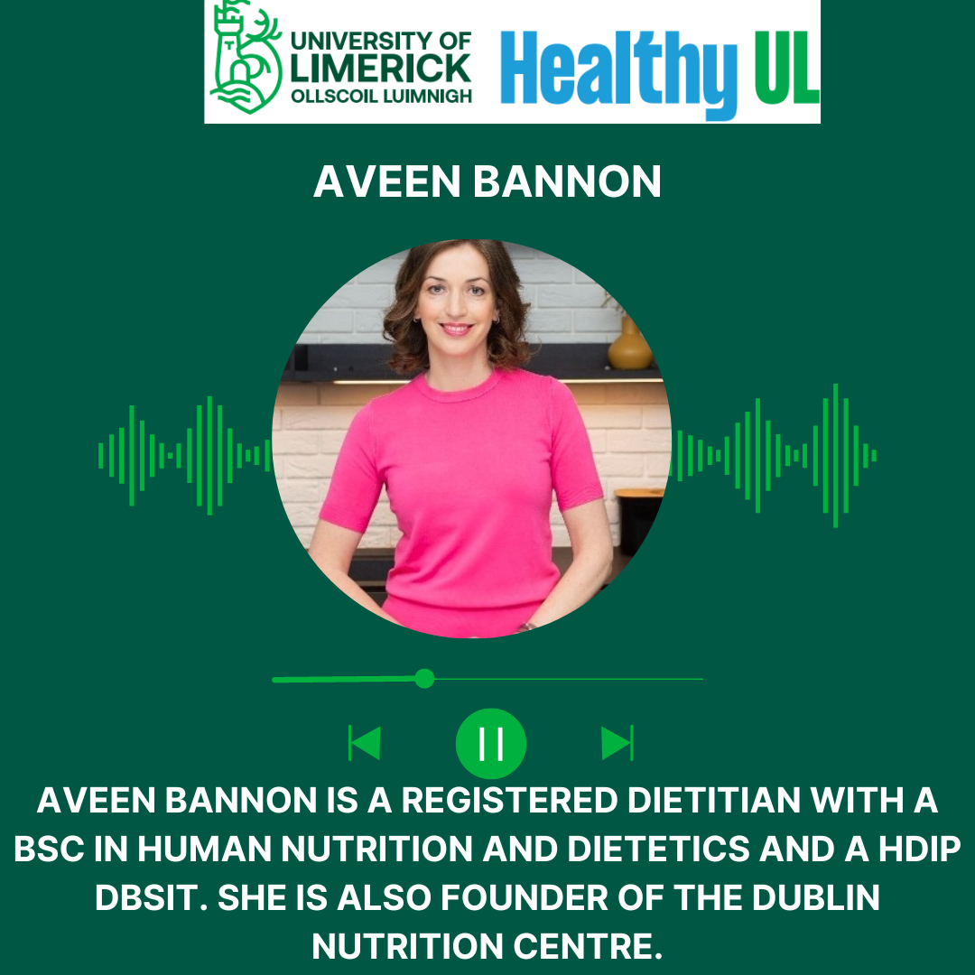
Harnessing Health Podcast

Slide 13

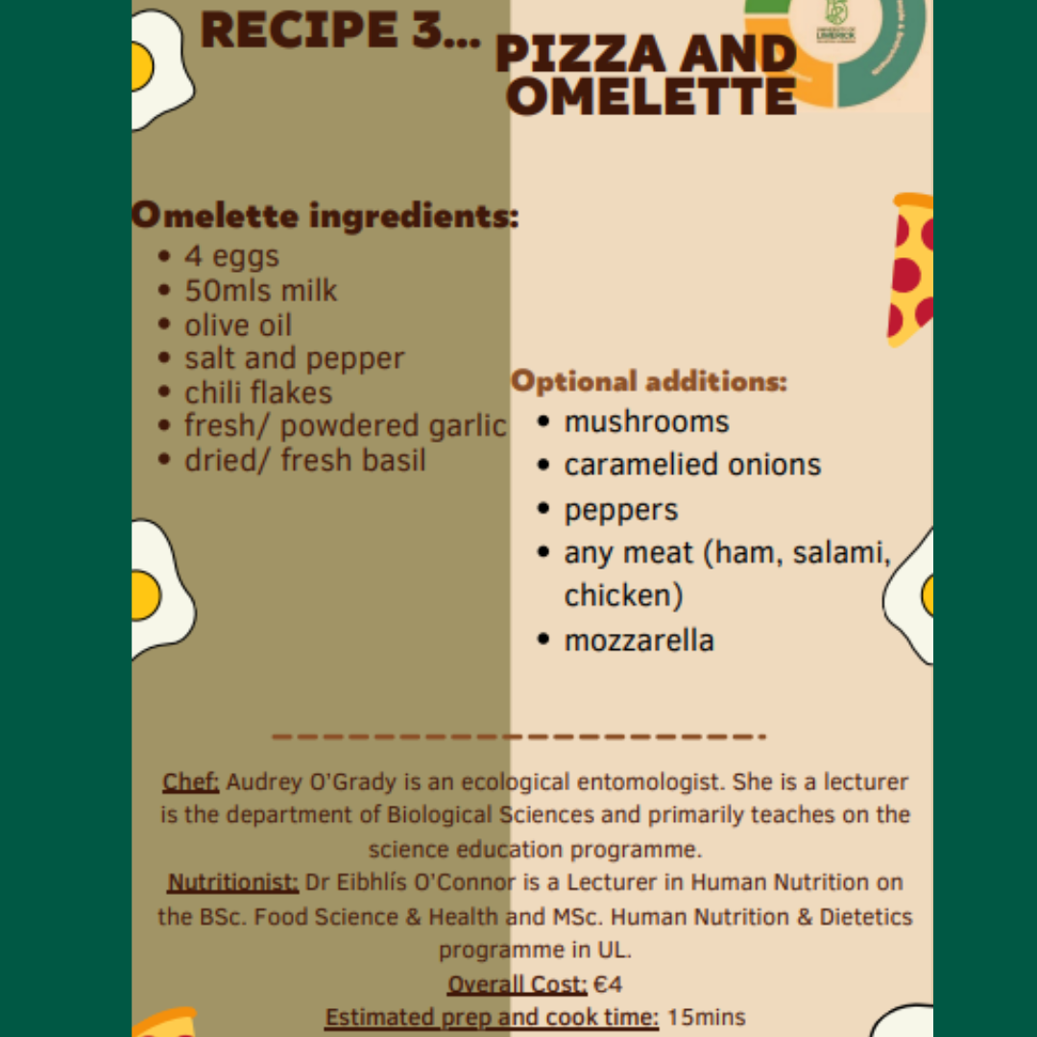

Cookalong

Slide 14
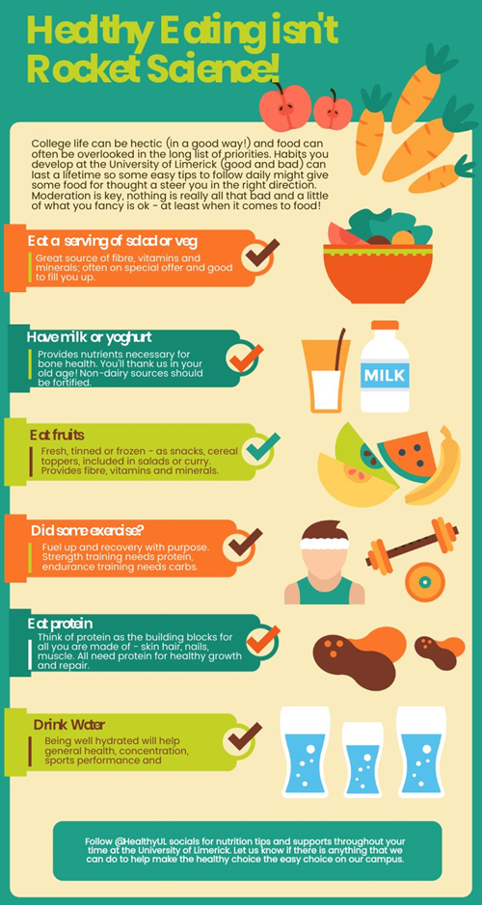
Healthy Eating

Slide 15
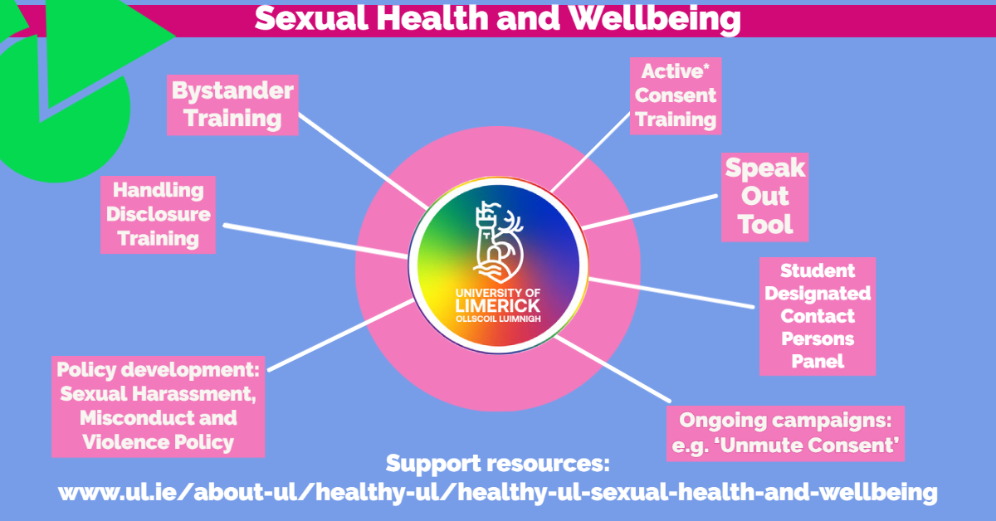
Sexual Health and Wellbeing

Slide 16
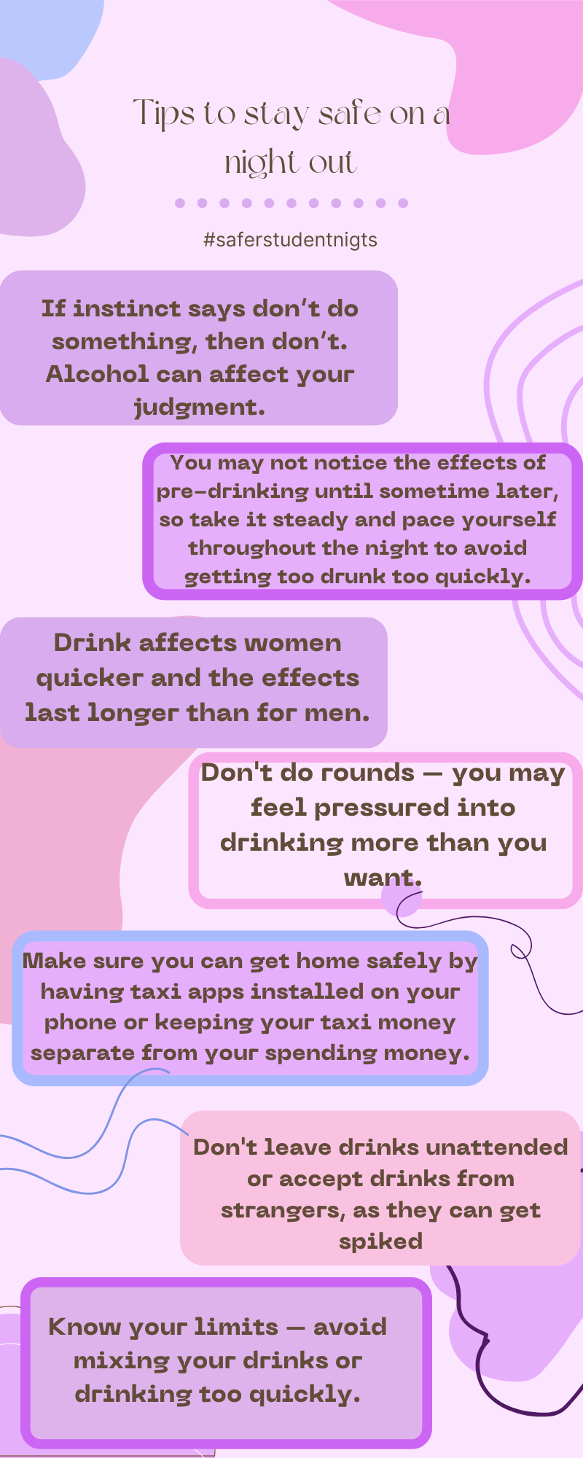
Addictive Behaviours

Slide 17
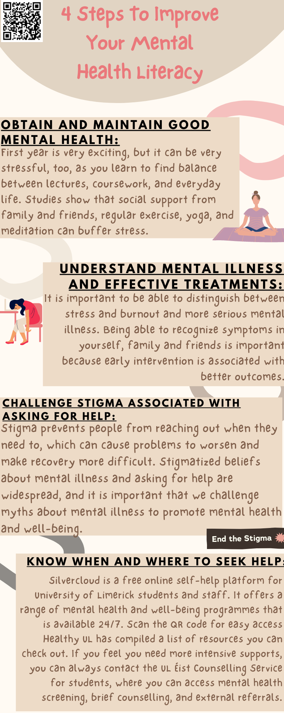

Mental Health & Wellbeing

Slide 18
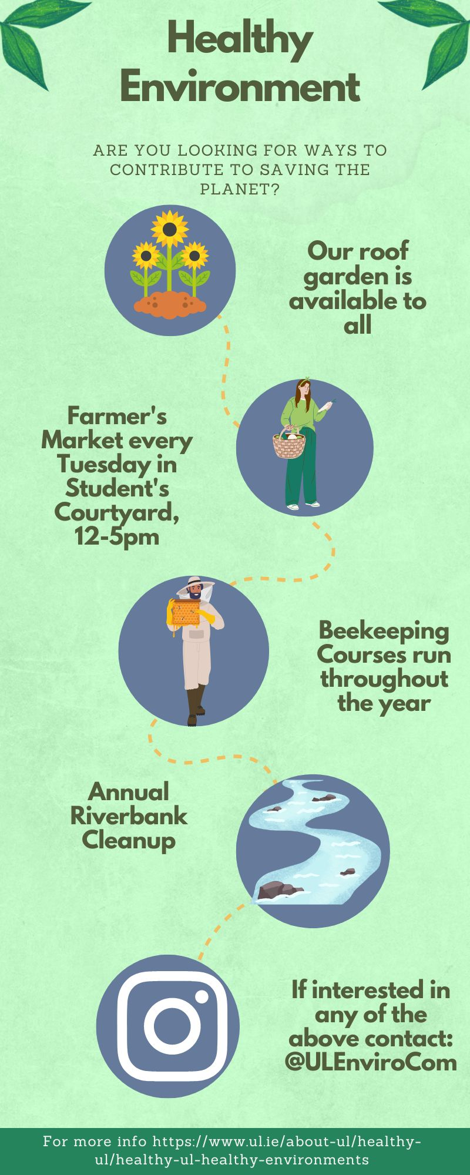
Environment

Slide 19
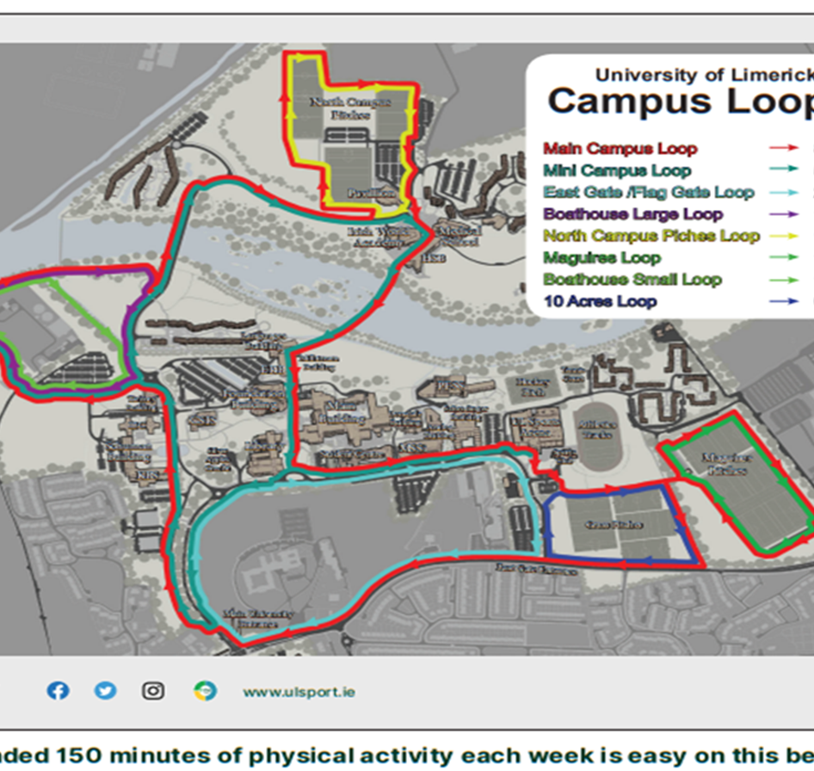
Physical Activity

Slide 20

Wellbeing-5 Key Principles
CONNECT-WITH OTHER PEOPLE
BE ACTIVE-EXERCISE WE ENJOY MAKES US FEEL GOOD
KEEP LEARNING-LEARNING NEW THINGS BUILDS CONFIDENCE
GIVE –DOING SOMETHING FOR OTHER BEEFITS GIVER ALSO
TAKE NOTICE-BECOME MORE AWARE OF THE PRESENT MOMENT

