Slide 1
Researcher Development
UL PGR Orientation - Autumn 2022
Dr Ger Downes
Graduate and Professional Studies

Slide 2
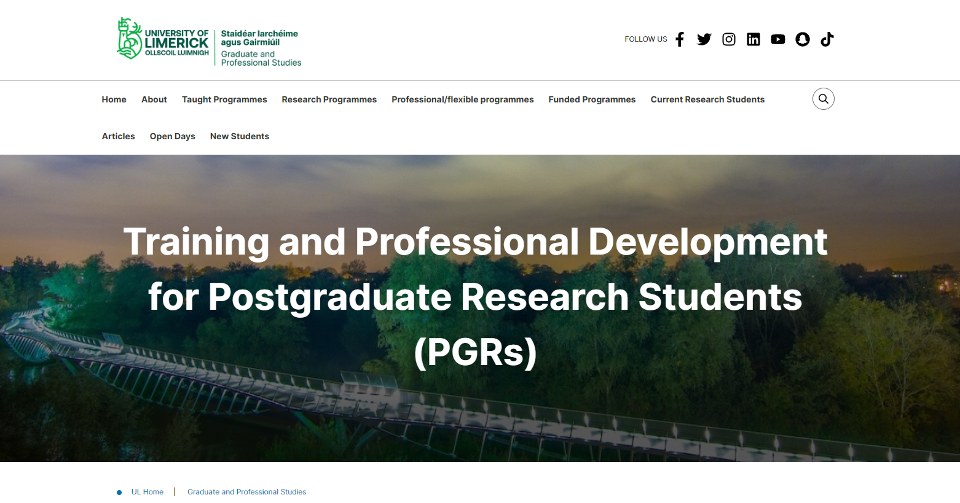
Training and Professional Development for PGRs
Training and Professional Development for PGRs page

Slide 3

Researcher Development
Summer School in Generic and Transferable Skills
Transferable Skills workshops
Weekly GPS webinars on PhD skills
NVivo Workshops for PGRs / NVivo & SPSS for PGRs via Topdesk
Shut Up and Write! for UL & Ulster University PGRs
Teaching Workshops for PGR Tutors
Essentials for teaching and learning online & Essentials of e-moderating
Research Integrity Training
LinkedIn Learning for UL PGRs
Thesis-in-Three competition
UL PhD Research Video Podcast Series
‘Picture This’ competition

Slide 4
GPS Transferable Skills Summer School
Research Integrity (EHS)
Digital Research Management (Library and Information Services)
Planning Research and Publication (Library and Information Services)
Developing Ideas and Arguments: Writing into Academic Communities (Regional Writing Centre)
Research Ethics (AHSS)
Research Networking: Developing an Academic Profile (KBS)

Slide 5
GPS Skills Workshops
Questionnaire Design
Statistical Inference using SPSS
Multi-variable Data Analysis
Formatting your thesis
NVivo Specialist Training
Microsoft Teams Training
Effective Presentations
Excel Levels 1 & 2
SPSS

Slide 6
GPS Weekly Webinar Series
Demonstrating the ‘Impact’ of your PhD Research
Design of Experiments
Disseminating Your Research
Doing a Literature Review
Project Managing Your PhD Thesis
Research Integrity and Ethics in Your PhD
Wellbeing Through Healthy UL
Surviving The Viva
The Importance of Data Management Planning

Slide 7
Other Providers of PGR Training & Professional Development
Human Resources
Research Office
Library & Information Services
Careers Office
Regional Writing Centre
Information sessions, e.g. Irish Research Council Scholarship applicants

Slide 8
HR Learning & Development Courses
Advanced Grant Writing
CV Building Workshop
Effective Peer Review of Articles
Formulating Your Research Proposal
Grant Writing Workshop
Innovation and Creativity Workshop
Inter-Faculty Research Collaboration Events

Slide 9
HR Learning & Development Courses
Networking Event for New Researchers
Networking for Success - A Key Element of your Research Strategy
Presenting Your Research With Impact
Research Ethics Training
Research Week - Career Development Panel Discussion
Researcher Development
Writing for Publication Workshop to support International Researchers & Academics

Slide 10
Regional Writing Centre
PhD Writers' Group
PhD Writers' Week
Modules on writing for publication and thesis writing
Online resources for writers
An opportunity to mentor undergraduate writers in the Writing Centre
UL One Campus One Book
Peer Tutoring In Academic Writing module

Slide 11


Slide 12
Library
Online training materials from Epigeum in research, teaching and development, studying, wellbeing etc.
Courses include: Research Integrity, Career Planning in the Arts, Humanities and Social Sciences, Intellectual Property in the Research Context, Managing Your Research Supervisor or Principal Investigator
Research Integrity Training: https://www.ul.ie/research/content/researchintegrity

Slide 13
Library Workshops-Research Services
How to Write a Great Research Paper, and get Published in a Top Journal
Maximising Your Research Impact
Selecting high impact journals
Referencing and EndNote
Google Scholar Researcher Profile
Importance of Research Data Management
Data Management Planning
Realising your Research Value
Research Profiles - ORCID & Google Scholar

Slide 14
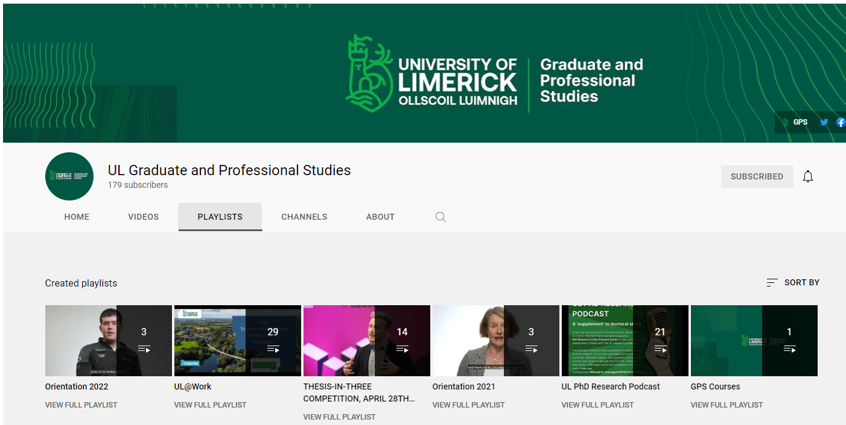
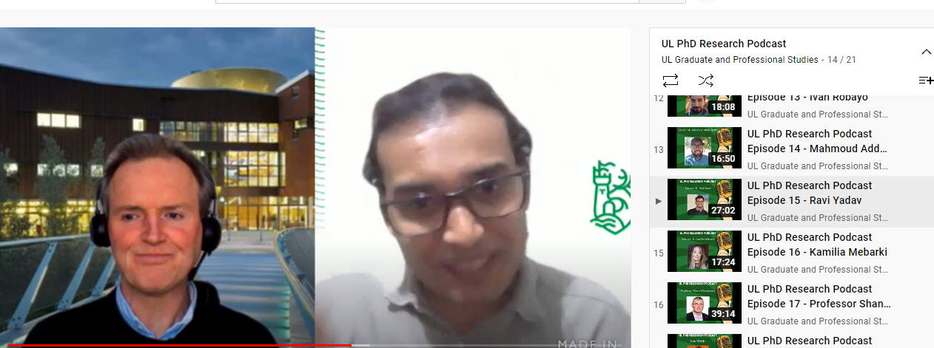
GPS YouTube Channel
PhD Video Research Podcast Series

Slide 15
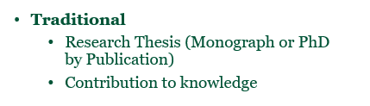
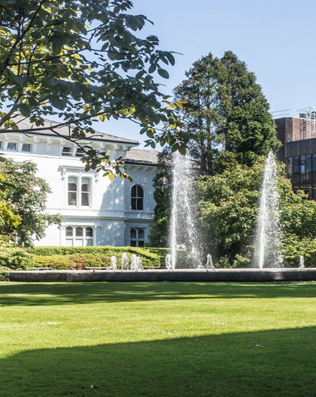
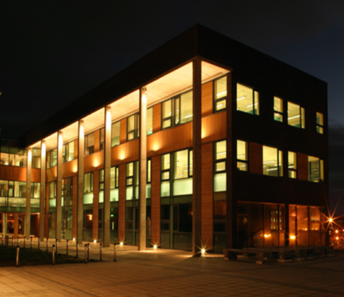
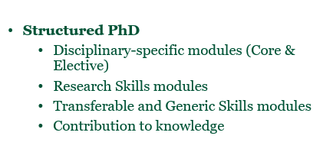

Different types of PhDs and Doctorates at UL

Slide 16
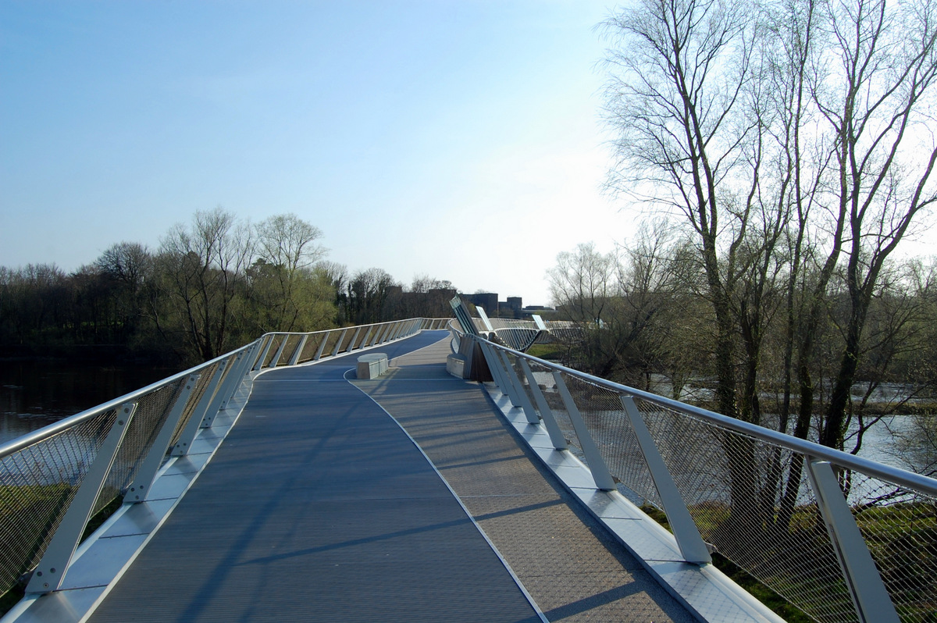
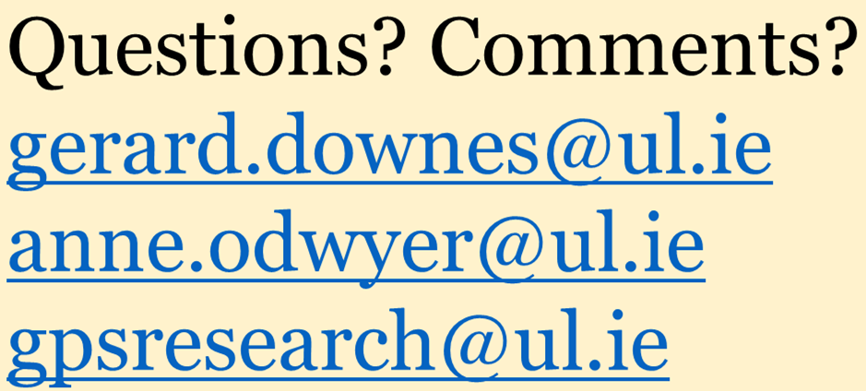

Slide 17
Thank you

