Slide 1
Need to know: library services for Postgraduates - 2022
Presented by the Department of Learning & Engagement – Glucksman Library

Slide 2
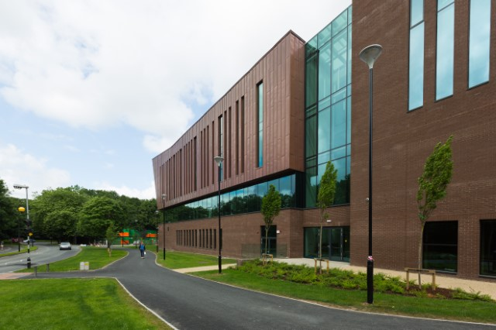
Welcome to UL!
The Glucksman Library welcomes all new students and researchers, and look forward to meeting and supporting you, both online and in person throughout your journey In UL.

Slide 3
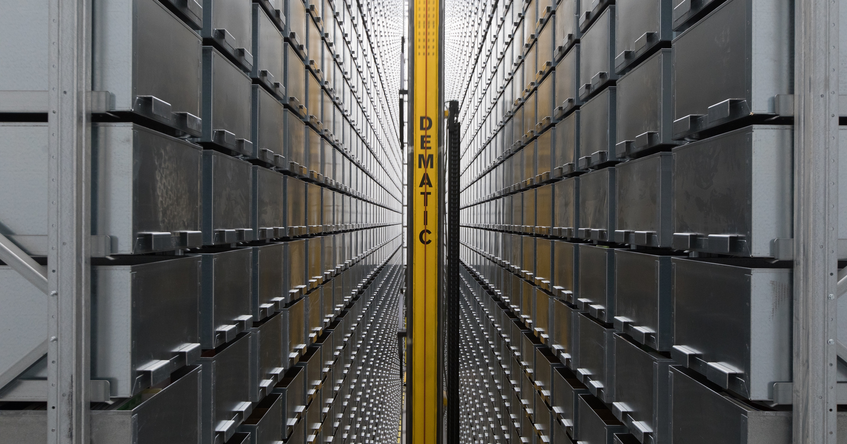

Using the library
We are open from
07:00-24:00 Mon – Fri
10:00-20:00 Sat and Sun
Use your UL ID card to swipe in to the library (and also to borrow books and laptops)
You won`t be charged fines for overdue books

Slide 4
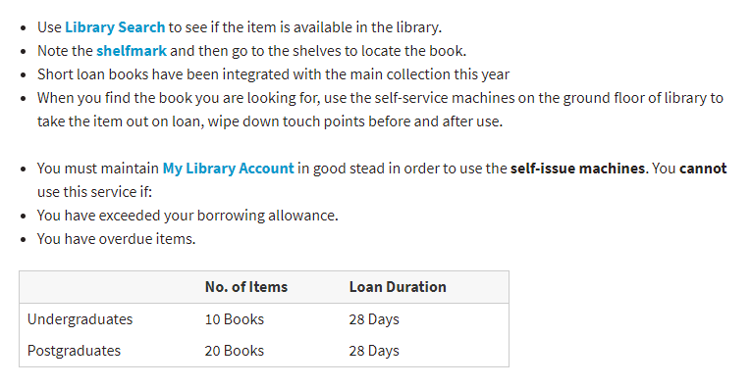

Borrowing

Slide 5
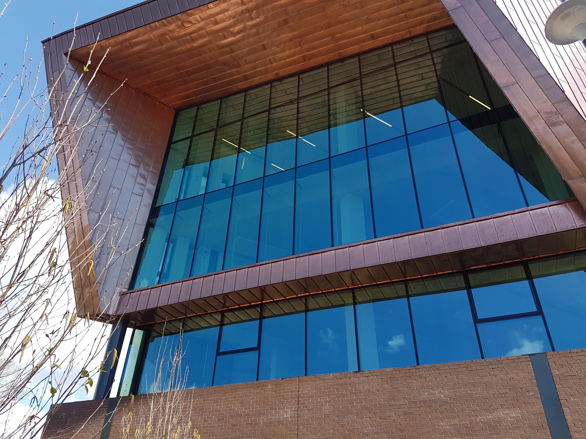
The online library at UL
  The library provides you with the material you need for your research.
  Any items we do not subscribe to can be found through our interlibrary loans service.
  24-hour access to library electronic content, at home or on campus
    Your UL network ID is your login for library online collections www.ul.ie/library
  Live chat service 09:00 – 21:00 and via email at libinfo@ul.ie

Slide 6
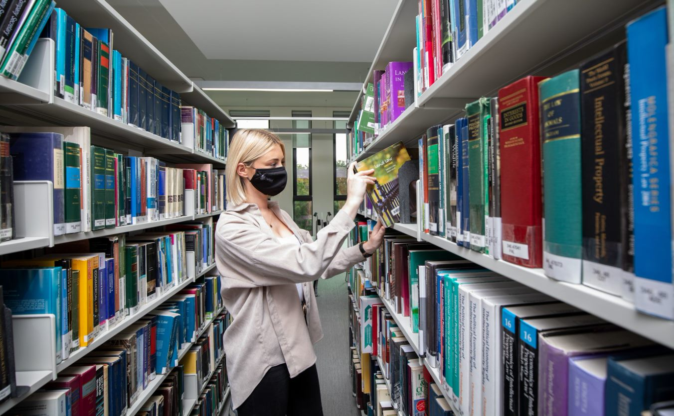
Access to all the resources you need for your research – for free!
over 350,000 printed books
450,000 electronic books
60,000 academic journals
270 online databases

Slide 7
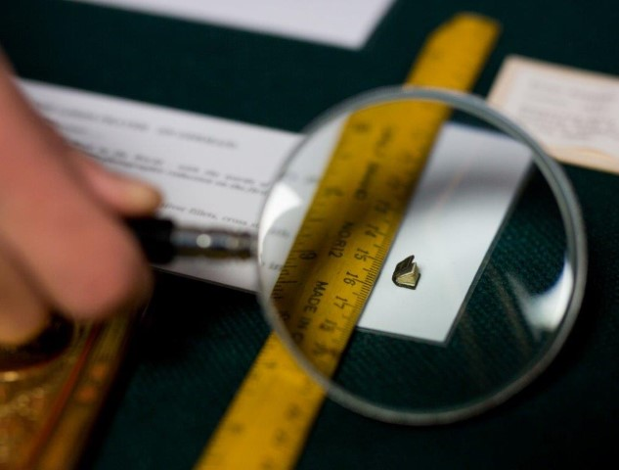
Library resources at UL
Even this microscopic book
Notes:
This item was for a time the smallest book in the world (no longer holds that title alas).
It is a copy of Lord’s Prayer in German, printed in Amsterdam in 1952.

Slide 8
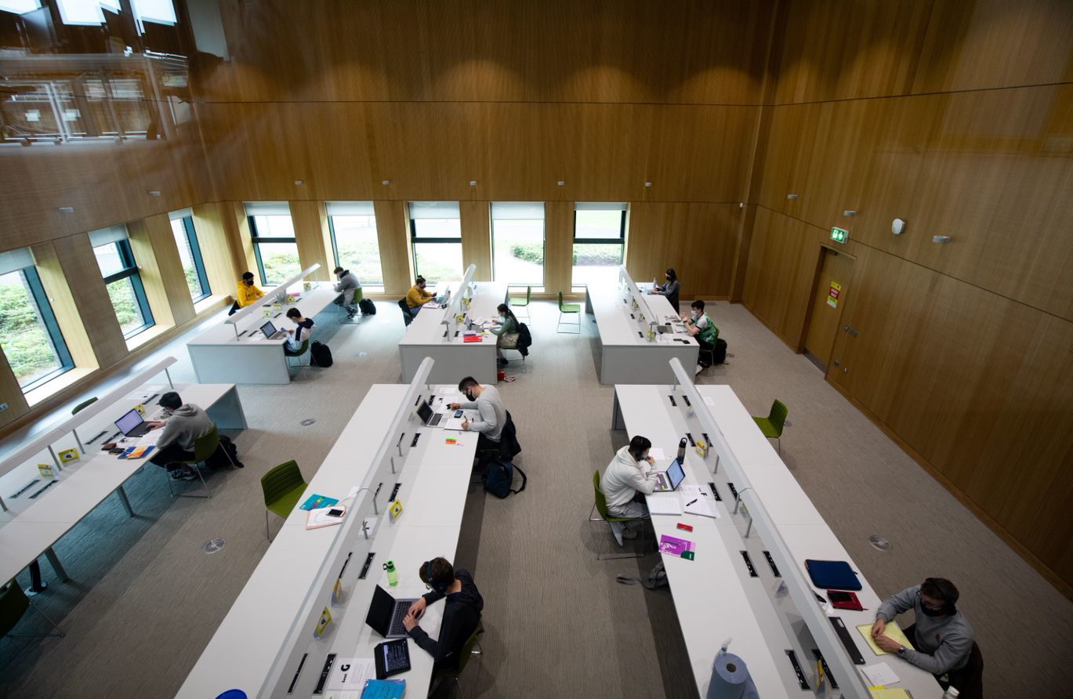
Spaces for quiet study

Slide 9
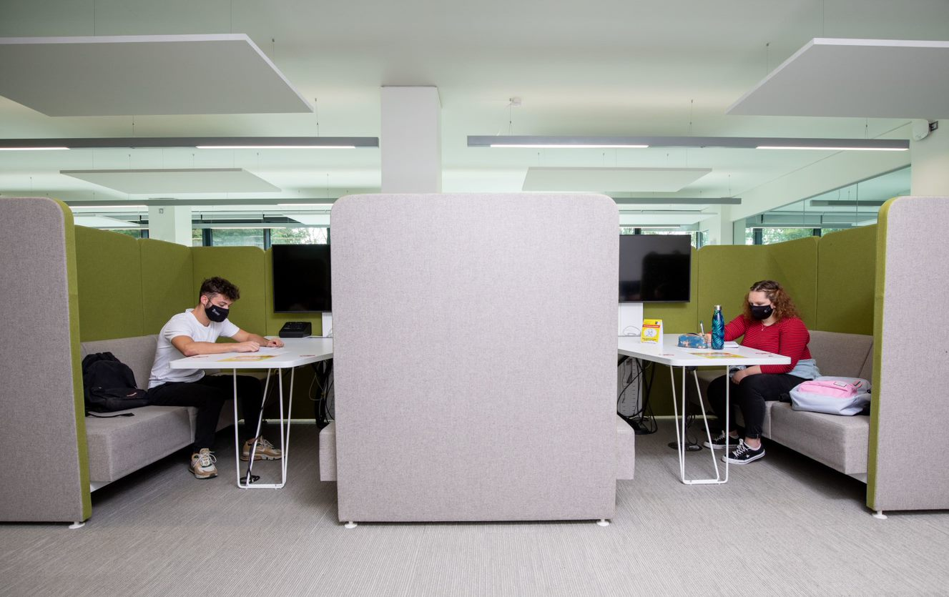
Individual and group booths for conversation/meetings

Slide 10
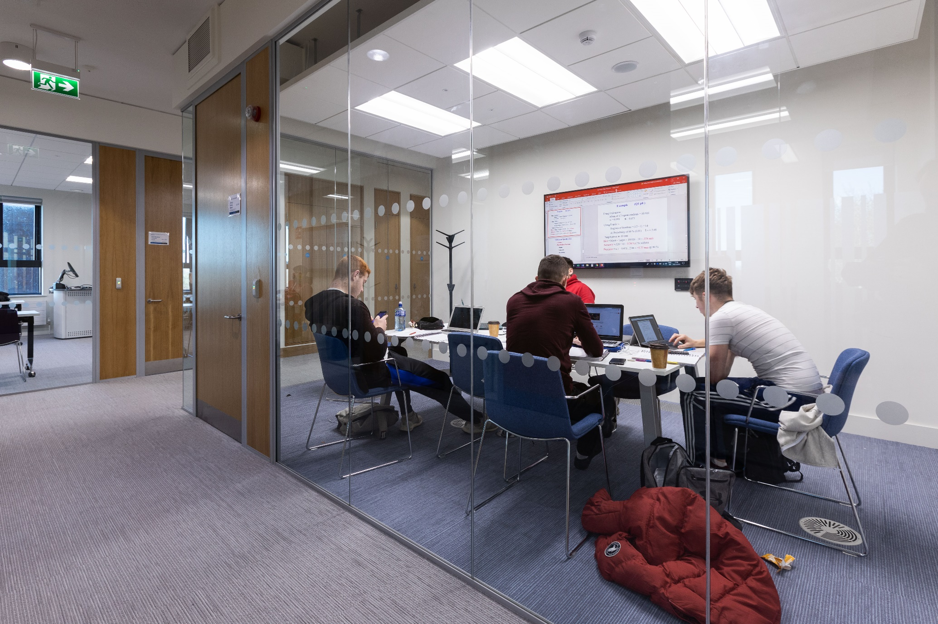
Bookable Group Study Rooms

Slide 11
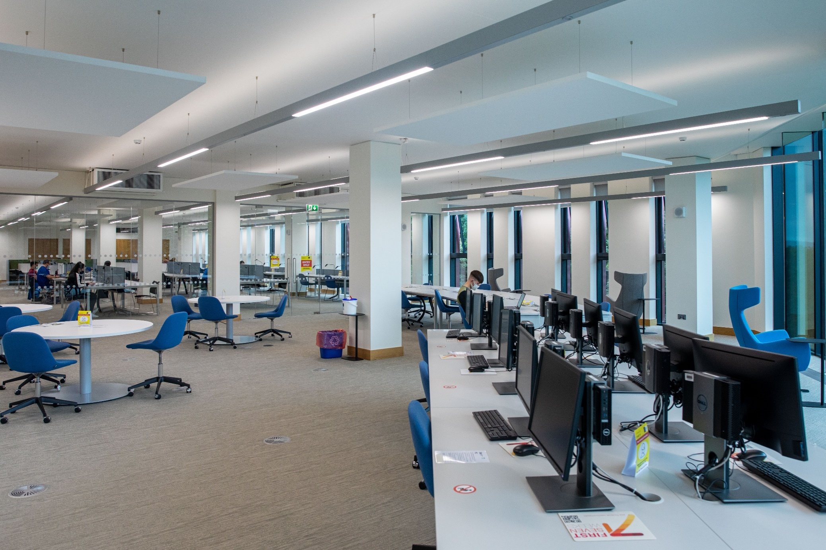
Dedicated Postgraduate Commons

Slide 12
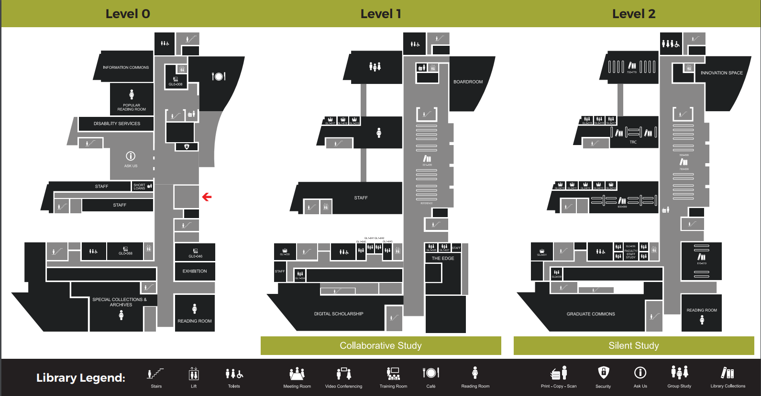
Floorplan – Graduate Commons, 2nd floor

Slide 13
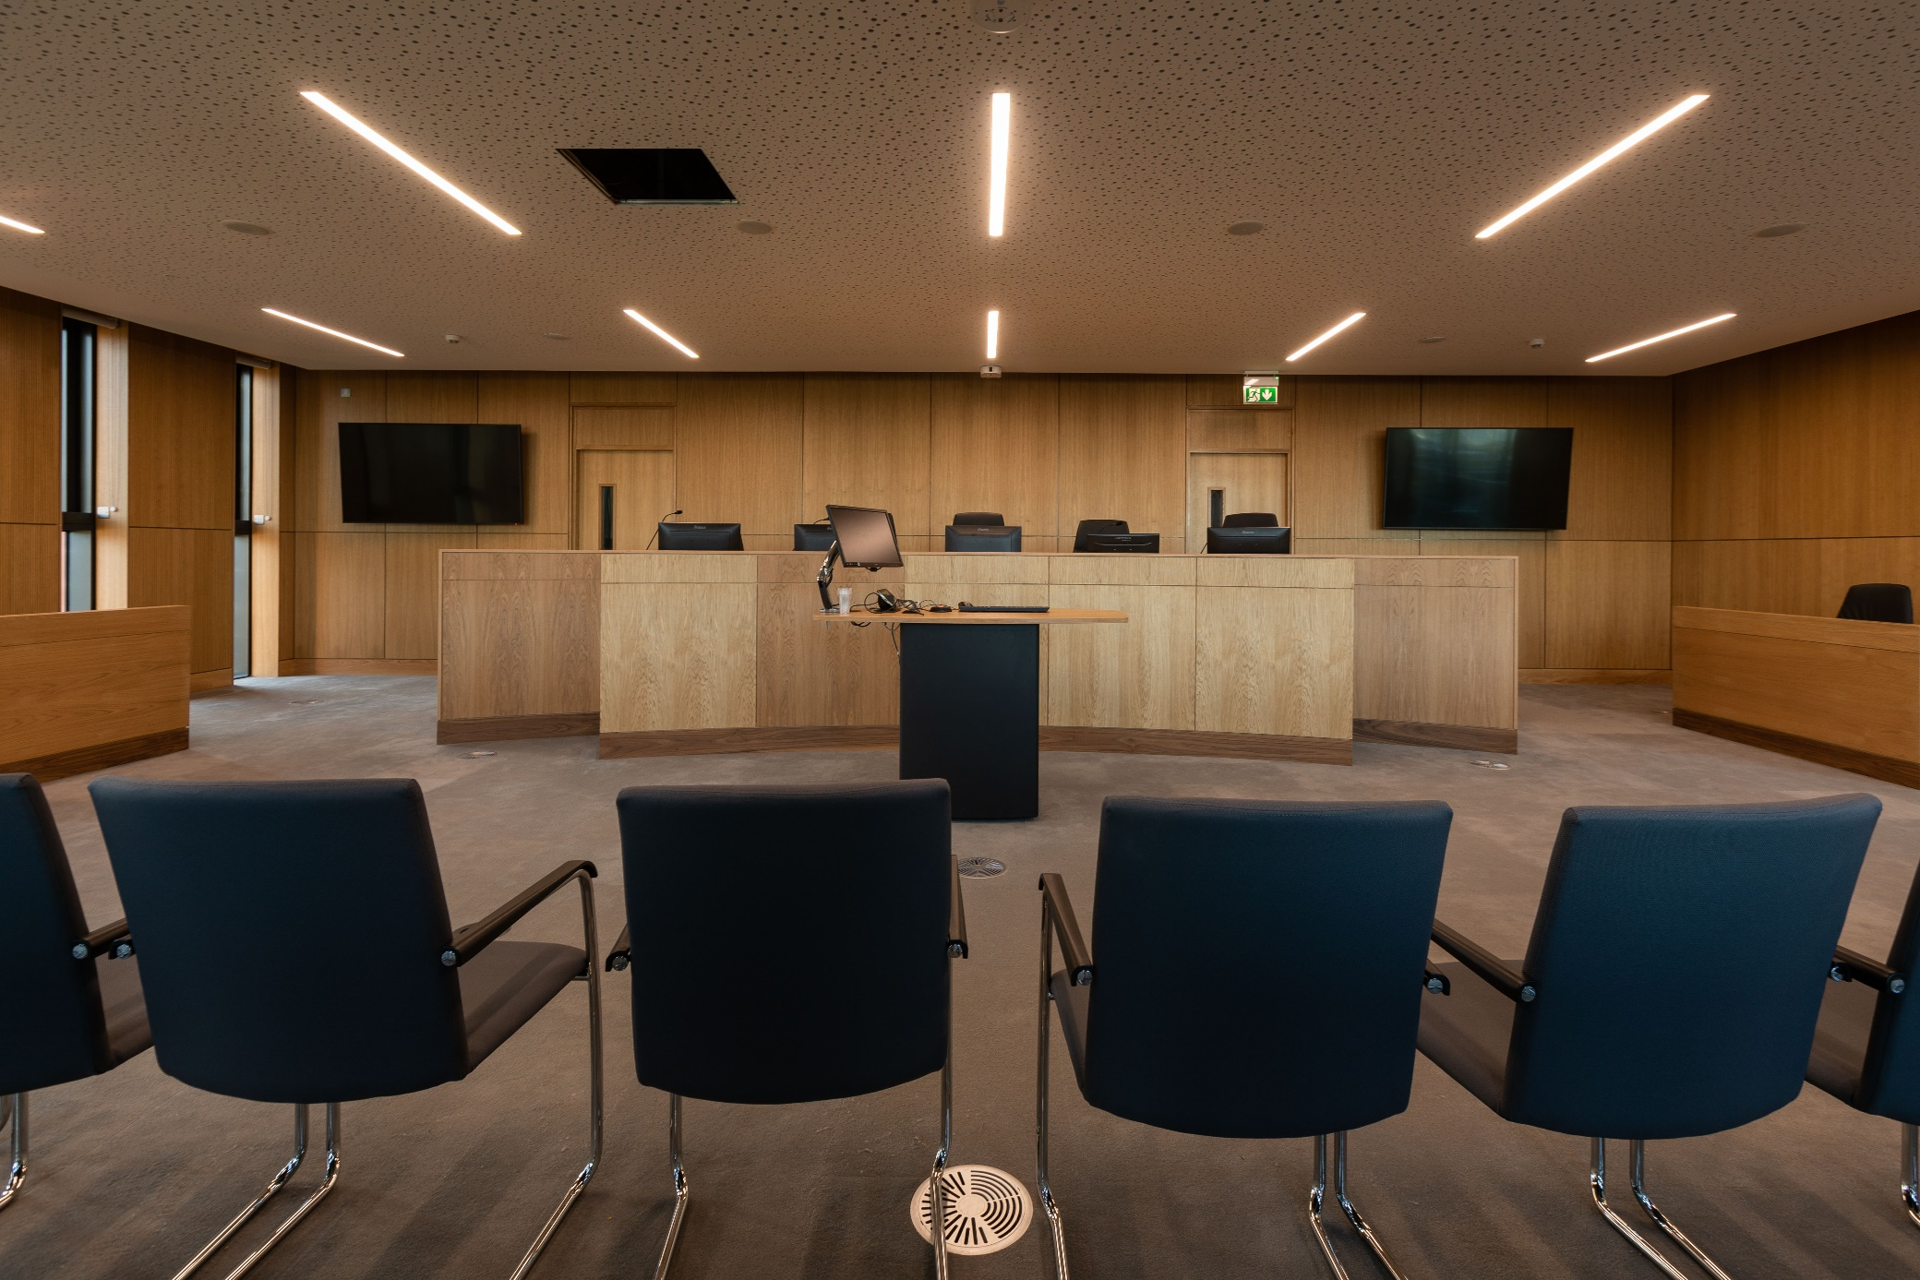
Moot appellate courtroom

Slide 14
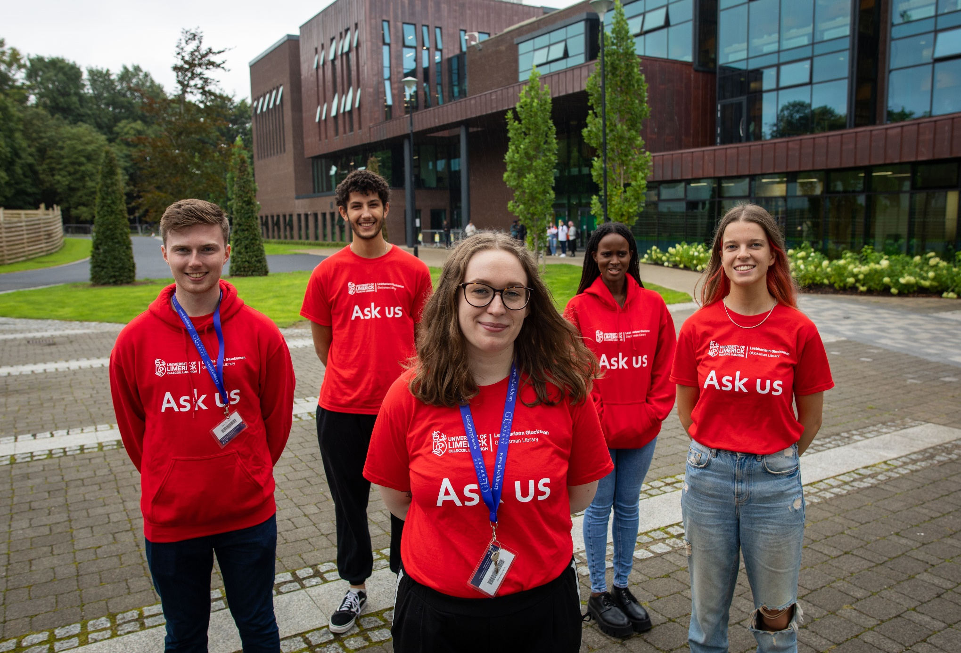
Student Peer Advisor Service
We`re in the library all semester to help you…
Find your way around
Book a group study room
Find, borrow, or return books
Print / photocopy
Settle into UL
Peer Advisors are here to help:
Peer Advisors are here to help:
9:48
find your way around
9:48
find your way around
9:48
book a study seat/room
9:48
book a study seat/room
9:48
find, borrow, and return books
9:48
find, borrow, and return books
9:49
print and photocopy
9:49
print and photocopy
9:52
settle into UL
9:52
settle into UL

Slide 15
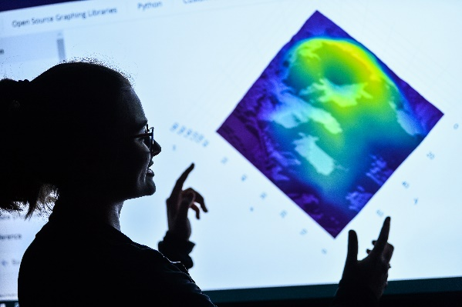
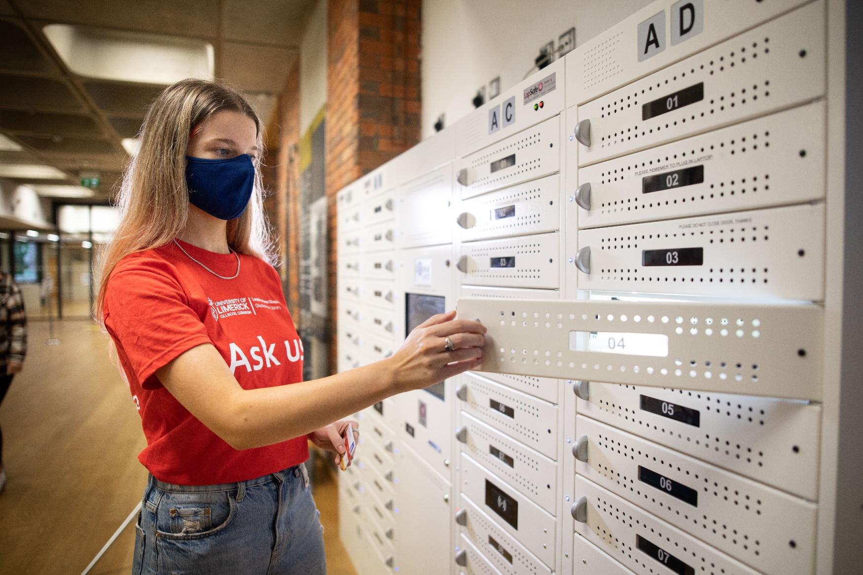
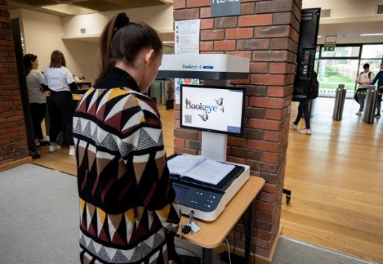
Technology Infused Spaces
Laptop lending service
High quality printing and scanning
Data Visualisation suite
Digitisation lab

Slide 16
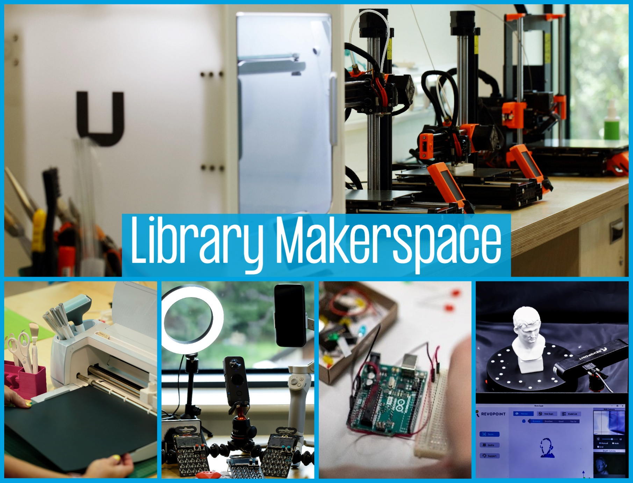
The Library Digital Edge
Watch out for The Library Digital Edge, a suite of technology-enhanced learning spaces including
a greenscreen lab
media production labs
a Makerspace
technology for loan
Coming on-stream during the semester.
Notes:
3D Printers
Cricut Machine
Tech for loan
Arduino
3D Scanner

Slide 17
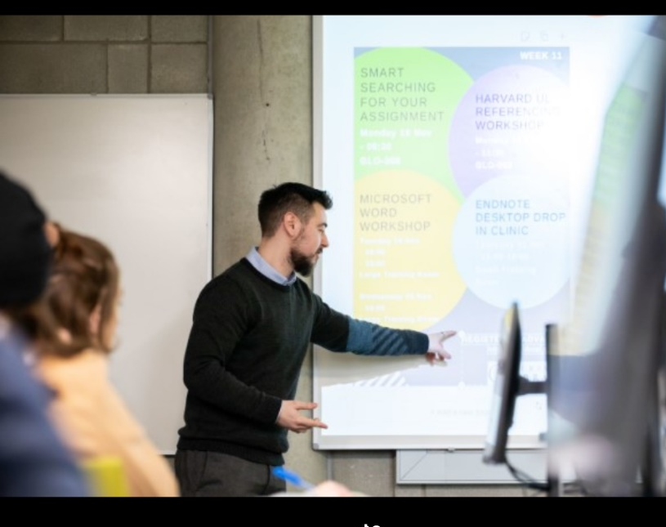
Library workshops
Learn how to search library holdings effectively, Referencing, EndNote and Research Data Management & much more.
Reserve your place here www.ul.ie/library/events

Slide 18
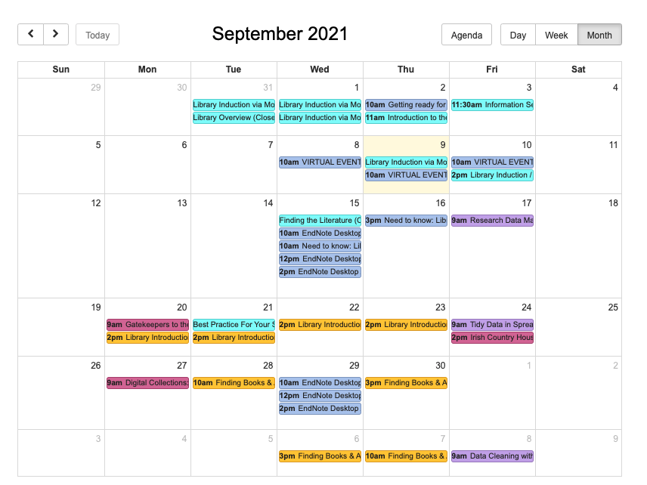

Training Sessions www.ul.ie/events

Slide 19

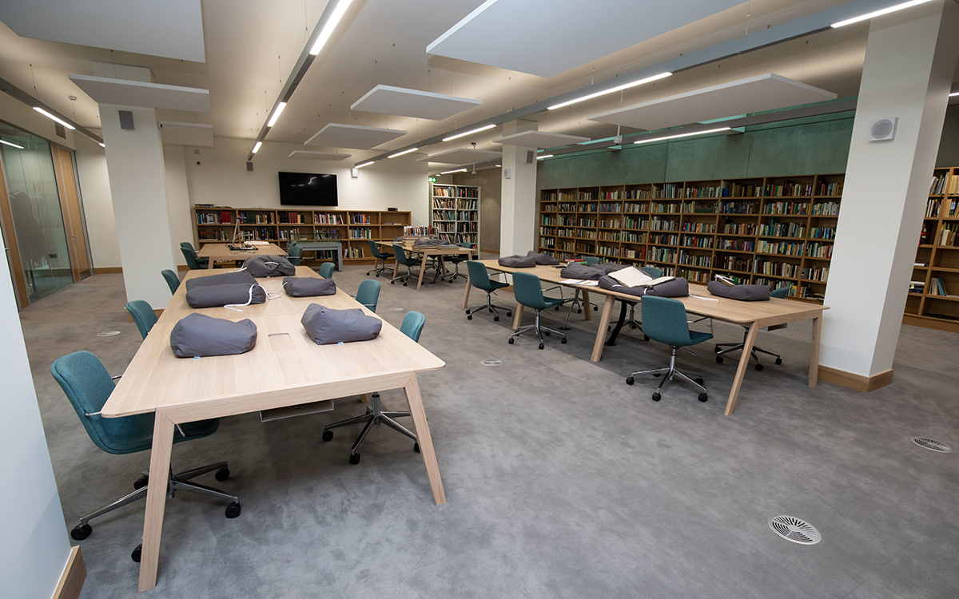
Unique and Distinctive Collections at UL
  Access is by appointment only
  Collections include rare books, manuscripts, archives and other primary sources covering literature, history, politics, architecture, science, medicine, religion…
  Boundless opportunities for discovery and original research and are open to all those interested
  Provides teaching, learning and research support to faculty and students
  Hosts workshops and classes for undergraduate and postgraduate students in the use of primary sources
  Work with faculty to embed primary sources in curriculum through assessment and digital scholarship (recent classes include History, English, Digital Humanities, Architecture, IWAMD)
  Archivist for student/staff engagement and teaching
  Contact specoll@ul.ie
https://www.ul.ie/library/explore-collections/special-collections/

Slide 20
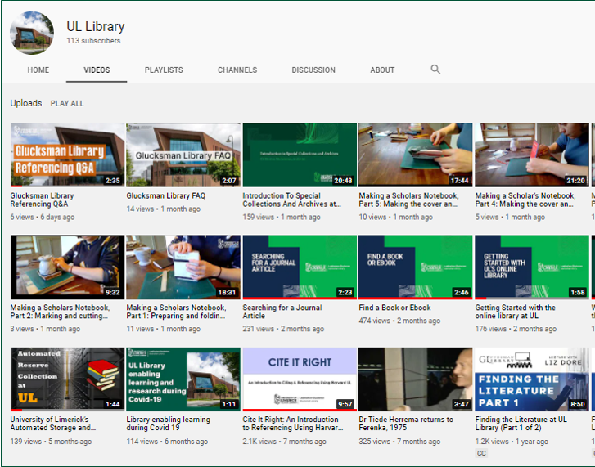
Subscribe to the Library`s YouTube channel
@ ULLibrary
Notes:
Include interactive component on how to search the library catalogue to find a book

Slide 21





libinfo@ul.ie
Follow us on social media & visit the Glucksman Library
@ullibrary
@ullibrary
ul.ie/library
@LibraryUL

