Slide 1
Technology Tools for Productivity and Accessibility – LevUL UP
Thomas O Shaughnessy
Educational Assistive Technology Centre (EATC)
https://bit.ly/LevULUP (case sensitive)

Slide 2
Learning Outcomes
Attendees will be able to identify new reading and writing features available across a range of applications
Attendees will be able to identify tools and features that can enhance learner productivity
Attendees will be able to demonstrate knowledge of software to support project planning, studying and organisation
Attendees will be able to demonstrate knowledge about the significance of accessibility and how to make documents more accessible

Slide 3
Technology Tools for Productivity and Accessibility
Non-Traditional Tools
    Inclusive options – Text to Speech / Mapping / Accessibility Features
    Available to all – a more Universal Design for Learning (UDL) Approach
Overview of Tools for:
  Enhance Reading, Writing, Planning & Group Projects
  Inbuilt Technology and Apps
  Promote and Foster Inclusive Practices

Slide 4
Reading Technologies

Slide 5
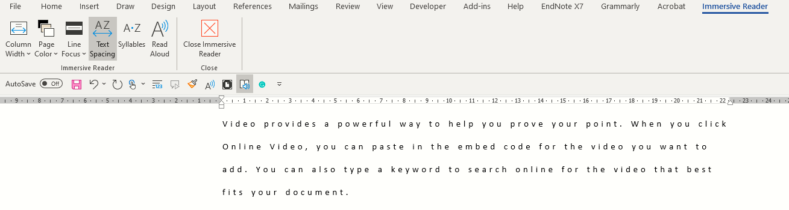
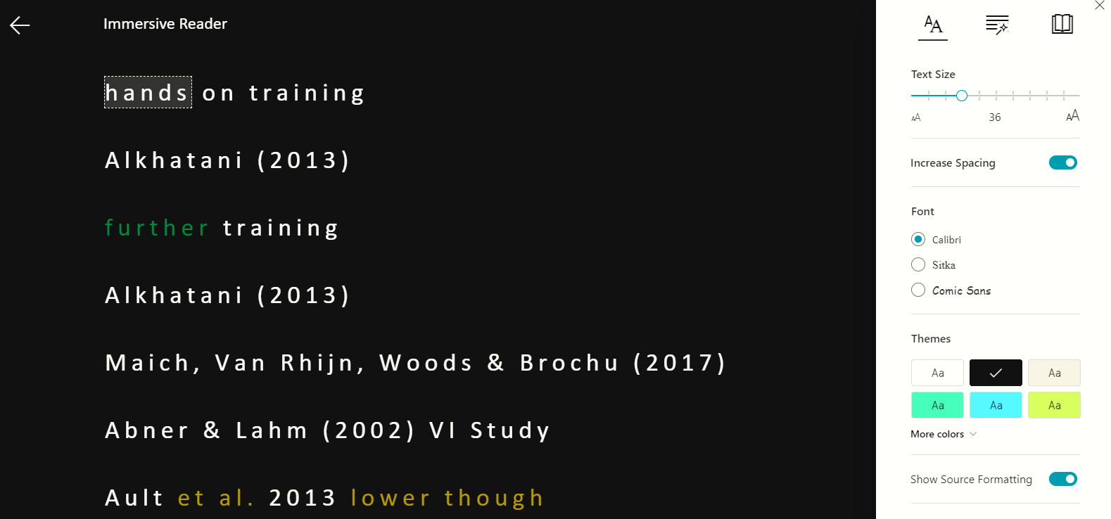
Microsoft Office 365 & Office 365 Online
Productivity in Office 365
=rand() – sample text (Latin online)
  Quick Access
  Changes – Editor (F7)
  Focus Feature
  Immersive Reader
    Text To Speech (TTS)
    Sharing
    Line Highlight
    Translation
    Irish

Slide 6
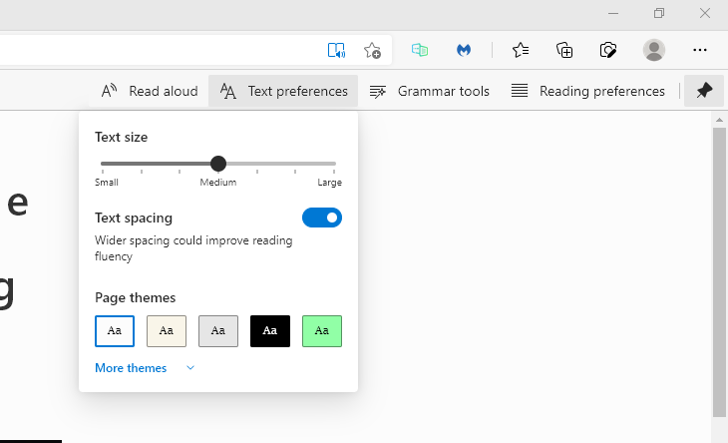
Immersive Reader with Microsoft Edge Browser
Immersive Reader with Edge
  Check for book Symbol Edge Toolbar
    Not on every page
  Text – Size. Spacing etc.
  Text To Speech (TTS)
  Syllables/ Parts of Speech
Reading PDFs
  Open with Edge Browser

Slide 7
Activity:
Open and Read any PDF using Edge Browser (3 mins)
Note: Won’t read? Do you need to apply OCR?
  Optical character recognition or optical character reader is the electronic or mechanical conversion of images of typed, handwritten or printed text into machine-encoded text, whether from a scanned document, a photo of a document, a scene-photo or from subtitle text superimposed on an image.

Slide 8
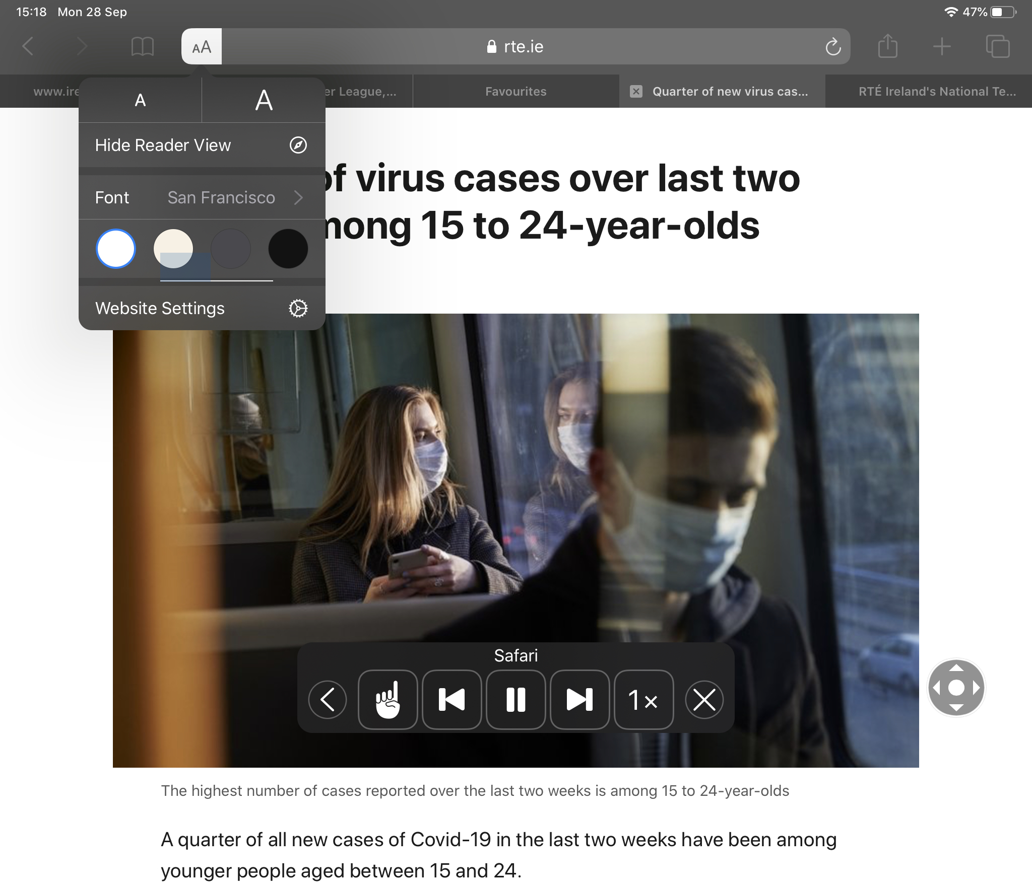
Safari Reader & Whisper Sync (Mobile/Tablets)
Using Safari Reader
  Open the RTE website in Safari
  Select a news article.
  Select lines in web address
  Select AA
  Turn on Speak Screen.
  Swipe down with two fingers from the top of the screen
  A speak screen menu will appear
Using WhisperSync – links Kindle and Audible

Slide 9
Writing Technologies

Slide 10

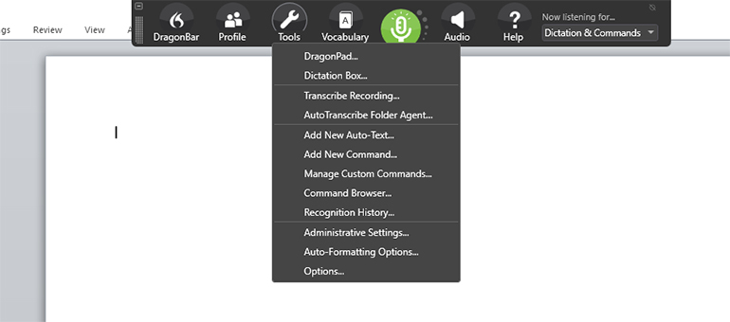
Writing Technology – Speech to Text (STT)
Dragon Naturally Speaking v15 Professional
Voice Recognition Features
  Dictation
  Custom Commands
  Boilerplate Text
  Formatting
Programming in Java
Others: Dictate in Word (Alt + ¬) or Google Voice Typing

Slide 11
Activity:
Practice using Dictate on Word (3 mins)
Note 1: Try turning it on and off using the Alt + ¬ (below Escape key)
Note 2: Trying using Commands (examples below)
  Punctuation commands include:
    full stop = .
    comma = ,
    question mark = ?
    open quotes / close quotes = "
    left / open parentheses = (
    right / close parentheses = )

Slide 12
Planning & Organisation

Slide 13
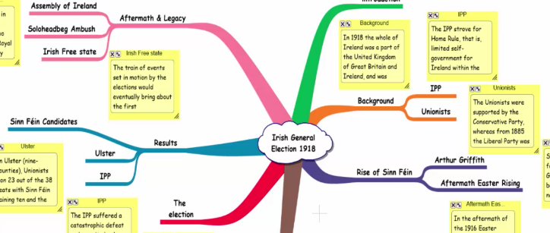
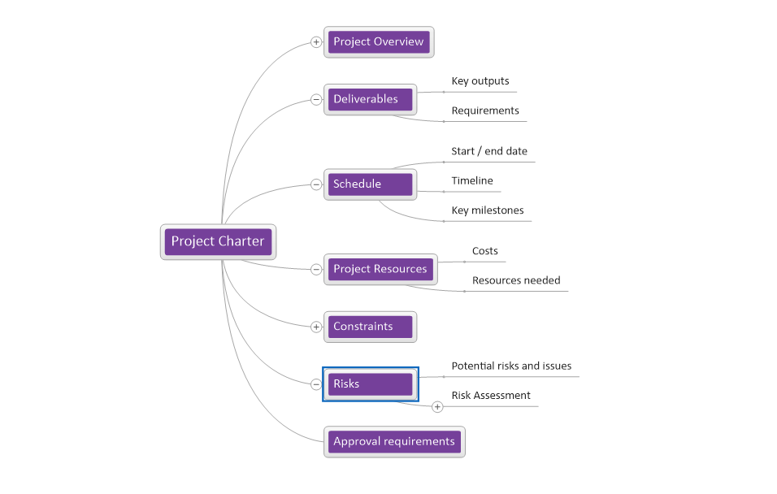
Planning and Organization Technologies
Mind Mapping – Inspiration & Mind Genius
  Group Projects and Assignments
  Assignment / Chapter Planning e.g. Literature Review
  Brainstorming
  Organisation
  Understanding relationships & Critical Thinking
Easy to use but not for everyone
Site Licence with Home Install

Slide 14
Discussion Activity:
Do you think Mind Genius would work for you? If so, how? (2 mins)
Note: If you don’t want to speak or use the chat, please feel free to use the anonymous Padlet.

Slide 15
Productivity

Slide 16
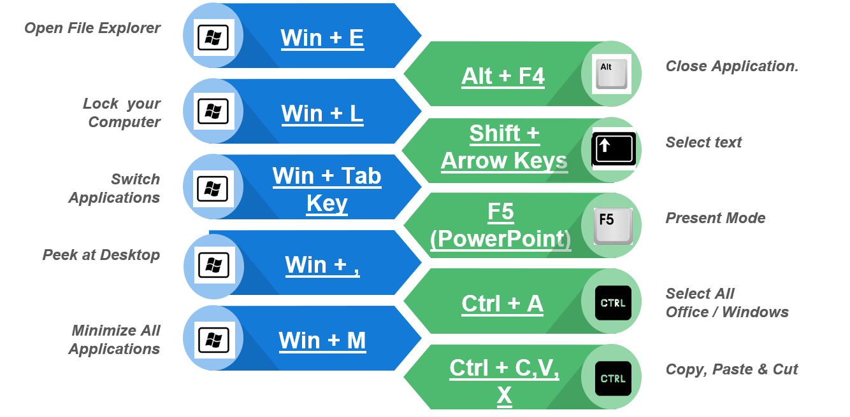
Productivity & Shortcut Keys
Why?
  Productivity
  Low Vision Students
  Physical
More Short Cut Keys
Can you name more?
  Win + V?
  Win + U?
  Win + I?

Slide 17
Feedback & Practice Activity:
Try some shortcut keys (2 min)
Note: Do you know any more in Windows, Word or PowerPoint you want to share? Again, if you don’t want to speak or use the chat, please feel free to use the anonymous Padlet.

Slide 18
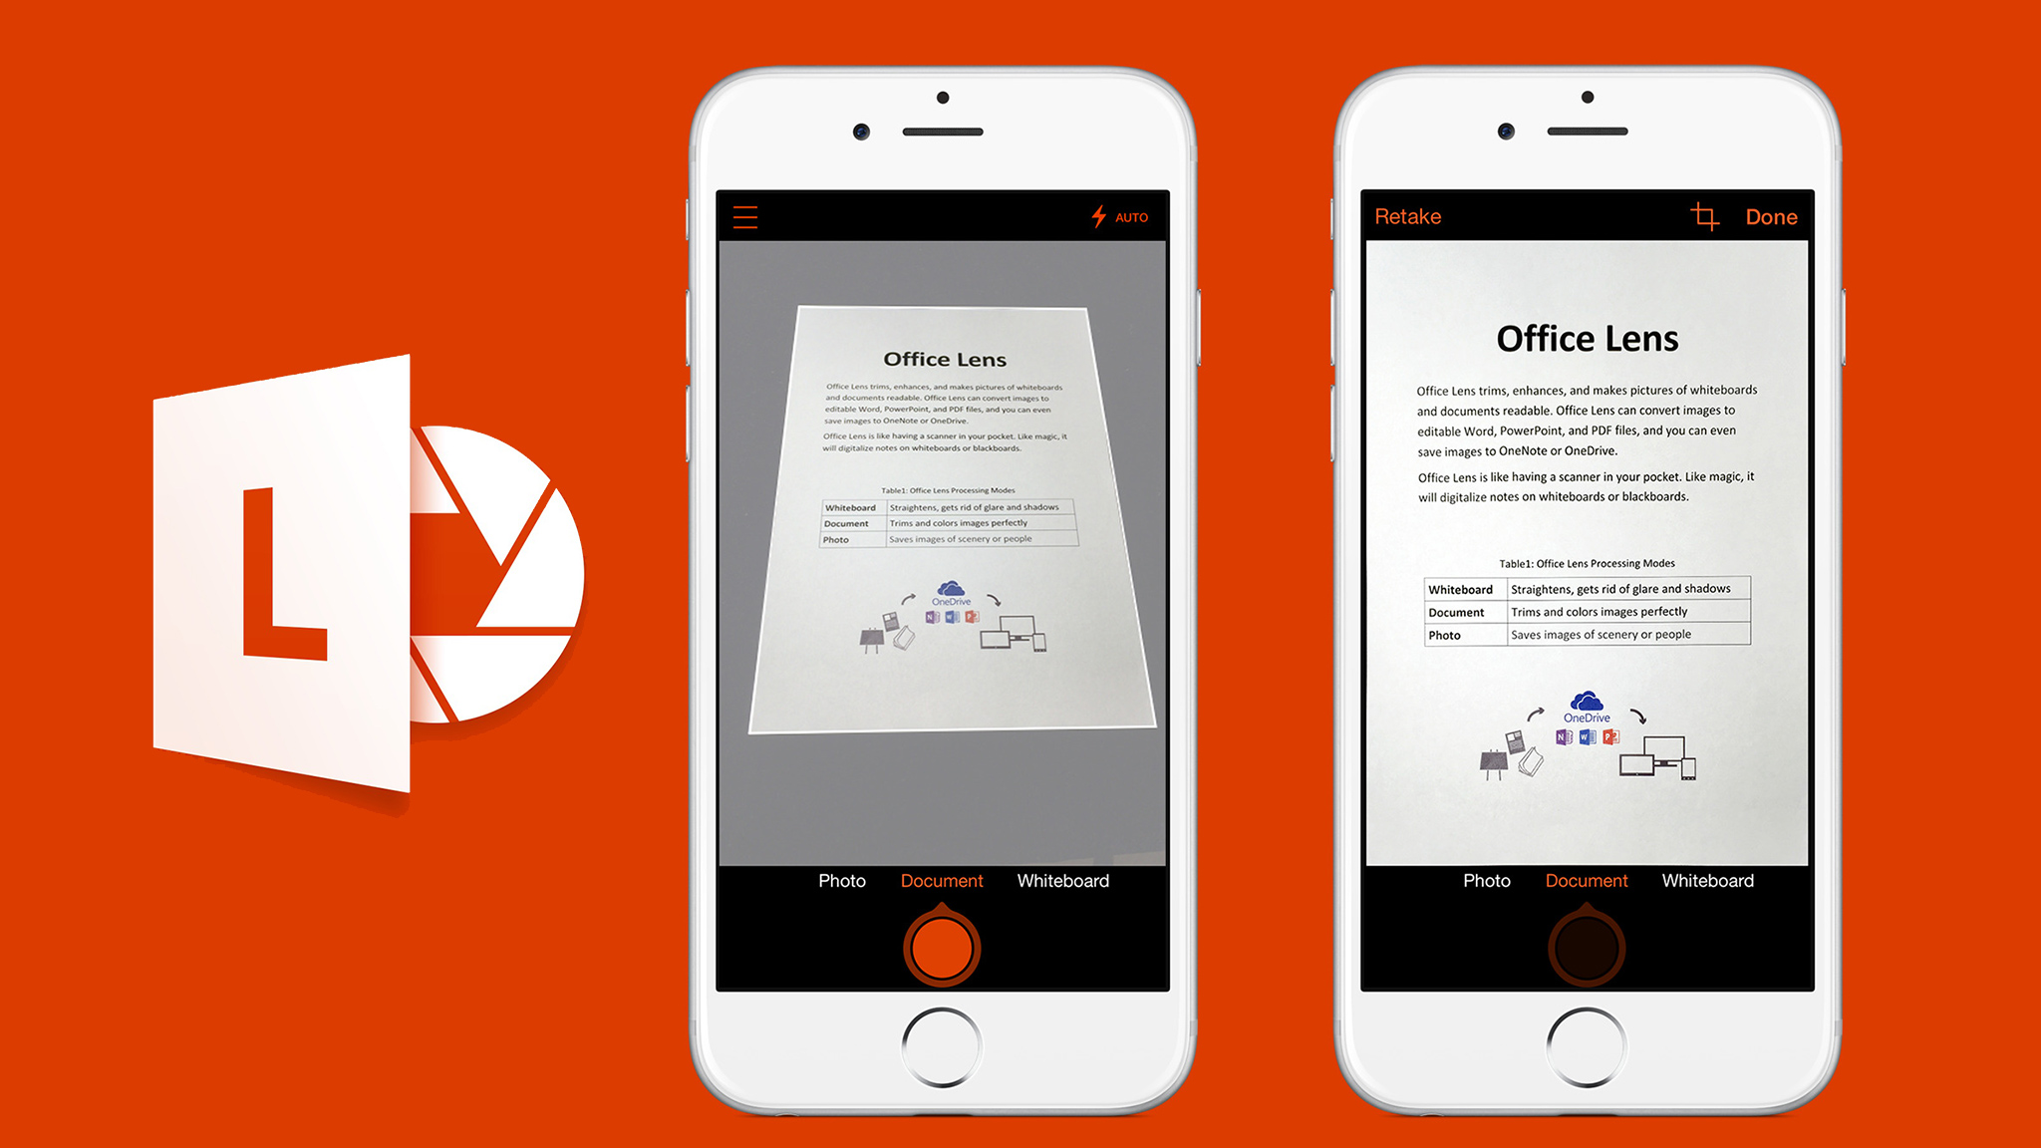

Microsoft Lens and Adobe Fill & Sign
  Activity: Download Office Lens and Adobe Fill & Sign and try reading any book or document you have. If using Lens, try using Immersive Reader and try saving to your OneDrive.

Slide 19
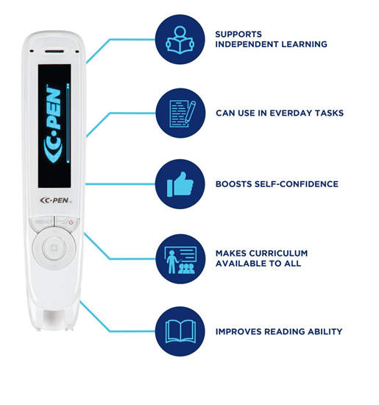
Scanning Pens
Reader Pen
  Humanities
  Postgraduates
Reader Pen Features
  Scan to Screen
  Scan to File
  Scan to Read
Available from the Library with Booklet

Slide 20
Accessibility

Slide 21
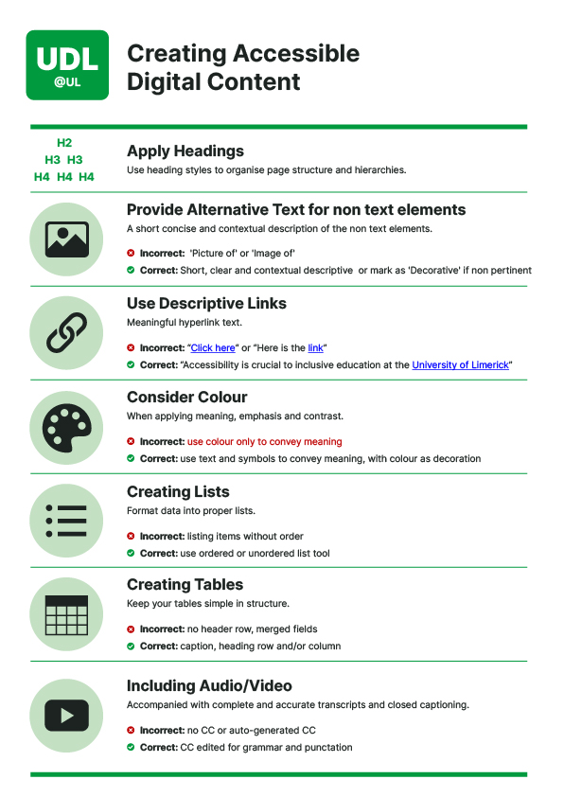
Accessibility
Better for everyone
Screen Reader, Voice and Keyboard Support
Accessibility Word Docs
  Headings & Styles, Alternative Text & Links
  Accessible Fonts And Size
  Arial, Lato, Tahoma & Trebuchet, Dyslexie
    Min 12pt (.docx) / 24pt (.pptx)
  Save as PDFs
Microsoft 365 Accessibility Checker - Word & PowerPoint

Slide 22
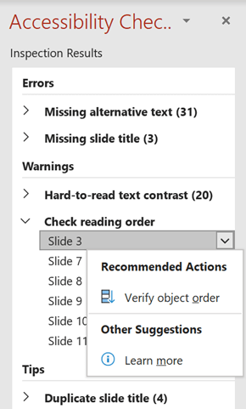
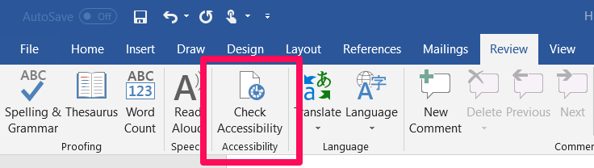
Microsoft 365 Accessibility Checker
Review Tab
  Can check while you work
Tables (headers and merged fields), Alt Text, Colour Contrast
Colour Contrast Analyser (CCA) or https://www.tpgi.com/color-contrast-checker/
PowerPoint
  Reading Order

Slide 23
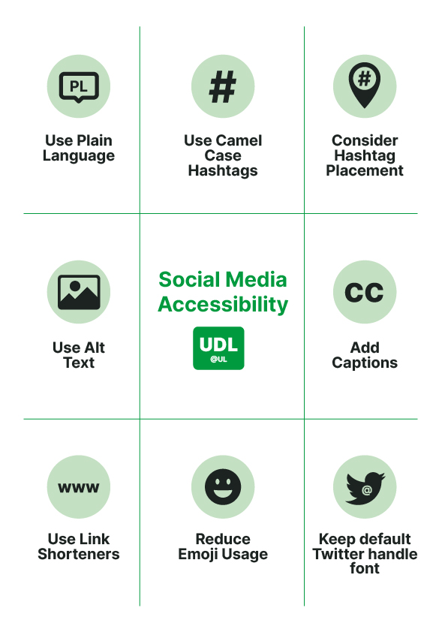
Accessibility & Social Media
Use Plain Language
Use Camel Case Hashtags
Consider Hashtag Placement
Use Alternative Text for non text elements
Add captions to all video and audio
Use descriptive link shorteners
Reduce Emoji use
Don’t edit twitter handle style

Slide 24

Questions, Feedback & Contact Information
Questions?
Feedback LevUL Up Spring 2023: Post-workshop Feedback Form
Contact
  Thomas O Shaughnessy
  Educational Assistive Technology Centre
  @tjoshaughnessy
  thomas.oshaughnessy@ul.ie
  (061) 21 3373
  www.ul.ie/EATC

