Slide 1



MS Sway
This Photo by Unknown Author is licensed under CC BY-SA
E-portfolios, blogs and digital storytelling
By @angelica_tel

Slide 2
Why to use MS Sway
Interactive website, blog or portfolio
More engaging than your traditional written essay
Alive, you can include links to other documents or resources in progress, keep updating it, etc

Slide 3
Free and usable
Very intuitive
Easy to share
Mobile and screen size responsive

Slide 4
Examples
What is Sway? (office.com)
Sway Tutorial (office.com)
Image based Sway
Multimedia based Sway example
Using Sway to embed multiple platforms

Slide 5
Integrated in MS Office 365
Supported UL tool
Integration with OneDrive docs
Can embed interactive features that you can track, e.g. MS Forms
Controlled sharing
Easy collaboration

Slide 6
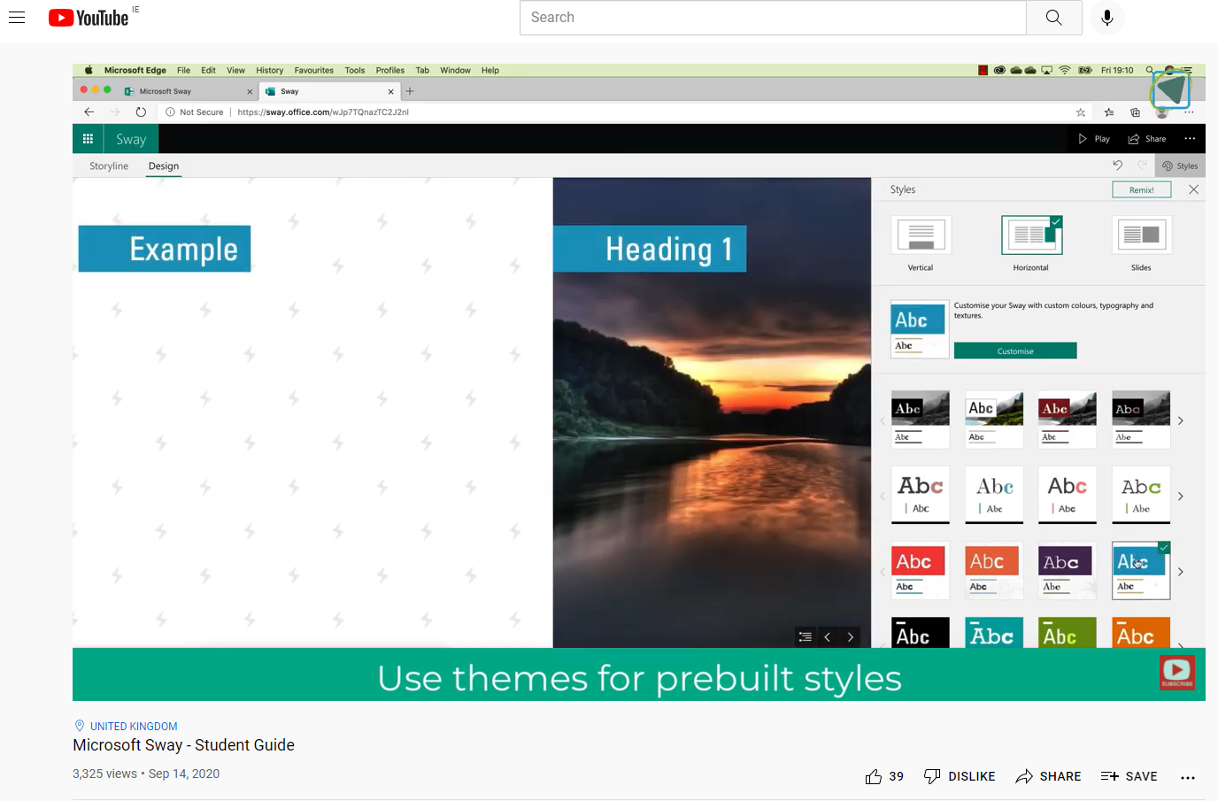
MS Sway – Student Guide
https://www.youtube.com/watch?v=WzacD9FHxKU

Slide 7

Activity 1
Create a Sway from scratch, add a title

Slide 8

Activity 2
Add a first heading with an image, and some text

Slide 9

Activity 3
Click + and add a group to create a grid of images, upload some images

Slide 10

Activity 4
Click + and Media to add a video.

Slide 11
Activity 5
In Design, choose a style for your Sway

Slide 12

Activity 6
Share with ‘Those in organisation with the link’ and share in the chat (if you want to)

Slide 13

Questions?

Slide 14


Complete our Post-workshop Feedback Form (2mins) for a chance of winning a €25 voucher.
A number of vouchers are available. A random draw will take place after the programme concludes.
bit.ly/levulupfeedback23

