Slide 1


Student Fees
Academic year 22/23

Slide 2
What do I have to pay ?
Course Fee
5,654/7,358
Tuition Fee
2,558/4,262
Student Contribution
3,000
Student Centre Levy
96
HEA (if eligible)
SUSI/Student
Student

Slide 3
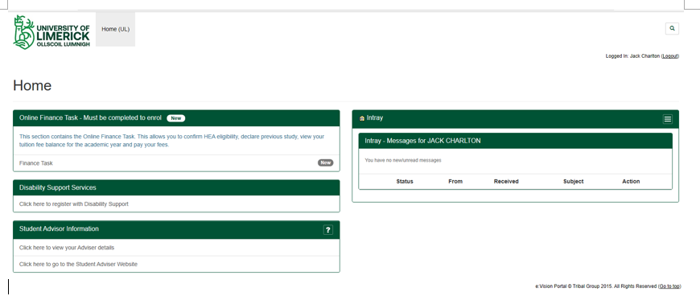
Online Finance Task
Log onto www.si.ul.ie
You will need your Student ID and Password

Slide 4
When do I need to pay ?
Fees are payable in 2 instalments
  Semester 1 fees are due by 02 September 2022
  Semester 2 fees are due by 20 January 2023
  UL also offers flexible payment options if needed

Slide 5

How can I pay ?
Automated Telephone Line 061-529097. (ID number, Date of Birth and valid card needed)
Online via Student Portal – Student login needed

Slide 6



Grants
If you are waiting on a Susi grant then we do not require you to pay until 60 days after the term begins.
You will be billed initially for the fees and when your grant is awarded we will adjust the account.

Slide 7
Exit Dates
What happens if I change my mind ?
If you exit before these dates:
31st October – Sem 1 Fees are refunded and UL will not claim from Susi
31st January – Sem 2 Fees are refunded and UL will not claim from Susi

Slide 8
Contact
We are here to help – if you have any concerns or queries please contact us
Visit our website for FAQs
https://ulsites.ul.ie/finance/frequently-asked-questions-student-fees
Email
student.fees.office@ul.ie
  THANK YOU

