Slide 1
Getting Started in a VLE
Education Technology, ITD

Slide 2
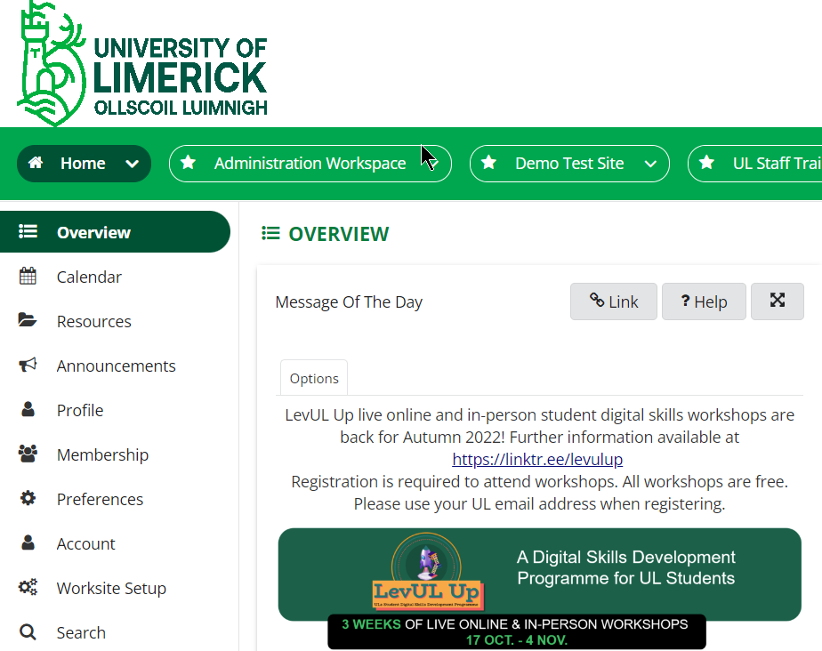
Introduction
What is a VLE?
VLE stands for Virtual Learning Environment
There are many different VLE’s:
Brightspace, Sulis (Sakai), Moodle, Blackboard, Canvas……
Coming from Secondary to Third Level
Allows for more control on Time Management - 24/7 Access
Better communication
A VLE can serve a purpose in:
Fully Face to Face Teaching
Blended
Fully Online
Notes:
A generic introduction to a VLE and what they are capable of doing. Should be appropriate for both Sulis and Brightspace.

Slide 3
Objectives
Goal
To understand how a VLE operates so you are better able to interact with one.
Content
First Steps in a VLE
Content
Communication
Assessment

Slide 4
First Steps
What should you do first on a VLE?
Login – How is login handled? Do you need to register?
Set up your profile – Upload a Profile Pic? Introduce yourself to your class in a forum?
Set your preferences – Notifications? Mobile Application?
Find your content – Multiple Sites? Different tools?
Support
Is there support available to you?
Training Resources
Some VLE’s host training courses about themselves
LinkedIn Learning
Online Resources – Wiki’s, Youtube Videos

Slide 5
Content
What kind of content is on the VLE
Lecture Slides & Documents
Videos and Podcasts
Online Classes
Do you need extra resources to view and interact with the content?
Office 365
Adobe Reader
VLC Media Player
Find your Content & Ensure access
Organisation Level Content
Programme Level/ Modules/ Labs &Tutorials
Do you need additional software?
External Resources
Engage fully with the content

Slide 6
Communication
What forms of communication are there in a VLE?
Announcements – Communication from your Lecturer
Email – Are you being asked to communicate through the VLE or other tools?
Communication amongst your Peers?
Is there direct Chat? Are your conversations saved for review week and exam time?
Are there Discussion Forums? Are they Graded?
Communication outside the VLE – Phone Groups/ Social Media, Can these be linked into the VLE?
Notifications
Do you have control over how you receive these alerts?
Do they send email or app alerts?

Slide 7
Assessment
How will I be assessed in a VLE?
Online Assignments
Understanding Deadlines and Upload Procedures
Multiple Choice Quizzes
What kind of questions are available?
Polling & Class Interaction
Are activities like forums graded?
Peer assessment
Group projects
Uploading as a group
Will I get Grading & Feedback through the VLE.
Built in Feedback options
3rd Party - Turnitin

Slide 8
Thank you

