Slide 1
How to find copyright free images for your UL assignments

Slide 2
What you will learn at today’s class
Where to find high quality images that are free to use
Understand what Copyright, Creative Commons and Public Domain content is
How to reference an image from the internet in an assignment

Slide 3
Where do you search for images when you need to insert a picture in a Word document or Powerpoint for an assignment?
Image from Pixabay.com

Slide 4
Find images you are allowed to use on Google Images
In Settings, go to Advanced Search
In the Usage Rights drop down menu select Creative Commons Licences
The search will return only images that you are free to use or share
You still need to reference the source in your assignment
Image from Pixabay.com

Slide 5
3 terms to know when searching for images
Copyright
Copyright gives the creator of an image the right to reproduce, distribute, display and adapt it. You will infringe copyright if you use someone else’s work without
obtaining their permission.
2. Public Domain
When copyright expires, the work enters the public domain. When copyright expires,
creative materials are no longer protected by intellectual property laws such as
copyright, trademark or patent laws. You must still acknowledge and cite the source
you got the image from even if it is in the public domain.
3. Creative Commons (CC)
Creative Commons licenses are legal tools that image creators can use to offer certain usage rights to the public, while reserving other rights. Even the most
restrictive CC licence (Attribution-NonCommercial-NoDerivatives “BY-NC-ND”)
allows you to use the image for non commercial purposes as long as
you attribute the work to the creator.

Slide 6
Sources for copyright free images
Pixabay
Pexels
StockSnap.io
Flickr Creative Commons e.g. The British Library on Flickr Commons
Unsplash – scenery and artistic themes
The Noun Project (icons) https://thenounproject.com/
There are others, please remember to reference them in your work
Image from British Library Creative Commons Flickr

Slide 7
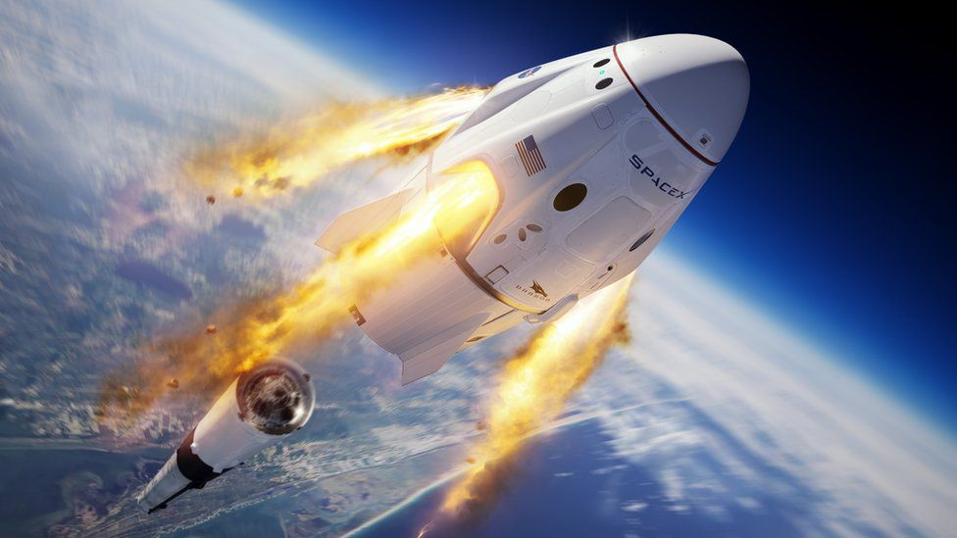
How to reference and cite an image from the web
Reference in your bibliography: Creator or Owner of website (year of publication) Title of Image [type of image], available: web address [accessed date].
BBC, 2020, SpaceX Crew Dragon {Online}, available: https://www.bbc.com/news/science-environment-52840482 [accessed 18 Feb 2022].
In Text Citation: (BBC, 2020)
See section 4 of Cite it Right for examples of how to reference images
Fig 1. SpaceX Crew Dragon shuttle
Notes:
If you use an image from a web page you should reference the individual image. If known, or possible to determine, cite the image creator in the caption and year of publication.
The creator may be different from the author of the web page or blog.
They may be individual people or an organisation.
List the image reference within your references list at the end of your work, using the format:
Creator, Year. Title [Online]. Place of publication: Publisher (if known). Available from: URL [Accessed date].
BBC, 2020, SpaceX Crew Dragon {Online}, available: https://www.bbc.com/news/science-environment-52840482 [accessed 18 Feb 2022].

Slide 8
How to reference and cite an image from the web
Reference in your bibliography: Artist(s) or Creator(s) name, initial(s). (year of creation)
Title of the work [type of image], available: web address
[accessed date].
Titian (1520-3) Bacchus and Ariadne [painting], available:
https://www.nationalgallery.org.uk/paintings/titianbacchus-and-ariadne [accessed 02 Feb 2021].
In Text Citation: (Titian 1520-3)
See section 4 of Cite it Right for examples of how to reference images
Painting of Bacchus and Ariadne from nationalgallery.org.uk

Slide 9
Let’s test what we just learned
Open menti.com
Enter code 4914 7136

Slide 10
Some questions to think about
Q1. Do I have to reference images I use in a Powerpoint?
For a presentation or assignment that you hand in for academic work you should include a brief citation under any images you use. It is also good practice to include the list of references at the end of your slides. Making a public presentation or posting it online to Slideshare or elsewhere is publishing your work so you should include references, and get permission for reuse of images if you need to.
Q2. If you use a photo you took yourself, do you have to reference that?
Any image that you use should be given a brief description of what it is. If it’s your own photo, you don’t need permission but say it’s your own in the description of the image.
Q3. If you want to use images from UL’s online databases or ebooks/articles, do you have to get permission to use them?
For educational assignments it is sufficient to cite and reference any image used from UL’s licenced collections and print books. If you publish your work in any way, including posting online, then you will need to follow copyright rules. It is your responsibility to find out whether, and in what ways, you are permitted to use an image in your research. You must get permission for the content you use in your work if it is not either freely available online, owned by you or part of UL’s subscribed collections.

Slide 11
ul.ie
Contact Library
Email: libinfo@ul.ie
Web/Chat: ul.ie/library
Ask Us: ul-ie.libanswers.com
Social media
ullibrary
ullibrary
LibraryUL

