Slide 1
Presenting Your Research Visually
Jesse Waters,
Librarian for Student Engagement & Success​

Slide 2
Do you have any experience making posters for academic or personal reasons?
Please visit www.menti.com and use the code 2633 6763 to provide your answer
https://www.menti.com/a7gbo3hsba

Slide 3
If you have created posters before, what tools/apps/software did you use?
Please visit www.menti.com and use the code 2633 6763 to provide your answer
https://www.menti.com/a7gbo3hsba

Slide 4
1. Purpose
What is the goal? Are you:
Selling a product
Promoting an event
Promoting research
Evoking an emotional response (Don’t be offensive)
Seeking help/volunteers

Slide 5
2. Concept
Consider your target audience.
How are you going to visually convey your message to them (it should be instantly recognisable).
Tip: Browse Canva templates for inspiration if you do not have a concept.

Slide 6
3. Message
Ensure that…
The message is clear & to the point
Important information stands out
You use headings and sections to differentiate ideas
You use bullet points or numbering in favour of long sentences or blocks of text
Include essential information.

Slide 7
4. Colour, Font, Size
Contrasting colours and striking fonts will draw attention to your poster.
Be selective & ensure they work together.
Varying fonts and headings are useful to identify different sections.
Use a larger size to distinguish importance.
Source: Business Insider, 250 YEARS OF GENIUS: A Look At The Evolution Of Guinness Advertising
https://www.businessinsider.com/an-evolution-of-guinness-advertising-2012-3?r=US&IR=T#1966-guinness-creates-a-parody-of-the-bayeux-tapestry-10
Notes:
https://www.creativebloq.com/inspiration/print-ads-1233780

Slide 8
5. Don't over do it
Less is more.
Keep some clean space.
Minimalism is effective in poster design.
Source: Behance.net, Minimalist advertising posters
https://www.behance.net/gallery/59004649/Minimalist-advertising-posters

Slide 9
General guidelines to approach accessibility from a design perspective
Designing for users on the autistic spectrum
Do
use simple colours
write in plain English
use simple sentences and bullets
make buttons descriptive - for example, Attach files
build simple and consistent layouts
Don't
use bright contrasting colours
use figures of speech and idioms
create a wall of text
make buttons vague and unpredictable - for example, Click here
build complex and cluttered layouts
Designing for users with dyslexia
Do
use images and diagrams to support text
align text to the left and keep a consistent layout
consider producing materials in other formats (for example, audio and video)
keep content short, clear and simple
let users change the contrast between background and text
Don't
use large blocks of heavy text
underline words, use italics or write capitals
force users to remember things from previous pages - give reminders and prompts
rely on accurate spelling - use autocorrect or provide suggestions
put too much information in one place
Source: https://accessibility.blog.gov.uk/2016/09/02/dos-and-donts-on-designing-for-accessibility/

Slide 10
Source: https://accessibility.blog.gov.uk/2016/09/02/dos-and-donts-on-designing-for-accessibility/

Slide 11
Academic Posters
Have a clear theme/concept
Use visual elements where possible - Graphs, diagrams, charts, images, icons, emojis.
Papachristopoulos, Leonidas, & Tsakonas, Giannis. (2019). More than a Feeling: Insights and Information from a Sentiment Analysis Study. Zenodo. http://doi.org/10.5281/zenodo.3250209

Slide 12
Information Sheet
Resource created by UL ITD. Available in Microsoft 365 Training Centre

Slide 13
Early Concept

Slide 14
Redesign Draft 1
Take it handy with the colour

Slide 15
Redesign Draft 2
Change the alignment of the graphics and colour scheme

Slide 16
Draft 3
Too much text
Where are the headings?

Slide 17
Draft 8
Edited text
Included headings

Slide 18
Draft 11!
More headings for consistency

Slide 19
Draft 12! Final version
Reverted to original alignment

Slide 20
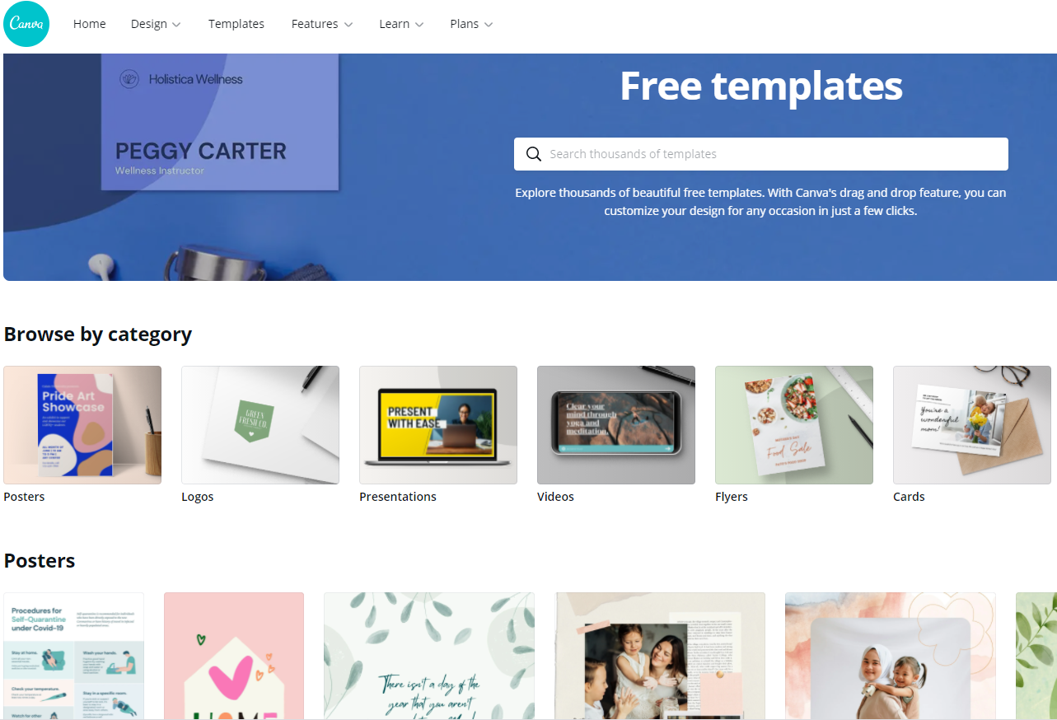
What is Canva?
Free online graphic design tool
Design posters, presentations, infographics, greeting cards, CVs, social media content
Two versions – Free & Premium (Paid)
Register for an account at https://www.canva.com

Slide 21
Tip 1. Group elements together
Move multiple elements together at once.
Highlight the desired elements and use CMD+G to create a group.
Ungroup the elements to make additional edits

Slide 22
Tip 2. Positioning and layering your elements
You can use the ‘Position’ controls to
move elements into the foreground
send them to the background
align them to a particular area of the design
Layering also is useful to create your own designs free from copyright.

Slide 23
Tip 3. Upload images
Canva has excellent free high-quality images, along with premium pay-to-use images.
If you cant find what you need for free on Canva, look elsewhere, and upload your own image.
Pixabay and Freeimages are good providers for images free from copyright.

Slide 24
Tip 4. Create a team for group projects
You can create small teams in Canva.
Useful if you`re in a group project as multiple people can access and make edits.
Ensure you trust who you give access to, they can also delete your work!

Slide 25
Tip 5. Downloading your product
Multiple file format options available.
Download as PNG or JPG - I have had issues printing with the recommended PDF option.

Slide 26
ul.ie
Contact Library
Email: libinfo@ul.ie
Web/Chat: ul.ie/library
Ask Us: ul-ie.libanswers.com
Social media
ullibrary
ullibrary
LibraryUL

