Slide 1


👋 Hello & Welcome
⏳ This session will begin shortly.
While you wait, please download the slides for today’s session from the LevUL up website.
In association with:

Slide 2
Recording
This session will now be recorded. Any further information that you provide during a session is optional and in doing so you give us consent to process this information.
These recordings will be stored by the University of Limerick for one year and may be published on our website during that time.
By taking part in a session you give us your consent to process any information you provide during it.

Slide 3
Notetaking in a digital world

Slide 4


Who we are
Míchéal Ó hAodha
Library & Information Services
Sinead Spain
Research Fellow, REAP Project
Centre for Transformative Learning
Notes:
The team presenting in this video is comprised of

Slide 5
Learning outcomes
Know why it is important to take good notes
How to file the notes you take
How to plan what you do before, during and after a lecture
Learn different methods of notetaking
#LevULupdigiskills

Slide 6
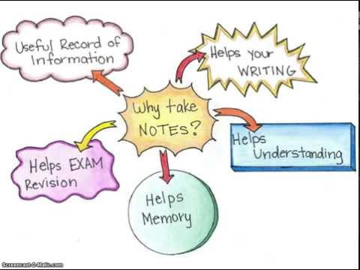
Why is it important to take good notes?
#LevULupdigiskills

Slide 7

What could you do in advance to make sure you take better notes at the lecture?
Type suggestions in chat
Image from Pixabay.com
#LevULupdigiskills
Notes:
Invite students to suggest what to do before the lecture: suggestions on the next slide

Slide 8

Before your lecture – top 5 tips
Download & read new lecture notes from SULIS or Moodle
Formulate questions to answer
Know where you’re going to take the notes, have your notebook or tablet/laptop ready
Make sure you can see and hear the lecturer
Arrive 3-5 mins before the lecture.
Image from Pixabay.com

Slide 9
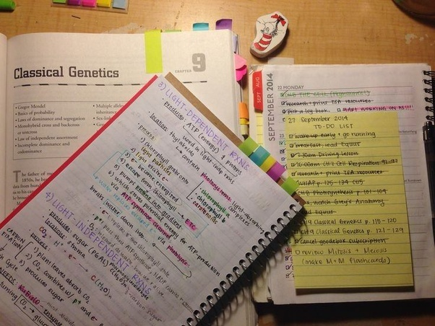
How to file the notes you take
Organise the notes by module, maybe
keep a notebook for each subject, or
lecturer
Use post-it notes or dividers as shown
to keep them organised
Keep materials together under each topic
from the start
Use a cloud based digital system is probably best e.g. OneNote
Transfer from paper notes to digital notes system as quickly as you can after the lecture
Image from Pixabay.com
#LevULupdigiskills

Slide 10
Use acronyms and symbols in your notes
Only in notes, not in assignments or exams
Use acronyms and symbols
Abbreviations
experiment | expt
Education | ed
Curriculum | curr
Probably | prob
support | supp
exercise | exer
strategy | strat
Important | NB
Symbols
Increases/goes up/rises
Decreases/lowering
Leads to/causes/produces
Come from/is the result of
Notes:
Question for class, what other acronyms do you use in lectures to represent common phrases used by your lecturers?

Slide 11
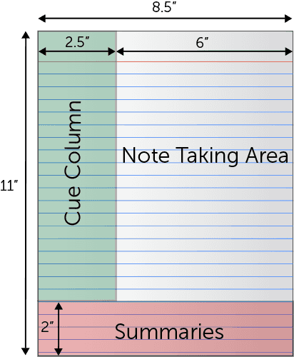
Cornell Method of notetaking
The right Note Taking area is where you put your most important ideas that the lecturer covers during a class.
Summarize as much as possible, don’t worry if it looks messy.
After the lecture, add the key ideas to the left Cue Column. These cues are what will help you prepare for assignments/exams and identify things you need to read up on or find out more about.
The bottom section is called ‘summary’ and you fill this in AFTER the lecture. If your summary is good, you won’t have to revisit ALL the notes, just the summary.
Additional information on Cornell here https://www.youtube.com/watch?v=agz0JqbaLMg
https://www.umfk.edu/student-success/academic-support/notes/
#LevULupdigiskills

Slide 12
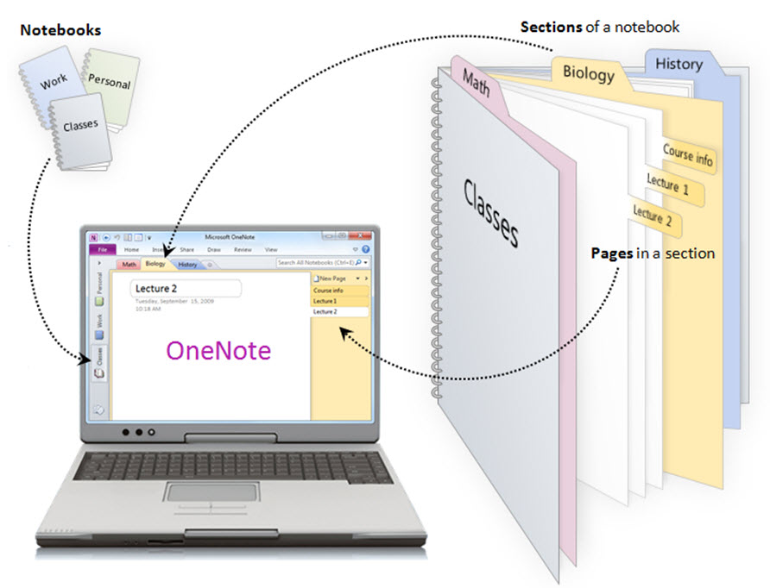
Whether digital or traditional notes, 5 tips:
Read the lecture material in advance
Annotate Powerpoint lecture notes provided by lecturer
Write aide memoires to help recall
Review the notes as soon after the lecture as you can
Use a note taking style that works for you
https://offices.depaul.edu/information-services/services/technology-training/topics/Pages/OneNote.aspx
#LevULupdigiskills

Slide 13

REMEMBER, good notes are only PART of what you need to do
REMEMBER
Taking good notes will help you with your study, but you MUST study them

Slide 14

Notetaking using
Sinead Spain
Centre for Transformative Learning

Slide 15
Overview
  OneNote Features
  Demo:
    Organise your modules and topics
    Add images and voice notes
    Paste, search and tag text
    Access across devices

Slide 16
OneNote Features
  synchronous across devices
  helps you organise your modules and topics
  allows you to 'tag' your notes so they are easily searchable
  you can record audio and text to speech as an alternative to typing
  you can embed video/spreadsheets/documents/clipped images
  you can share your own notebook sections with others

Slide 17

Over to you…

Slide 18


We want to improve LevUL up for you
Take the 5-minute IT Survey and be in with a chance of winning daily prizes!
Visit: www.ul.ie/studentsurvey2022

