Slide 1
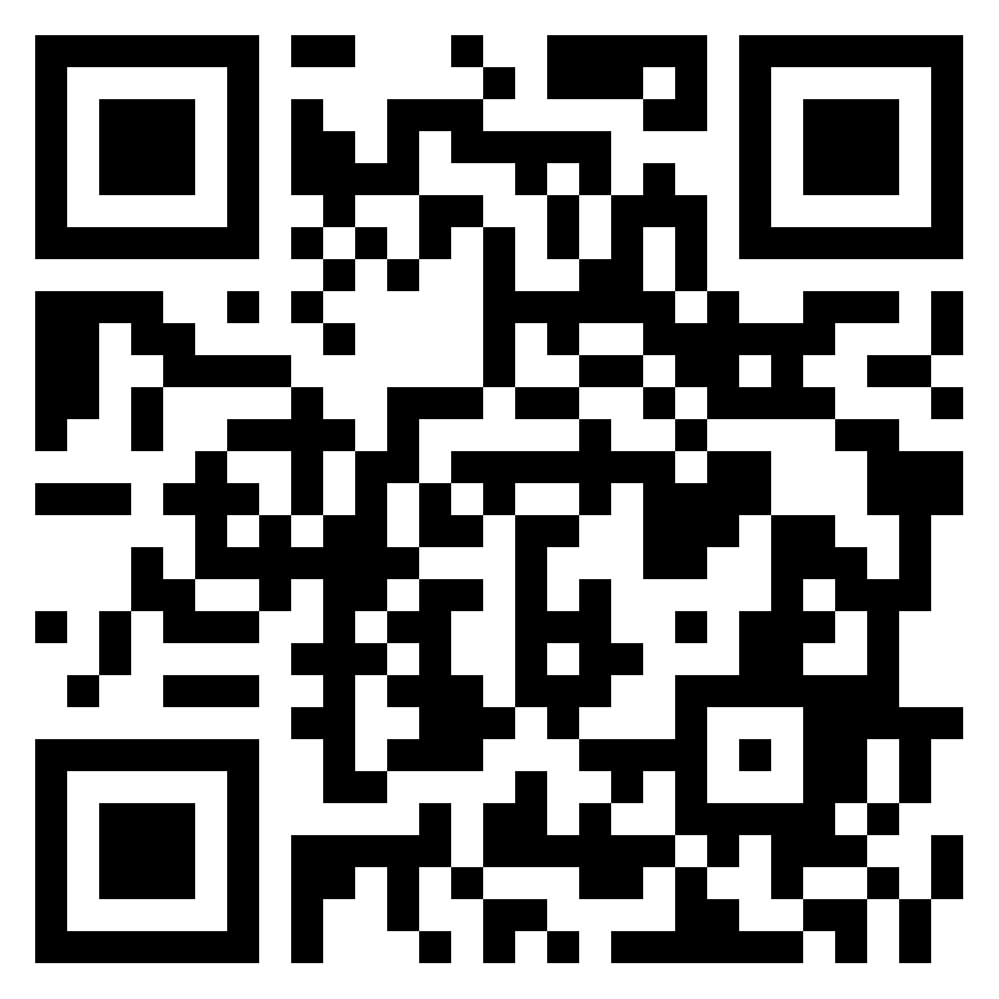
Technology Tools for Productivity and Accessibility – LevUL UP
Thomas O Shaughnessy
Educational Assistive Technology Centre (EATC)
https://bit.ly/LevULUP (case sensitive)

Slide 2
Technology Tools for Productivity and Accessibility
Non-Traditional Tools
Inclusive options – Text to Speech / Mapping / Accessibility Features
Available to all – Universal Design for Learning (UDL) Approach
Overview
Reading
Writing
Planning & Group Projects
Productivity Tools
Accessibility

Slide 3
Learning Outcomes
Attendees will be able to identify new reading and writing features available across a range of applications
Attendees will be able to identify tools and features that can enhance learner productivity
Attendees will be able to demonstrate knowledge of software to support project planning, studying and organisation
Attendees will be able to demonstrate knowledge about the significance of accessibility and how to make documents more accessible

Slide 4
Reading Technologies

Slide 5
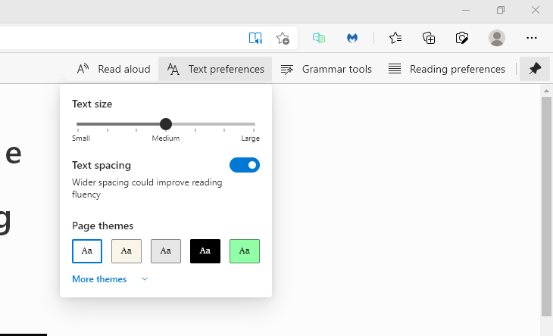
Immersive Reader with Microsoft Edge Browser
Immersive Reader with Edge
Check for book Symbol Edge Toolbar
Not on every page
Text
Size
Spacing
Theme
Text To Speech (TTS)
Syllables/ Parts of Speech
Reading PDFs
May have to install voices

Slide 6
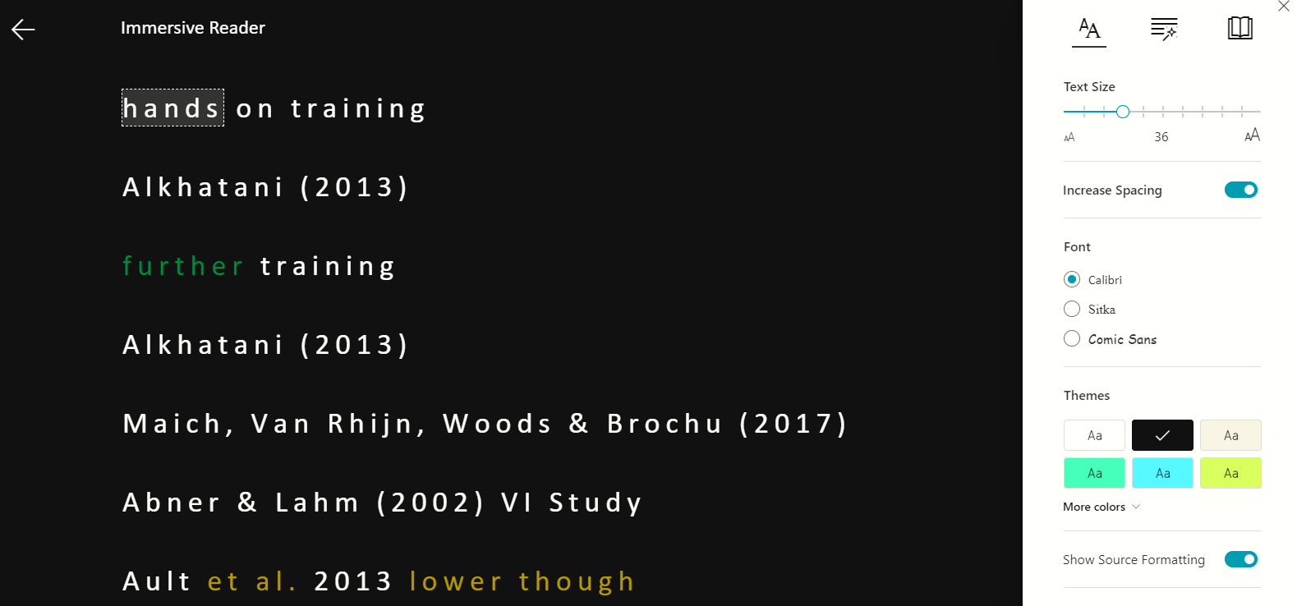
Microsoft Office 365 & Office 365 Online
Office 365 & Other software
New Features
=rand() – sample text (Latin online)
Changes – Editor (F7)
Focus Feature
Immersive Reader
Text To Speech (TTS)
Sharing
Line Highlight
Translation

Slide 7
Activity:
Open and Read any PDF using Edge Browser (5 mins)
Note: Won’t read? Do you need to apply OCR?
Optical character recognition or optical character reader is the electronic or mechanical conversion of images of typed, handwritten or printed text into machine-encoded text, whether from a scanned document, a photo of a document, a scene-photo or from subtitle text superimposed on an image.

Slide 8
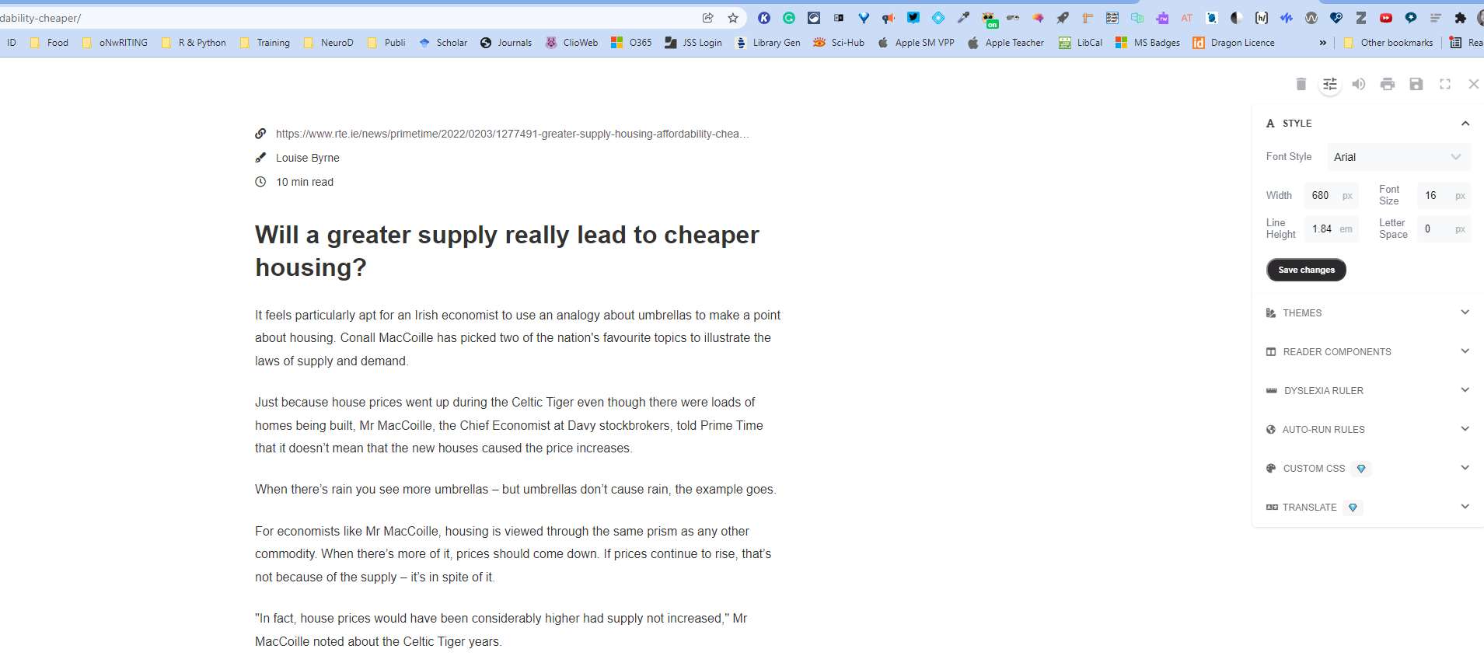
Reader Mode Chrome Extension

Slide 9
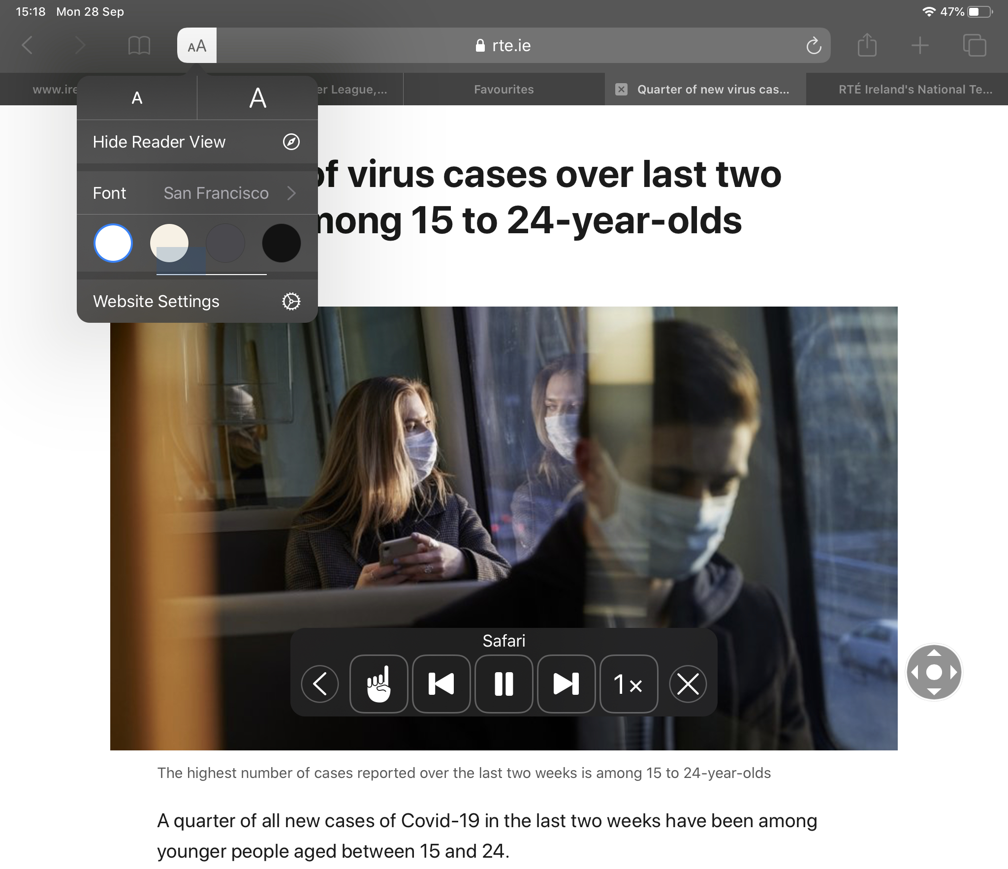
Safari Reader & Whisper Sync (Mobile/Tablets)
Using Safari Reader
Open the RTE website in Safari
Select a news article.
Select lines in web address
Select AA
Turn on Speak Screen.
Swipe down with two fingers from the top of the screen
A speak screen menu will appear
iPad read the page from the top
Works in Books too
Using WhisperSync
Kindle and Audible

Slide 10
Writing Technologies

Slide 11
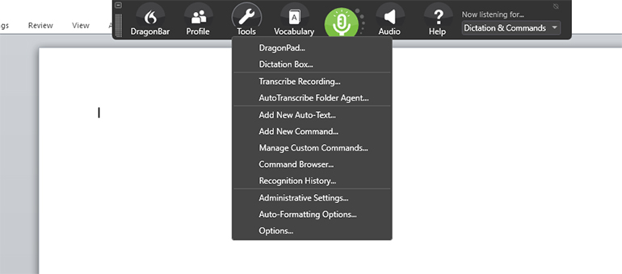
Writing Technology – Speech to Text (STT)
Dragon Naturally Speaking v15
Physical, Ongoing Illness & SpLD
Features
Dictation
Custom Commands
Boilerplate Text
Formatting
Customisation
Programming in Java
Dictate in Word (Alt + ¬)

Slide 12
Activity:
Practice using Dictate on Word (5 mins)
Note 1: Try turning it on and off using the Alt + ¬ (below Escape key)
Note 2: Trying using Commands (examples below)
Punctuation commands include:
full stop = .
comma = ,
question mark = ?
open quotes / close quotes = "
left / open parentheses = (
right / close parentheses = )
Editing commands include:
new line = add a new line
delete = remove the last word

Slide 13
Writing Support - Grammarly
Grammarly
Premium vs Free
Windows vs Mac
Grammarly
Adjust Goals
Correctness – Spelling Grammar & Punctuation (Free)
Clarity – Clarity of sentences and Conciseness (wordy)
Engagement – Variety (repetition of words)
Delivery – Tone, Formality etc.
Plagiarism detection – link to articles/content
Settings – English US/UK

Slide 14
LightKey – Prediction
Not Like on your phone
AI driven
Insert = Tab Key
Demo
Latest breakthrough
LightKey Website
Light Key Free-Text-Editor
LightKey Typing

Slide 15
Planning & Organisation

Slide 16
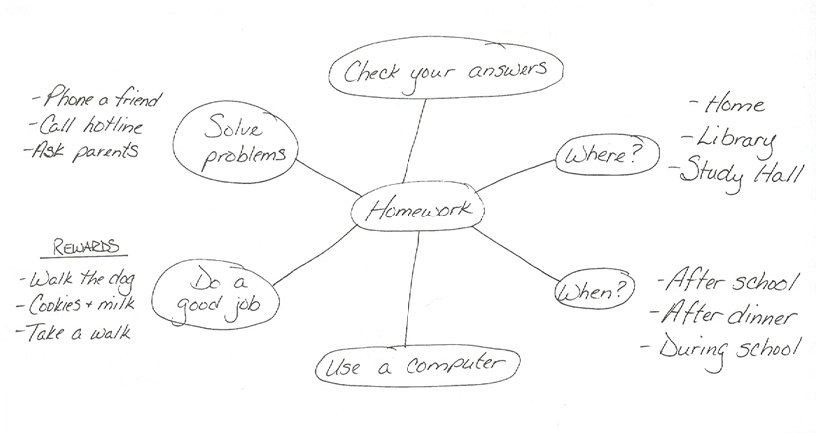
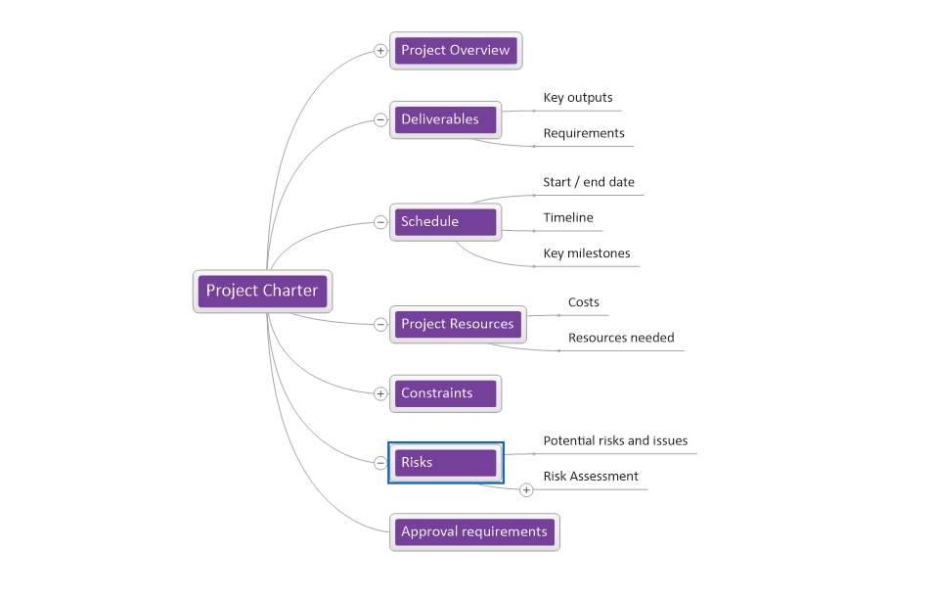
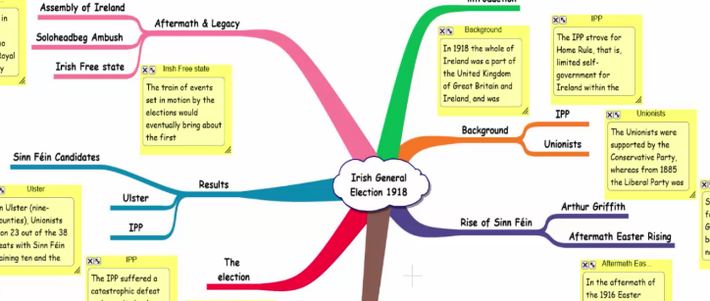
Planning and Organization Technologies
Mind Mapping – Inspiration & Mind Genius
Group Projects and Assignments
Chapter Planning e.g. Literature Review
Essay Plans
Brainstorming
Organisation
Understanding relationships
Critical Thinking
Recall
Easy to use but not for everyone
Options: Coggle, MindMeister
Site Licence with Home Install

Slide 17
Discussion Activity:
Do you think Mind Genius would work for you? If so, how? (5 mins)
Note: If you don’t want to speak or use the chat, please feel free to use the anonymous Padlet.

Slide 18
Productivity

Slide 19
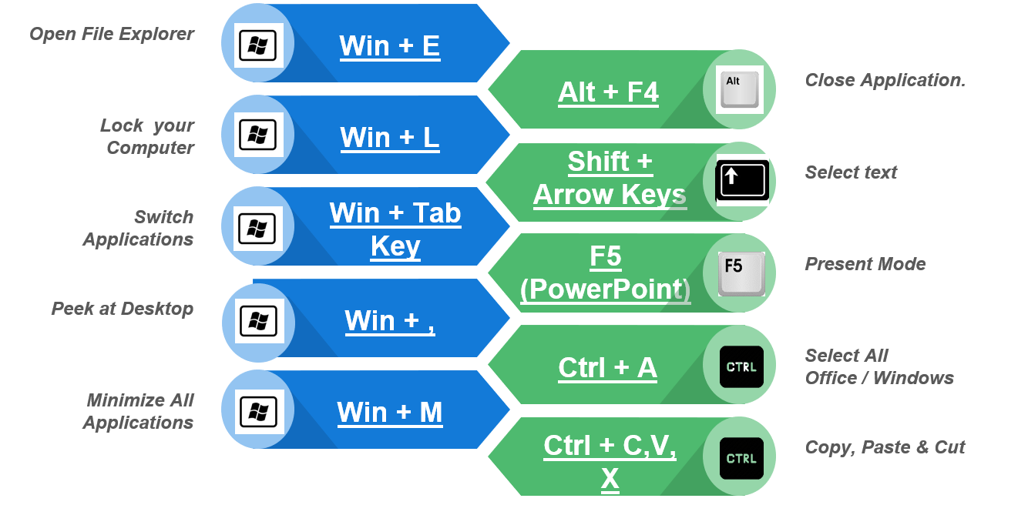
Productivity & Shortcut Keys
Why?
Productivity
Low Vision Students
Physical
Speed
More Short Cut Keys
See handouts
Can you name more?
Win + V?
Win + U?
Win + +?

Slide 20
Feedback & Practice Activity:
Try some shortcut keys (2 min)
Note: Do you know any more in Windows, Word or PowerPoint you want to share? Again, if you don’t want to speak or use the chat, please feel free to use the anonymous Padlet.

Slide 21
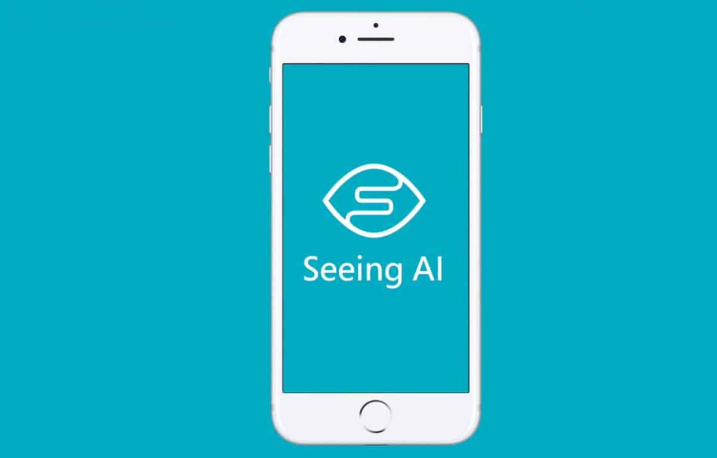
Microsoft Lens & SeeingAI
Activity: Download Office Lens or Seeing AI and try reading any book or document you have. If using Lens, try using Immersive Reader and try saving to your OneDrive.

Slide 22
Activity:
Download Microsoft Lens (5 mins)
Note 1: Download Office Lens or Seeing AI and try reading any book or document you have. If using Lens, try using Immersive Reader and try saving to your OneDrive.
Note 2: Another good app to try is Adobe Fill & Sign

Slide 23
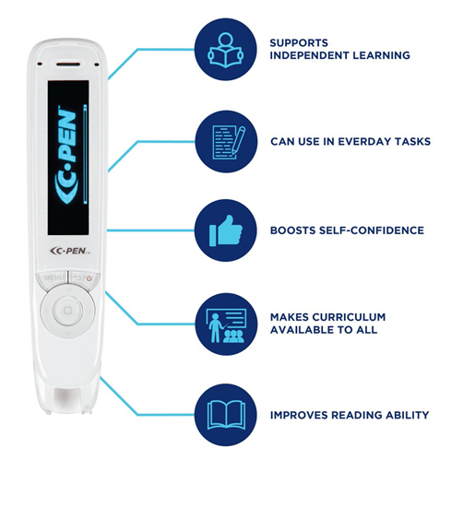
Scanning Pens
Reader Pen
Humanities
Papers
Postgraduates
Reader Pen Features
Scan to Screen
Scan to File
Scan to Read
Available from the Library Soon

Slide 24
Transcribing with Office 365 Online

Slide 25
Accessibility

Slide 26
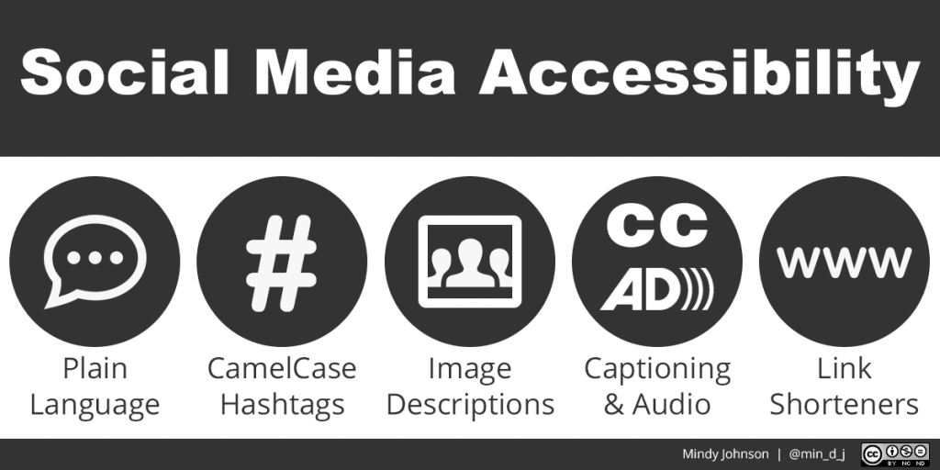
Accessibility
Better for everyone
Screen Reader, Voice and Keyboard Support
Word Docs
Headings & Styles
Alternative Text & Accessible Links
Accessible Fonts
Arial Verdana, Tahoma & Trebuchet
12pt (.docx) / 24pt (.pptx)
Dyslexie Font Link & OpenDyslexic Font Link
Save as PDFs
Microsoft 365 Accessibility Checker - Word & PowerPoint
Accessibility & Social Media

Slide 27
Activity:
Open a PowerPoint Presentation and run the Accessibility Checker. Can you fix one of the issues? (5 mins)
Note 1: This presentation PowerPoint can be used if you have downloaded it already.
Note 2: If you use Social Media, consider using CamelCase for you hashtags.

Slide 28
Reflection Activity:
Use Chat, Microphone or Padlet (don’t have to share)
What are your key takeaways for today?
What would you like to see more of / less of?
Is there any new tool you plan to use straight away?
Did this session meet your personal objectives for this session?

Slide 29
Contact Information
Thomas O Shaughnessy
Assistive Technology Officer
Educational Assistive Technology Centre
@tjoshaughnessy
thomas.oshaughnessy@ul.ie
(061) 21 3373
www.ul.ie/EATC

