Slide 1
Level Up Sulis 20
Education Technology, ITD

Slide 2
Overview
Sulis
  Why are things different on every site?
  Organising your Space
  Preferences
  Communication
Panopto
  Viewing Videos
  Video Assignments
Assignments
  How to Upload an Assignment?
  No seriously, How to make sure your Lecturer got your assignment so you get the grade you deserve back.
Turnitin
  What is Turnitin?
  Understanding a Turnitin Report.

Slide 3
Sulis

Slide 4
Why are things different on every site?
When dealing with a VLE it is important to remember that every lecturer will use the tools and features in different ways to deliver their content.
Sulis offers lecturers a wide range of tools to help deliver their content, so it’s important for users to take note which tools are being used and familiarise yourself with how your lecturer teaches.
Content
  Lessons
  Resources
Assessment
  Assignments
  Test & Quizzes
Communication
  Announcements
  Forums

Slide 5

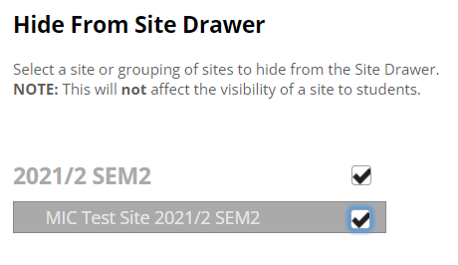
Organising your Space
Organise your Banner using the star to favourite your current sites.
Hide old sites that clutter up your Site Drawer. (Preferences > Sites)

Slide 6
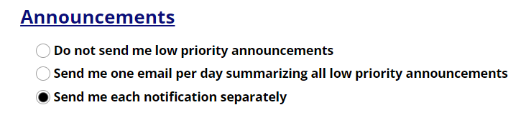
Preferences
Setting your preferences can give you more control over your emails, you can choose;
  Get individual emails as default.
  Get all emails for that day combined into 1 at the end of the day. Excluding High Priority emails.
Pros & Cons
  Easier to manage 1 email instead of many.
  Risk missing important information if you only check your email at the end of the day.

Slide 7
Communication
It is important that you know how your lecturer will be communicating with you and what means they will be using. Apart from email, Sulis offers your lecturer and you several options to keep in touch with your class.
Announcements
  Message of the Day
  Module Notices
Forums
  Engage in your module forums
  Share insight’s and additional content with your peers
Chat
  Instant messaging
  Chat content is not saved permanently (!!!)

Slide 8
Panopto

Slide 9
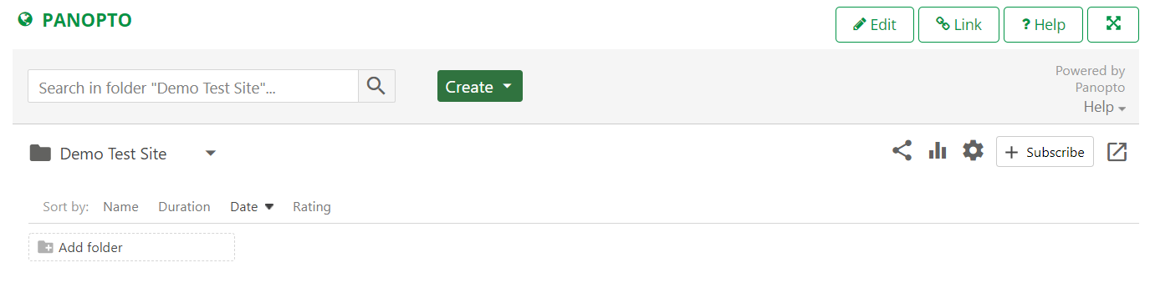
Viewing Videos
Enable permissions during your first login.
This will ensure you don’t run into any trouble when watching embedded videos.
https://www.ul.ie/ltf/supported-tools/panopto

Slide 10
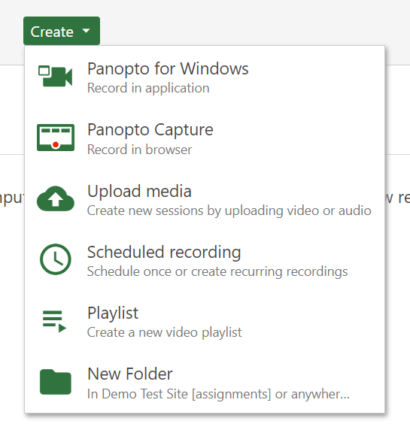
Video Assignments
Your lecturer may assign video assignments through Panopto.
This will allow you to create and upload videos to a special folder in Panopto

Slide 11
Assignments

Slide 12
How to Upload an Assignment?
View the assignments.
Ensure you have correctly uploaded the document.
Submit (Important)
Verify with email receipt

Slide 13
Turnitin

Slide 14
What is Turnitin?
Turnitin checks your documents for similarities with:
  Publicly available material (websites).
  Periodicals and Journals.
  Other submissions.

Slide 15
Understanding a Turnitin Report.
What does my score mean and why is it that colour?
Why can’t I see the source material?
Feedback from your lecturer?
What should I do next?

Slide 16

Questions and Survey

Slide 17
Thank you

