Slide 1
Evaluating Sources: The C.R.A.A.P Test
BY
Peter.Reilly@ul.ie

Slide 2
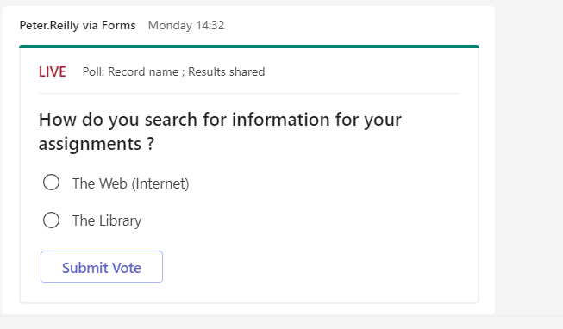

Slide 3
Learning Outcomes
Awareness of range of strategies to use
Able to Apply CRAAP Test
Distinguish between Good & Bad Sources
Critically evaluate information
Developing lifelong learning skills

Slide 4
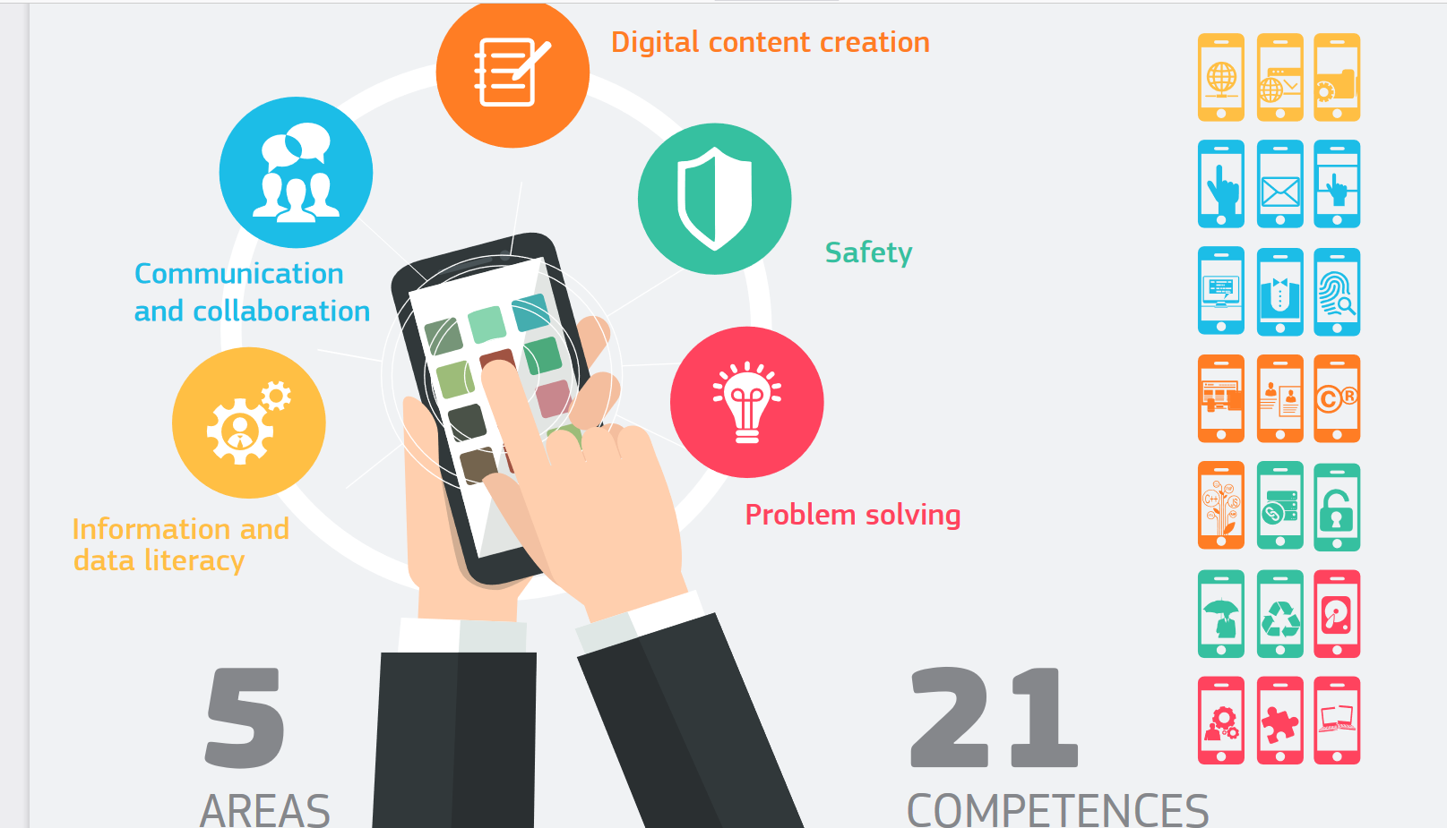

https://ec.europa.eu/jrc/sites/default/files/DIGCOMP-FINAL-%20UPDATED%2002-06-2016.pdf

Slide 5
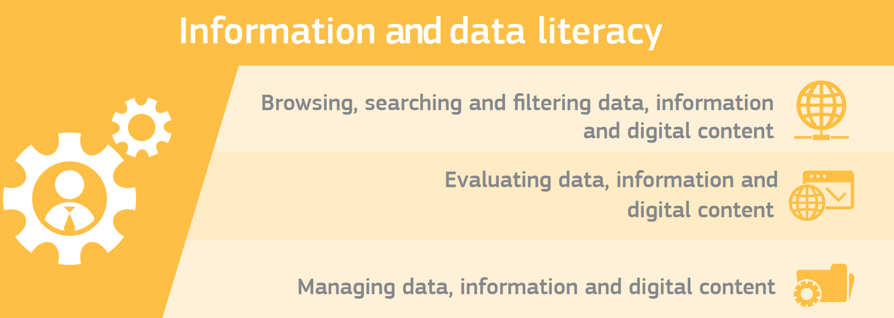
https://ec.europa.eu/jrc/sites/default/files/DIGCOMP-FINAL-%20UPDATED%2002-06-2016.pdf

Slide 6


Problem – So Much Information Available

Slide 7
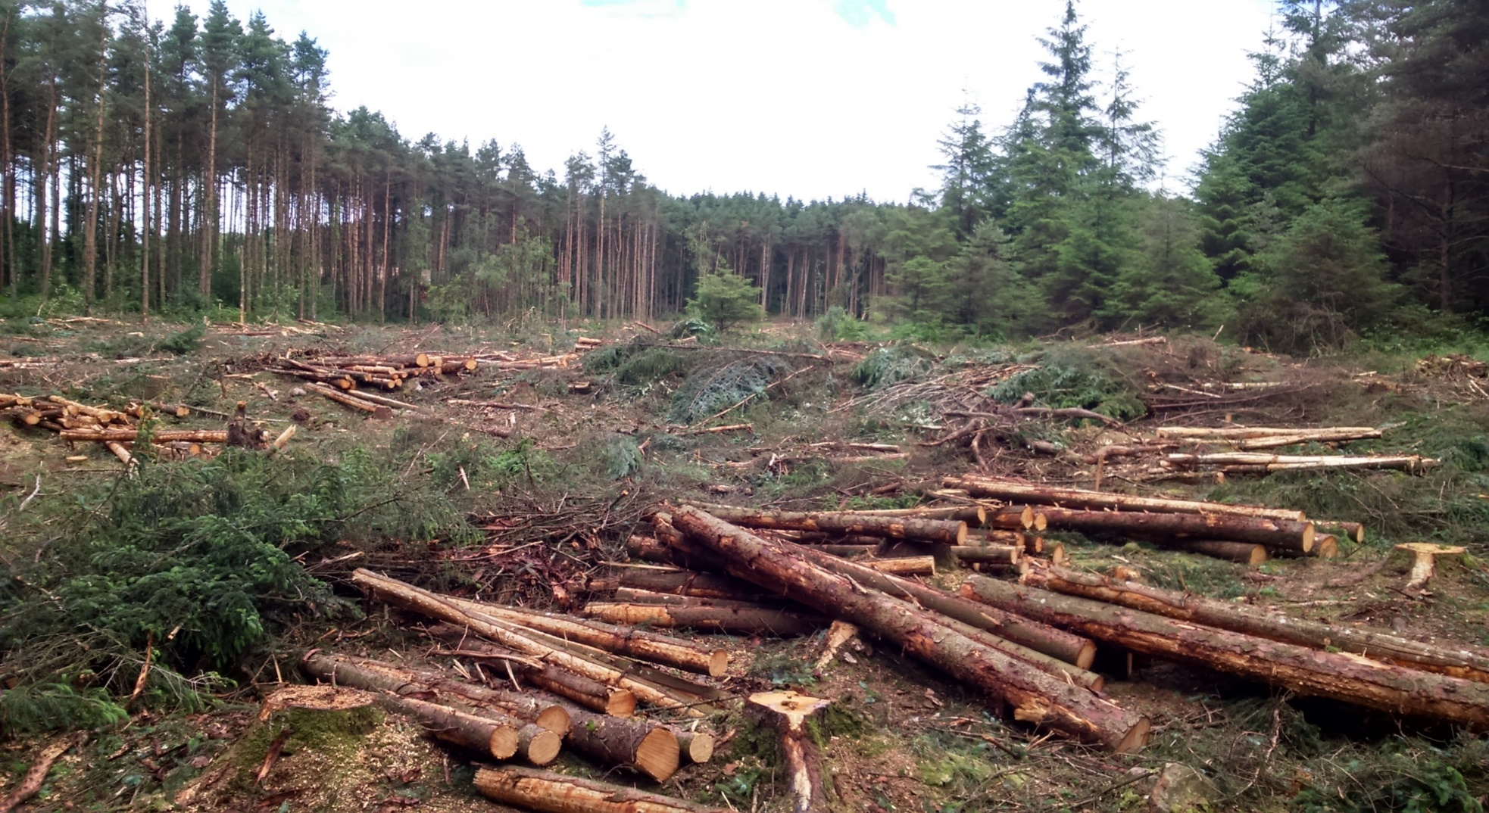
How Do You Sort the Wood from the Trees ?
To Find Relevant Information

Slide 8
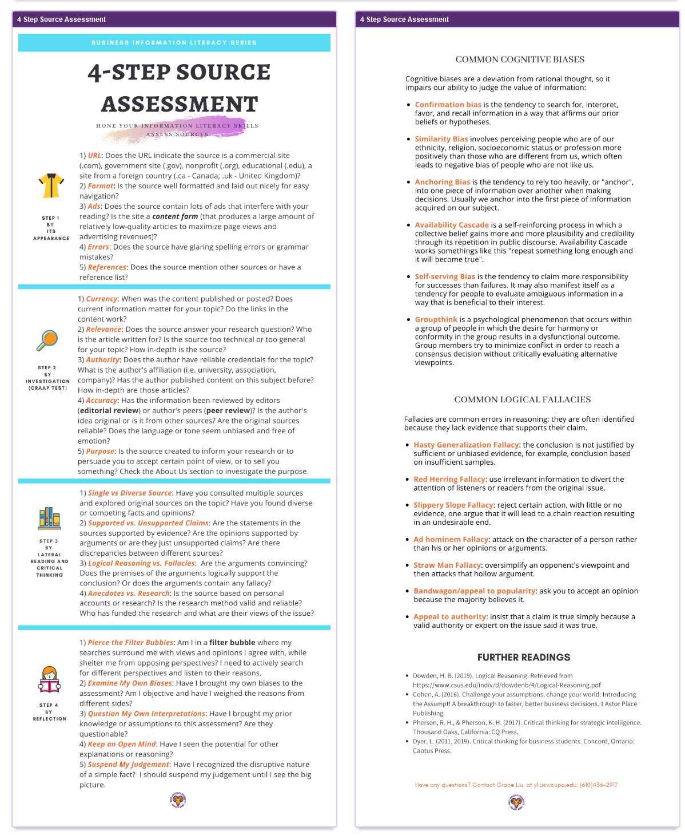
Infographic
On Assessing
Sources
https://library.wcupa.edu/c.php?g=1083914&p=7901322

Slide 9
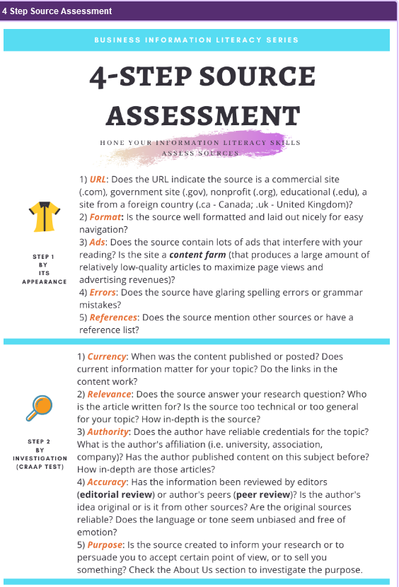

Slide 10
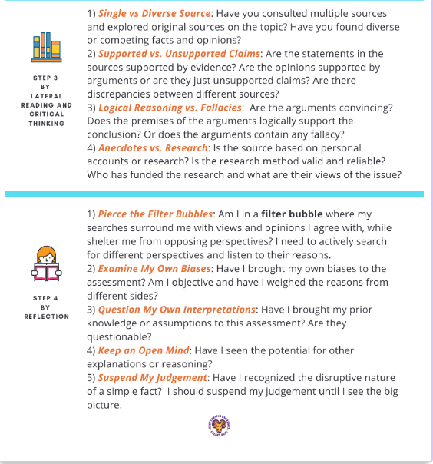

Slide 11
Apply CRAAP Test
CRAAP TEST
Currency
Relevance
Authority
Accuracy
Purpose
https://library.csuchico.edu/sites/default/files/craap-test.pdf

Slide 12
Strategies for Critically Evaluating Information
CRAAP
Test
SMELL

Slide 13
Use SMELL To Detect Fake News
SMELL
Source
Motivation
Evidence
Logic
Left Out

Slide 14
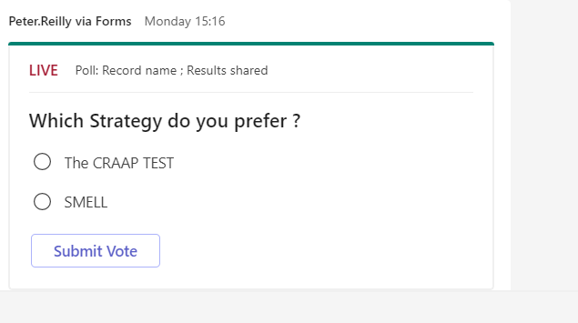

Slide 15
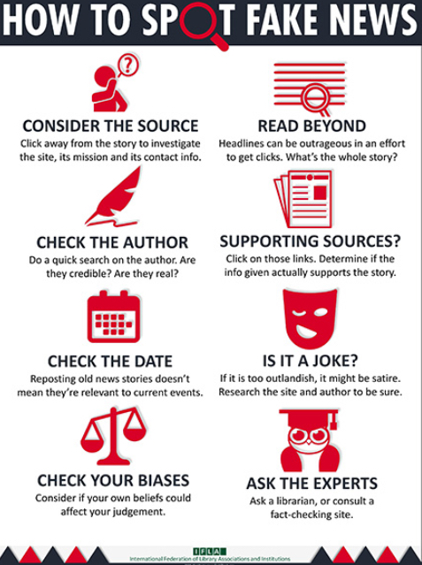
https://repository.ifla.org/bitstream/123456789/167/2/how_to_spot_fake_news.pdf

Slide 16
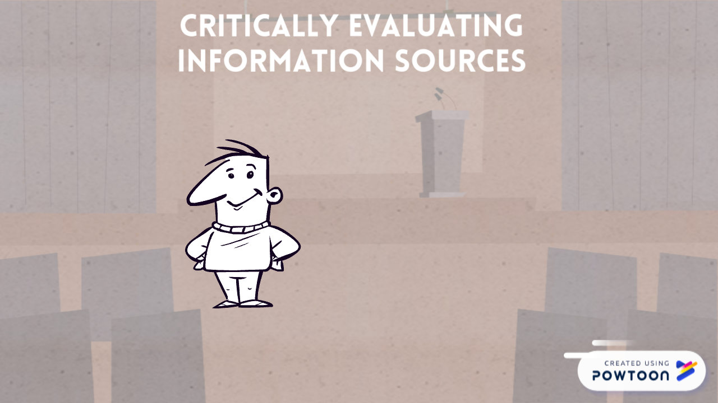

Slide 17


Slide 18
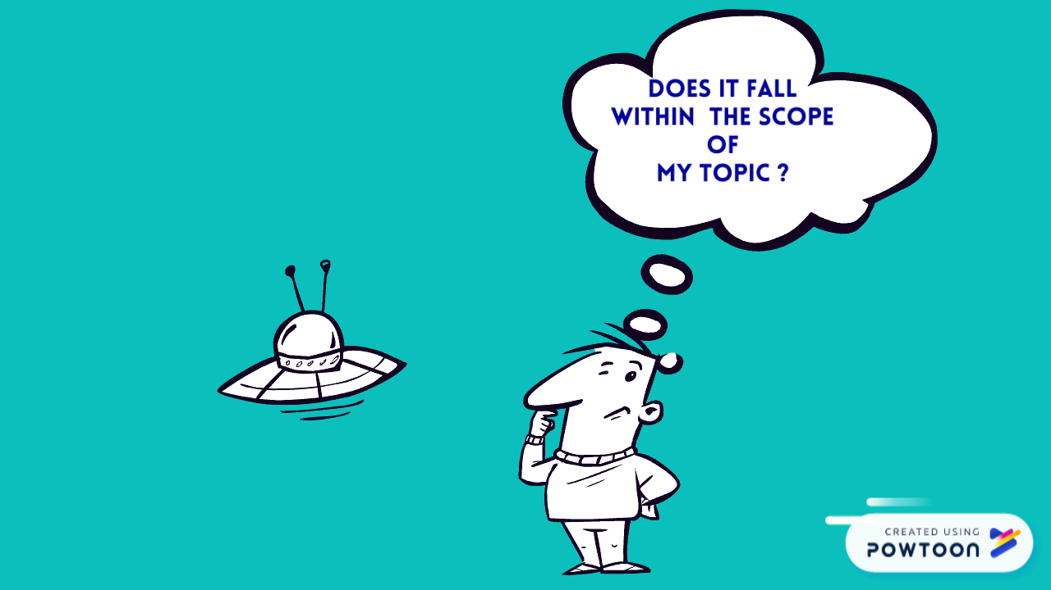
CONSIDER

Slide 19

Author/s

Slide 20
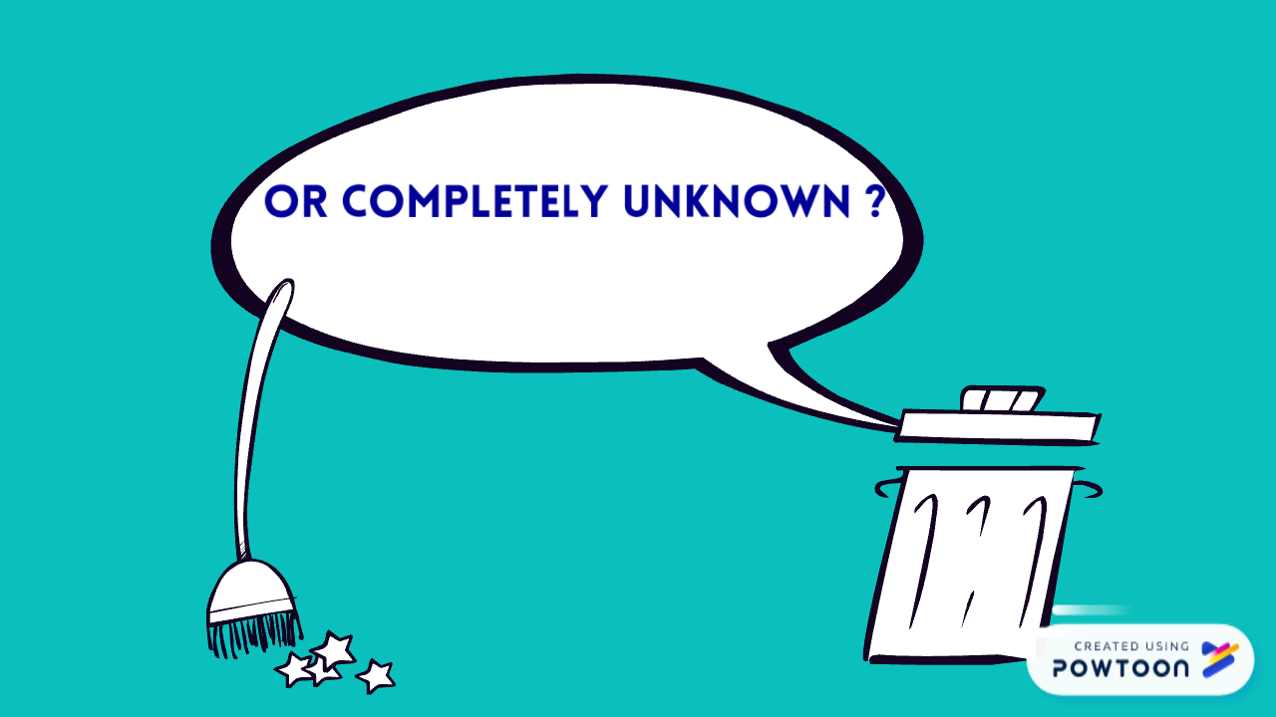

Slide 21
Recap of Learning Outcomes
Awareness of range of strategies to use
Able to Apply CRAAP Test
Distinguish between Good & Bad Sources
Critically evaluate information
Developing lifelong learning skills

Slide 22
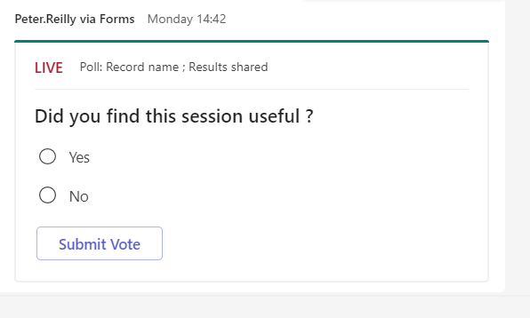

Slide 23
Thanks for your Attention.
ul.ie

