Slide 1
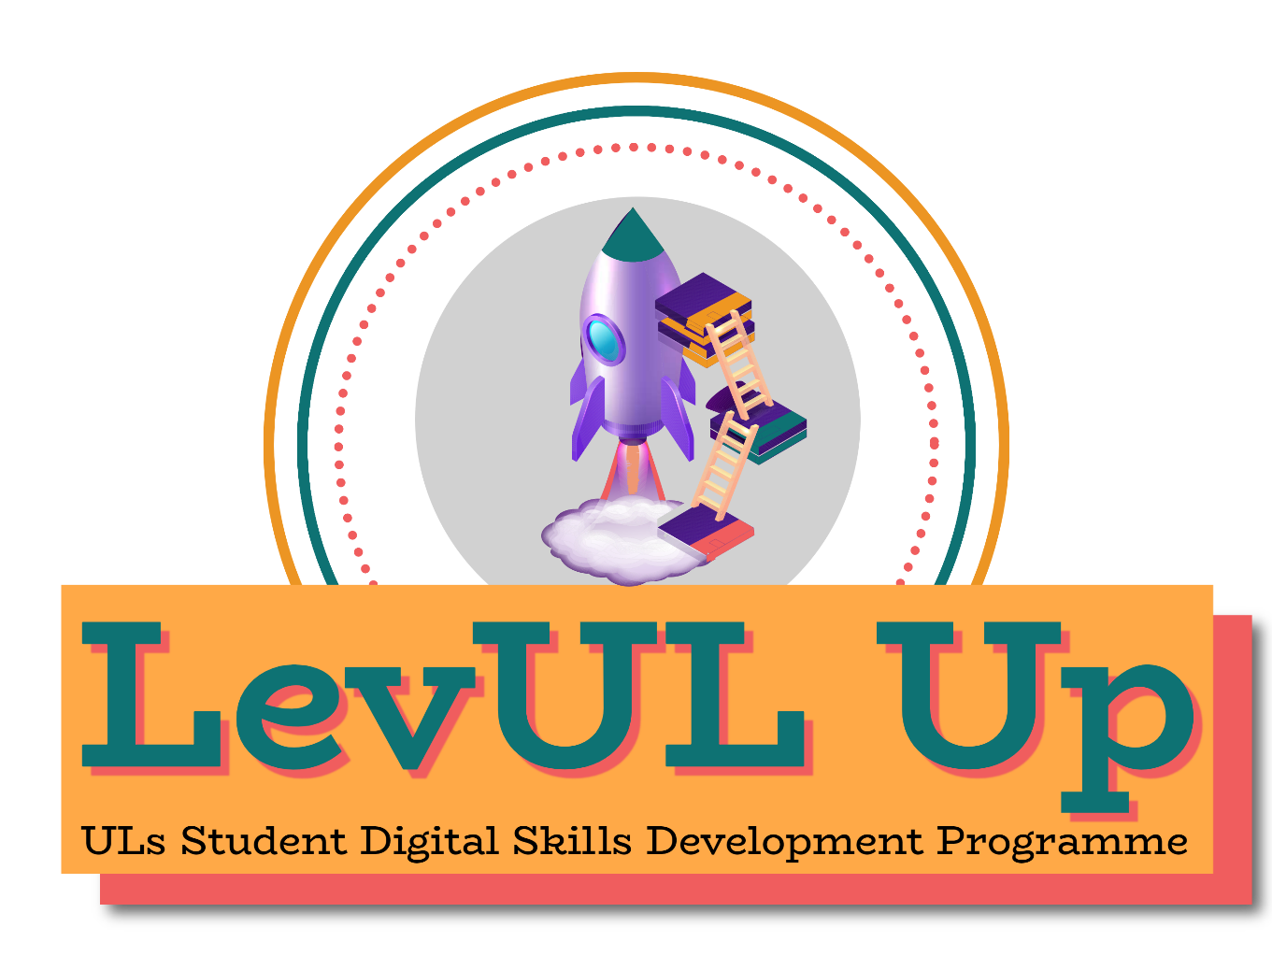

👋 Hello & Welcome
⏳ This session will begin shortly.
While you wait, please download the slides for today’s session from the LevUL Up website.
In association with:

Slide 2
Recording
This session will now be recorded. Any further information that you provide during a session is optional and in doing so you give us consent to process this information.
These recordings will be stored by the University of Limerick for a fixed period and may be published on our website during that time.
By taking part in a session you give us your consent to process any information you provide during it.

Slide 3
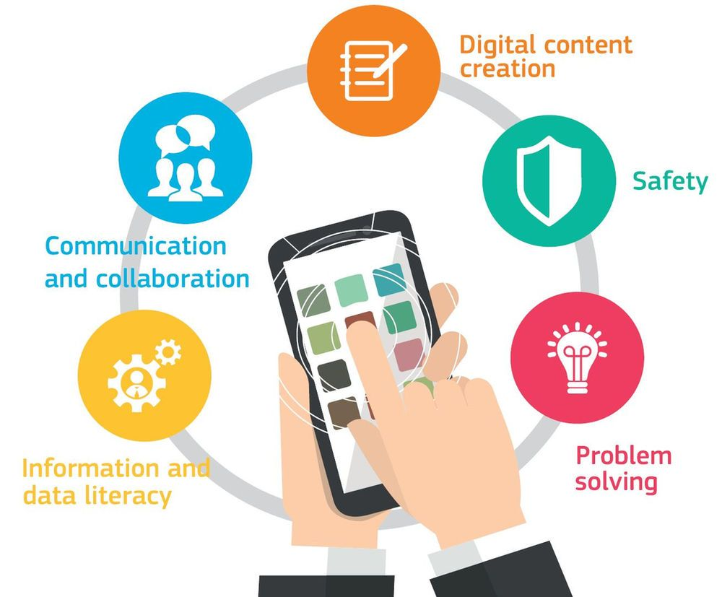

Discover Your Digital Competence and Skill Levels
David Moloney
Source

Slide 4

Who I am
​ | David Moloney UL Project Lead, Irish Universities Association Enhancing Digital Teaching and Learning project Centre for Transformative Learning, UL
Notes:
The team presenting in this video is comprised of

Slide 5
Overview
Current context for Digital Skills Development in Europe
Introduction to the DigComp Framework for Citizens
Activity: Discover Your Competence and Skill Levels (~20mins)
Reflection
Recap & Summary
Further Support & Resources

Slide 6
Outcomes
By the end of this workshop you will
know in greater detail the areas and competences on the DigComp framework
discover your own competence and skills levels by using an online self-assessment tool based on the DigComp framework
have a visual report of your own competence and skill levels.

Slide 7
Mapping this workshop to DigComp
Area 5: Problem Solving
5.4 Identifying digital competence gaps

Slide 8


To identify needs and problems, and to resolve conceptual problems and problem situations in digital environments. To use digital tools to innovate processes and products. To keep up-to-date with the digital evolution.
To understand where one’s own digital competence needs to be improved or updated.
To be able to support others with their digital competence development.
To seek opportunities for self-development and to keep up-to-date with the digital evolution.

Slide 9
Digital skills are becoming essential for everyone
They are increasingly a necessity for success as a student, graduate, citizen, and current or future employer/employee.

Slide 10
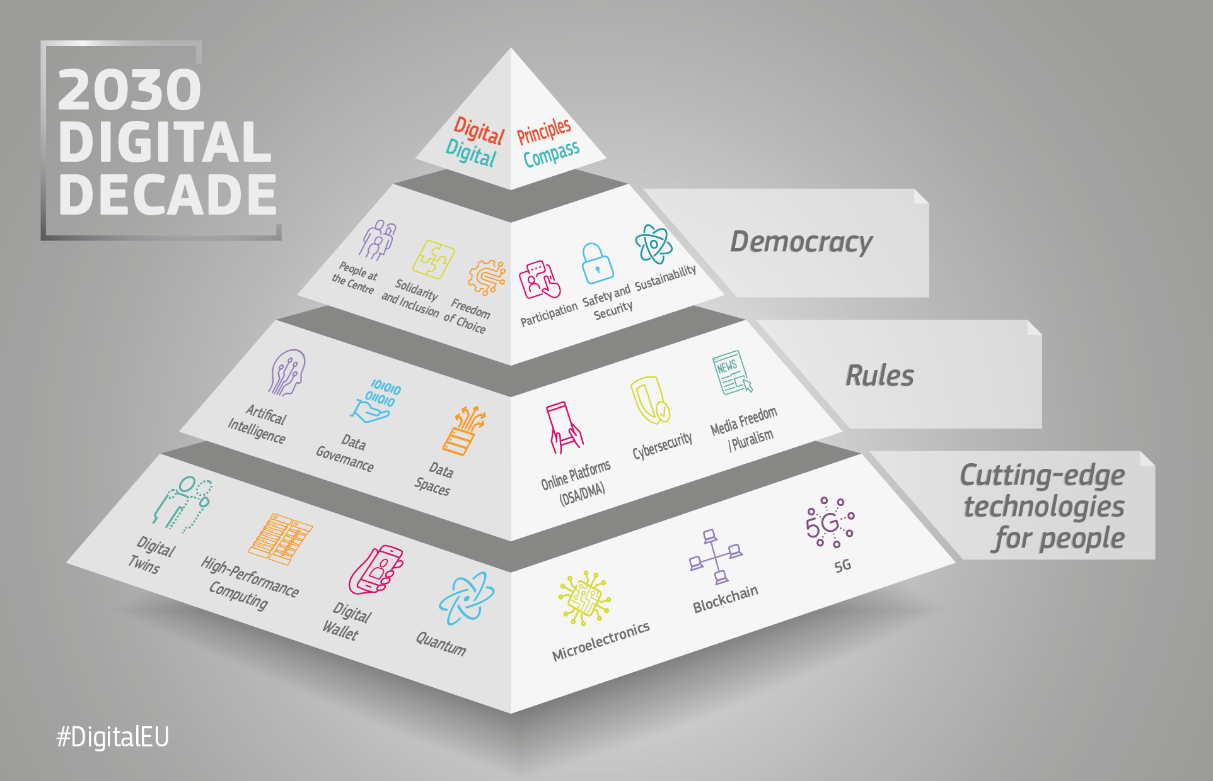

Source

Slide 11
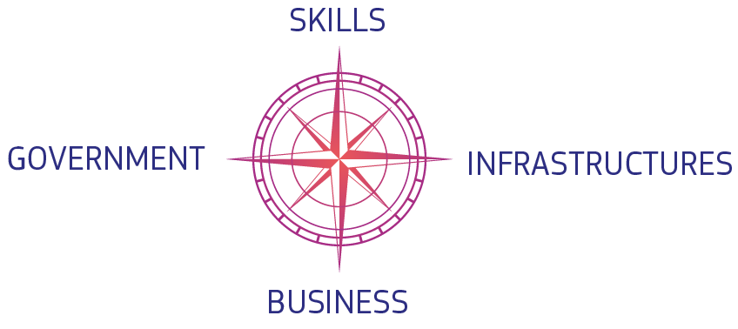
EU Commission:
Digital Decade
In March 2021, the European Commission presented a vision and avenues for Europe’s digital transformation by 2030.
The Commission proposed a Digital Compass for the EU's digital decade that evolves around 4 cardinal points.
Source

Slide 12
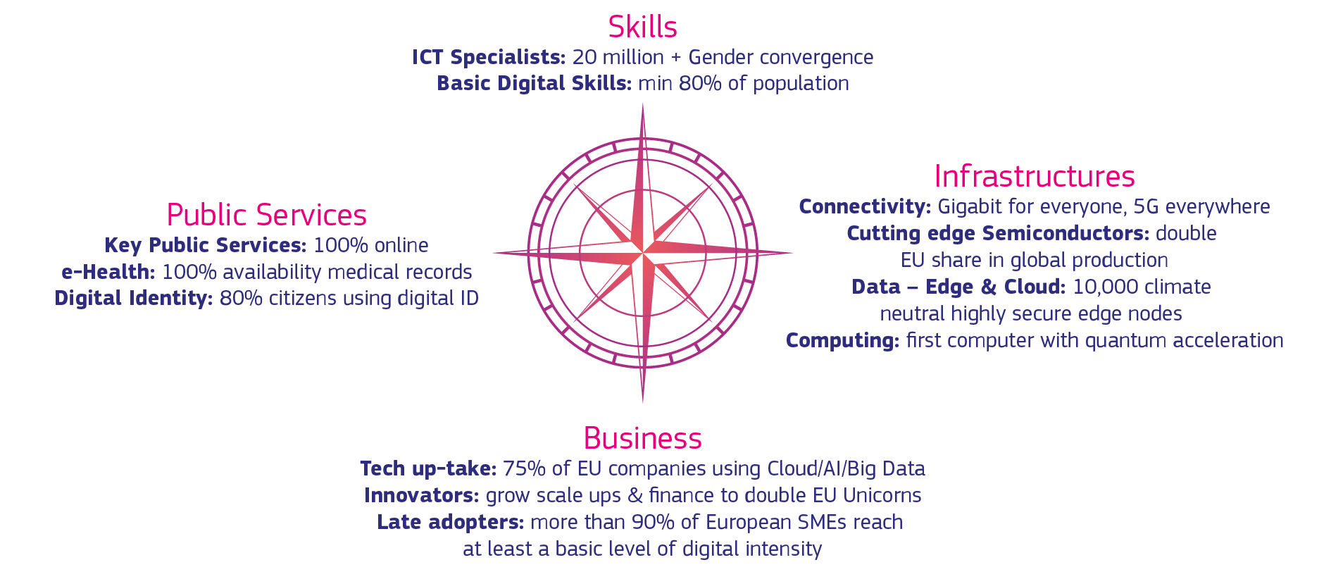
EU Commission:
Digital Decade
Source

Slide 13
EU Commission:
Declaration on Digital Rights and Principles
In January 2022, the Commission proposed a Declaration on digital rights and principles.
The draft Declaration covers key rights and principles for the digital transformation, shaped around 6 chapters.

Slide 14
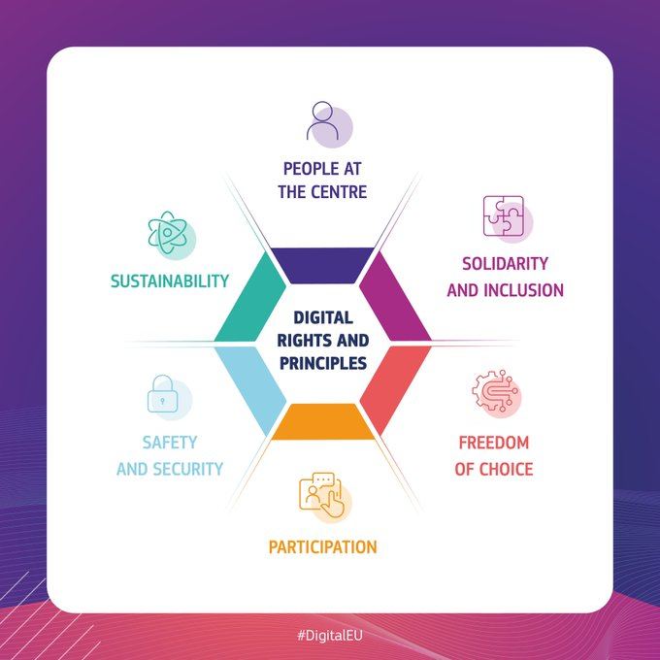
EU Commission:
Declaration on Digital Rights and Principles
putting people and their rights at the centre of the digital transformation;
supporting solidarity and inclusion;
ensuring the freedom of choice online;
fostering participation in the digital public space;
increasing safety, security and empowerment of individuals;
promoting the sustainability of the digital future.
Source

Slide 15

Declaration on Digital Rights and Principles: Solidarity and Inclusion
Everyone has the right to education, training and lifelong learning and should be able to acquire all basic and advanced digital skills.
We commit to:
promoting and supporting efforts to equip all education and training institutions with digital connectivity, infrastructure and tools,
supporting efforts that allow learners and teachers to acquire and share all necessary digital skills and competences to take an active part in the economy, society, and in democratic processes.
giving everyone the possibility to adjust to changes brought by the digitalisation of work through up-skilling and re-skilling. (p. 3)

Slide 16

Harnessing Digital:
The Digital Ireland Framework (2022)
As highlighted by the OECD, new digital technologies are reshaping the way people live, work and learn. This trajectory is intensifying and has been accelerated by the COVID-19 pandemic. Digitalisation will increasingly have profound and long-lasting impacts on the world of work. It is of fundamental importance to the skills and competencies people need to secure, retain and flourish in employment and the ongoing development of a workforce which can adapt successfully to the digital revolution. (p. 24)

Slide 17
This workshop is about helping you to discover and map your current digital competence and skill levels using an available tool

Slide 18
Introduction to DigComp

Slide 19
Introduction to DigComp
Source

Slide 20
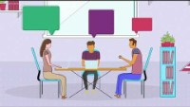
Source

Slide 21
3 Dimensions of Digital Competence
Areas (5)
  Competences (21)
    Levels of Proficiency for each Competence (8)

Slide 22
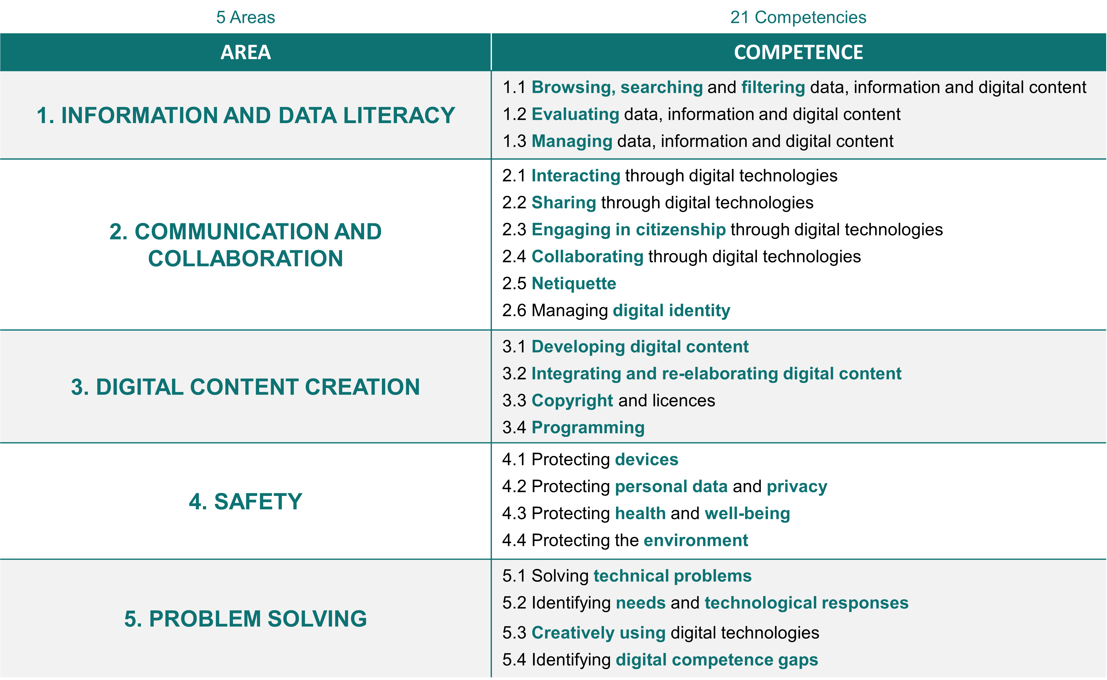





1
2

Slide 23
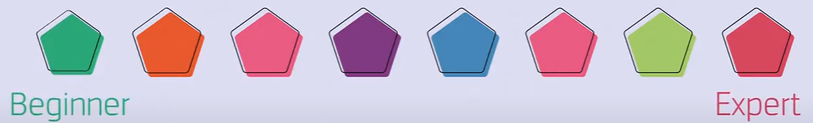
3. Level of Proficiency
3

Slide 24
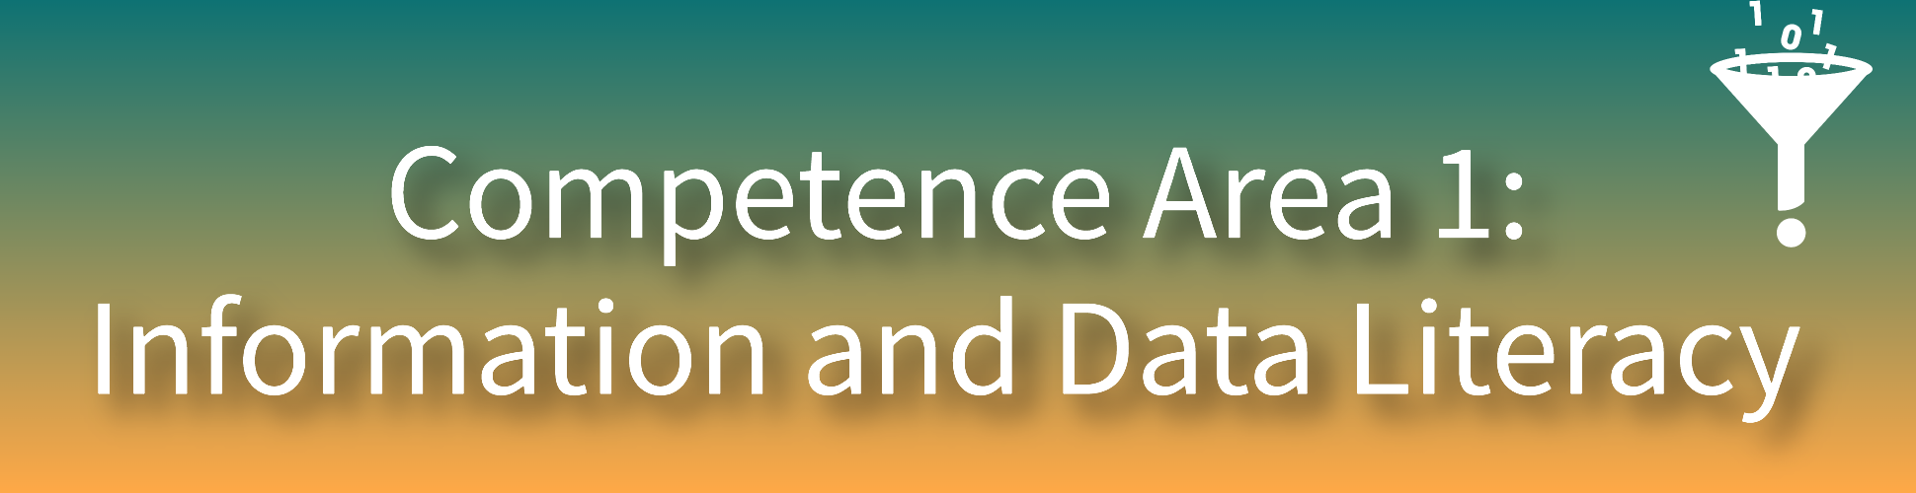
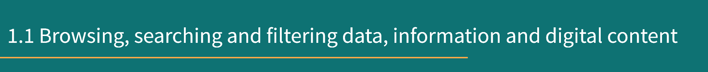


To articulate information needs , to search for data, information and content in digital environments, to access them and to navigate between them. To create and update personal search strategies.
To articulate information needs, to locate and retrieve digital data, information and content. To judge the relevance of the source and its content. To store, manage, and organise digital data, information and content.
To analyse, compare and critically evaluate the credibility and reliability of sources of data, information and digital content. To analyse, interpret and critically evaluate the data, information and digital content.
To organise, store and retrieve data, information and content in digital environments. To organise and process them in a structured environment.

Slide 25



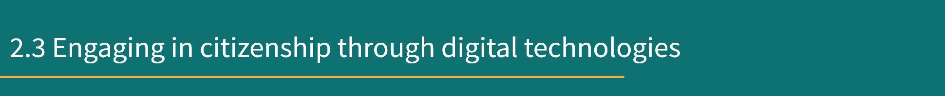
1/2
To interact through a variety of digital technologies and to understand appropriate digital communication means for a given context.
To interact, communicate and collaborate through digital technologies while being aware of cultural and generational diversity. To participate in society through public and private digital services and participatory citizenship. To manage one’s digital identity and reputation.
To share data, information and digital content with others through appropriate digital technologies. To act as an intermediary, to know about referencing and attribution practices.
To participate in society through the use of public and private digital services. To seek opportunities for self-empowerment and for participatory citizenship through appropriate digital technologies.

Slide 26



2/2
To use digital tools and technologies for collaborative processes, and for co-construction and co-creation of resources and knowledge.
To interact, communicate and collaborate through digital technologies while being aware of cultural and generational diversity. To participate in society through public and private digital services and participatory citizenship. To manage one’s digital identity and reputation.
To be aware of behavioural norms and know-how while using digital technologies and interacting in digital environments. To adapt communication strategies to the specific audience and to be aware of cultural and generational diversity in digital environments.
To create and manage one or multiple digital identities, to be able to protect one's own reputation, to deal with the data that one produces through several digital tools, environments and services.

Slide 27

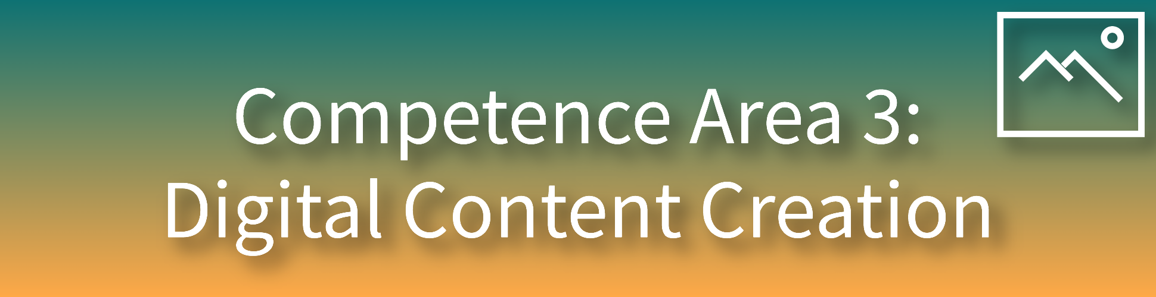



To create and edit digital content in different formats, to express oneself through digital means.
To modify, refine, improve and integrate information and content into an existing body of knowledge to create new, original and relevant content and knowledge.
To create and edit digital content. To improve and integrate information and content into an existing body of knowledge while understanding how copyright and licences are to be applied. To know how to give understandable instructions for a computer system.
To understand how copyright and licences apply to data, information and digital content.
To plan and develop a sequence of understandable instructions for a computing system to solve a given problem or perform a specific task.

Slide 28





To protect personal data and privacy in digital environments. To understand how to use and share personally identifiable information while being able to protect oneself and others from damages. To understand that digital services use a “Privacy policy” to inform how personal data is used.
To protect devices, content, personal data and privacy in digital environments. To protect physical and psychological health, and to be aware of digital technologies for social well-being and social inclusion. To be aware of the environmental impact of digital technologies and their use.
To be able to avoid health-risks and threats to physical and psychological well-being while using digital technologies. To be able to protect oneself and others from possible dangers in digital environments (e.g. cyber bullying). To be aware of digital technologies for social well-being and social inclusion.
To protect devices and digital content, and to understand risks and threats in digital environments. To know about safety and security measures and to have due regard to reliability and privacy.
To be aware of the environmental impact of digital technologies and their use.

Slide 29
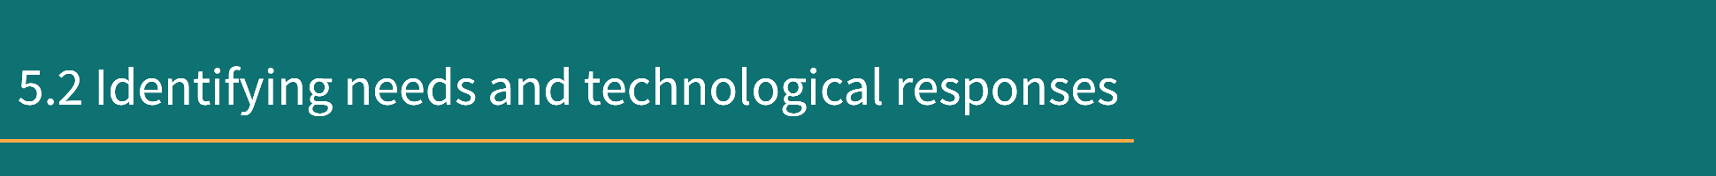


To assess needs and to identify, evaluate, select and use digital tools and possible technological responses to solve them. To adjust and customise digital environments to personal needs (e.g. accessibility).
To identify needs and problems, and to resolve conceptual problems and problem situations in digital environments. To use digital tools to innovate processes and products. To keep up-to-date with the digital evolution.
To use digital tools and technologies to create knowledge and to innovate processes and products. To engage individually and collectively in cognitive processing to understand and resolve conceptual problems and problem situations in digital environments.
To identify technical problems when operating devices and using digital environments, and to solve them (from trouble-shooting to solving more complex problems).
To understand where one’s own digital competence needs to be improved or updated. To be able to support others with their digital competence development. To seek opportunities for self-development and to keep up-to-date with the digital evolution.

Slide 30
Discover Your Digital Competence and Skill Levels

Slide 31
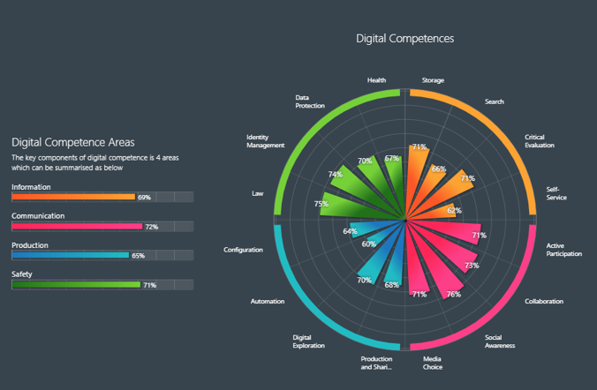
The Digital Competence Wheel

Slide 32
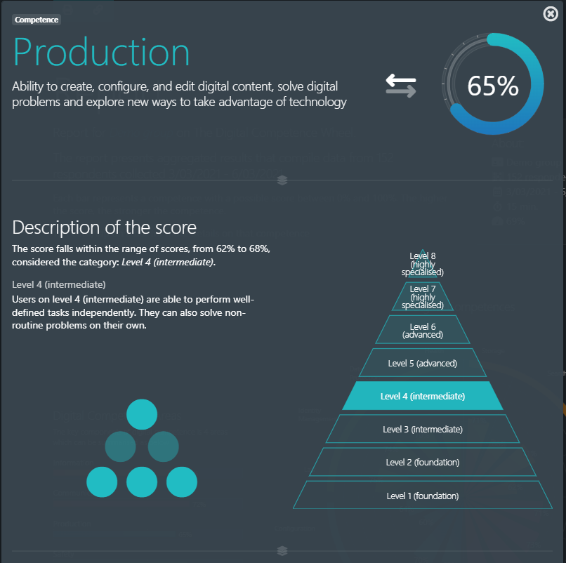
Digital Competence Wheel: The Report

Slide 33
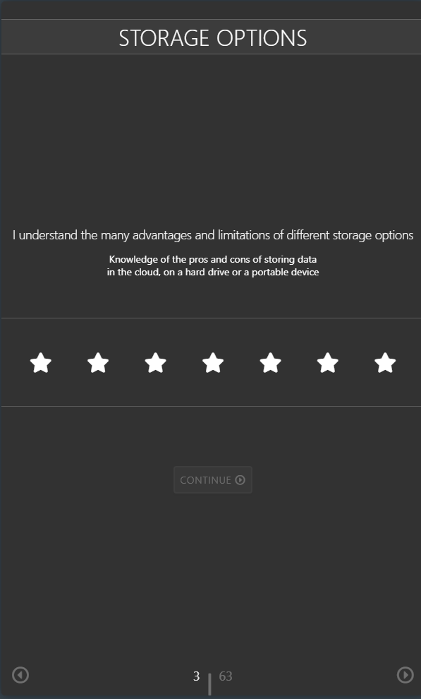
What to expect
7-star rating system

Slide 34
What to expect
1.
To a very
small degree
3.
To a lesser extent
5.
To some extent
7.
To a very large extent
2.
To a small degree
4. Partially
6.
To a large extent
7-star rating system
Foundation
Intermediate
Advanced
Highly specialised

Slide 35
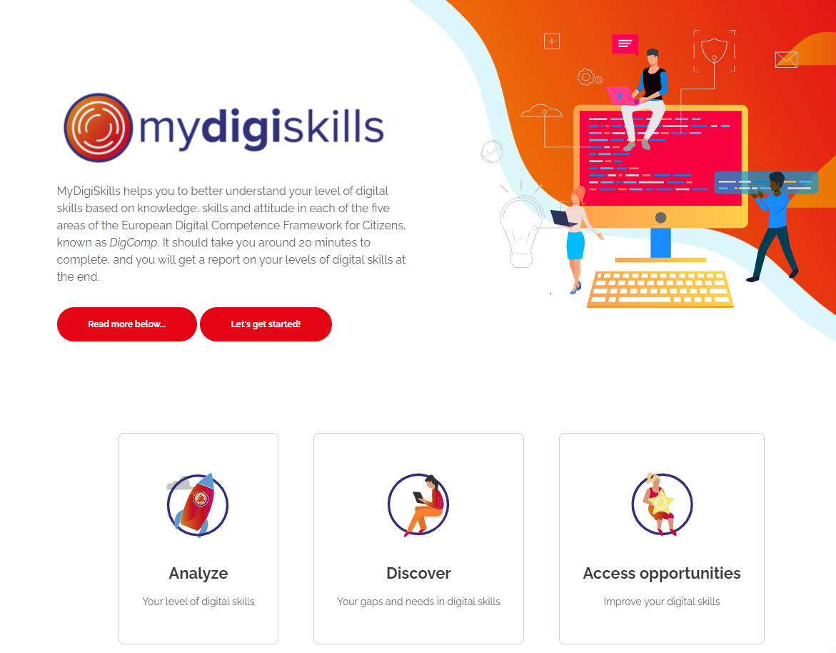
MyDigiSkills.eu

Slide 36
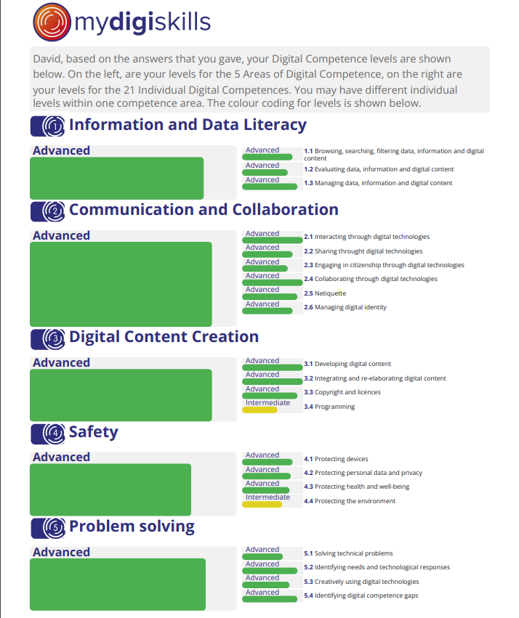
MyDigiSkills.eu: The Report

Slide 37
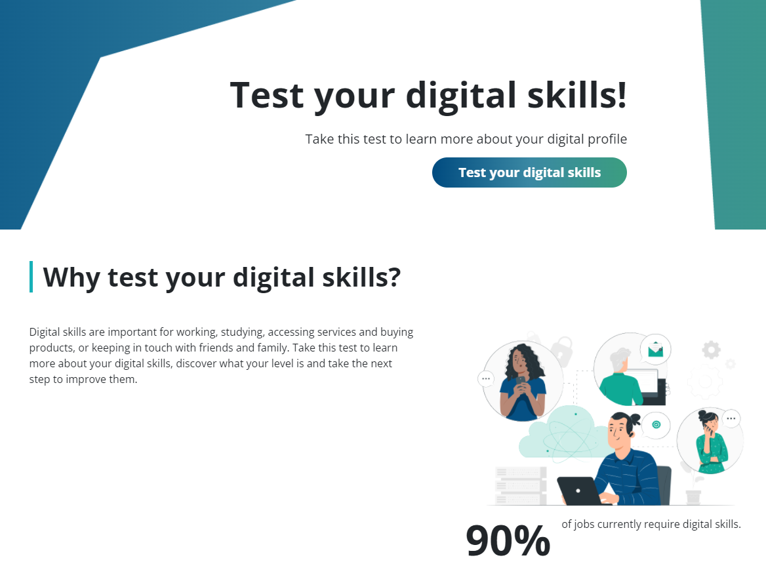
Similar digital skill self-assessment resource
Europass Digital Skills Test

Slide 38
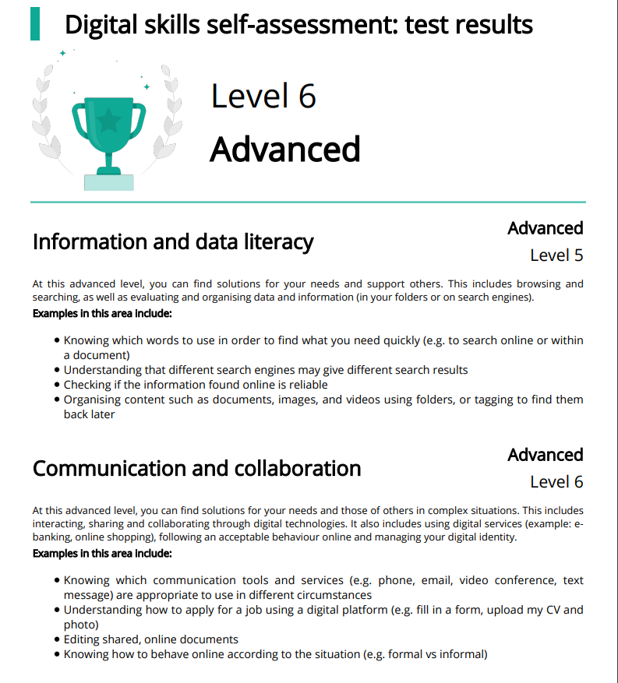
Europass:
The Report

Slide 39
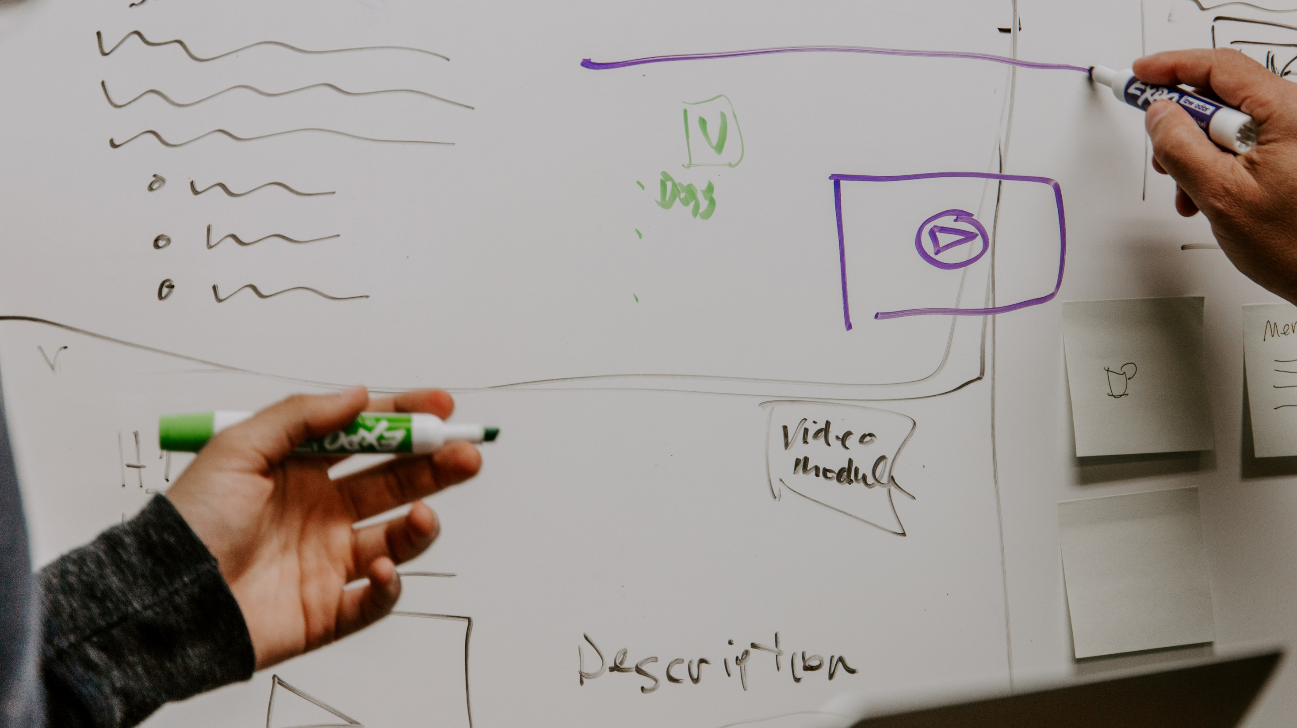
Activity

Slide 40

Activity
Navigate to https://digital-competence.eu/dc/
Click on Start
Answer questions
You have 20 minutes... ⏱

Slide 41

20 minutes

Slide 42

Reading Your Report

Slide 43
Reflection

Slide 44
Reflection
Did anything surprise you in your report?
Where next for you in terms of digital skills development?

Slide 45
Recap & Summary
Current context for Digital Skills Development in Europe
Introduction to the DigComp Framework for Citizens
Activity: Discover Your Competence and Skill Levels (~20mins)
Reflection
Recap & Summary
Further Support & Resources

Slide 46

Where from here?
This Photo by Unknown Author is licensed under CC BY-SA

Slide 47
Similar Self-Assessment Tools
The Digital Competence Wheel – Specific DigComp Edition
MyDigiSkills.eu
Europass Digital Skills Test
Check out the DigComp area of the LevUL Up website

Slide 48
Thank you

Slide 49


Slide 50
Images
DigComp circular graphic from njszt.hu
Declaration on European Digital Rights and Principles Pyramid
The Digital Competence Wheel
MyDigiSkills.eu
Europass Digital Skills Test

Slide 51
This work is licensed under a Creative Commons Attribution-NonCommercial 4.0 International (CC BY-NC 4.0)

