Slide 1
👋 Hello & Welcome
⏳ This session will begin shortly.
While you wait, please download the slides for today’s session from the LevUL up website.
In association with:

Slide 2
Recording
This session will now be recorded. Any further information that you provide during a session is optional and in doing so you give us consent to process this information.
These recordings will be stored by the University of Limerick for one year and may be published on our website during that time.
By taking part in a session you give us your consent to process any information you provide during it.

Slide 3
How to become a Super User on MS Teams & OneDrive
Chloe Carroll & Anna Marie Gildea, Information Technology Division (ITD)

Slide 4
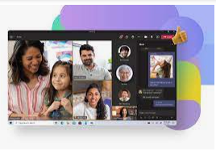
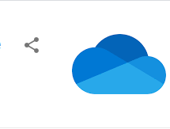
Using Microsoft Teams & OneDrive: your project group can hold meetings, share and work collaboratively on documents, coordinate tasks and do brainstorming. UL’s IT Division is going to introduce you to some of the features of Teams & OneDrive that support group work and give you tips and advice on best use of Teams & OneDrive.

Slide 6
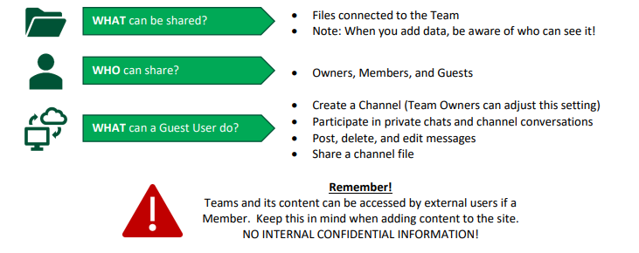

Slide 8
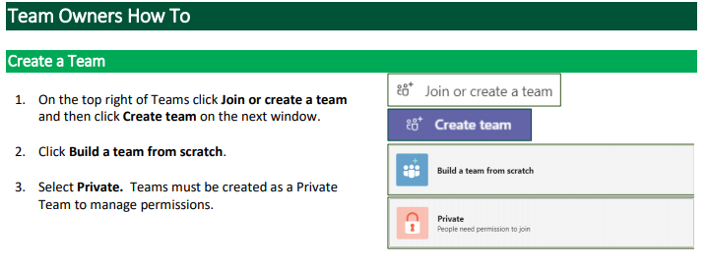
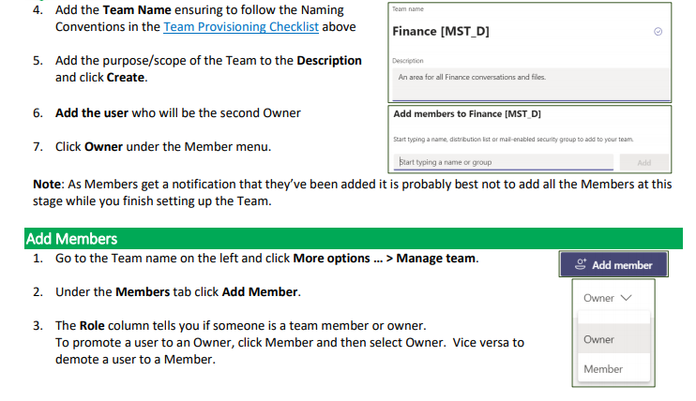
Notes:
Chloe might create a screen record for this to play around this point?

Slide 9
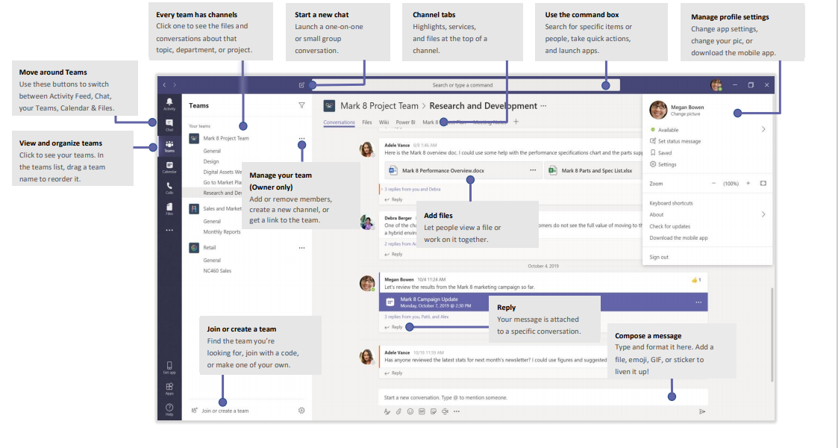

Slide 10
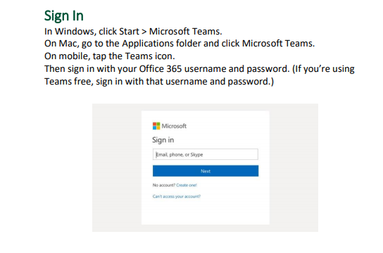
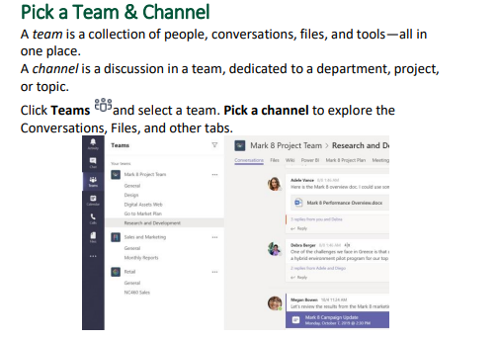
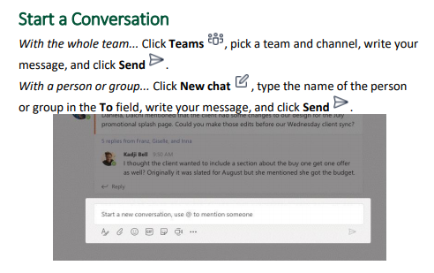
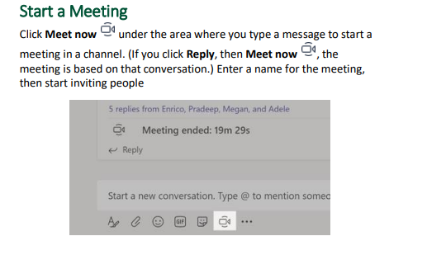

Slide 11
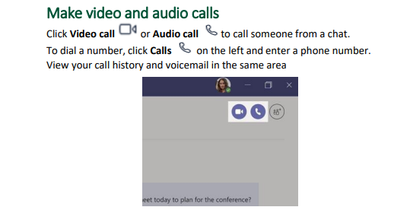
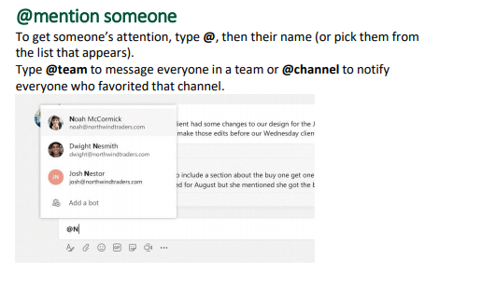
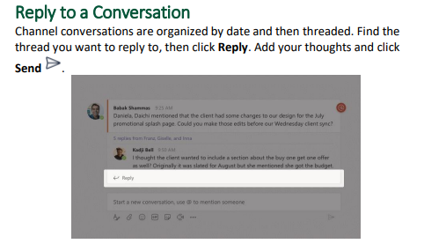
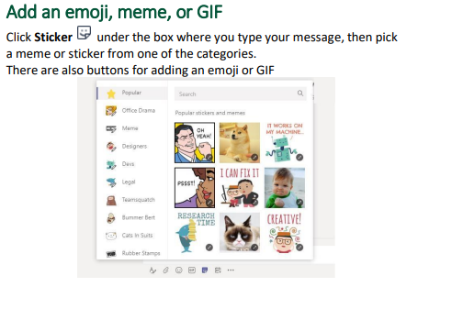

Slide 12
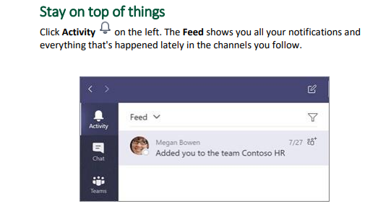
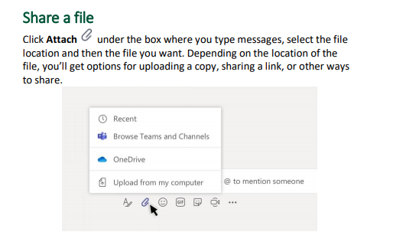
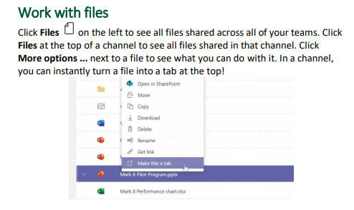
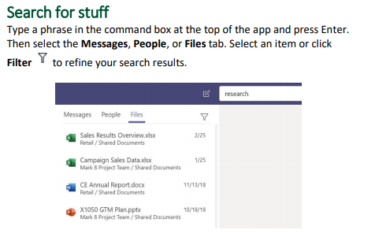

Slide 13
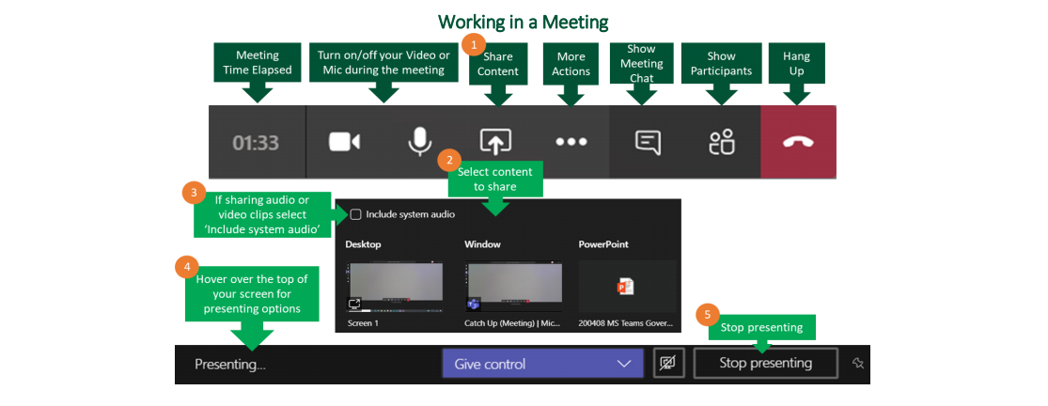
Notes:
Could show examples of each of these – How to create a Team meeting from Teams; Outlook & how to join a meeting

Slide 14
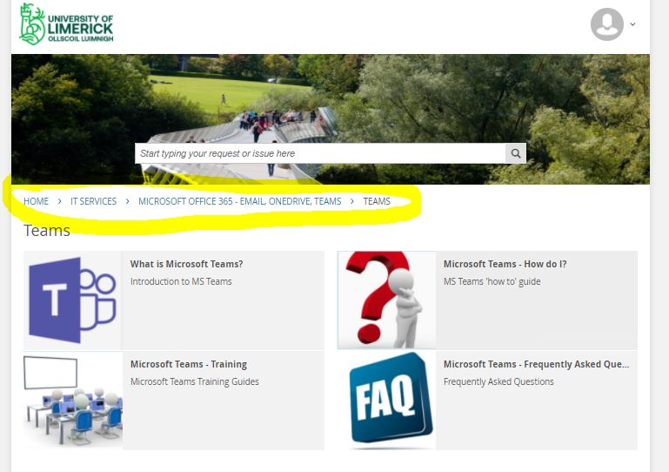
Where To find more information on MS Teams ? https://ul.topdesk.net/
Notes:
Open Topdesk as a student and show the Attendees where this is

Slide 15
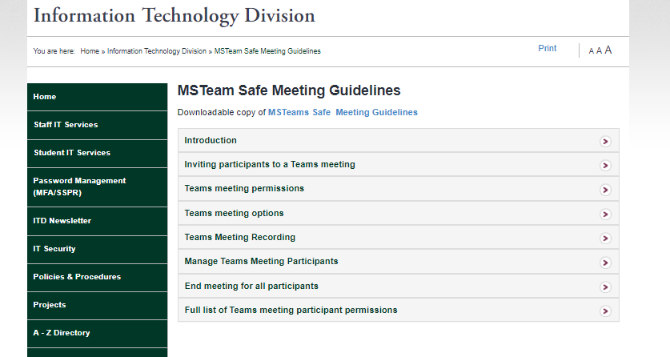
Microsoft Teams – Training Guides
ITD have produced a Team Owners Guide and a Team Members Guide which will help you learning the basics and get started with Teams.
MS Teams safe meeting guidelines. This has good info on how to safely manage a teams meeting. https://ulsites.ul.ie/itd/node/128921

Slide 16
As a Team Owner you will receive an email notification prior to expiration of the group where you will have the ability to renew the group if still required.
Team Owners are responsible for ensuring any files worked on within the Teams Files should be relocated to the appropriate ITD supported solutions for document storage (SharePoint, OneDrive or File Share).
When a group expires, the group is deleted one day after the expiration date.

Slide 17
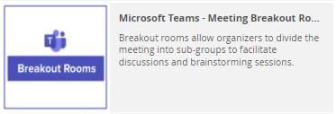
Microsoft Teams – Breakout Room Guide
Breakout rooms allow organizers to divide the meeting into sub-groups to facilitate discussions and brainstorming sessions.
More information around Break out Rooms can be found here on our Self Service Portal.
Notes:
Just a mention around Breakout Rooms. Open link on Topdesk to show where the content can be found

Slide 18
Microsoft Teams – Breakout Room Guide FAQ
For best practice it is recommended to close all rooms, bringing all participants back to the main lobby before ending the meeting.
As noted at the beginning of this guide, currently only the organiser of a meeting can create breakout rooms.
Any files from the breakout rooms can be shared in the main meeting once everyone is back together and will be available afterwards in the meeting chat.
If you are the organiser of a meeting and cannot create breakout rooms make sure that the new meeting experience is enabled (Teams -> Settings -> General -> Check “Turn on new meeting experience”)
The meeting organizer can record a Breakout Room. To record a Breakout Room, the organizer must be in the room to start the recording. The organizer can leave the room and the recording will continue.
Click More Actions ⋯ and select Start Recording.

Slide 19
OneDrive – Become a Super User : How Can you benefit from using OneDrive

Slide 20
What is OneDrive
UL’s OneDrive for Business is the University’s recommended option for cloud-based storage of personal work files. It provides a place for UL staff and registered students to store, edit and share their work. It is compatible with most devices and interacts seamlessly with Office 365 collaboration features, such as enabling multiple users to work on Office 365 documents simultaneously.
To view UL’s One Drive Guidelines for Personal Data and Synchronisation please click here

Slide 21
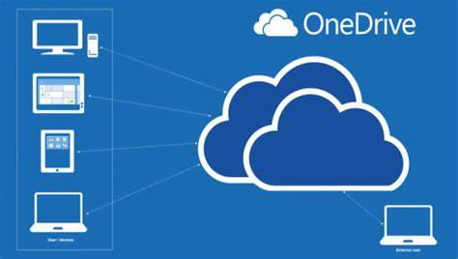
Why would I use OneDrive ?. – Benefits of OneDrive
Automatically Backup your files
Anywhere, Anytime, Any device access
View Files from Any Device
Share securely and effortlessly
Simplified organization and discovery
Restore Previous Version

Slide 22
Let's Get Started
How Do I access One Drive if I am using a personal device ?
You can access OneDrive by opening a Browser and going to https://portal.office.com/ . Once you are logged in, click OneDrive to access your online files and storage
How Do I access One Drive if I am using PC in a UL LAB?
When you logon to a PC in a UL ITD Managed LAB, you will automatically be logged onto your OneDrive. You will see a OneDrive icon on the desktop.
Your Desktop and My Documents folder on the device you are logged onto will
re-direct to your OneDrive account. Saving a file on the Desktop on a UL ITD Managed
LAB PC will automatically save it to your OneDrive account on https://portal.office.com/
Note: We would recommend this as a more secure solution to storing and backing up your data than using USB’s as USB’s can corrupt and can easily get lost.
Notes:
Note: Demo on remote machine as a student Account for the Attendees

Slide 23
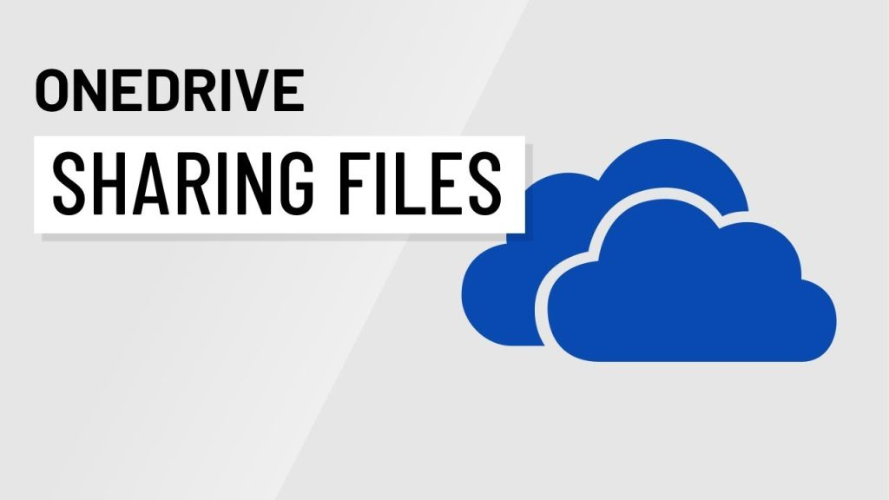
Let’s Start Collaborating
How do I share a file with a peer ?
Sign into your OneDrive account.
Pick the file or folder you want to share by selecting the circle in the upper corner of the item
Select Share at the top of the page.
Under Copy Link, select People in <Your Organization> with the link can edit to open the link settings.
To change the link permissions, editing and other permissions please see OneDrive Sharing Permissions
Notes:
Note: Demo on remote machine as a student Account for the Attendees

Slide 24
Never lose documents again
How do I recover a file I deleted ?
Sign into your OneDrive account.
In the navigation pane, select Recycle bin.
Select the files or folders you want to restore by pointing to each item and clicking the circle check box that appears, and then click Restore.
Note: If you're signed in with your UL account, items in the recycle bin are automatically deleted after 30 days.
Notes:
Note: Demo on remote machine as a student Account for the Attendees

Slide 25
OneDrive FAQ’s
Can I share my OneDrive for Business documents with users outside of UL?
Yes you can shares files outside. Please click here for further information
What’s happens my file on One Drive after I leave UL ?
Please note that all Microsoft 365 Apps (Office 365) licences will be revoked and your Office 365 account deleted approximately 90 days after you graduate or cease studies at UL. Please ensure that you have backed up your data from your OneDrive before your account is deleted.
How much storage space do I get?
1 Terabyte of storage
Are their restrictions or characters and names not supported?
Yes there are restrictions, please click here for detailed information.
For further information on using OneDrive in UL please go to TopDesk
Click here
Notes:
Open link to Topdesk as a student to show the attendees the content available for OneDrive

Slide 26
UL Microsoft 365 Training Centre
ITD has released UL Microsoft 365 Training Centre which will enable UL staff and students to access training resource for Microsoft Teams, SharePoint, and OneDrive. The site is intended to be a self-learn portal to facilitate self-training on Microsoft 365 applications and to enable ad-hoc knowledge enhancement for users.
This training centre lets you find any topic in an easy convenient way, with everything you need in one place — available anytime, on any device. We’re confident you’ll love it.
The Training Centre provides you everything to start with. You can watch tailored UL video tutorials which are prefixed with UL- and the Microsoft materials are updated on a quarterly basis to reflect any changes or updates.
Start here »
Notes:
Open the Training Centre to show them the Site and valuable information

Slide 27
UL Microsoft 365 Training Centre

Slide 28
Raise a ticket by logging a call at https://ul.topdesk.net
If you have any issues, please contact ITD (Information Technology Division). Tell us as much information as you can i.e., location, room, device, software and version etc. This will help us to improve our service to you.

