Slide 1
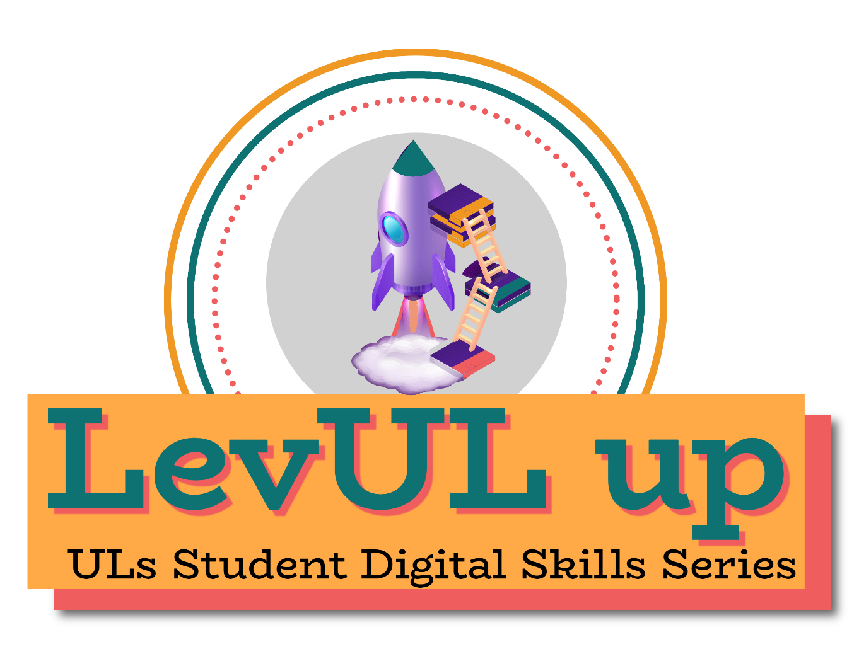

👋 Hello & Welcome
⏳ This session will begin shortly.
While you wait, please download the slides for today’s session from the LevUL up website.
In association with:

Slide 2
Recording
This session will now be recorded. Any further information that you provide during a session is optional and in doing so you give us consent to process this information.
These recordings will be stored by the University of Limerick for one year and may be published on our website during that time.
By taking part in a session you give us your consent to process any information you provide during it.

Slide 3


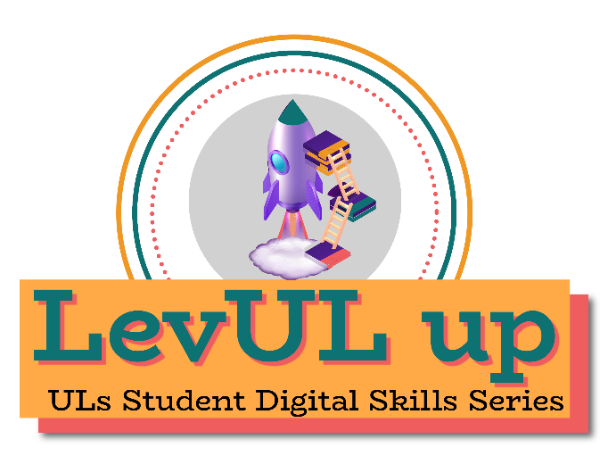
7 Simple Steps to Stay Safe Online: Protecting your Digital Identity
Eoghan McGrath & Anna Marie Gildea, Information Technology Division (ITD)

Slide 4
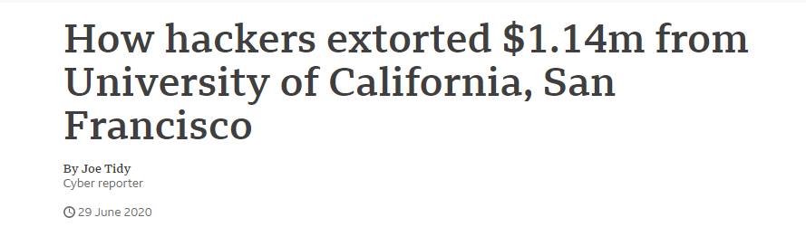
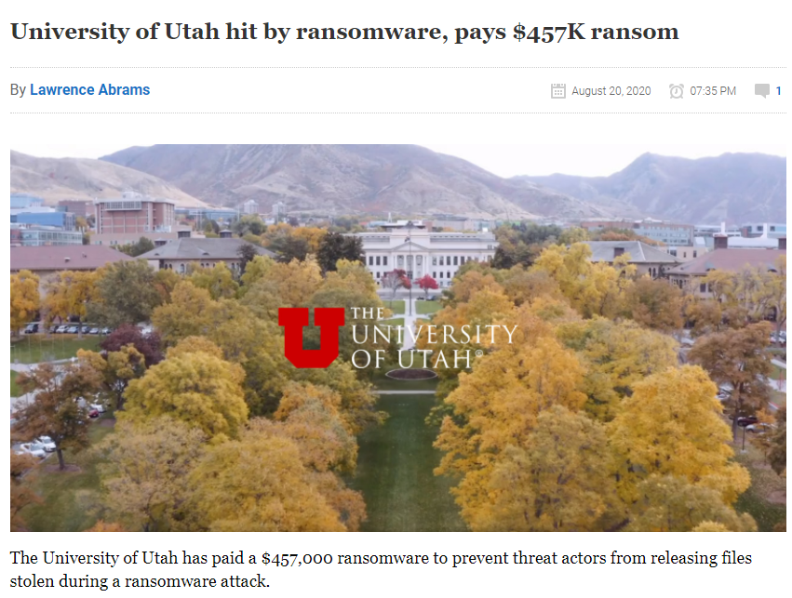
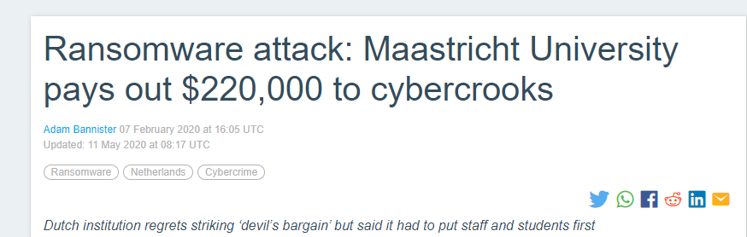
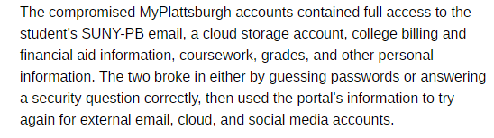
Universities & Students are targets for Cybercrime
https://www.bbc.com/news/technology-53214783
https://www.bleepingcomputer.com/news/security/university-of-utah-hit-by-ransomware-pays-457k-ransom/
https://portswigger.net/daily-swig/ransomware-attack-maastricht-university-pays-out-220-000-to-cybercrooks
https://www.theregister.com/2021/02/11/hacker_suny_pictures/
Notes:
Universities are specifically targeted by hackers & cybercriminals in attempt to gain launch ransomware across university networks or in order to steal valuable research data (Covid-19 research data is an example of this).
The examples above are of ransomware attacks from the last 12 months and these are just a sample – universities in the UK were also hit in October 2020 and a ransomware attack on Dusseldorf University Hospital led to the death of a woman in a critical condition who had to be transferred to a different hospital as the attack crippled their systems.
Students are also targeted, not just for the access they provide to a University, but also for their own valuable personal information. The example on the bottom right relates to hacking campaign carried out on students in New York, by guessing their passwords to their University portal and using that information to gain access to personal email accounts, stealing sensitive personal data.

Slide 5
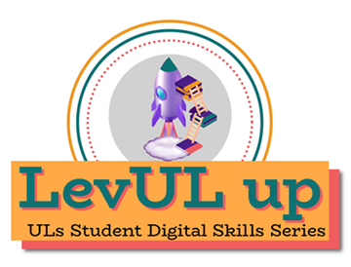
7 Steps to Stay Secure – Protecting Your Digital Identity
Practice Good Password Management
Use Anti-Virus (AV) Protection
Backup Your Data
Watch out for Phishing Emails
Keep your device & Software Up-To-Date
Use Multi-Factor Authentication (MFA)
Stay Informed
Notes:
So with that in mind, we’ve set out 7 simple steps that you can take to help keep your accounts and data secure – whether it relates to your studies in UL or if its your own personal data. Taking on-board any of the advice set out here will help you not only while in UL but also help keep your digital identity safe in the future.
For this workshop, we’ll go through the 7 steps outlined on this slide with more tips throughout – these tips are for everyone and there’s very little (if any) technical knowledge required.

Slide 6

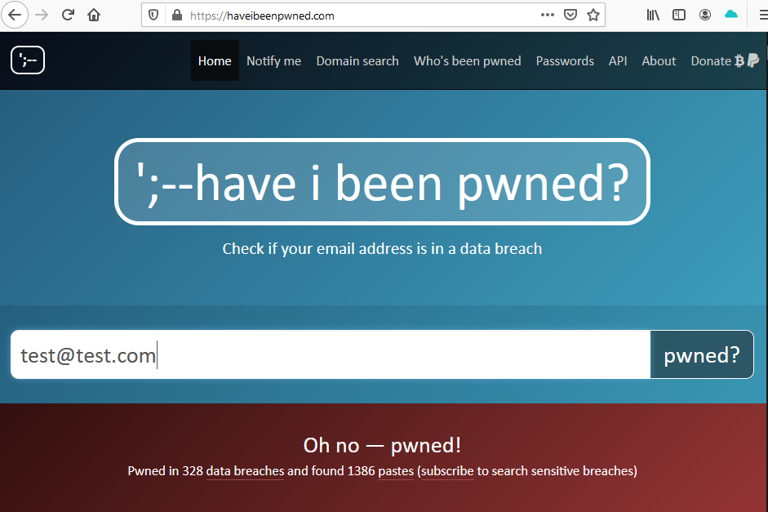
Practice Good Password Management
Use strong, secure passwords
Avoid using the same password across multiple accounts
Use a Password Manager
  Browser
  Desktop Application
Don’t share your password with anyone!
Check if your email address & credentials have been found in a previous data breach
  https://www.haveibeenpwned.com
Read UL’s Password Standard!
  https://ulsites.ul.ie/itd/node/22201
Notes:
The first tip is to Practice Good Password Management and what we mean by that is [in the first 4 bullet points
Use strong, secure passwords – that is passwords that are not easy to guess and cannot be cracked easily
Avoid using the same password across multiple accounts -> It only takes one site to be hacked to lose your password
Consider using a Password Manager – Whether it’s in the browser or application, these can be very useful
It’s also possible to check if your accounts have been identified in a previous data breach -> Have I Been Pwned is a great site for this and lets you enter an email address to see if it’s been involved in a previous data breach. As part of UL’s effort to keep students & staff safe online, we are provided with alerts when new data breaches are discovered involving UL email addresses so we can alert users.
We also have a Password Standard in UL and this governs the minimum requirements for setting passwords when using UL IT systems & resources.

Slide 7
Creating Secure Passwords
  What to Avoid:
  using things that can be guessed easily – Pa$$w0rd, L!merick01, 123456
  very similar passwords - Frid@y01, Frid@y02, Frid@y03
  using personal info – birthday as a PIN, pet’s name, favourite sports team, etc -> Someone might be able to find this information on social media!
  One method for creating strong passwords:
  Think of 3 random words that are memorable to you and use those as the basis for your password
Step | Password | Length
Think of 3 random words | tonicblanketmouse | 17
Make the first letter of each uppercase | TonicBlanketMouse | 17
Add in numbers at the start | 44TonicBlanketMouse | 19
Add in symbols between each word | 44Tonic%Blanket%Mouse | 21
Notes:
So how can we create secure passwords? By secure, we don’t mean a password that is incredibly long and so complex that you need to write it down somewhere!
Firstly, there some common things that should be avoided –
Easily guessable passwords -> This Pa$$w0rd example meets most complexity requirements but it would be one of the first things someone would guess. Using a single word and change an A to @ or I to ! would be pretty obvious and there are dictionaries and word lists available to go through millions of combinations in minutes.
Very similar passwords – Reusing a password by just changing 1 part, like Friday01 to Friday02 is easily guessable – if one of the passwords was found in a data breach then it a hacker would like try to just increase a number at the end or try similar passwords when trying to gain access to your account
Personal Info – We share lots of personal information online, across social media and other sites. If you were targeted then an attacker could gather that information through social media profiles -> This is how the criminals gained access to student accounts in the example on the first slide!
Personal Info can also be important for sites that require security questions to reset passwords or provide access. Its very easy to work out where someone was born, the city they grew up in or their favourite sports team. If you do have to set up security questions, its best to just make up answers that aren’t actually true!
One way of creating a secure password, that can’t be easily guessed or cracked, is to follow the 3 word method. The steps outlined here are just a suggestion, you can vary it whatever way you like but the end product 44Tonic%Blanket%Mouse is a very strong and unique password. You can always change this so you add numbers in the middle, symbols at the end.

Slide 8
What is a Password Manager?
Remembering lots of random, complex passwords can become very difficult! Luckily password managers can help. Password managers can store & encrypt your credentials to multiple sites, protected by a master password (and MFA in some cases).
Benefits
Only need to remember the master password -> This password has to be complex and long so that it can’t be easily guessed!!
Can suggest a random complex password when you sign up to a new website
Some password managers can be synced across multiple devices
They can warn you if a password you use has been identified in a data breach before
What Password Manager should I use?
There are lots of good password managers available (Paid & Open Source)
  LastPass
  BitWarden
  Browser based (Firefox/Chrome/Edge) -> Don’t let the browser remember your password when using a shared device!
Notes:
Benefits of a Password Manager
Since you only need to remember the master password - you can have completely random and complex passwords for different accounts without having to remember each one
Most Password Managers will suggest a secure password when you signup to a new account online – This is much easier to create random & complex passwords across all your accounts
Some Password Managers are cloud based so allow you access the encrypted passwords across multiple devices
What Password Manager should I use?
There is no need to pay for one if you don’t want, the free/open source options are just as secure as the paid options
Note: LastPass, OnePass, KeePass, BitWarden & Dashlane are just examples of Password Managers – UL doesn’t have a particular opinion on using one Password Manager over the other.
The browser based password managers in Chrome/Firefox/Edge are useful -> If you share a device you should never allow your browser to save your credentials!
Possible Questions
“How is it more secure to have all your passwords in 1 place, protected by 1 password?” – The biggest risk to a password being compromised is down to password reuse, using a password manager means all the other passwords can be completely random as you don’t need to remember them. It is critical however that the Master password is complex and not easily guessable – Some Password Managers also offer 2FA as another layer of security.

Slide 9
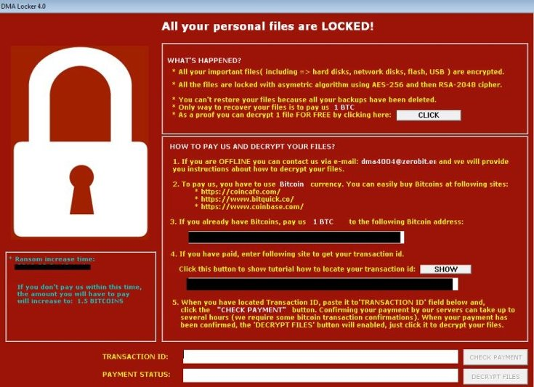
Use Anti-Virus (AV) Protection
Anti-Virus (AV) protection helps to prevent malicious programs & code (malware) running on your machine.
How does malware get on my device?
Downloading an application you didn’t realise has malicious code
Phishing emails containing links/attachments
Documents (pdf, Word, Excel) can have malicious code!
Visiting websites that redirect you to a malicious site – frequently used for people who visit sites to watch streams of sporting events
Visiting a legitimate website that has been compromised

Slide 10
Use Anti-Virus (AV) Protection
Does this mean I need to buy an AV product?
No, there are some free solutions already available that you can use.
Windows 10 - Windows Defender comes as standard and offers good protection.
macOS – Xprotect is built-in and offers protection against common threats.
Paid for AV products often offer additional functionality over basic free versions and can be useful. The most important thing is to only use tools from trusted companies!
How to make sure AV protects you:
Whatever AV tool you use, there are some simple steps will help protect you:
1 – Make sure the AV product is running! AV products will automatically update to identify the latest threats once they are running.
2 – Check that your AV is setup to scan your machine regularly!

Slide 11

Backup Your Data
Making sure you have a backup of your data is one of the most important things you can do when studying in UL.
You don’t want to find that the only copy of your thesis was stored on a laptop that has just crashed or that you actually deleted the wrong version!
OneDrive
As a student in UL, you have access to OneDrive as part of the Microsoft suite. Using OneDrive to store documents means that you will be able to access them from any device.
You can find more information in TopDesk on how to use OneDrive to protect your data.
NOTE: UL’s OneDrive is only available to students – You will lose access to it when you finish in UL!

Slide 12
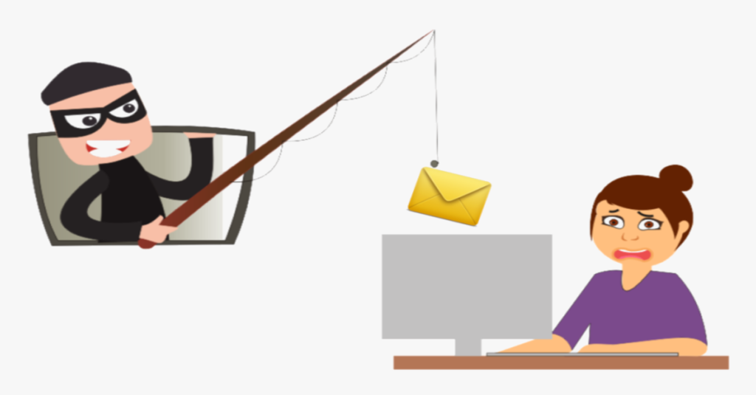
Watch Out For Phishing
  Phishing emails are an attempt to steal usernames and passwords, bank account details, credit card numbers or infect a computer with malware.
  The messages are designed to look like emails from legitimate, trusted sources and encourage recipients to click on a link or open an attachment. Some can be quite convincing but there are some steps to take to help protect yourself online.
  Basic Phishing Attacks often:
  Have generic greetings
  Request personal info such as your password or bank details
  Are short, vague or just odd
  Have unexpected attachments
  Have poor spelling or grammar
Notes:
Phishing emails are an attempt to steal usernames and passwords, bank account details, credit card numbers or other valuable information. They can also be used to infect computer systems with malware.
The messages are designed to look like emails from legitimate, trusted sources and encourage recipients to click on a link or open an attachment. Some can be quite convincing but there are some steps to take to help protect yourself online.

Slide 13
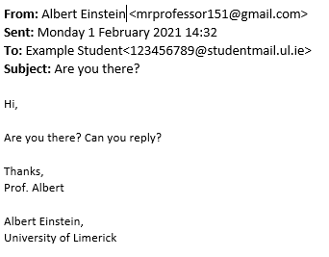
Types of Phishing Emails
Impersonating UL Staff – Ask you to arrange gift cards as an award and send them the code
What do you notice?
Email address is @gmail.com, not @ul.ie.
It’s a very short email, asking you to reply but not using your name in the greeting…..
What could you do to check if it’s real?
Contact the person at their ul.ie address and ask if they sent this.
Report it to IT so they can give you advice.
This example doesn’t contain any links – in this case they are waiting for a reply from you before asking for anything….
Tip: All emails that have been sent from outside UL’s email system will have this banner
Notes:
Phishing emails are an attempt to steal usernames and passwords, bank account details, credit card numbers or other valuable information. They can also be used to infect computer systems with malware.
The messages are designed to look like emails from legitimate, trusted sources and encourage recipients to click on a link or open an attachment. Some can be quite convincing but there are some steps to take to help protect yourself online.

Slide 14
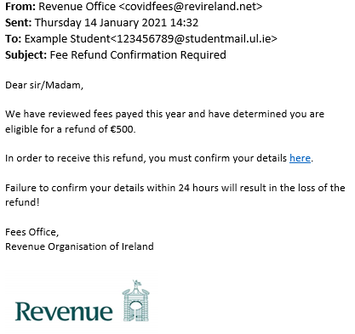

What should I look for?
Pretending that you are owed a refund – Tries to capture sensitive data if you follow the link!
What to Check
Always look at the sender’s email address (not just the Name beside it) and ask yourself –
Have I seen this email address before?
Does the domain (the bit after @) look odd (@ul.ie v @uniofl1merick.biz)?
Also watch out for spelling/grammatical errors!
Were you expecting this?
Were you expecting a refund or an email from the sender? If not, then you should be suspicious of it – if it’s too good to be true, it normally is!
Hyperlinks
Always hover over hyperlinks in emails, both in the body of the mail and in any images, before deciding to click on them. This allows you to see the true location!
Is this urgent?
It is very common for a hacker to push you into making a quick decision by saying there’s some urgency to dealing with this.
Don’t trust the logo!
It’s very easy to add an organisation’s real logo to a fake email!

Slide 15
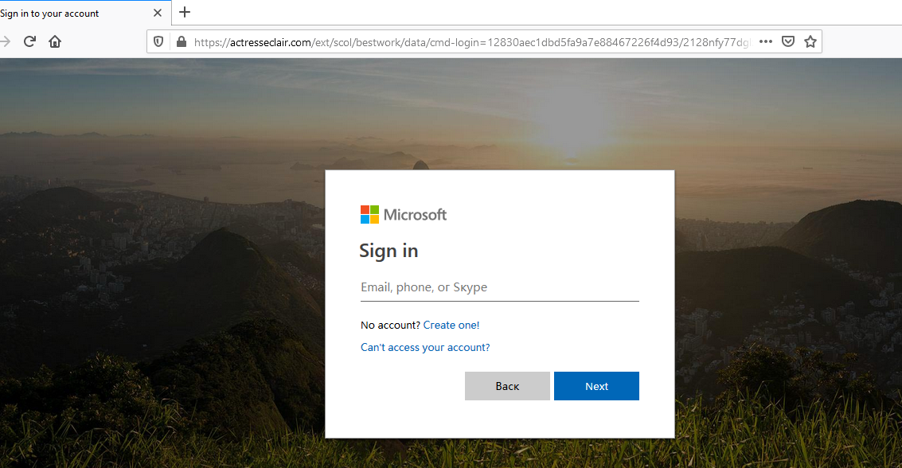
Is this a legitimate site or a phishing site?
Before entering data into a website, check the address bar look for 2 things –
1 - Do you recognise the URL? If it the page looks like a service you use but the URL is odd, then open a separate tab and google the login page.
2 – Look at the lock – if it has a red line through it then any data you provide to the site is unencrypted and insecure!
If you’re even a little unsure, DON’T enter anything.
Take a screenshot and report it to IT (along with the email you received)!
Notes:
When someone clicks on a link they are brought to a website and asked for their credentials. Some of these can look exactly like legitimate sites but the most important thing to check is the address bar at the top.
This example looks exactly like the site you would go to in UL to login to access office.com, except it’s a fake site created to steal credentials

Slide 16
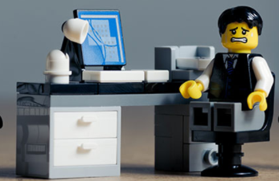
I might have clicked on a phishing email….
What should I do?
It’s quite common for people to only realise an email or website was suspicious afterwards.
You should always report a phishing mail or suspicious website to ITD so that we can help protect your account, data and everyone else in UL.
If you have given away your credentials or clicked on a link – Reporting it means ITD can take steps to protect your account.
If you receive a suspicious email – Reporting it means ITD can remove the email from every mailbox in UL and prevent it going to anyone else.

Slide 17
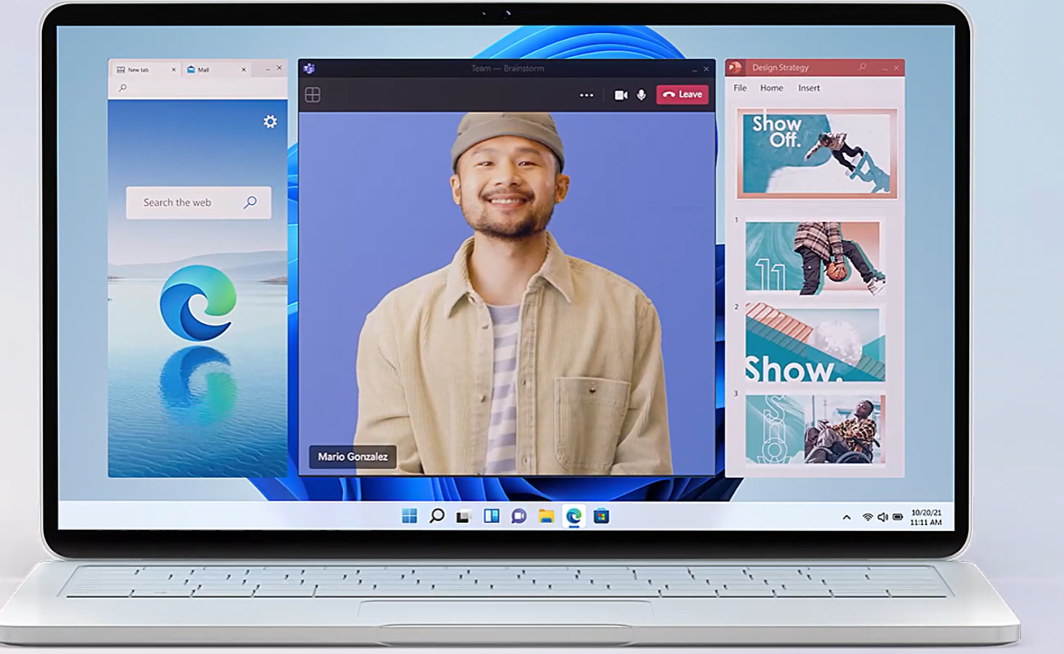
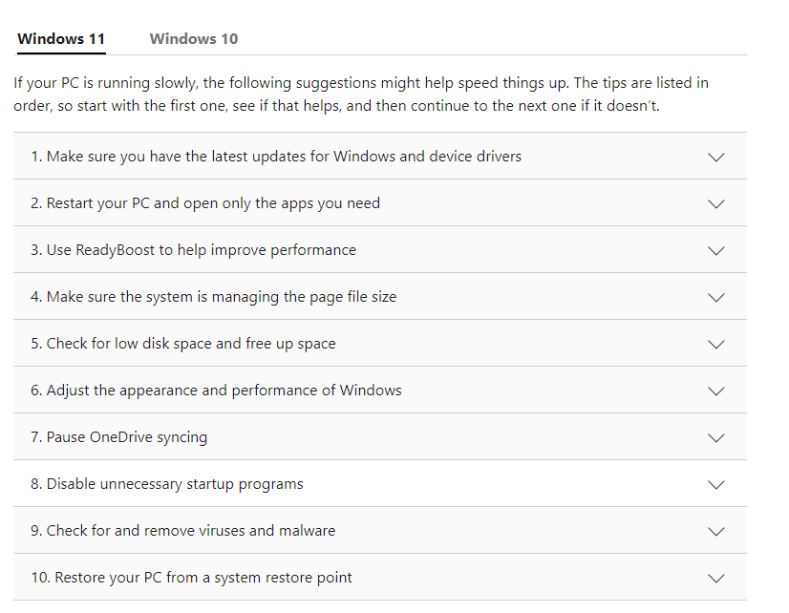
Tips to improve PC performance in Windows
Tips to improve PC performance in Windows (microsoft.com)
Disclaimer: ITD do not Support Personal Devices
Notes:
Click on Web link to show the MS page

Slide 18
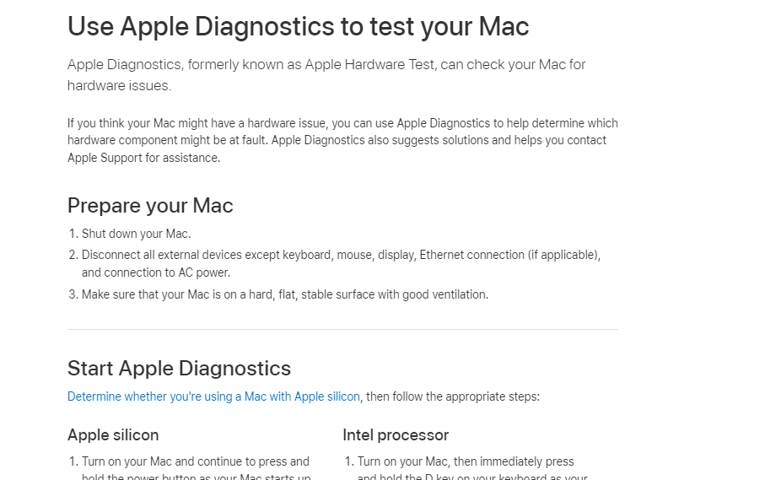

Tips to improve Mac performance in Mac OS
Use the official Apple Diagnostics tool to test your Mac and ensure it is running efficiently
https://support.apple.com/en-ie/HT202731
Disclaimer: ITD do not Support Personal Devices
Notes:
Click on link to show Apple page

Slide 19
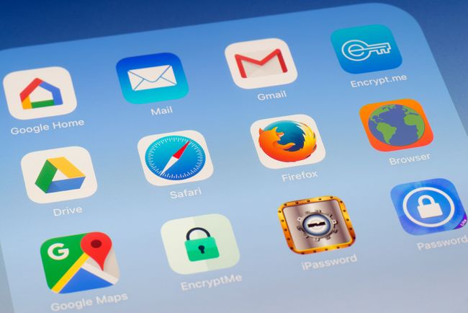
Keep Software Up-To-Date
Security experts and hackers discover new security flaws in software all the time. Manufacturers update their software to fix all the security weaknesses they know about. You need these updates to remain protected.
Keep computers & devices up-to-date
All manufacturers will eventually stop supporting older Operating Systems. Manufacturers will announce well in advance when they plan to do this, so make sure you upgrade to a supported Operating System.
Devices that are no longer supported will be vulnerable to any security flaws that are discovered from then on, as the manufacturers will not provide any fixes to those devices!
How do I keep my device up-to-date?
Luckily most modern Operating Systems (Windows 10/Apple Mac) will tell you when there are new updates waiting to be installed and these can be scheduled for when you’re not using the device.

Slide 20

Be careful what you install!
Even with your Operating System up-to-date, that doesn’t mean your system is secure from vulnerabilities.
One of the most common ways for a hacker to gain access to your system or data is through software you install without realising it has been developed with backdoors.
These can range from “free” VPNs tracking your activity and selling the data to applications that provide remote access to your machine!
Tips to help keep your device safe
Only install applications that come from reputable sources
  For example, avoid downloading free/cracked applications from torrent sites
Uninstall applications you no longer need
Make sure your AV is up-to-date & running!
Only download apps onto your phone from official sources (App Store/Google Play)

Slide 21
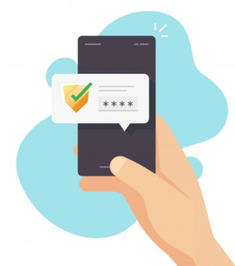
Use Multi-Factor Authentication (MFA)
MFA is one of the most effective protections when it comes to protecting your digital identity.
It works by requesting a second piece of information when someone logs onto a service, normally a code or notification from a device already associated with the account.
Even if credentials are lost, your account is still protected as the second item is still needed.
Always enable MFA whenever possible!
MFA is in place for students in UL – you can find more info on it on the ITD Website under Password Management | University of Limerick (ul.ie)

Slide 22
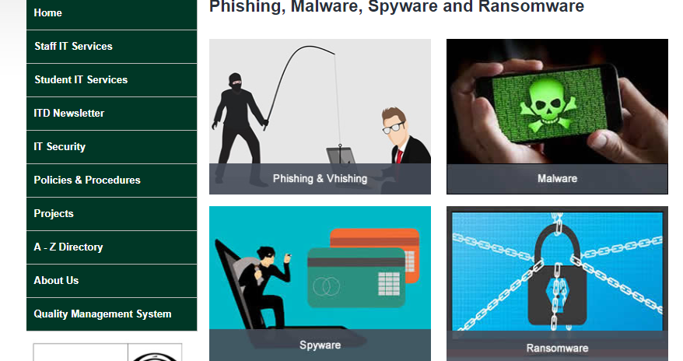
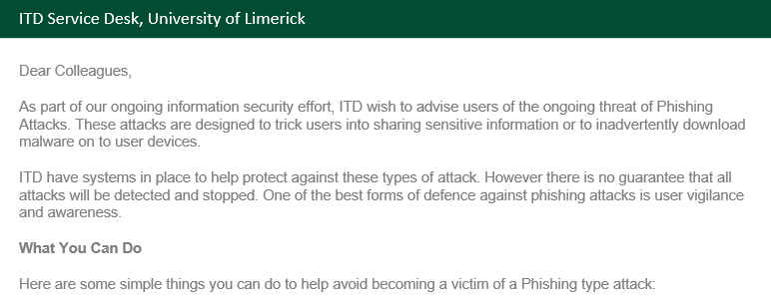
Stay Informed
  ITD provide information to staff & students on an ongoing basis to help keep you informed of the latest threats and how to protect yourself.
  UL Website – ITD Security Section
  Email – Security Notifications (Active Phishing Threats/Potential Credential Theft)
  IT Policies & Procedures – These govern how UL IT systems should be used
  Cybersecurity Training – Available on Sulis

Slide 23
Raise a ticket by logging a call at https://ul.topdesk.net
If you have any issues, please contact ITD (Information Technology Division). Tell us as much information as you can i.e., location, room, device, software and version etc. This will help us to improve our service to you.

