Slide 1
UNIVERSITY OF LIMERICK
Additional Voluntary Contribution Plan - AVC
Not Peer Reviewed
September 2016
Tom O’Halloran & Jim O’Neill

Slide 2
WHAT WE’LL COVER TODAY
How do the Plans work?
Why should you consider making AVCs?
What are your benefits from the AVC Plan?
Do you need to make investment decisions?
How can we help you make the right decisions?
This presentation does not provide you with personal financial advice in relation to your investment choices
PLEASE NOTE!

Slide 3
WHAT YOUR AVC PLAN DOES FOR YOU
Enables you to save to maximise your retirement lump sum
Allows you increase your regular income in retirement
Pay less tax: you get tax relief on your AVCs
Tax free investment growth
N.B. It is important to understand your main scheme retirement benefits when considering making AVCs

Slide 4
WHO’S WHO?
TRUSTEES: Irish Pensions Trust Ltd
Act within the terms of the Deed and Rules and also act in the best interest of the members
ADMINISTRATOR: Irish Life
Responsible for day-to-day administration of the Plan
Hold records, produce benefits statements, produce annual report
INVESTMENT MANAGER: Irish Life
Invest & manage monies in your retirement Plan for you
CONSULTANT: Mercer
Advisor to the employer and to the members

Slide 5
YOU!
YOU
decide if you should make AVCs
YOU
decide how to invest your savings
YOU
choose your benefits

Slide 6
GETTING STARTED
HOW DO THE PLANS WORK?

Slide 7
HOW DOES PLAN WORK?
THE AVC PLAN
Your AVCs are invested with aim of growing in value over time
The value of your AVC Account is used to buy your choice of benefits
AVC PLAN
CASH LUMP SUM
ENHANCED
INCOME
ARF / AMRF
OR
OR
LUMP SUM
LUMP SUM
MAIN PLAN
INCOME IN RETIREMENT
INCOME IN RETIREMENT
CASH LUMP SUM
&
Pre- retirement
Post retirement

Slide 8
Maximum Gratuity
EXAMPLE
  Salary € 80,000
  Service 30 Years
  Gratuity € 80,000 X 3/80 X 30 = € 90,000
  Revenue Maximum €120,000
  Shortfall € 30,000
  Solution
  Build An AVC Fund Of € 30,000 And Take It Tax Free At Retirement
  Only possible if less than 40 years pensionable service
  Revenue maximum check in all cases but especially for Cost Neutral Early retirement
  Overall lifetime limit of €200,000

Slide 9
STEP 1
CONTRIBUTING AVCs

Slide 10

CONTRIBUTING TO THE PLAN
GETTING TAX RELIEF
You get tax relief at your marginal rate
How much would it cost you to contribute €100?
Higher Rate Tax Payer:
40%
Standard Rate Tax Payer:
20%
Notes:
One of the most obvious and immediate advantages of saving to the Plan is that you get income tax relief on your contributions at your marginal rate.
Your contributions are paid at source, so they come out of your Salary before any tax is deducted.
So, how much would it cost you in terms of take home pay to contribute e100?
If you are on the higher rate of income tax, currently 40%, for every 100 euros invested in the plan, 40 euro of the contribution is covered by tax relief, and you only have to pay 60 in terms of take home pay.
If you are on the lower rate of income tax, currently 20%, for every 100 euros invested in the plan, 20 euro of the contribution is covered by tax relief, and you only have to pay 80 in terms of take home pay.
Even before you take investment into account that’s the equivalent of an immediate return of 67% or 25% respectively compared to investing your after tax salary in a private savings account.
226649 10/05

Slide 11
CONTRIBUTING AVCs
You can make regular AVCs – a percentage of your Salary or an amount each month
and/or
You can make a once-off AVC payment – often used to maximise your tax savings for the year
Notes:
226649 10/05

Slide 12
CONTRIBUTING TO THE PLAN
MAXIMUM LIMITS FOR TAX RELIEF
You may pay contributions up to the Revenue limits, in any one tax year. The current Revenue limits are:
AGE | PERCENTAGE OF TOTAL TAXABLE INCOME
Up to 29 | 15%
30-39 | 20%
40-49 | 25%
50-54 | 30%
55-59 | 35%
60+ | 40%
Current earnings cap of €115,000 for tax relief applies.

Slide 13
STEP 2
GROWING YOUR ACCUMULATED AVCs

Slide 14
The longer you wait to make AVCS, the less time your savings have to grow
Savings €96,091
Income €3,844 p.a.
Yellow contributes
€5,000 p.a.
from age 50
Blue contributes
€3,000 p.a.
from age 40
Both members contribute
€75,000
total AVCs
Savings €86,467
Income €3,459 p.a.
40
45
50
55
60
65
Assumptions: Total AVCs €75,000, Annual real investment return 2%, drawing down at age 65, Annuity Rate 25:1
Notes:
Now, you may be thinking of making AVCs, but maybe not just yet… But remember, that the longer you wait to make AVCs the more it will cost you to achieve the same savings goal. The longer you wait, the longer you are missing out on the cumulative effect of investment returns.
Let’s compare two members, both of whom contribute the exact same amount of money over time.
Mr Yellow decides to delay making AVCs until age 50. He contributes a total of 5000 euro each year. By the time he retires at age 65 he will have built up savings of e100,000. If he takes all of that as a regular income it would be worth e4000 each year.
Mr Blue, however, starts making AVCs at age 40. Contributes just e3000 each year. His contributions have more time to grow and by the time he retires at age 65 he has built up savings of e125,000, which would provide an income of e5000 each year.
So, by starting to contribute earlier Mr Blue actually contributes less on a year by basis, but he still ends up receiving a greater final income from his contributions.

Slide 15
WHAT SHOULD YOU CONSIDER WHEN MAKING INVESTMENT DECISIONS?
Your personal circumstances
Your investment timeframe
Your attitude to risk
Your attitude to short-term loss
Your retirement objectives
Do you know which fund(s) your contributions are invested in?
Notes:
There are no right or wrong investment decisions. The most important thing is that you choose what you are comfortable with and that you understand the implications of your choices.
Your investment choices are your personal choices – you need to consider how close you are to retirement, how you feel about the chance of losing money in the short-term and overall, what your retirement objectives are….

Slide 16
GROWING YOUR RETIREMENT ACCOUNT
THE FUNCTION OF DIFFERENT INVESTMENT OPTIONS
GROWTH OPTIONS
are more volatile but potentially generate more return
CONSERVATIVE OPTIONS
are less volatile and potentially generate lower returns

Slide 17
CHOOSING INVESTMENTS FOR YOUR TIME TO RETIREMENT
RISK AND REWARD OVER TIME
It’s important to aim for growth in the long term
And equally important to protect your savings as you approach retirement
It can be good practice to reduce risk as you get close to retirement
What if you were retiring here?

Slide 18
STEP 3
SELECTING YOUR BENEFITS

Slide 19
SELECTING YOUR BENEFITS
WHEN YOU RETIRE
Use the value of your Accumulated AVCs to fund a combination of benefit options, where applicable:
Additional Tax Free Cash Lump Sum*
Additional tax free Cash Lump Sum* + Enhanced retirement Income
Additional Tax Free Cash Lump Sum* + Balance invested in an Approved Retirement Fund
* Up to maximum revenue limits allowable

Slide 20
SELECTING YOUR BENEFITS
WHEN YOU RETIRE
Use the value of your Accumulated AVCs to fund a combination of benefit options, - Maximise Cash lump sum
AVC
ACCOUNT
VALUE
CASH LUMP SUM
AVC PLAN
ARF / AMRF
CASH LUMP SUM
MAIN PLAN
INCOME IN RETIREMENT
CASH LUMP SUM
&
RETIREMENT BENEFIT OPTIONS

Slide 21
SELECTING YOUR BENEFITS
WHEN YOU RETIRE
Use the value of your Accumulated AVCs to fund a combination of benefit options, Cash plus income (annuity)
AVC
ACCOUNT
VALUE
ENHANCED
INCOME IN RETIREMENT
AVC PLAN
CASH LUMP SUM
ARF / MRF
+
MAIN PLAN
INCOME IN RETIREMENT
CASH LUMP SUM
&
RETIREMENT BENEFIT OPTIONS

Slide 22
SELECTING YOUR BENEFITS
WHEN YOU RETIRE
Use the value of your Accumulated AVCs to fund a combination of benefit options, Cash plus ARF / AMRF
AVC
ACCOUNT
VALUE
ARF / AMRF
AVC PLAN
CASH LUMP
SUM
ARF / MRF
+
MAIN PLAN
INCOME IN RETIREMENT
CASH LUMP SUM
&
RETIREMENT BENEFIT OPTIONS

Slide 23

LINK BETWEEN INVESTMENT CHOICES AND RETIREMENT BENEFITS
ARF / AMRF
Cash
Annuity
Investment strategy should reflect your likely retirement benefits
Pattern of retirement benefits in Ireland:
  Everyone takes a cash lump sum
  Many purchase an annuity
  Some stay invested via an Approved Retirement Fund (ARF)
Your investment strategy should facilitate safe arrival at
your chosen destination

Slide 24


GROWING YOUR RETIREMENT ACCOUNT
TWO APPROACHES TO INVESTMENT
I’m not
interested in making investment decisions, I just want someone to
DO IT FOR ME
I already
have experience making investment decisions and want you to
LEAVE ME TO IT

Slide 25
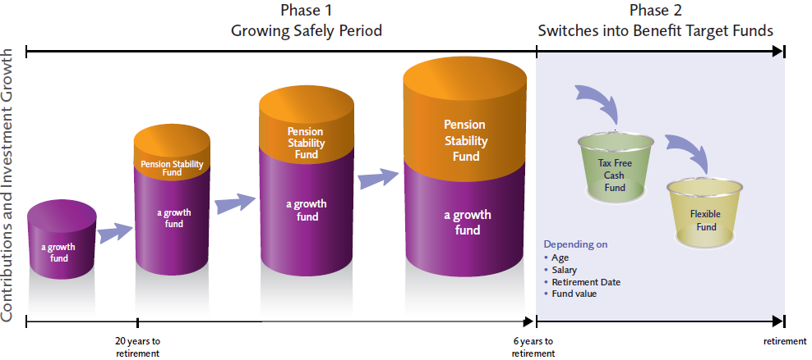
Personal Lifestyle Strategy

Slide 26
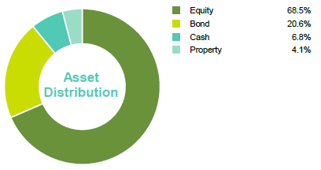
Consensus Plus Fund
Key Fund Characteristics
The Consensus Plus Fund is a passively managed fund that aims to provide performance that is consistently in line with the average of all managed funds in the Irish marketplace.
The assets of the fund are predominantly invested on a consensus basis, replicating the average asset allocation of the Irish fund management industry.
The remainder of the fund is invested in other assets to help improve the investment diversity of the fund.
It is suited to those investors who want long-term managed fund growth with reduced manager and stock selection risk. The fund is considered a high risk fund for short term investors e.g. 10 years or less.
However, generally the longer investments are held the less volatile they become, so the fund is considered medium risk for longer term pension investors.
Returns to 31 December 2015 | YTD | 1 Year | 3 Year p.a. | 5 Year p.a.
Fund | 8.02% | 8.02% | - | -
Composite Benchmark | 8.90% | 8.90% | - | -
Fund Returns are net of management fees
Benchmark returns do not take account of management fees or Dividend Withholding Tax
Past performance is not be a reliable guide to future performance.

Slide 27
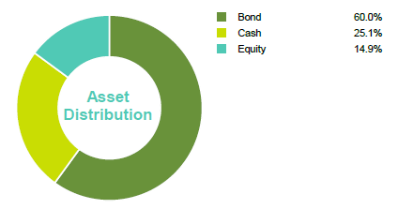
Pension Stability Fund
Key Fund Characteristics
The Pension Stability Fund is mainly invested in bonds with the balance in equities, cash and alternative assets. There may be some movement between cash and equities depending on market conditions.
This is a low risk fund. It is suitable for investors who are getting closer to retirement or have a medium appetite for risk.
Returns to 31 December 2015 | YTD | 1 Year | 3 Year p.a. | 5 Year p.a.
Fund | 1.7% | 1.7% | 2.9% | 3.2%
Composite Benchmark | 2.3% | 2.3% | 3.5% | 3.8%
Fund Returns are net of management fees
Benchmark returns do not take account of management fees or Dividend Withholding Tax
Past performance is not be a reliable guide to future performance.

Slide 28
Tax Free Cash Fund (PLS TFC Fund)
Key Fund Characteristics
Investment Philosophy Capital Security
Investment Process Deposits placed with highly rated counterparties (A- or better)
Monitoring Process Daily analysis of counterparty credit ratings
This fund can be used to protect the values of member’s funds against market movements
Returns to 31 December 2015 | YTD | 1 Year | 3 Year p.a. | 5 Year p.a.
Fund | -0.69% | -0.69% | -0.49% | -0.26%
Benchmark | -0.15% | -0.15% | 0.01% | 0.36%
Fund Returns are net of management fees
Past performance is not be a reliable guide to future performance.

Slide 29
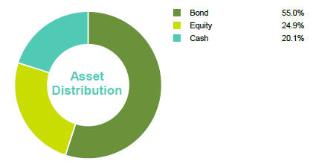
Flexible Fund
Key Fund Characteristics
The Flexible Fund is mainly invested in bonds with the balance in equities, cash and alternative assets. There may be some movement between cash and equities depending on market conditions.
This is a medium risk fund. It is suitable for investors who are getting closer to retirement or have a medium appetite for risk.
Returns to 31 December 2015 | YTD | 1 Year | 3 Year p.a. | 5 Year p.a.
Fund | 1.95% | 1.95% | 3.67% | 3.60%
Composite Benchmark | 2.63% | 2.63% | 4.40% | 4.63%
Fund Returns are net of management fees
Benchmark returns do not take account of management fees or Dividend Withholding Tax
Past performance is not be a reliable guide to future performance.

Slide 30
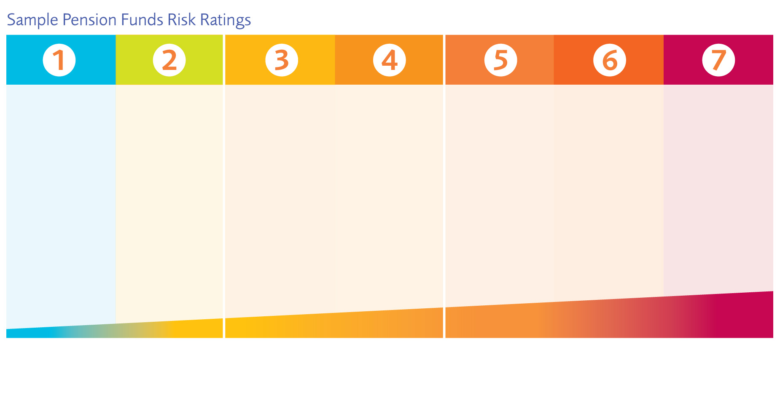
Funds available
Tax-Free
Cash Fund
Flexible
Fund
Pension for Life Fund
Global Consensus Fund
Indexed 50/50
Equity
Consensus Cautious Fund
Active Managed Fund
Active 50/50 Fund
Factsheets available at www.irishlifecorporatebusiness.ie

Slide 31


Keeping on track....
Goal-setting and Retirement Planning Tools

Slide 32

www.pensionplanetinteractive.ie

Slide 33
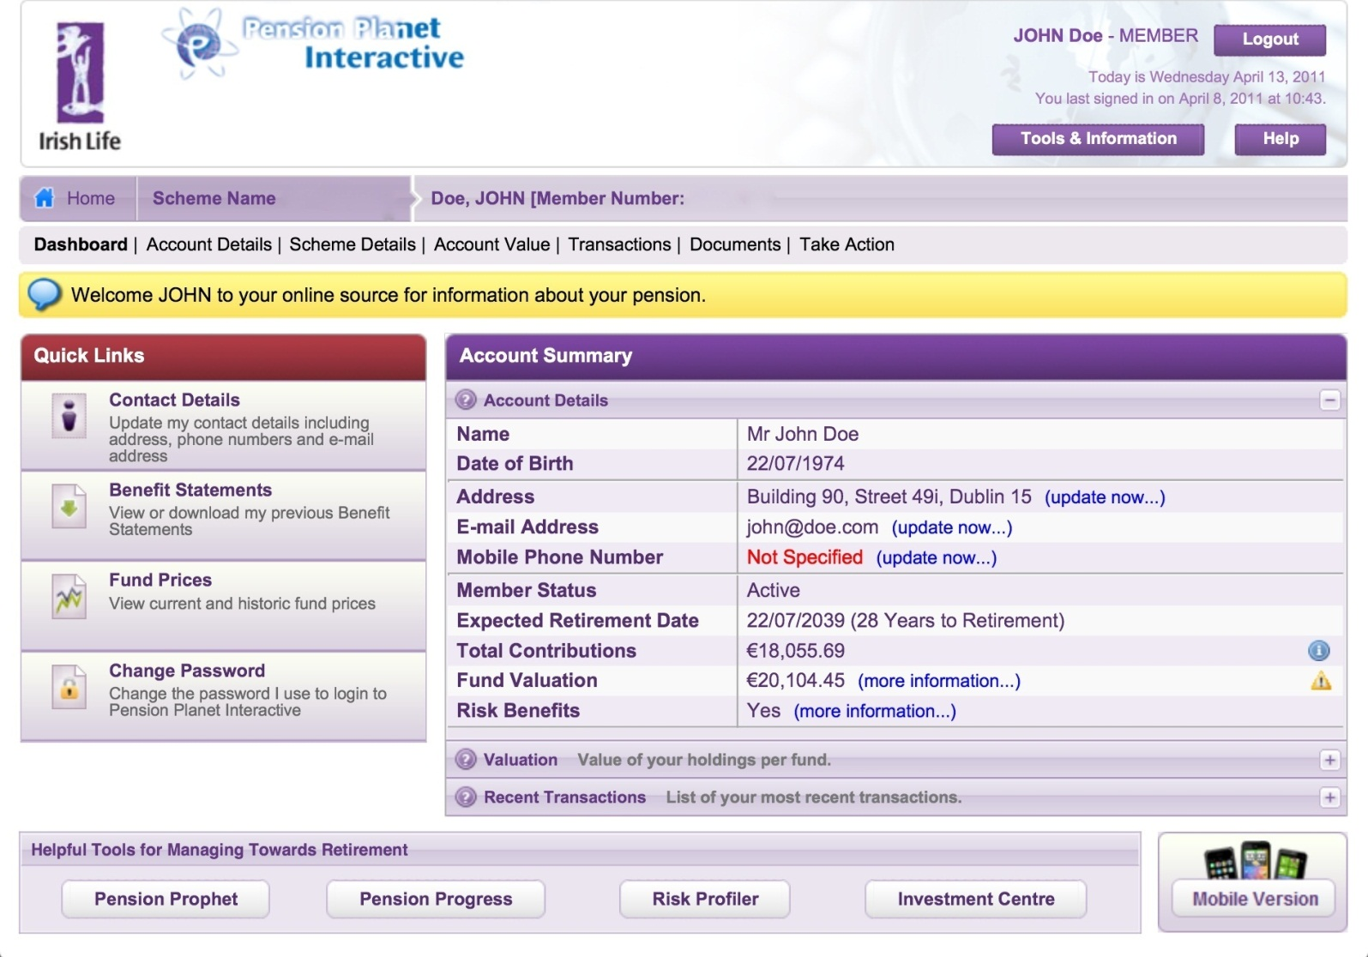
www.pensionplanetinteractive.ie

Slide 34
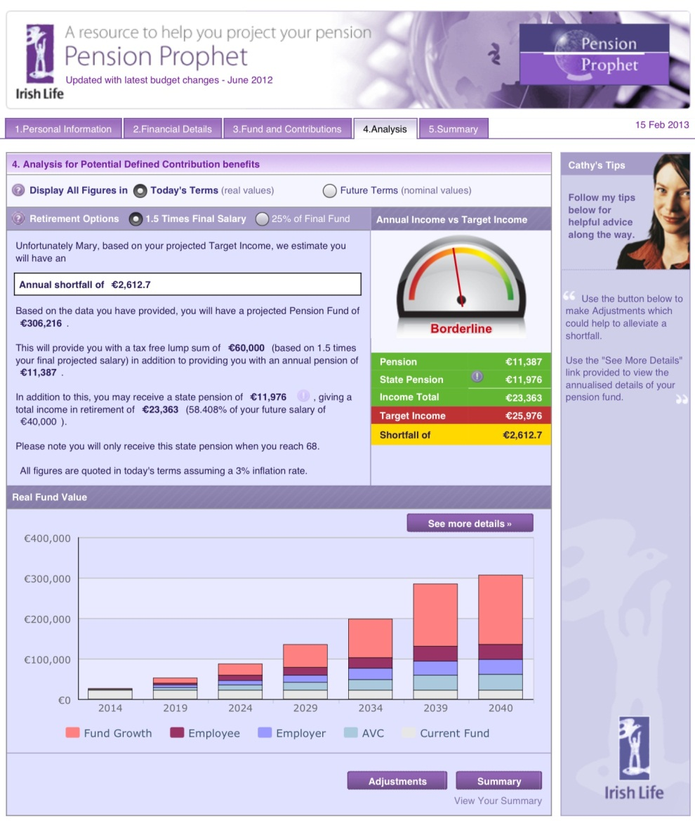
www.pensionprophet.ie
Estimated figures in terms of money today
Works out your Lump Sum
Includes State Pension to show overall income in retirement
Notes:
Lin
H
In

Slide 35
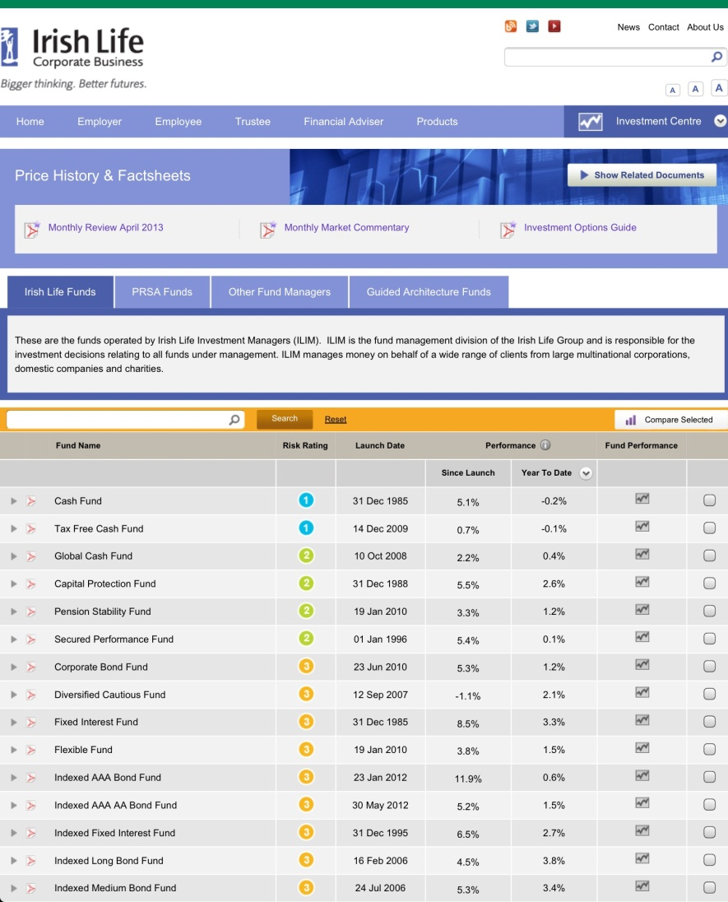
www.irishlifecorporatebusiness.ie
Investment Centre
Factsheets for all funds
Fund Performance Figures
Market Commentaries

Slide 36


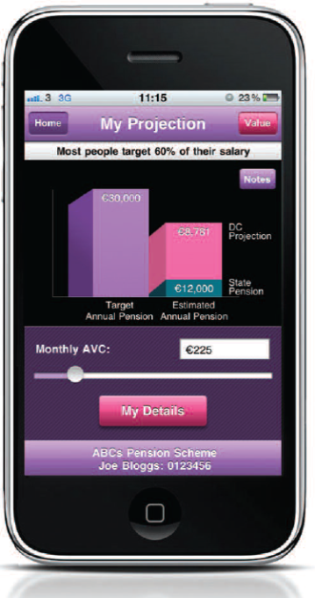
My Pension App
Free to download from the App Store or mypensionapp.ie

Slide 37

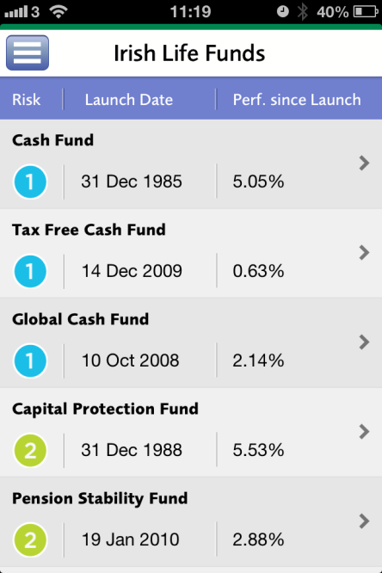
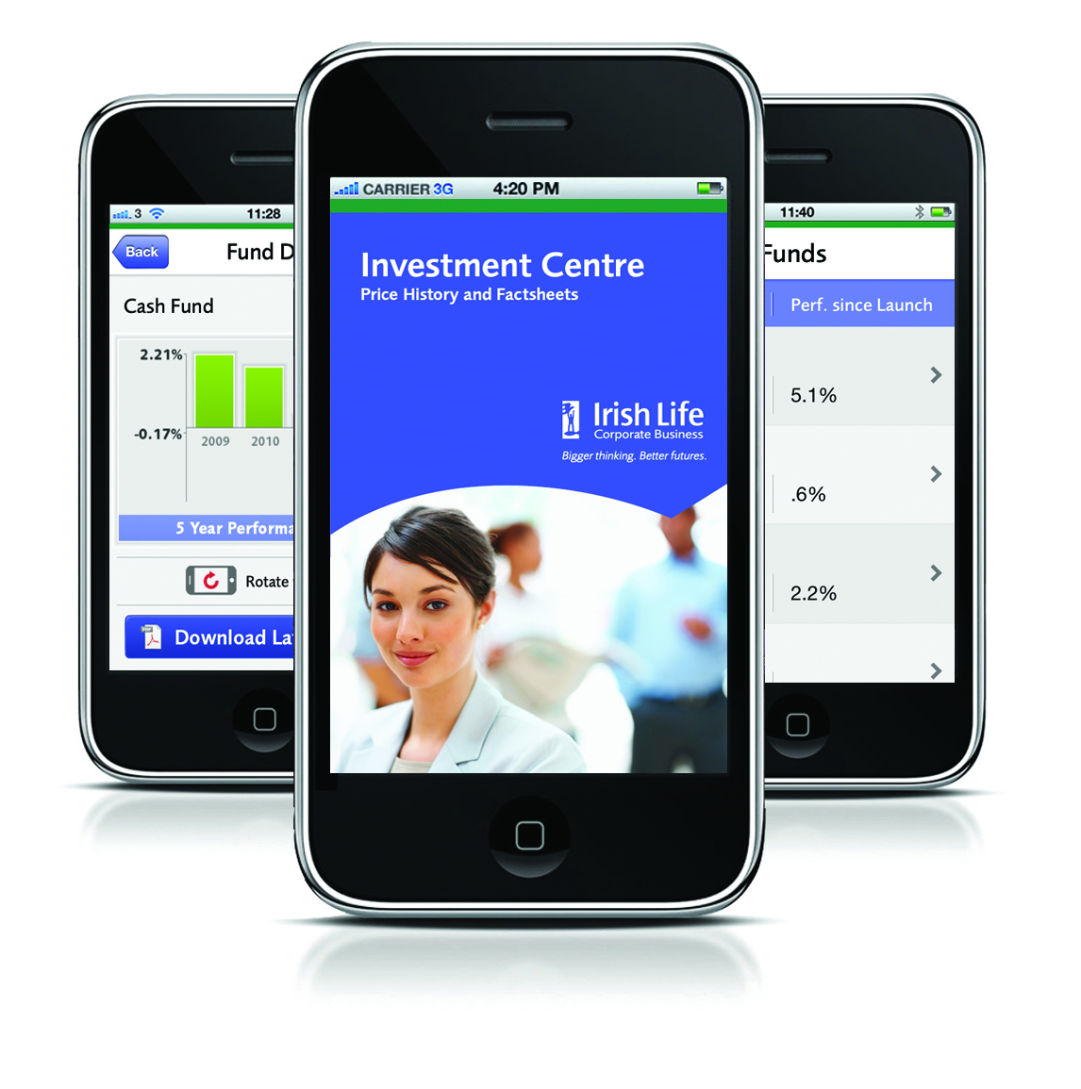
New Fund Centre App
The new investment app called “Fund Centre” is now available for Apple and Android devices
Quick access to stay up to date
Fund performance and charting tool
Factsheets
Add funds to your favorites
Search facility

Slide 38



My Projection
Estimated value of your fund at retirement
Estimated pension at retirement
Impact of making AVCs

Slide 39

The key to success....
What income do you want in retirement
Find out are you on track
Do you need to save more?
Review from time to time to ensure you stay on track!

Slide 40
OVER TO
YOU!

Slide 41

Mercer (Ireland) Ltd., trading as Mercer, is regulated by the Central Bank of Ireland. Registered Office: Charlotte House, Charlemont Street, Dublin 2. Registered in Ireland No. 28158.
Directors: Tom Geraghty, Vincent Sheridan, Tom Brennan.

