Slide 1
Introduction to
Performance & Development Reviews

Slide 2
Purpose of the Workshop
An overview of the Performance and Development Review System (PDRs) in UL
The process involved – from a Reviewee perspective
Reviewer Sessions – available separately

Slide 3
Purpose of the Workshop
Aligning University/Faculty/Division/Team/Individual Objectives.
Promoting a culture of continuous Improvement.
Understanding roles and expectations.
Supporting personal development.
Developing critical competencies – Competency Framework and Role Profiles.

Slide 4
The PDRs Review Cycle
The PDR Review Cycle
1
UL Strategic Plan
2
Faculty/Division Objectives
4
Individual Objectives
3
Team Objectives
Individual Objectives and Development Plan
Plan
Coach
Review

Slide 5
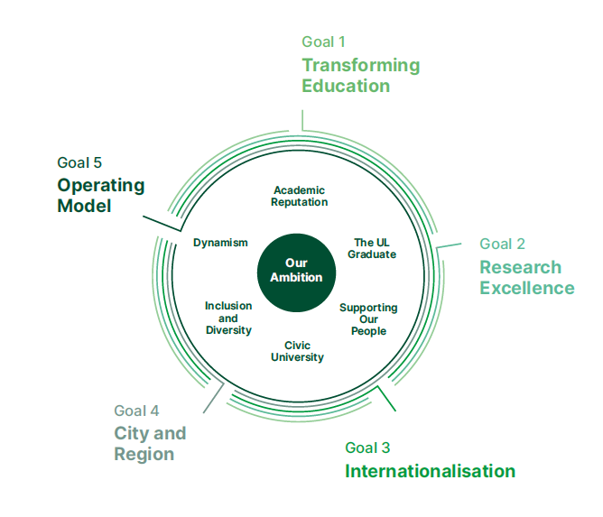
Strategic Plan – UL@50

Slide 7
Three Stages
Prior to the review. Preparation and documentation.
The review meeting.
Post review follow through and implementation.
Looking back and looking forward.
The first meeting is a planning meeting.

Slide 8
Objectives of the Review Stage
Formally review performance of previous 12 months on targets and competencies.
Discussion based on achievement of Targets and display of competencies
Agree targets for following 12 months.
Agree changes to competencies (if necessary).
Agree training and development plan for next cycle.

Slide 9
Exercise
What are the benefits of an effective PDRs?
The organisation
The manager
The individual

Slide 10
Purpose of PDRs
Recognise Achievements
Promote Communication
Good management practice
Set goals
Aid to performance
Provide clarity
Have consistent management practices.

Slide 11
Benefits
Communication
Increased awareness
Provides an overview
Aligns personal and departmental objectives
Highlights problems
Identifies training needs
Increases efficiency
Improves morale
Improves quality of services
Permission to change culture
Communication
Increased awareness
Provides an overview
Aligns personal and departmental objectives
Highlights problems
Identifies training needs
Increases efficiency
Improves morale
Improves quality of services
Permission to change culture

Slide 12
Challenges?

Slide 13
Challenges?
Time
Fear of Exposure
Fear of Criticism
Conflict
Unrealistic Expectations

Slide 14
Who?
All staff with the exception of those who will be retiring within one year.
Who Will Conduct the Review?
- Deans or Head of Department
- Division Director, Department Manager/Supervisor – i.e. the person you report directly to.
- Other appropriate nominated reviewers

Slide 15
Number of Meetings
One Formal Meeting per annum
Year 1 - Planning Meeting – Looking Forward
Year 2 – Review of Performance against agreed objectives and agreement on objectives for year ahead- Look back & forward.
Development Plan reviewed and new plan agreed.

Slide 16
Role of the Reviewer
Appeal to the Head of Department or the next most senior member of staff i.e. The reviewer is your Manager’s Manager and may be involved in your 1-1 meeting if required.
Requested in place of the Manager where there is a specific problem.
Reviewee and Reviewer cannot agree objectives- Reviewer can help the manager and jobholder reach agreement if necessary (i.e. act as a mediator).
Remain objective in the process.

Slide 17
Exercise
Identify what you feel are the responsibilities of the following people, to ensure the effective implementation and use of the PDRs process:
Responsibilities of the Jobholder
Responsibilities of the Manager

Slide 18
Individual
Be positive about PDR system
Be actively involved in the process
Be assertive but not aggressive
Define your own job clearly
Be clear on what is expected of you in your role
Identify your own development requirements
Review your own progress on an ongoing basis
Show initiative
Be flexible and open to change
Communicate openly with colleagues & managers

Slide 19
Manager
Be positive about PDR system
Encourage an open supportive climate – promote two way communication
Be assertive
Work with staff to develop the department/team work plan
Clearly communicate the team objectives
Complete and agree performance and development plans with individuals
Prepare an overall training and development plan for the section
Monitor progress, coach and support their staff
Maintain up to date documentation/records supporting the process
Involve team in agreeing Division/Department plans
Negotiate time and budget for development of staff.

Slide 20
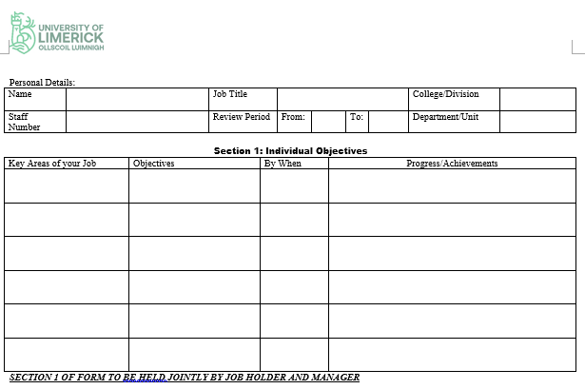
The Form

Slide 21
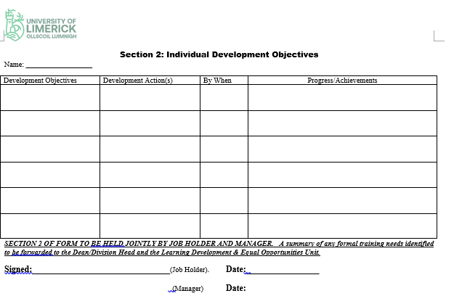
The Form

Slide 22
What Needs to be in Place Before Embarking on the Planning Process?
- A Faculty/Division Plan which has been translated into Section Plans
- A commitment to the PDRs process by the management team and staff
- An environment of participative consultative management
- A thorough understanding of the PDRs process by all staff and management

Slide 23
Why Set Goals?
To deliver organisation performance
To stretch and challenge individuals
To link an individual's performance to the achievement of higher goals.
To promote a means for measuring progress
To focus behaviours
To motivate and develop the individual
Focus on the outcome, not the activity.
Difference between goals and objectives.

Slide 24
Action Plans
Must be owned by reviewee:
Setting objectives
- Specific Measurable Attainable Relevant Timebound
Identify action strategies
Assess action strategies
Reviewee formulate plans with support
Reviewee implement plans with support

Slide 25
PDR Planning
Objective 1
Objective 2
Objective 3
Objective 4
What we do
Individual
Objectives
Results
The Job
Examples:
Strategic Thinking
Communications
Continual Improvement
How we do it
Development Objectives

Slide 26
Exercise
Using the information gathered in the previous step, write 1 objective that you need to accomplish in your role setting out the following:
Strategic Goal it links to
The Department Goal
The measurable outcome and
The target date to be completed.

Slide 27
What Should an Effective PDR Meeting Look Like?
Research Student Pathway

Slide 28
What Should a Good PDR Meeting Look Like?
Good body language
2 way communication
Honest & Truthful
Private meeting place – adequate time & space
Both parties prepared
Neutral venue
Structured
Clarity, no vagueness
Conflict – dealt with honestly, openly & constructively
Be prepared to take and give feedback.
Have an agenda
Set ground rules
Draft documents circulated in advance
Shouldn’t be negative/personalised
Focused – keep to the point
Sincere – both sides willing to engage

Slide 29
In Advance of the Meeting
Set time aside in advance of the review meeting.
Complete a self review and draft form setting out progress made on targets.
Where satisfactory progress has not been made, honestly review the reasons for lack of progress.
Review whether you have displayed the competencies required for the job.
Be clear on your department’s objectives.
Consider specific objectives that you would be seeking to achieve in your job to contribute to the department meeting those goals, and what you may need from your manager to enable you to meet these objectives.
Think about your own development – what do you need and what are the best strategies for this development?

Slide 30
Competency Frameworks and Role Profiles
A common definition is that competencies are:
Clusters of behaviours, skills and knowledge which are needed to undertake a job effectively.
Competencies are a signal from the organisation to the individual of the expected important areas and levels of performance.
They provide the individual with a map or indication of the behaviours that will be valued
They provide a transparent process where differences between grades are transparent.

Slide 31
Common Learning Strategies
On the job Training
Examining precedents
Lunchtime presentations
Press cuttings
Website
Library
One to one coaching
Additional Assignments/ Project work
Rotational Assignments
Shadowing another performer
Further study
Erasmus support for overseas visits.

Slide 32
Receiving Feedback
Be open: to learning and change;
If unclear, ask for explanations & examples;
Summarise briefly to check understanding;
Check validity with personal assessment;
Check with other sources if needed;
Be assertive, not defensive or aggressive.

Slide 33
After the Meeting
Book development plans items into your diary and book agreed formal training programmes.
Review your objectives and develop plans as to how you will go about attaining these objectives.
Follow through on any commitment given during the planning meeting.
Documentation is held between you and your manager. Development objectives are returned to HR.

Slide 34
Remember….
You are entitled to this time for a 1-1 meeting with your manager
You are entitled to expect open and honest feedback
Your meeting should be conducted in a professional and appropriate manner
Issues – refer to Dean/HOD or HR.
Information http: www.ul.ie/hr - Learning and Development
ANY QUESTIONS?

