Slide 1
👋 Hello & Welcome
⏳ This session will begin shortly.
While you wait, please download the slides for today’s session from the LevUL up website.
In association with:

Slide 2
Designing Digital Presentations: Level-up your PowerPoint game
David Moloney

Slide 3
Who we are
​ | Jasmine Ryan UL Student Associate Intern, Enhancing Digital Teaching and Learning (EDTL) project, Centre for Transformative Learning​
​ | David Moloney - david.f.moloney@ul.ie UL Project Lead, Enhancing Digital Teaching and Learning (EDTL) project, Centre for Transformative Learning​
Notes:
The team presenting in this video is comprised of

Slide 4
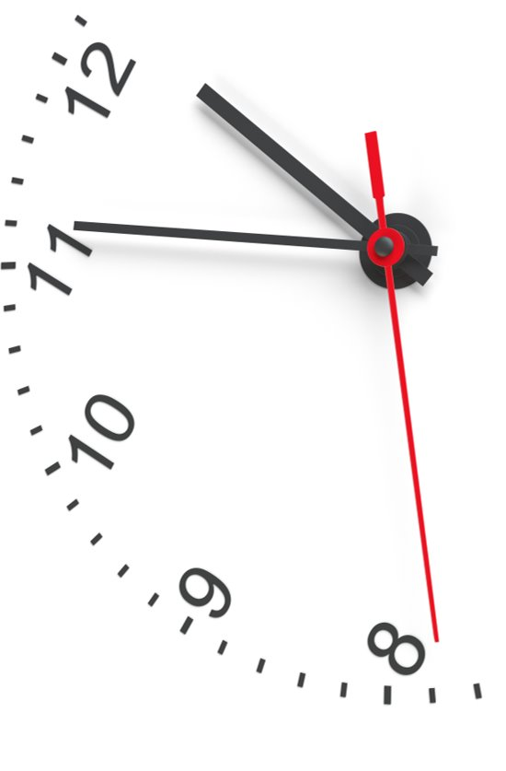
How we intend for you to engage with this workshop…
Follow along with us and make edits to your downloaded activity file if you wish – no obligation. ​
If you only have one screen, you can set up two windows side by side in a split screen set-up. ​
Please keep your camera & microphone off during the workshop​.
Ask questions in the chat.
‼ Remember to mute your microphone please! 🎙🔇

Slide 5
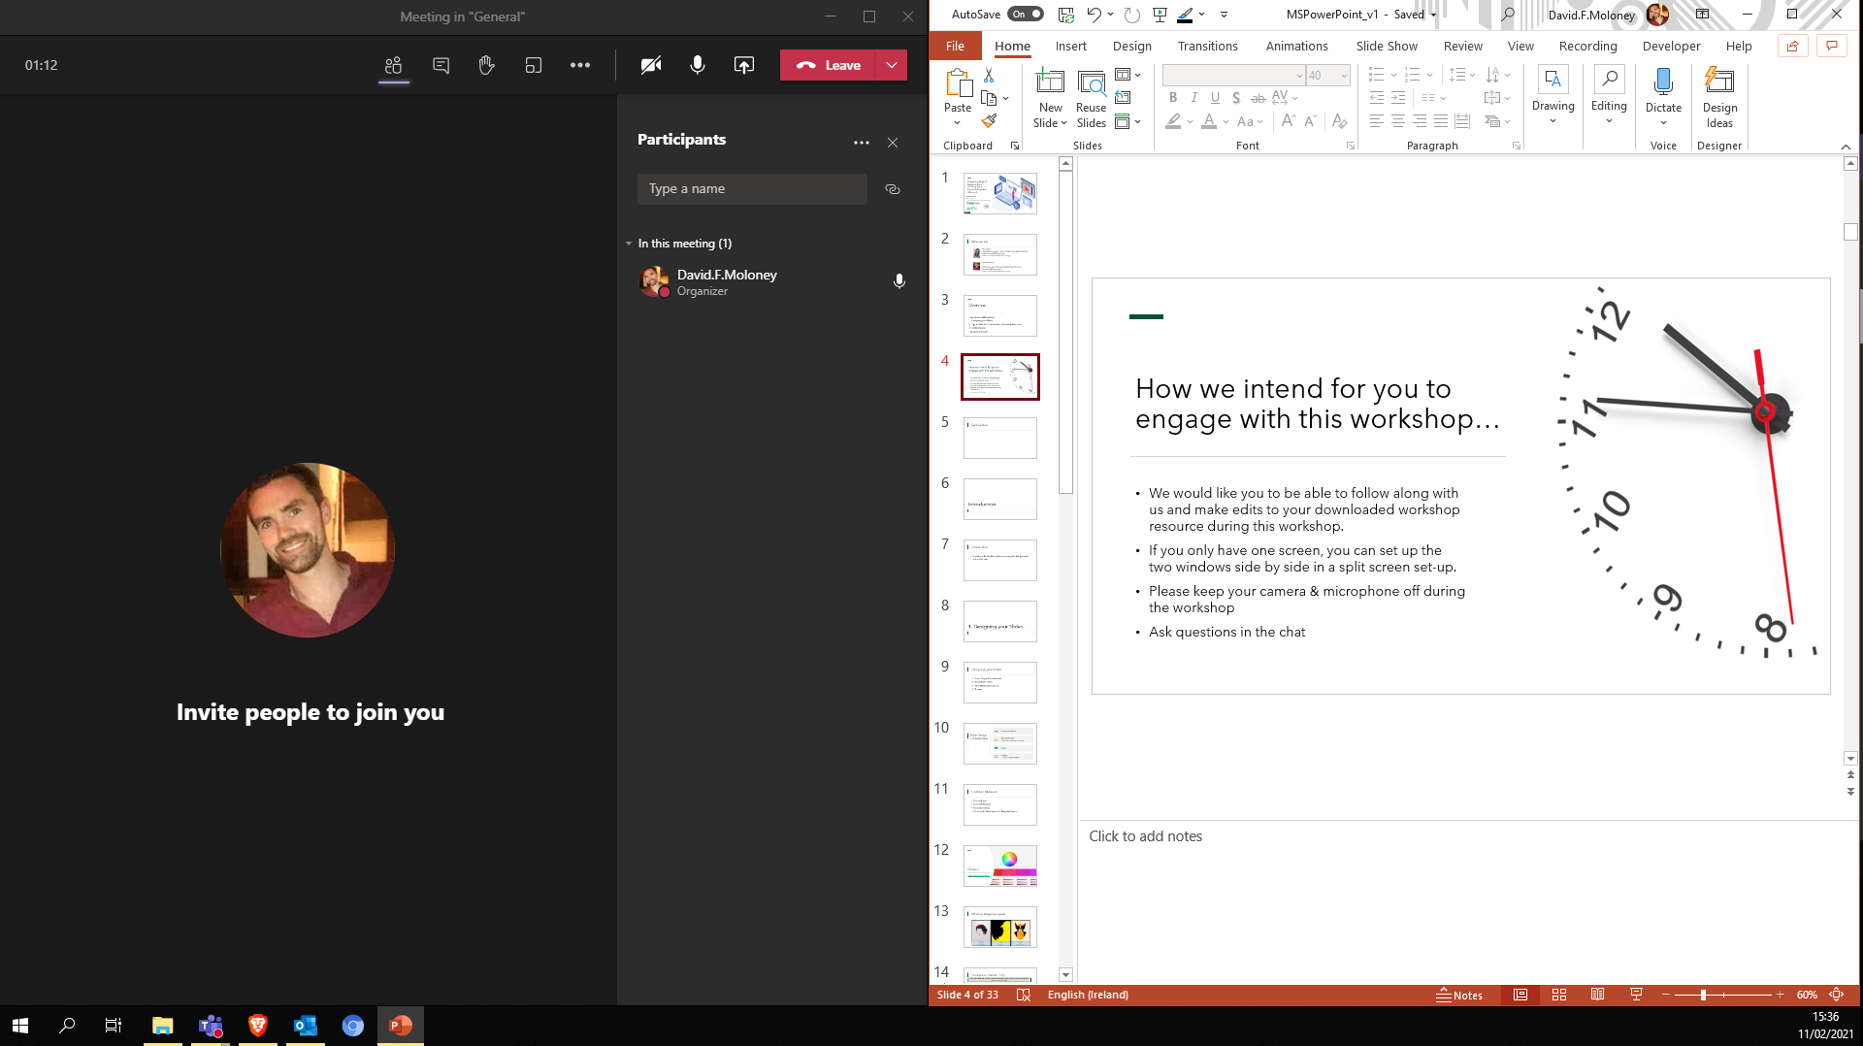

Slide 6
Overview
Introduction & Download
Designing your Slides
Tips & Tricks for Customisation (Workshop Resource)
Adding Media
Recap & Summary

Slide 7
Introduction & Download

Slide 8
Introduction & Download
2 files
Slides
Activity file

Slide 9
Introduction & Download
This is not prescriptive or all-encompassing
We will focus on elements of PowerPoint that are less Google/Youtube-able
There is no obligation on you to follow along during this workshop. You will have the link to the recording of this session and the Activity File available to you afterwards as well, to practice what I cover.

Slide 10
1. Designing your Slides

Slide 11
1. Designing your Slides
1.1 Some Design Fundamentals
1.2 Principles in Action
1.3 Themes
1.4 Slide Master and Layouts
1.5 Design Ideas

Slide 12
1.1 Some Design Fundamentals
Typography/Type
Colour
Imagery - Use as a representation of your concept
Know your audience

Slide 13
1.1 Some Design Fundamentals: Common Mistakes
Pitching the presentation inappropriately for the audience
Too much text
Too much imagery
Too many colours
Not enough White or Negative Space

Slide 14
Know your audience
Most major considerations for the designer relate to the audience
Who are you designing the presentation for?
What is the message you are trying to communicate to them with it?
When designing for a large diverse audience, try to be as inclusive as possible
Source

Slide 15
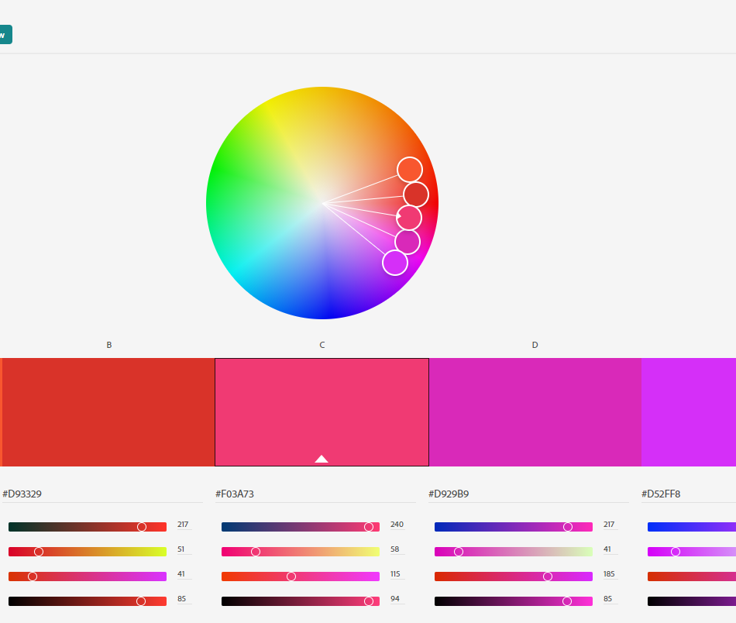
Colour
Adobe Interactive Color Wheel

Slide 16
White or Negative Space
Source

Slide 17
1.2 Principles in Action (1/2)
While good design can often go unnoticed, bad design can be difficult to look at. Click the tabs below for some examples.
Source

Slide 18
1.2 Principles in Action (2/2)
While good design can often go unnoticed, bad design can be difficult to look at. Click the tabs below for some examples.
Source

Slide 19
1.3 Themes
Download more PowerPoint themes/templates from https://templates.office.com/en-US/templates-for-PowerPoint
Notes:
https://templates.office.com/en-US/templates-for-PowerPoint

Slide 20
1.4 Slide Master & Layouts

Slide 21
1.5 Design Ideas

Slide 22
2. Tips & Tricks for Customisation

Slide 23
Activity File
This Photo by Unknown Author is licensed under CC BY-SA
Let’s level-up our PowerPoint game…

Slide 24
2. Tips & Tricks for Customisation
2.1 Add Images behind Custom Shapes
2.2 Cropping an Image to a Shape
2.3 Animating elements
2.4 Hyperlinking
2.5 Slide Transitions: The Morph Transition

Slide 25
3. Adding Media

Slide 26
3. Adding Media
3.1 Add Icons
3.2 Add Audio
3.3 Add Video

Slide 27
Reflection & Questions
Any questions?​
What are your initial impressions?​ Can you envisage using some of these for a project or assignment you have?

Slide 28
Recap & Summary
Introduction & Download
Designing your Slides
Tips & Tricks for Customisation (Workshop Resource)
Adding Media
Recap & Summary

Slide 29
Supports & Resources
Official Microsoft 365 Training >> https://support.microsoft.com/en-us/training
Goodwill Community Foundation LearnFree >> https://edu.gcfglobal.org/en/topics/powerpoint/

Slide 30
Thank you

Slide 31
Images
Isometric graphic on title slide originally from Freepik adapted by David Moloney
All other images used are licensed as freely-usable from Unsplash.com​

Slide 33
This work is licensed under a Creative Commons Attribution-NonCommercial 4.0 International (CC BY-NC 4.0)

