Slide 1
👋 Hello & Welcome
⏳ This session will begin shortly.
While you wait, please download the slides for today’s session from the LevUL up website.
In association with:

Slide 2
Recording
This session will now be recorded. Any further information that you provide during a session is optional and in doing so you give us consent to process this information.
These recordings will be stored by the University of Limerick for one year and may be published on our website during that time.
By taking part in a session you give us your consent to process any information you provide during it.

Slide 3
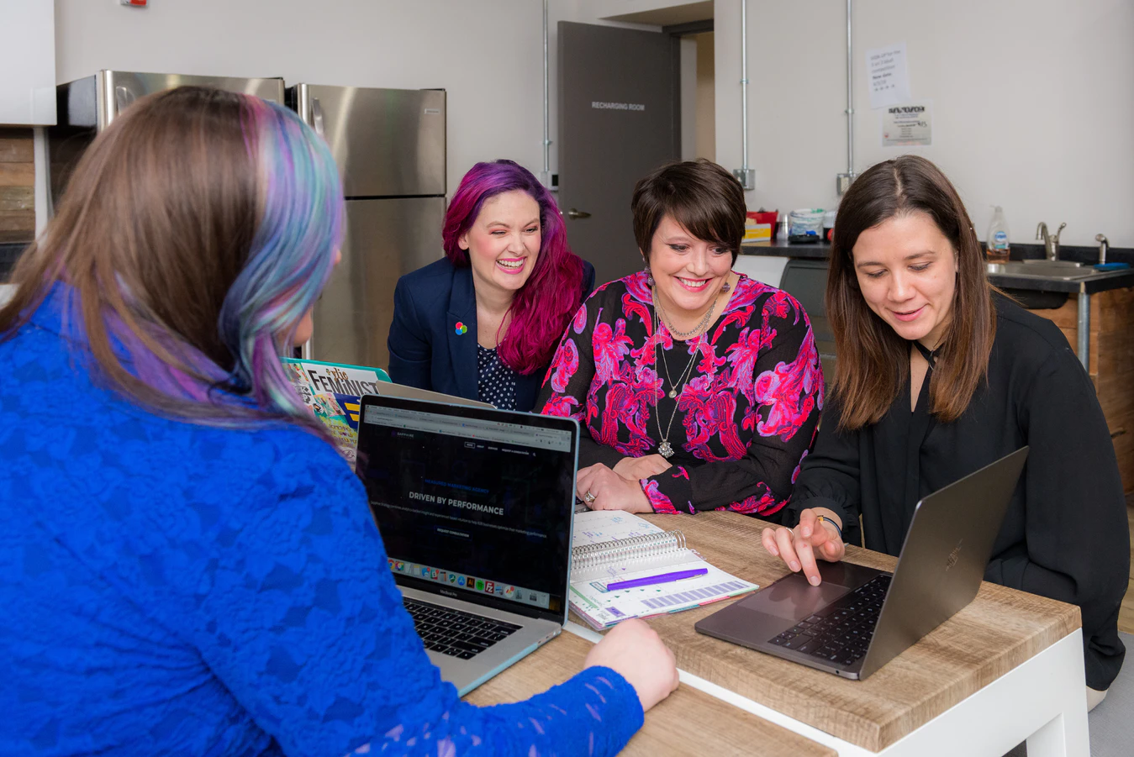
Making Videos for your Assignments using Panopto on Sulis
David Moloney

Slide 4
Who we are
​ | Jasmine Ryan UL Student Associate Intern, Enhancing Digital Teaching and Learning (EDTL) project, Centre for Transformative Learning​
​ | David Moloney - david.f.moloney@ul.ie UL Project Lead, Enhancing Digital Teaching and Learning (EDTL) project, Centre for Transformative Learning​
Notes:
The team presenting in this video is comprised of

Slide 5
Overview
‼ Remember to mute your microphone please! 🎙🔇
Introduction to Panopto
Accessing Panopto on Sulis
Creating a Video using Panopto
Uploading a Video
Editing a Video
Recap & Summary

Slide 6
Introduction to Panopto

Slide 7
Introduction to Panopto
Video platform that facilitates the recording, sharing, editing and management of video content.
It is integrated with Sulis and can be accessed from your computer, laptop or mobile device.

Slide 8
Introduction to Panopto
All-inclusive Video Suite includes:
Video Library
Video Recorder
Online Web Player
Video Editor

Slide 9
Benefits for Students
Can consume and create Panopto video content directly in Sulis.
Ability to review recordings.
Can search videos for specific words or phrases.
Can change the video quality and playback speed based on your own specific needs and internet speed.

Slide 10
Quick Questions
Link in Chat

Slide 11
Accessing Panopto on Sulis

Slide 12
Accessing Panopto on Sulis
1. Video Library

Slide 13
Accessing Panopto on Sulis
Ensure Cookies are enabled on your browser https://support.panopto.com/s/article/How-to-Enable-Third-Party-Cookies-in-Supported-Browsers
Notes:
https://support.panopto.com/s/article/How-to-Enable-Third-Party-Cookies-in-Supported-Browsers

Slide 14
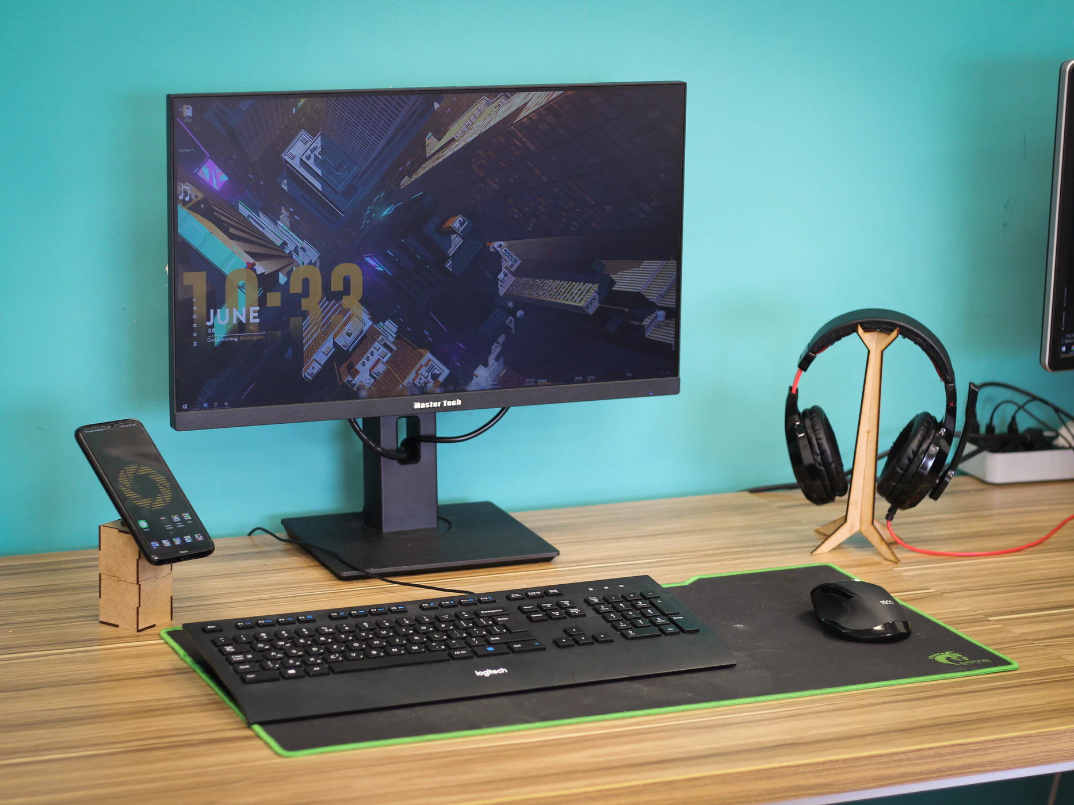
Creating a Video using Panopto
Note: Your lecturer must have a dedicated Panopto video assignment folder set up for you in order to do this.
2. Video Recorder

Slide 15
Practice Site on Sulis
Navigate to the LevUL up: Panopto site on Sulis (link in chat)
Notes:
LevUL up: Panopto site -> https://sulis.ul.ie/portal/site/35151cc4-5705-4e66-b93b-93a04f64bcb1

Slide 16
Creating a Video using Panopto

Slide 17
Creating a Video using Panopto

Slide 18
Creating a Video using Panopto
Panopto for Windows

Slide 19
Creating a Video using Panopto

Slide 20
Creating a Video using Panopto
Panopto Capture (Record in Browser)

Slide 21
Uploading a Video

Slide 22
Uploading a Video

Slide 23
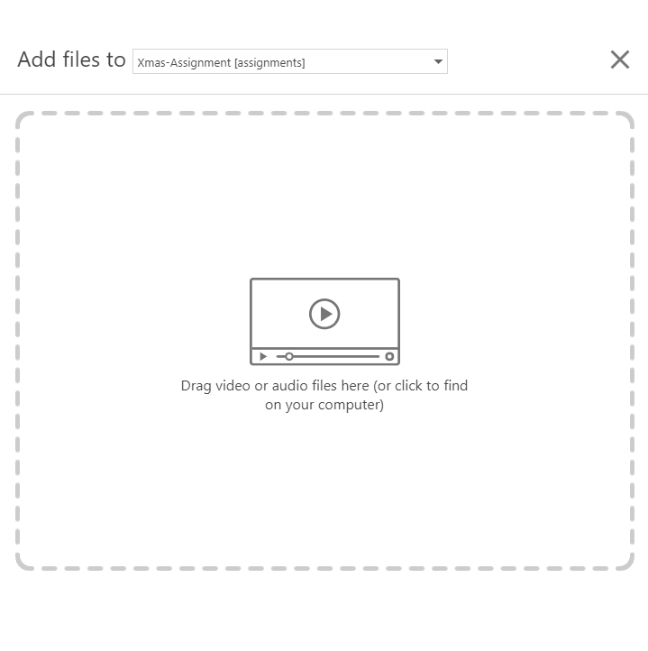
Uploading

Slide 24
Editing a Video

Slide 25
Editing a Video

Slide 26
Reflection & Questions
What are your initial impressions?
Do you think that you could create a video using Panopto for one of your assignments?

Slide 27
Recap & Summary
Introduction to Panopto
Accessing Panopto on Sulis
Creating a Video using Panopto
Uploading a Video
Editing a Video

Slide 28
Where from here?
This Photo by Unknown Author is licensed under CC BY-SA

Slide 29
UL IT Division Panopto Support Page
https://ulsites.ul.ie/itd/node/127271
Notes:
https://ulsites.ul.ie/itd/node/127271

Slide 30
Thank you

Slide 31
Images
"Support" image from Boffosocko (CC-BY-SA)
All other images used are licensed as freely-usable from Unsplash.com or CC0

Slide 33
This work is licensed under a Creative Commons Attribution-NonCommercial 4.0 International (CC BY-NC 4.0)

