Slide 1
Public Administration and Leadership
Introduction

Slide 2
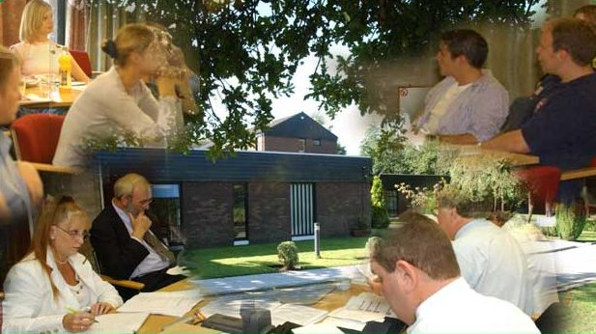
Administration has been an issue ever since human beings recognised the need to organise themselves in order to protect the environment where they lived!
Notes:
Administration is a function that has existed for centuries. It has been an issue ever since human beings recognised the need to organise themselves in order to protect the environment where they lived. Administrative actions were necessary for adequate defence against invaders or, for example, trade functions. The organisation, maintenance and direction of an army are illustrative of this. We noted that discipline and the capacity to cope with complex planning is required for territorial maintenance and colonial administration e.g. the great Roman Empire and centuries later the British Empire of the late nineteenth century… We will refer to the latter period in more detail later since this was when the ‘traditional model’ of public administration was introduced.
Managing affairs in Kings Landing, defence, the ‘nights’ watch’

Slide 3
What is Public Administration (PA)?
PA is doing collectively what cannot be done individually.
It is about making things happen in the ‘public space’.
It is sometimes described as the ‘law in action’
It serves government and citizens
It drafts and implements laws
PA advises elected representatives on policy options
It delivers services
It is involved in regulation across a range of areas from financial services to health care
PA is a major point of contact between the citizen and the state (revenue, gardai, teachers, nurses, social welfare officers)
It offers significant employment opportunities
It cultivates and needs leaders!

Slide 4
PA is hugely relevant to you!

Slide 5
Thinking about studying Public Administration and Leadership?
What / how you study and learn

Slide 6
What you will study
You can take Public Administration & Leadership as a single or joint honours option as part of the BA Arts at the University of Limerick.
If you take it as a single honours, from year 2 onwards you will study two core courses and then electives of your choice in the field of politics and public administration.
If you take it as a joint honours e.g. with economics, you will study core Public Administration subjects and core economics subjects.

Slide 7
How we teach…..how you learn
Teaching and learning in UL will be different from your experience in 2nd level.
Our main objective is to develop your capacity for critical thinking…not to fill your head with information!
You will be taught in lectures and tutorials; in big and small groups; by lecturers; by visiting speakers; your peers and yourself!
Assessment generally combine exams with continuous assessment – it is rare that you will face a 100% exam

Slide 8
This is an example of how we teach
https://drive.google.com/open?id=1PMFIAndigeGavXU4BIb2qL9x22Pm5RNF

Slide 9
Where can studying Public Administration and Leadership get you?

Slide 10
Careers
Our graduates work in wide range of organisations including:
The Public Sector e.g. Civil Service, state agencies, local authorities; European and international organisations; third level education (academic and administration); policy analysis
The Private Sector e.g. management, personnel &HR, marketing, IT, financial services, management consultancy
The not-for-profit sector including NGOs voluntary and community development organisations.

Slide 11
Key contacts for further information
Dr. Chris McInerney chris.g.mcinerney@ul.ie
Dr. Bernadette Connaughton bernadette.connaughton@ul.ie
Dr. Conor Little conor.little@ul.ie
Department of Politics and Public Administration
Foundation Building
University of Limerick

