Slide 1
FRENCH STUDIES IN UL

Slide 2
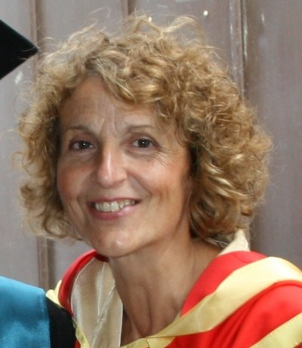
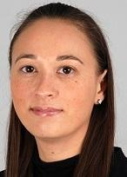
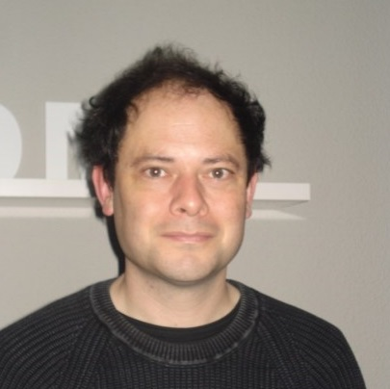
The French team

Slide 3
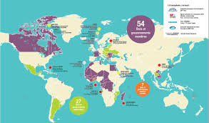
Why French?
Lots of good reasons for learning French
International job market
International language of cooking fashion, theatre, dance etc.
300 millions speakers of French
Language of love
More than 87 millions visitors per year
Good base for learning another romance language
Renowned universities

Slide 4
Why French?
But mostly because…
French is only offered at advanced level.
Language requirement: minimum H3 at Higher Level in Leaving Certificate
To build on what you already know
and become fluent in the French language

Slide 5
WHAT WILL YOU DO IN FIRST YEAR?
A CODE = FR4241 OR FR4141
4 contact hours per week:
Oral work
Grammar
Literature/Culture
Audio lab
In the target language
Ici, on parle français

Slide 6
GOING ABROAD
SEMESTER 4 (2d semester of 2d year) = COOP placement in a French company
SEMESTER 5 (1st semester of 3d year) = ERASMUS in a French university

Slide 7
Finally
Here is a testimony of a student who has just graduated and is giving her impression of studying French for four years at UL (she is recording while being at the airport going to France for one year, merci Dearbhla!)

Slide 8
MERCI et à bientôt
Further information
www.ul.ie/mlal

