Slide 1
Introduction to
Performance & Development Reviews

Slide 2
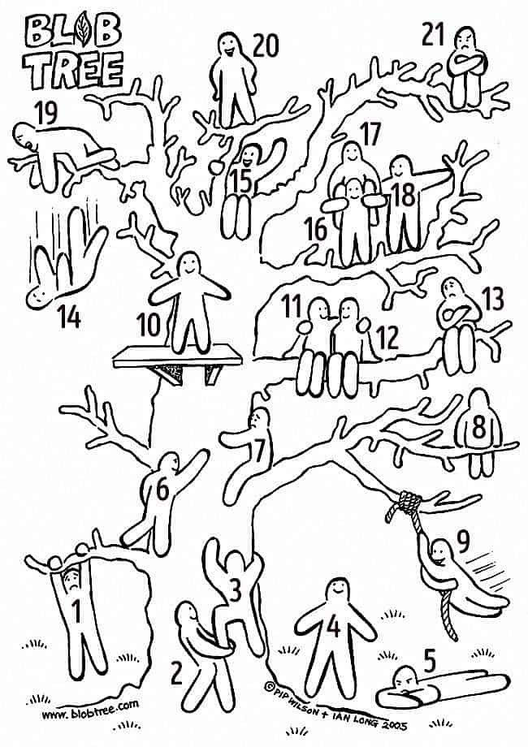

Slide 3
Purpose of the Workshop
Overview
Process
Benefit

Slide 4
The PDRs Review Cycle
The PDR Review Cycle
1
UL Strategic Plan
2
Faculty/Division Objectives
4
Individual Objectives (Job Description/Goals & Objectives)
3
Team Objectives
Individual Objectives and Development Plan
Plan
Coach
Review

Slide 5
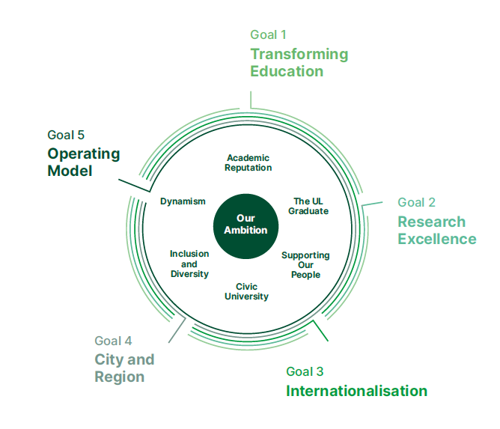
Context - Strategic Plan – UL@50

Slide 6
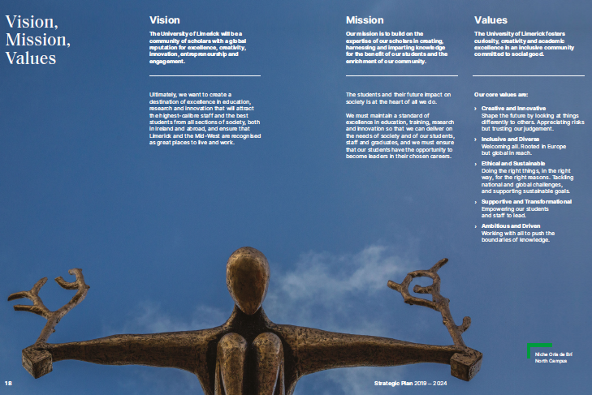
Context - Values
Creative and Innovative
Inclusive and Diverse
Ethical and Sustainable
Supportive and Transformational
Ambitious and Driven

Slide 7
PDR Planning
Objective 1
Objective 2
Objective 3
Objective 4
What we do
Individual
Objectives
Results
The Job
Examples:
Strategic Thinking
Communications
Continual Improvement
How we do it
Development Objectives

Slide 8
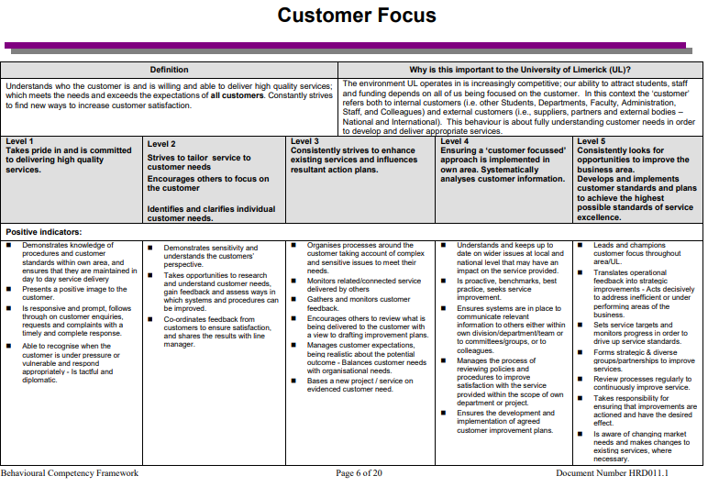
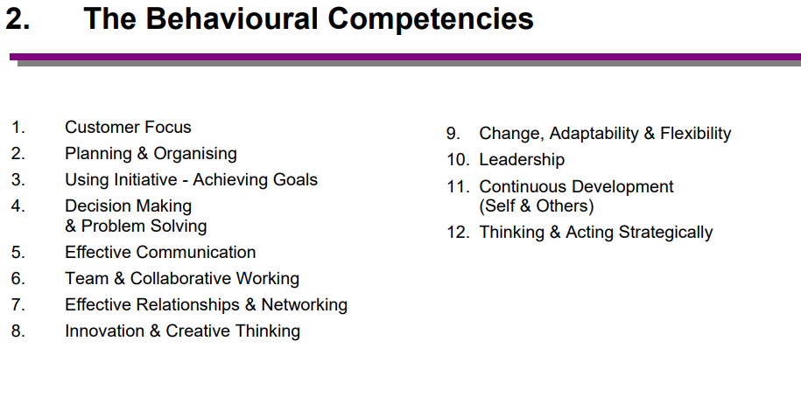
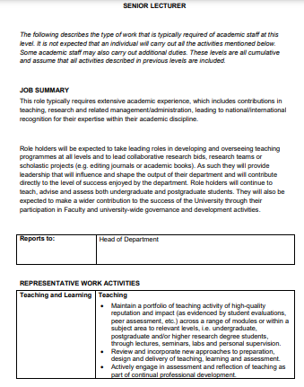
Context - Competency Framework / Role Profiles

Slide 9
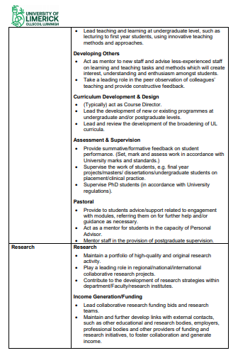
Context - Competency Framework / Role Profiles

Slide 10
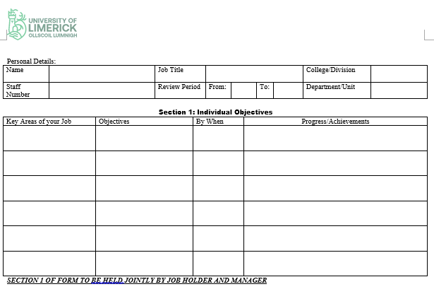
The Form

Slide 11
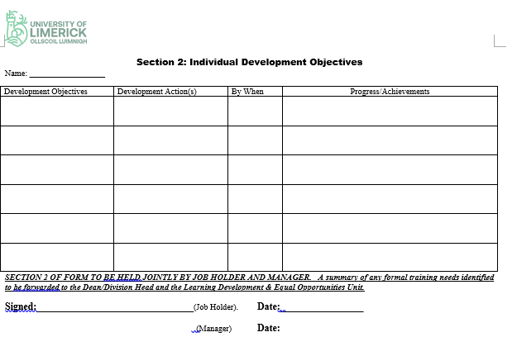
The Form

Slide 12
FAQs
Who does this apply to?
Who will conduct the review?
How often do PDR meetings occur and when?
What is the process? (Before, during, after)

Slide 13
Breakout Room
Have you ever had a particularly useful conversation about work?
What made it useful?

Slide 14
Benefits of PDRs
Recognise Achievements
Continual Improvement
Promote Communication
Changes culture
Good management practice
Set and align goals
Aid to performance
Highlight any problems
Improve quality of service
Increase efficiency
Provide clarity
Have consistent management practices.

Slide 15
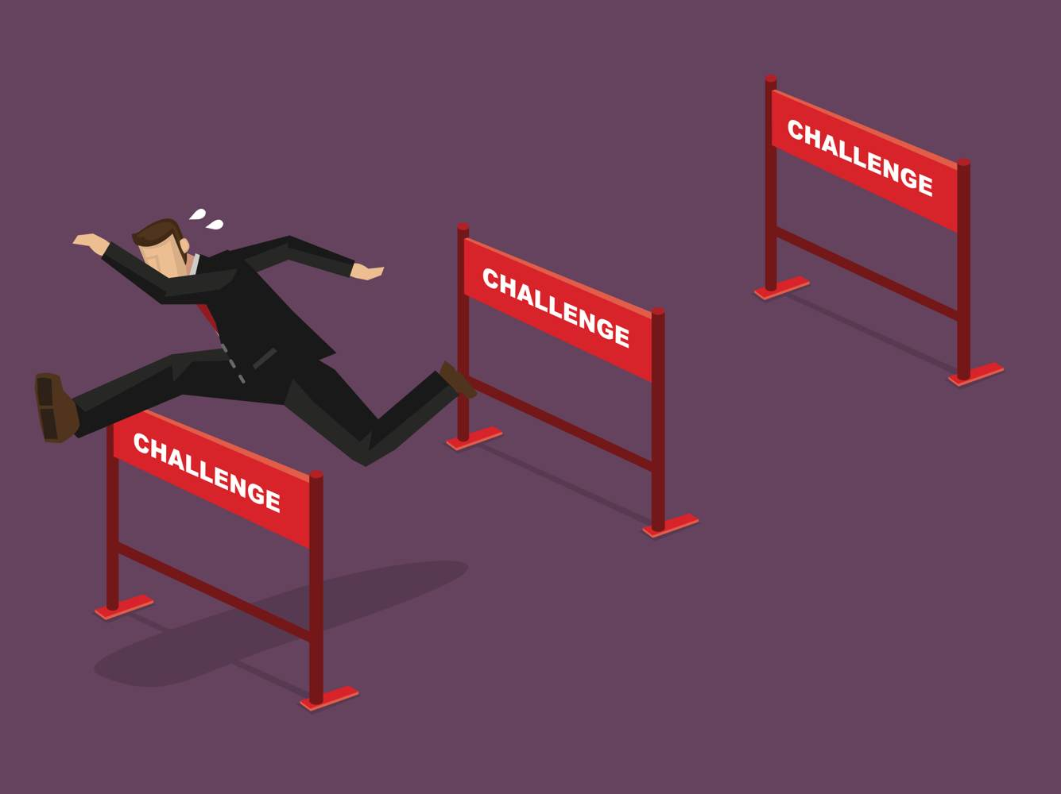
Challenges?

Slide 16
What can each person do to make the most of a PDR meeting?
Notes:
https://www.mentimeter.com/app/presentation/7686ad9a608a0ce1391feed934cd16bb/d9b7f6c700ca

Slide 17
Individual
Be actively involved in the process
Define your own job clearly
Be clear on what is expected of you in your role
Identify your own development requirements
Review your own progress on an ongoing basis
Show initiative
Keep an open mind
Be assertive
Communicate openly with colleagues & managers

Slide 18
Possible Questions for your Preparation
What can be different this time next year?
What change would make the biggest difference to my stakeholders / customers?
What is working well?
What is the one thing that is holding me back?
What makes me feel “stuck”?
How can your manager help?
What are my two biggest challenges?

Slide 19
Manager
Encourage an open supportive climate – promote two way communication
Ask good questions – coaching questions
Be assertive and constructive
Work with staff to develop the department/team work plan
Clearly communicate the team objectives
Complete and agree performance and development plans with individuals
Prepare an overall training and development plan for the section
Monitor progress, coach and support their staff
Maintain up to date documentation/records supporting the process
Involve team in agreeing Division/Department plans
Negotiate time and budget for development of staff.

Slide 20
Setting Goals
Must be owned by reviewee:
Setting objectives
- Specific Measurable Attainable Relevant Timebound
Identify action strategies
Assess action strategies
Reviewee formulate plans with support
Reviewee implement plans with support

Slide 21
Setting Goals
Using the information gathered in the previous step, write 1 objective that you need to accomplish in your role setting out the following:
Strategic Goal it links to
The Department Goal
The measurable outcome and
The target date to be completed.

Slide 22
Examples of Goals
Customer service. Use feedback to develop a plan to improve customer service with at least two specific strategies. Define and share with supervisor by 1st March. Implement by 1st September.
Publication. Submit article for publication to x journal by x date.
Teaching. To get feedback on my teaching through x mechanism and identify one area for enhancement within my current teaching and assessment practice. Create plan for this, including how progress will be monitored. Monitor implementation.
Teaching. To take on responsibilities of Course Director by [date].
Collaboration. Contact at least eight new potential collaborative partners and explore possibilities for collaboration, with a view to continuing working relationship with one.
Records Management. To ensure that 100% of information and records processed (received, created, used, destroyed) on behalf of the University are managed in compliance with GDPR legislation.
Student Supervision. To supervise successfully x FYPs by X date.

Slide 23
Your Development
On the job Training
Lunchtime sessions
What happens elsewhere?
Books, articles, websites
Library
Mentoring
Additional Assignments/Project work
Shadowing someone
Further study
Erasmus support for overseas visits.

Slide 24
Receiving Feedback
Be open: to learning and change;
If unclear, ask for explanations & examples;
Summarise briefly to check understanding;
Check validity with personal assessment;
Check with other sources if needed;
Be assertive, not defensive or aggressive.

Slide 25
After the Meeting
Book development plans items into your diary and book agreed formal training programmes.
Review your objectives and develop plans as to how you will go about attaining these objectives.
Follow through on any commitment given during the planning meeting.
Documentation is held between you and your manager. Development objectives are returned to HR.

Slide 26
Remember….
You are entitled to this time for a 1-1 meeting with your manager
You are entitled to expect open and honest feedback
Information http: www.ul.ie/hr
ANY QUESTIONS?

