Slide 1

ABC Learning Design
Curriculum design workshop
Dr Ide O’Sullivan, David Moloney
and Dr Angelica Risquez

Slide 2
Learning outcomes
Explore ABC Learning Design framework as a planning tool
Understand the Enhancing Digital Teaching and Learning approach and the European Digital Competence Framework for Educators
Start to map out the plan for an online module
Demonstrate a collaborative tool that you might like to use
Experiment with working synchronously online in groups
Notes:
Dara

Slide 3
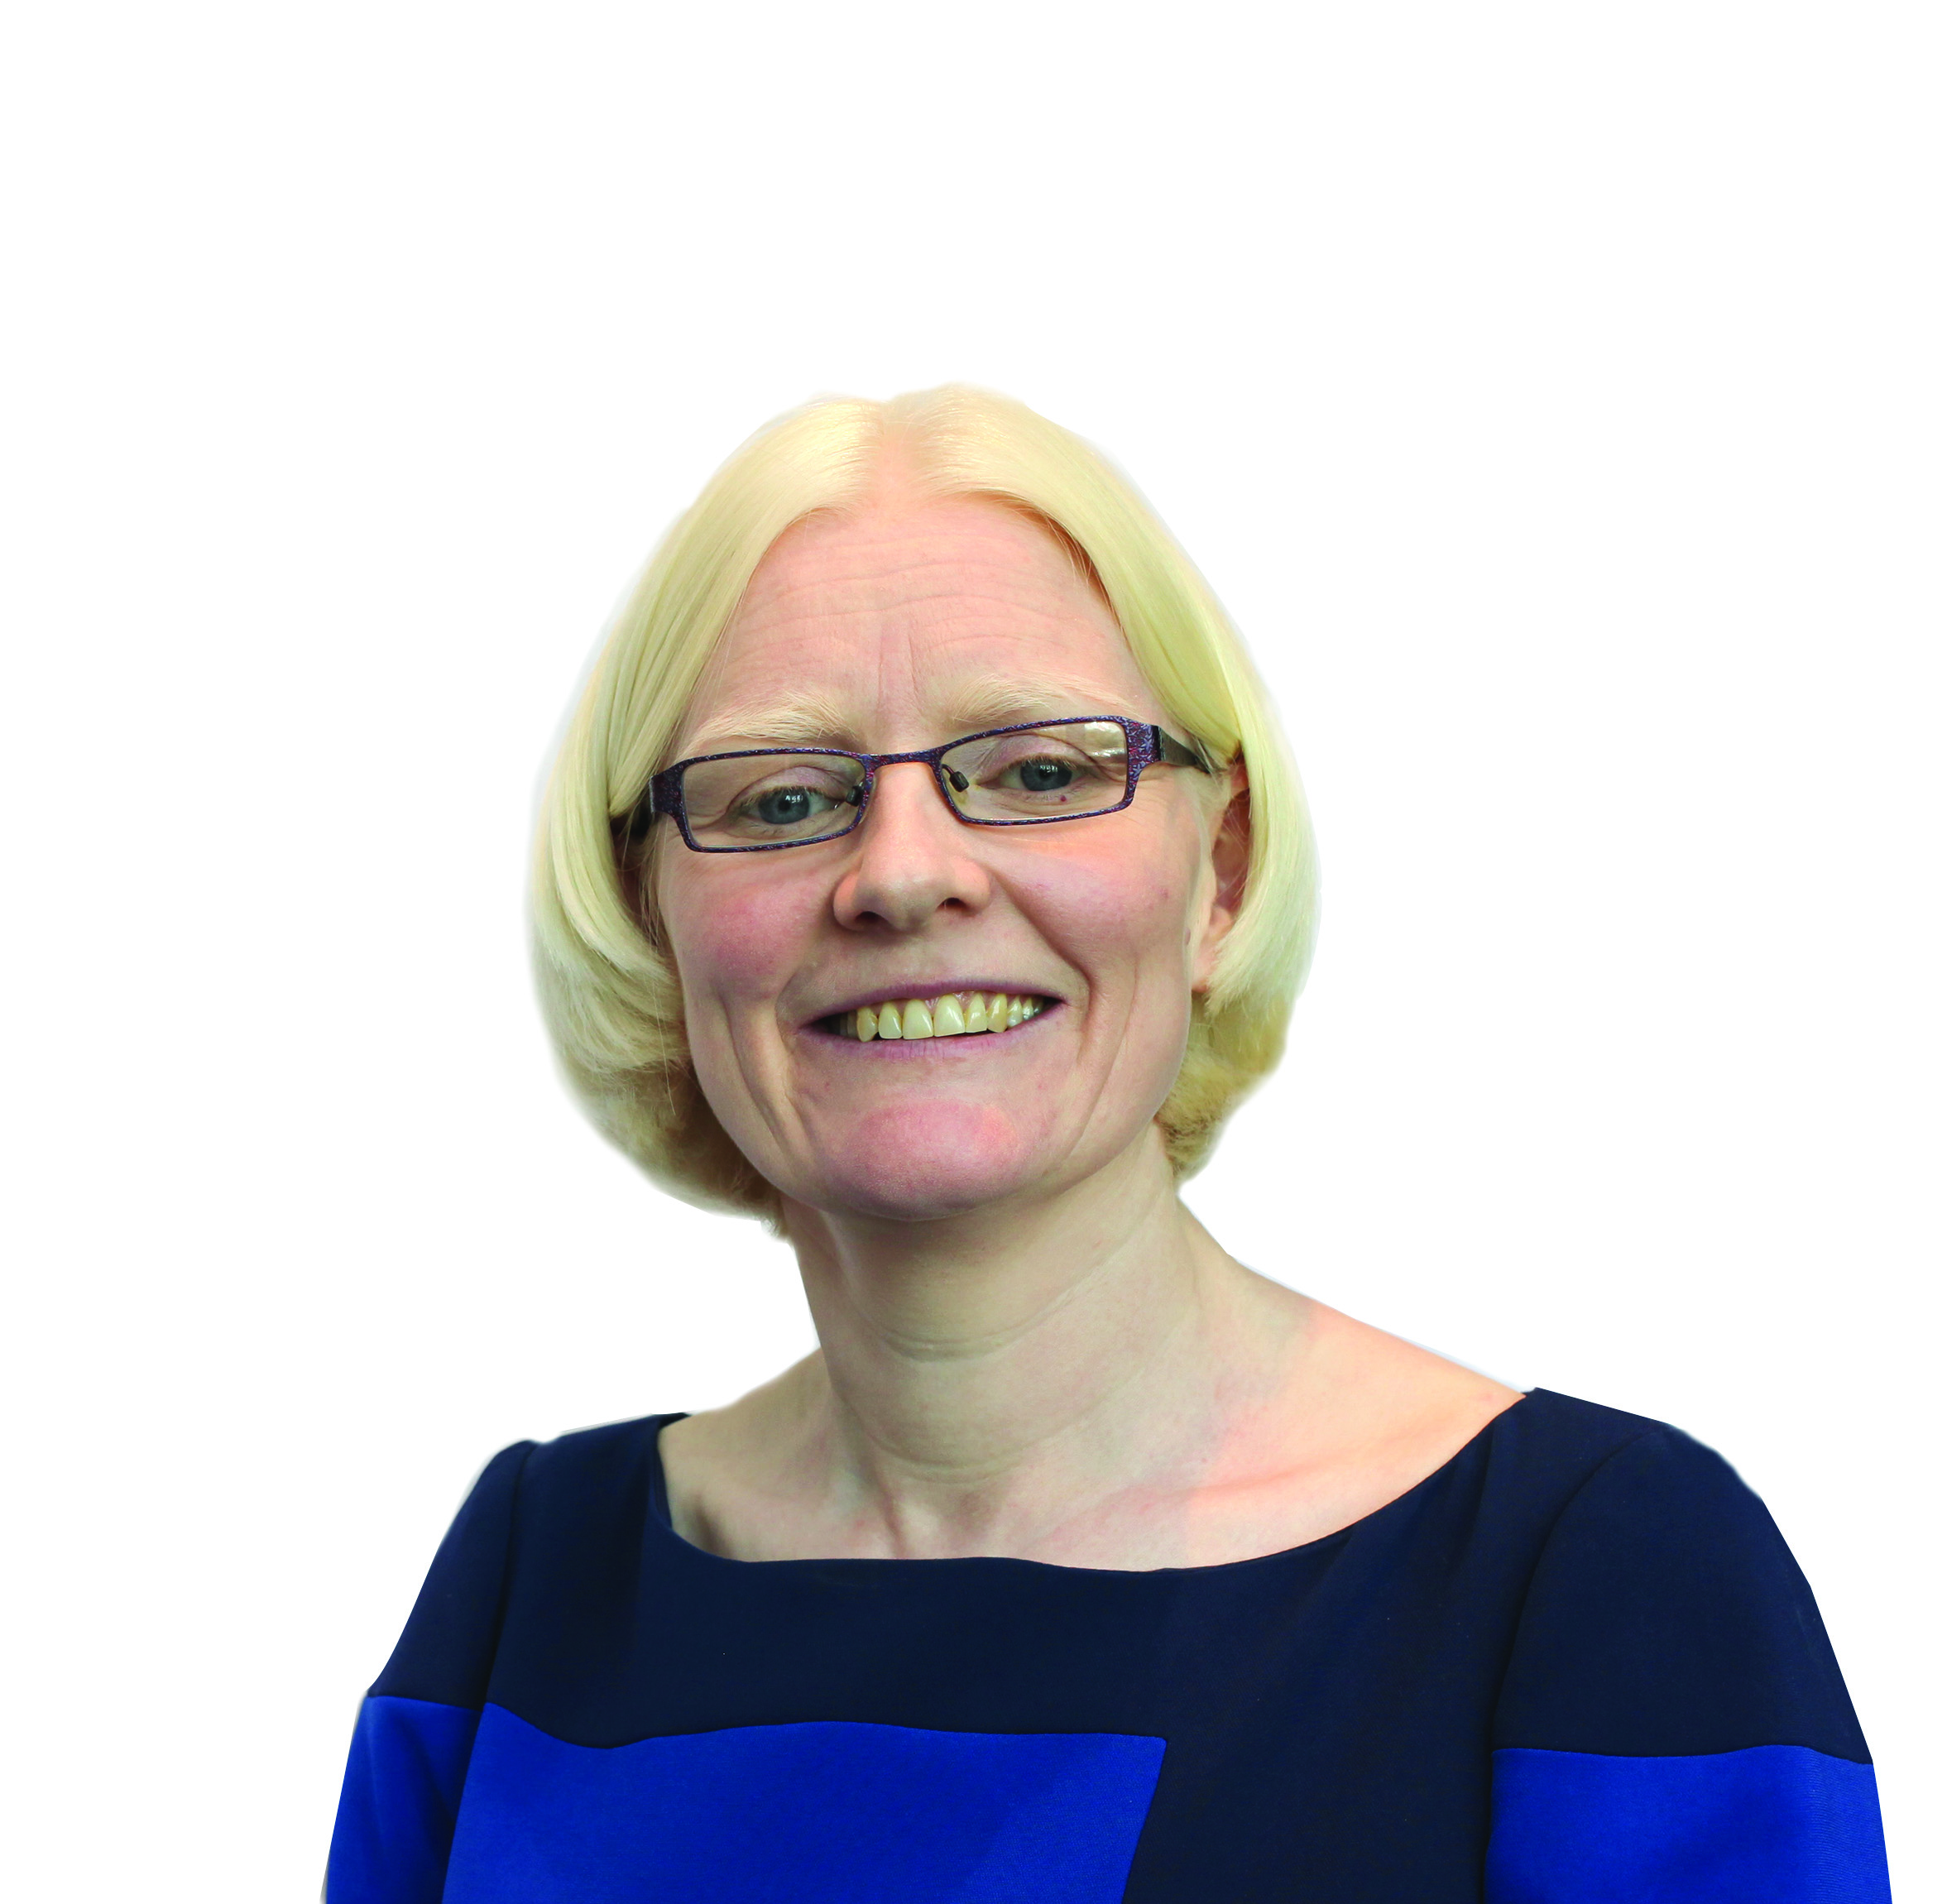


Team presentation
 | Íde O’Sullivan, Senior Educational Developer, Centre for Transformative Learning
 | David F Moloney, UL Project Lead, IUA Enhancing Digital Teaching and Learning in Irish Universities project, Centre for Transformative Learning
 | Angélica Rísquez, Lead Educational Developer, Centre for Transformative Learning

Slide 4
Team presentation: facilitators
Jennifer Farrell, KBS
Sinead Spain, GPS/CTL
Adrienne Horan, Education
Jess Beeley, AHSS
Maura Griffin, S&E
Robert Dalton, KBS
Maria Rieder, AHSS

Slide 5

Workshop in association with
Enhancing Digital Teaching and Learning project
Find out more at 👉 https://edtl.blog

Slide 6

European Digital Competence Framework for Educators (DigCompEdu)
https://ec.europa.eu/jrc/en/digcompedu

Slide 7
European Digital Competence Framework for Educators (DigCompEdu)

Slide 8
Mapping this ABC workshop to DigCompEdu
Area 2: Digital Resources
2.1 Selecting
Area 3: Teaching
3.1 Teaching
Area 5: Empowering Learners
5.3 Actively engaging learners
Area 4: Assessment
4.1 Assessment strategies
Area 1: Professional Engagement
1.3 Reflective Practice
1.4 Digital CPD

Slide 9
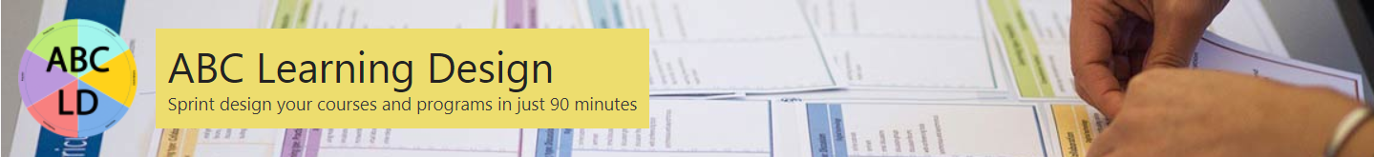

Developed in UCL as a structured and fast process for those involved in module design and delivery
student-centred approach – based on established theory ‘Conversational Framework’ (Laurillard 2012)
fast – requires minimal preparation
stimulates informed dialogue among teams
aligns to strategic aims
encourages blended approaches
discipline-neutral
widely used - growing international community

Slide 10
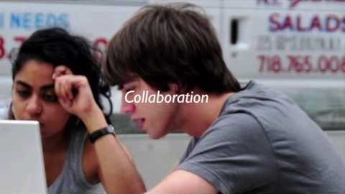
Source: https://youtu.be/wnERkQBqSGM

Slide 11
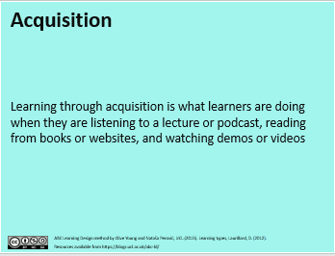
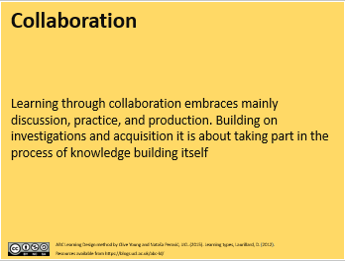
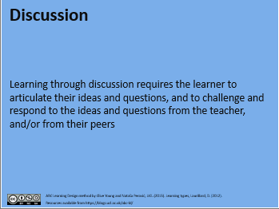
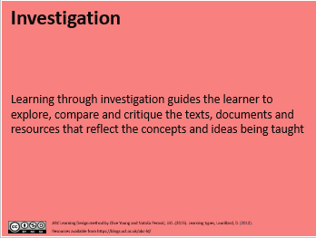
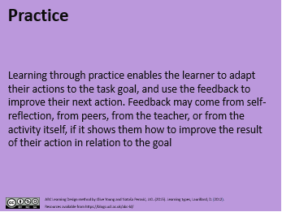
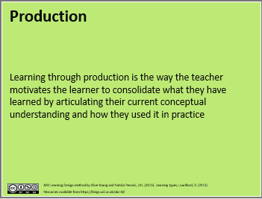
Learning type cards (front)
Notes:
You will focus on the balance that you are going to achieve between these types of learning. The ABC LD framework will provide a start with plenty of suggestions for each of these types of learning.
Learning types on one side and examples of activities on the other

Slide 12
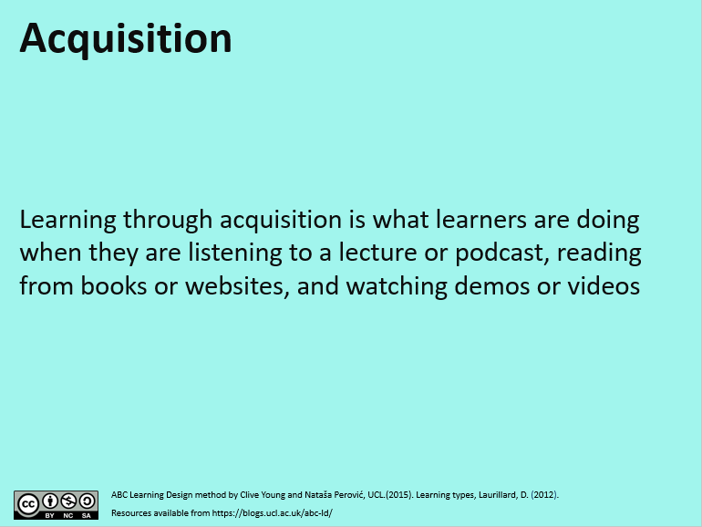
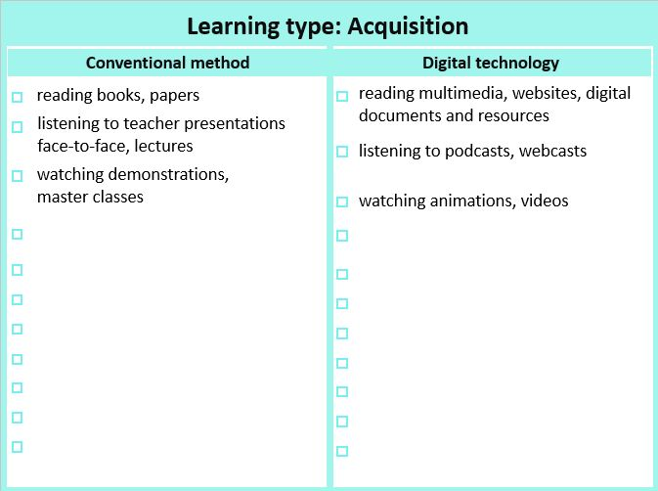


Slide 13
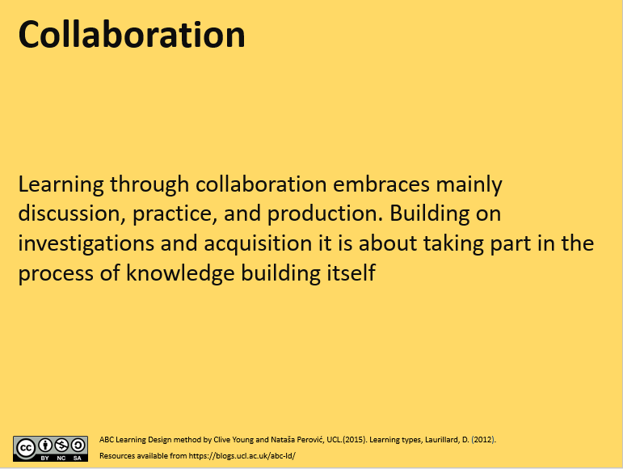
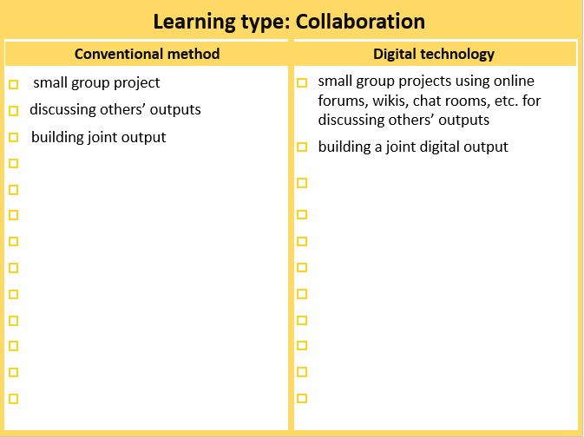

Slide 14
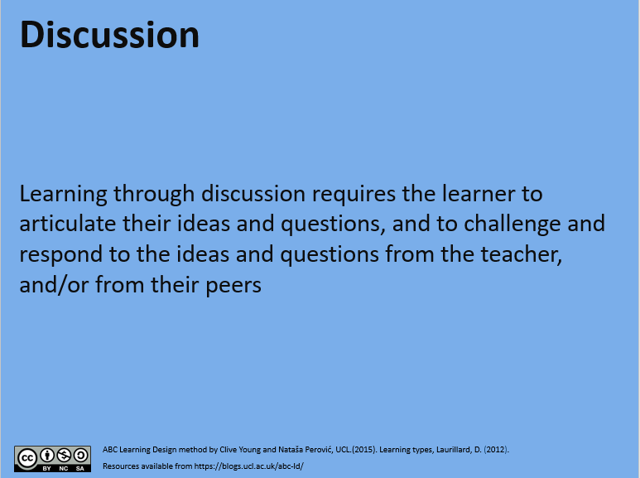
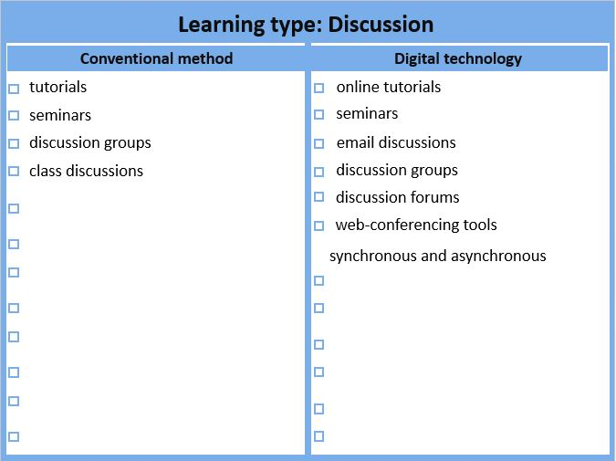

Slide 15
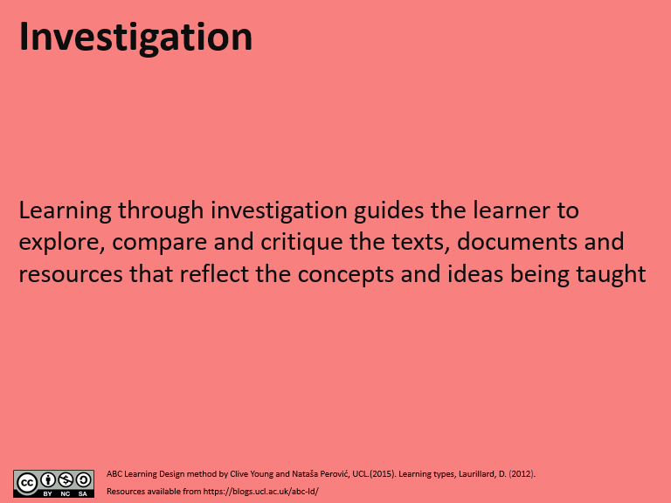
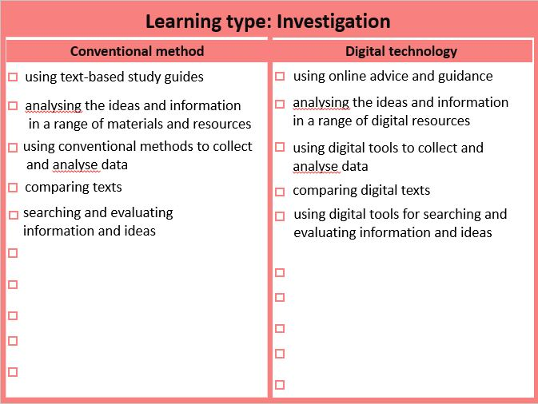

Slide 16
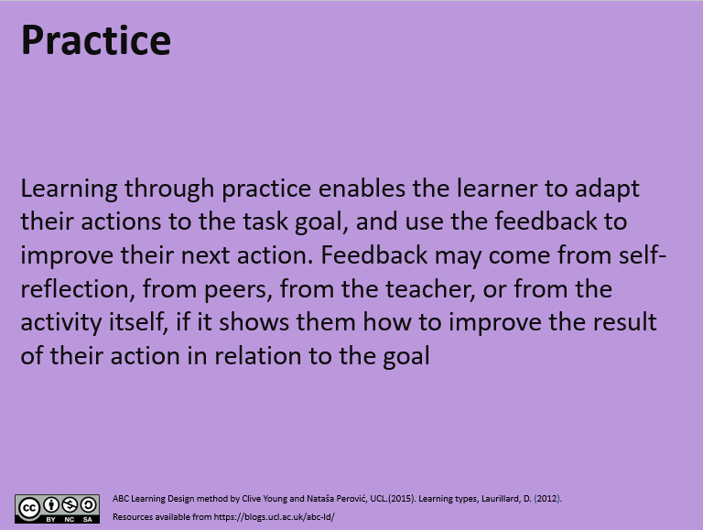
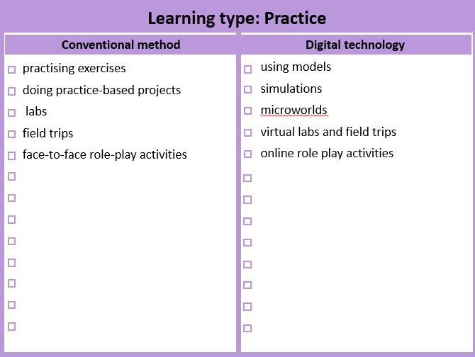

Slide 17
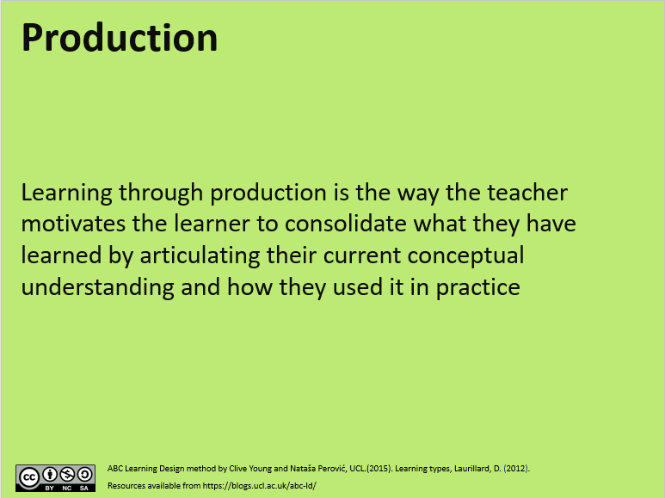
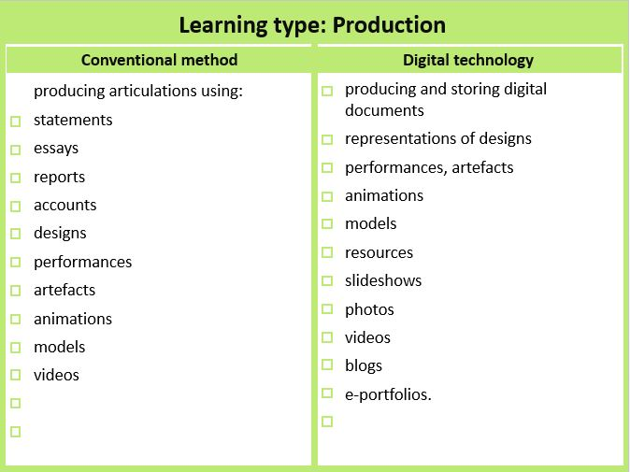

Slide 18
Learning types activities , V- Visible learning A - can be assessed (formative or summative)
Investigation
Practice
Production
Web search (forum, wiki) V
OER resources (external)
Literature reviews and critiques (forum/blog/wiki/RSS) V
Field/lab observations (media/blog/wiki) V
Action research V
Authentic research / data analysis – write a paper V
Lead a group project V
MCQs - formative with automatic feedback V/A
Online role play (forum, virtual classroom)
Reflective tasks – group or individual (forum) V/A
Case studies (forum, lesson) V/A
Rapid-fire exam questions (forum) V/A
Advanced role play – you are the consultant etc. V
Interview an expert (video/forum/chat) V
Literature reviews and critiques (forum/blog/wiki/RSS) V/A
MCQs - formative with automatic feedback V/A
Develop a shared resource library (database/glossary/wiki) V/A
Shows/demonstrates learning (displays, posters, presentations) V/A
Portfolios (MyPortfolio) V/A
Case studies (forum, lesson) V/A
Summarisation tasks (upload texts – individual or group) V/A
Rapid-fire exam questions (forum) V/A
Concept mapping (external) V
Create video of performance (media) V/A
Audio commentary of performance (media) V/A
Skype or virtual classroom 'viva' V/A
Make and give a presentation (external) V/A
Video blog (external) V/A
Write a report (external) V/A
Make an analysis (external) V/A
Case studies V/A
Advanced role play – you are the consultant etc. V
Action plan for workplace V/A
Action plan for further study V/A
Authentic research / data analysis – write a paper V/A
Prepare professional briefing V/A
Create, make a case (study) V/A
Create podcast (media) V/A
Work assignment (blog/report) V/A
Interview professional colleagues V/A
Lead a group project V/A
Collaboration
Collaborative wiki - what do we know about ...? V/A
Develop a shared resource library (database/glossary/wiki) V
Social networking – participate (external) V
Special interest groups - share on a topic (forum) V
Mentor other learners V
;
Acquisition
Guided readings (library resources)
OER resources (external)
Podcast (media) V if students do it
Webinars (virtual classroom) V
Q&A forum (forum, where teachers answer student questions) V
Video lectures (webcast),
YouTube videos (external)
Field/lab observations (media/blog/wiki) V
MCQs - formative with automatic feedback V
Portfolios (MyPortfolio) V
Discussion
Interview an expert (forum/chat) V
Webinars (virtual classroom) V
Model answers/examples of previous work (forum)
Analyse chat text (in course or uploaded) V
Job/professional reflections (blog) V/A
Group discussions on the topic, problem, reading (chat/blog/wiki) V/A
Social networking – participate (external) V
Reflective tasks – group or individual (forum) V/A
Special interest groups - share on a topic (forum) V
Lead a group project V/A
@ABC_LD
UCL Digital Education

Slide 19

This Photo by Unknown Author is licensed under CC BY-SA-NC

Slide 20
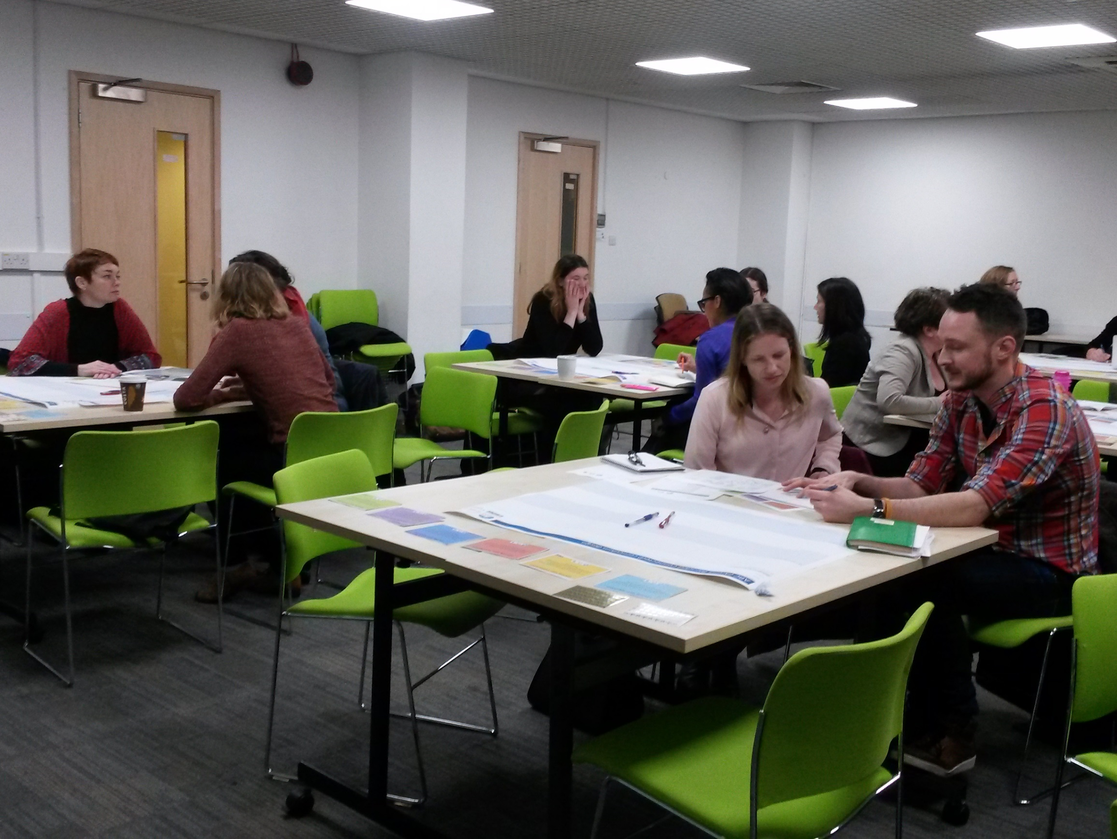
ABC LD is designed to take place in a classroom setting…

Slide 21
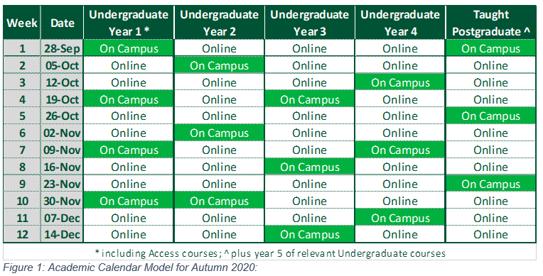
SEM1 2020/21 Delivery

Slide 22
Timetable SEM1 2020/21
 | On campus weeks | Off Campus Weeks
Lectures | 1 hour synchronous lecture centrally scheduled for each module. This lecture will not have a room assigned and will be delivered online. | Lecture/s scheduled as per request from Academic Department, keeping within hours approved by APRC.
Lab. or Tutorial Sessions | 2 hours F2F for each module scheduled per student each week. Can be scheduled as 2 X 1 hour or 1 X 2 hour. | Sessions scheduled as per request from Academic Department, keeping within hours approved by APRC.

Slide 23
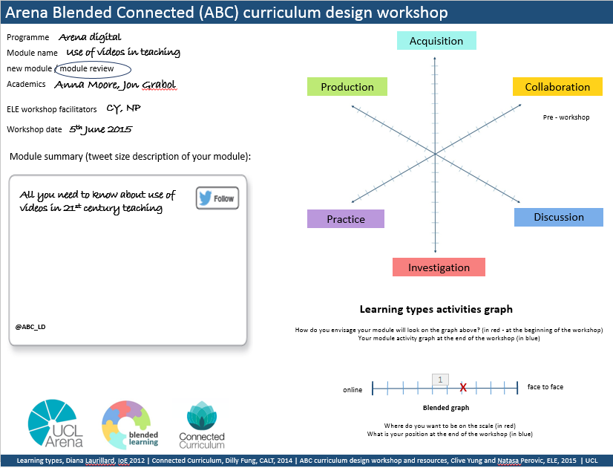
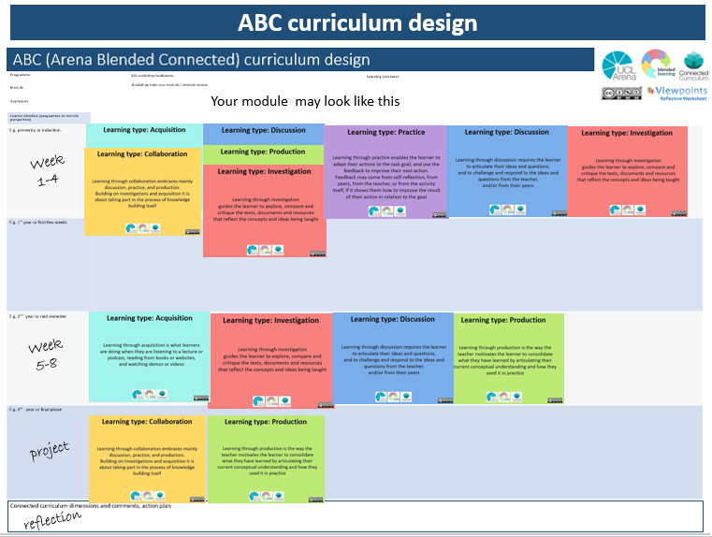
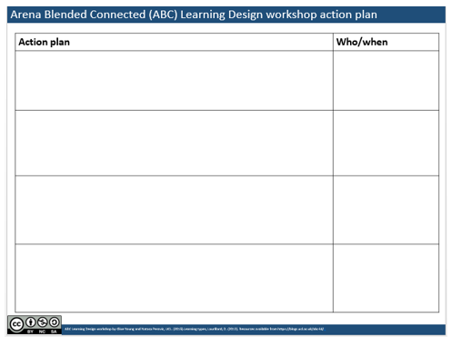
ABC Learning Design process
Module info, tweet and shape
2. Storyboard of learning journey
3. Module new shape and next actions

Slide 24
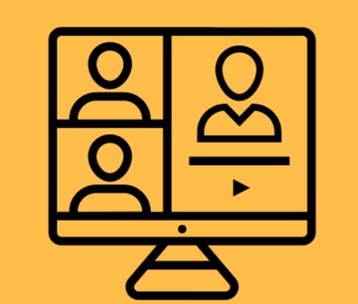
Breakout rooms
Sub-rooms created within the training session, used for splitting a large group into smaller groups that can talk or collaborate.
Timed: when time expires, you are brought back to the main room.

Slide 25

1. Module info, tweet and shape
  Decide on a module you want to work with today as a group
  Module shape (Learning types activities graph) distribution of learning types of the module as it is currently designed
  Write in the document the module title and a Tweet (160 characters) that best describes your redesigned module
Tool: Learning types form (for each room)
15 mins
This Photo by Unknown Author is licensed under CC BY-SA-NC

Slide 26
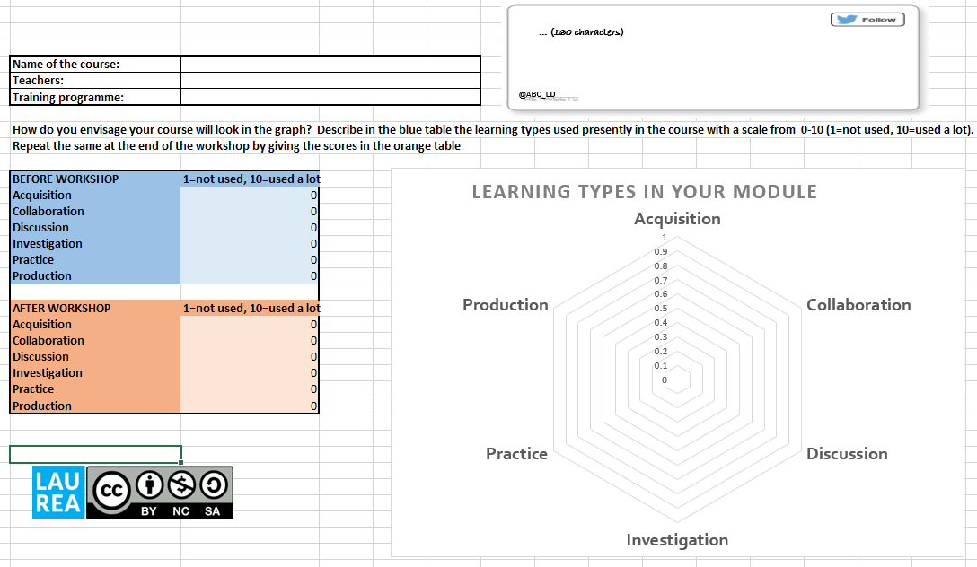

Slide 27
2. Storyboard of student journey
  Storyboard – learning types sequences and activities
  Assessment – align activities and assessment
Tool: MS Planner
30 mins
This Photo by Unknown Author is licensed under CC BY-SA-NC
Notes:
David

Slide 28
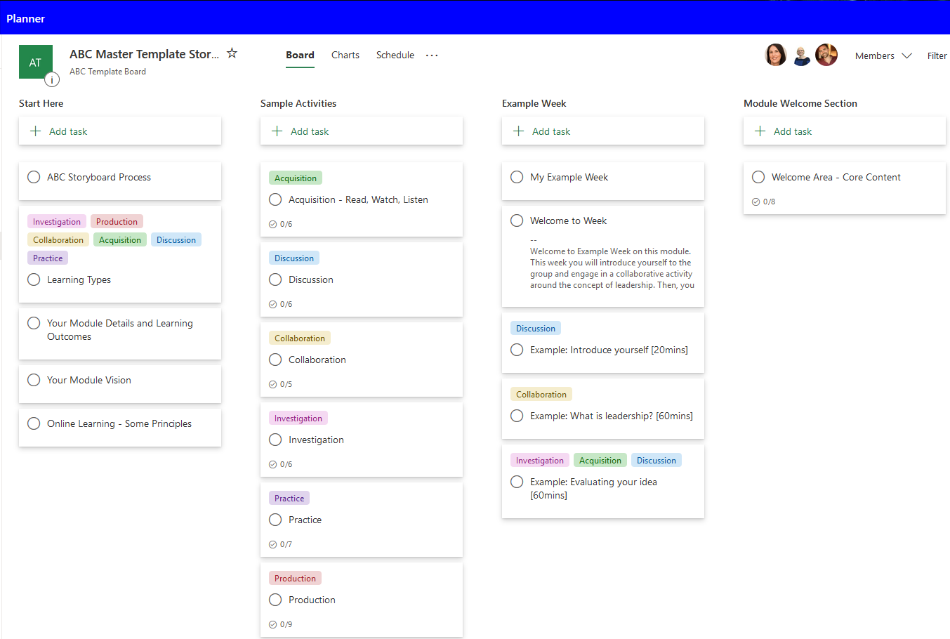
Tool MS Planner

Slide 29
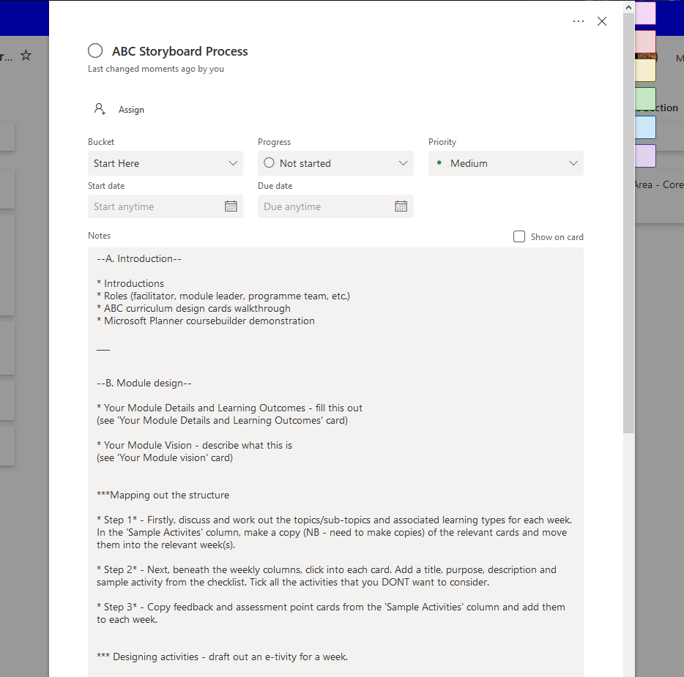
Tool MS Planner
In your groups, discuss the module details, outcomes, etc. and then the topics and sub-topics for each week
After initial discussion and consideration, map Learning Type Cards across to the weekly storyboard
Next, once discussions and considerations have advanced, click on each card you've mapped over and fill out details such as a purpose for it, a description for it, possible digital tools to realise it, and associated activities

Slide 30
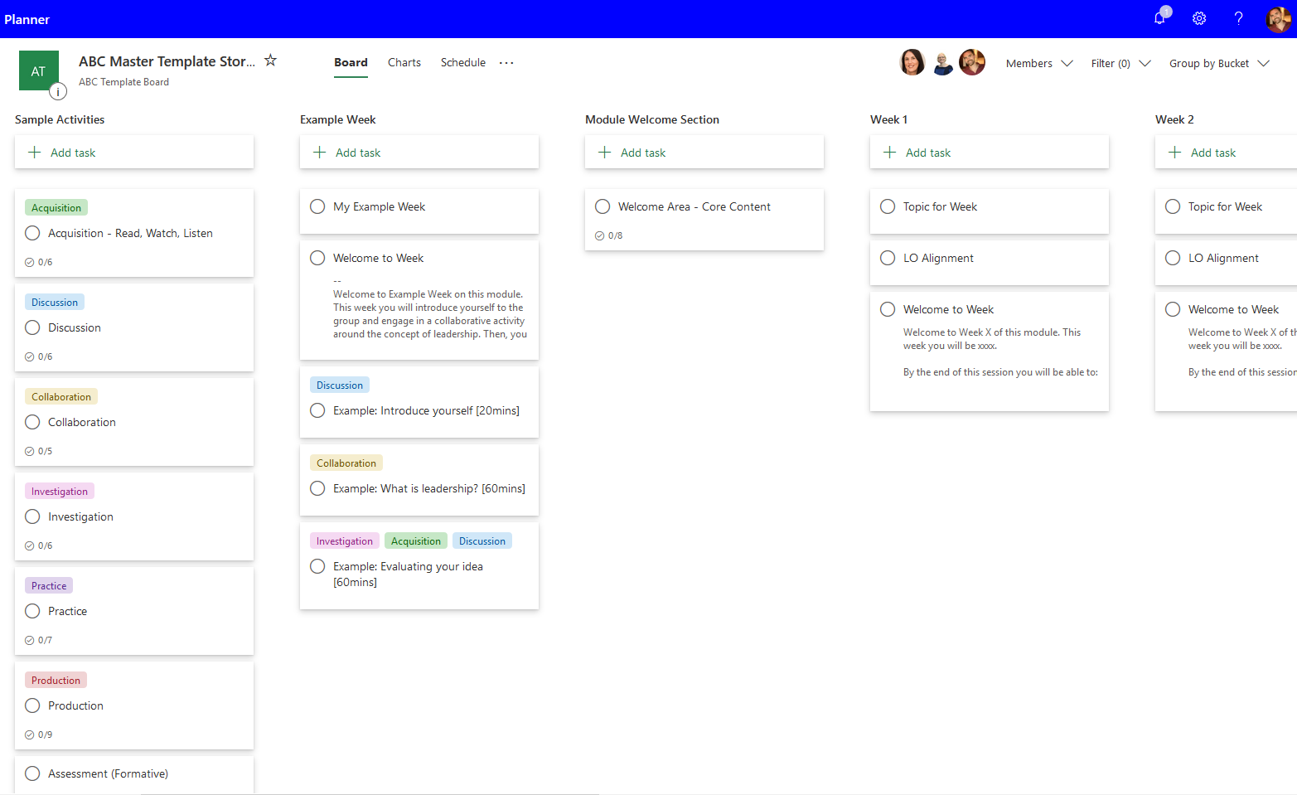
Tool MS Planner
In your groups, discuss the module details, outcomes, etc. and then the topics and sub-topics for each week
After initial discussion and consideration, map Learning Type Cards across to the weekly storyboard
Next, once discussions and considerations have advanced, click on each card you've mapped over and fill out details such as a purpose for it, a description for it, possible digital tools to realise it, and associated activities

Slide 31
Tool MS Planner

Slide 32
Tool MS Planner

Slide 33
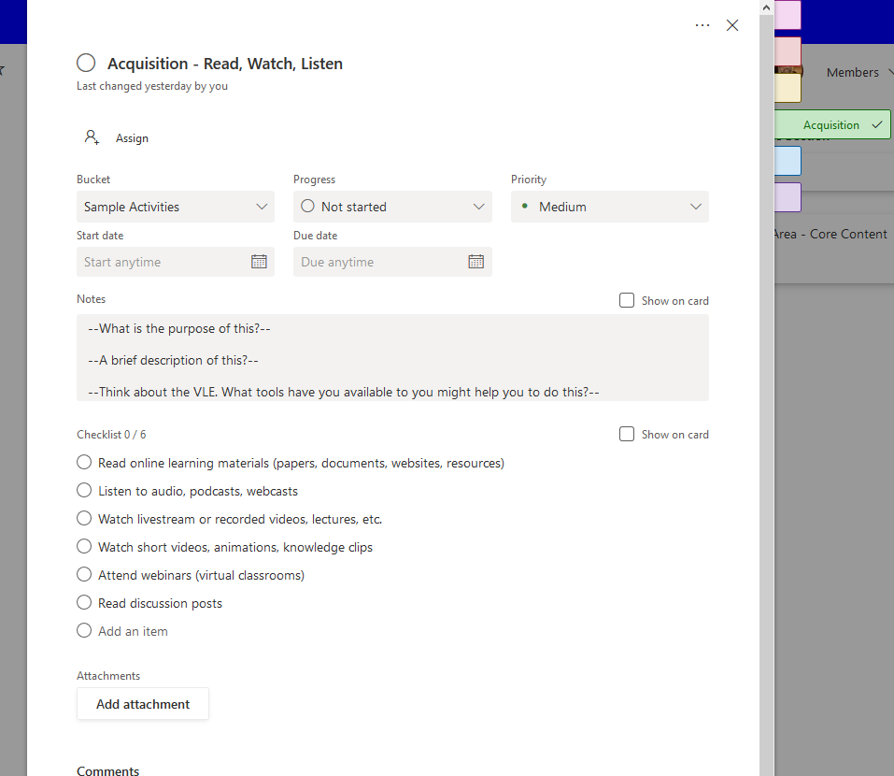
Tool MS Planner
In your groups, discuss the module details, outcomes, etc. and then the topics and sub-topics for each week
After initial discussion and consideration, map Learning Type Cards across to the weekly storyboard
Next, once discussions and considerations have advanced, click on each card you've mapped over and fill out details such as a purpose for it, a description for it, possible digital tools to realise it, and associated activities

Slide 34
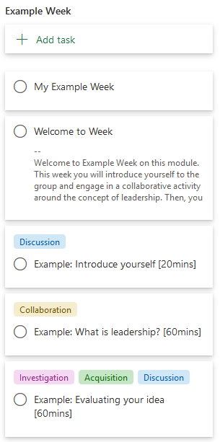
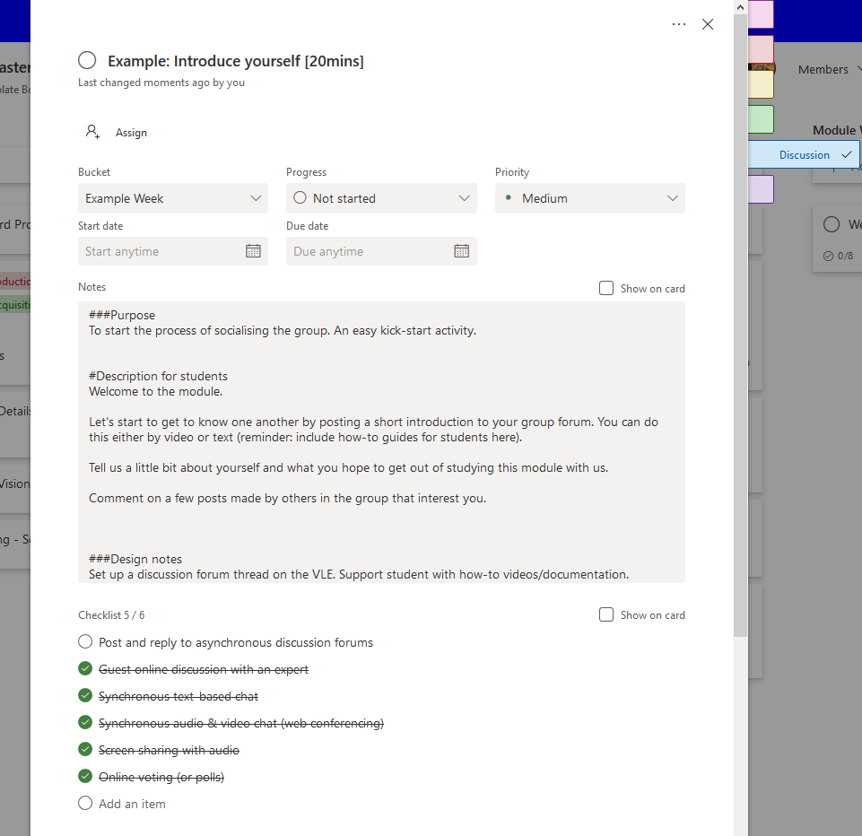
Tool MS Planner

Slide 35
Tool MS Planner

Slide 36
45 mins
This Photo by Unknown Author is licensed under CC BY-SA-NC

Slide 37
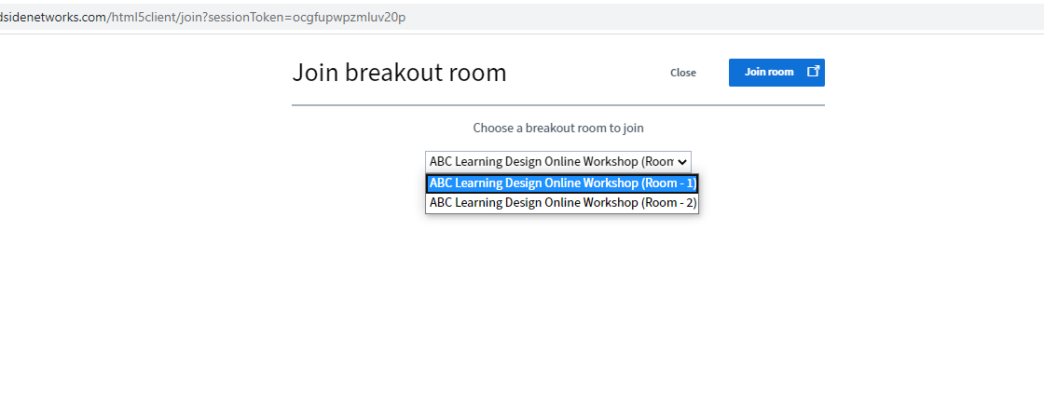
Breakout rooms

Slide 38
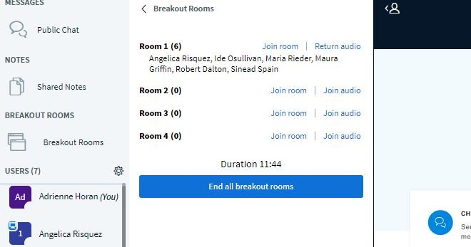
Breakout rooms

Slide 39
SEM1 2020/21 Delivery

Slide 40
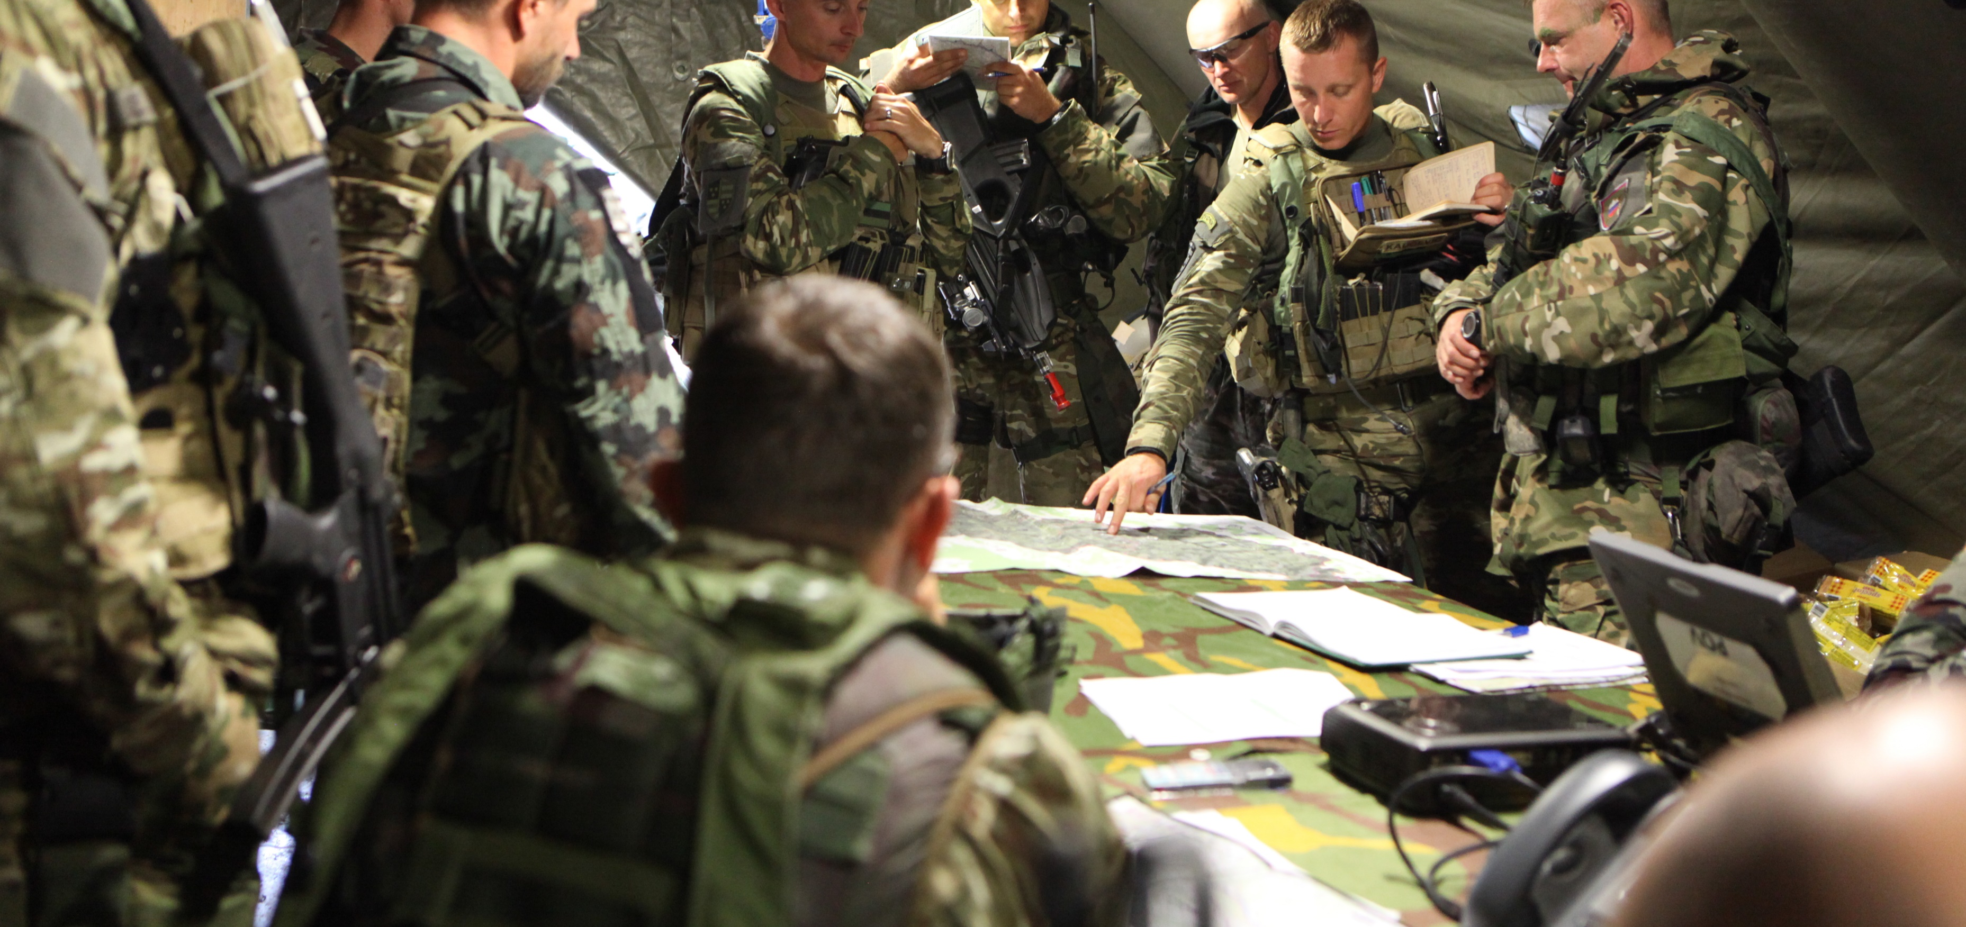
Debrief storyboarding (10 mins)

Slide 41
3. Module shape and next actions
Review the graphs – what has changed? Why?
Actions: what next?
Tool: Learning types form (create for each group)

Slide 43
What next
Complete a storyboard for your online module following the process that we used in this webinar.
Tools:
MS Planner (instructions for download on SULIS site)
Storyboard in PowerPoint (support resource in Sulis site)
Pen and paper!
Notes:
David

Slide 44
Team notes
5 mins arrival
5 mins EDTL
15 minutes for ABC LD method presentation and contextualisation (main room)
10 minutes for instructions for filling in the storyboard (main room)
Breakout rooms (45 minutes)
  10 minutes for defining the learning types used currently in the course (in break out rooms)
  30 minutes for designing the storyboard (in break out rooms)
10 minutes to debrief work in the breakout rooms
5 minutes for conclusions

